Slide 1
Impact of Fluoride Concentrations on Natural Waters throughout Texas
Mark Stehouwer
GIS in Water Resources
Fall 2013

Slide 2
Project Goal:
“To generate a visual medium by which fluoride contamination of water sources in the state of Texas along with the impacted populations and geographic regions can better be understood”
Agenda:
Context and fluoride in water
Impacted regions/mapping
Connections with geography and hydrology
4. Project conclusions

Slide 3

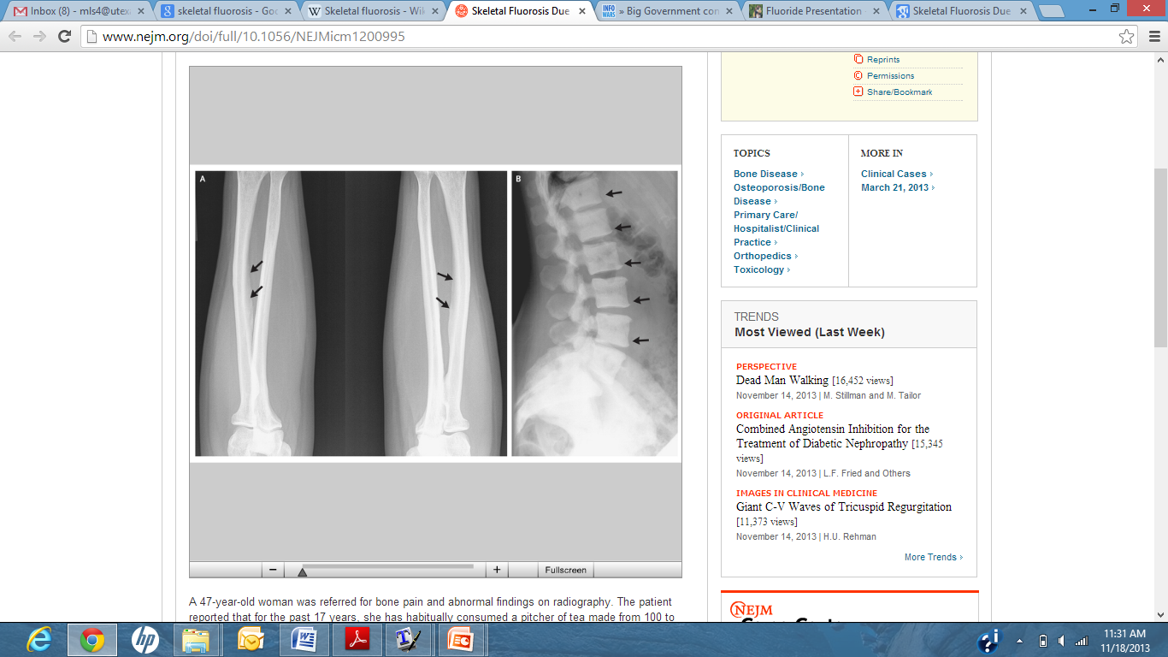
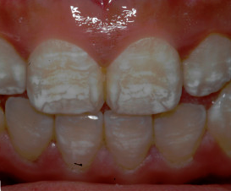
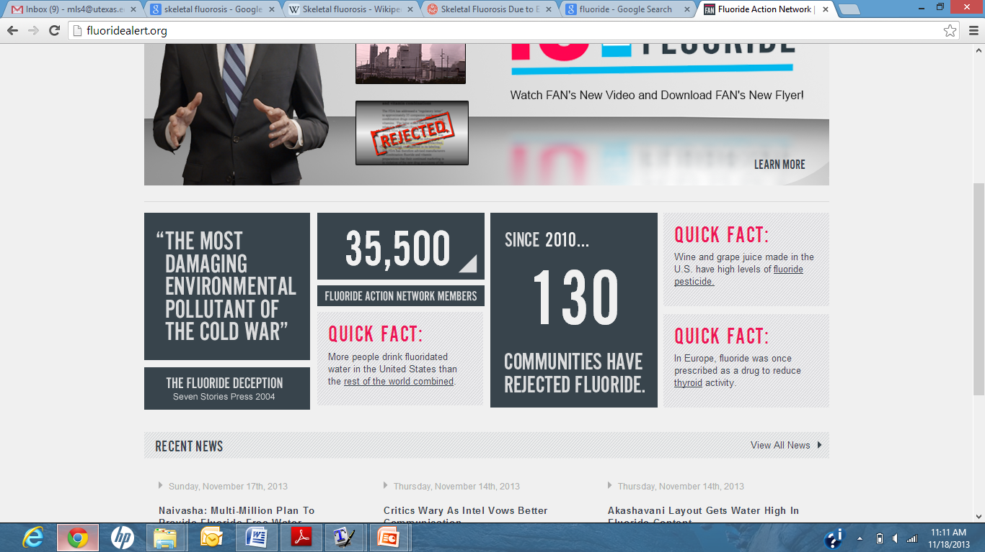
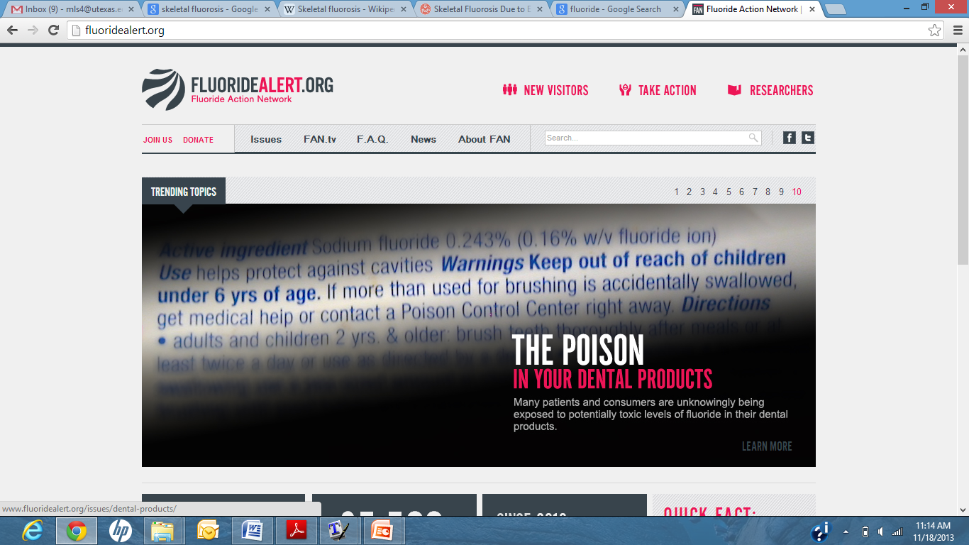
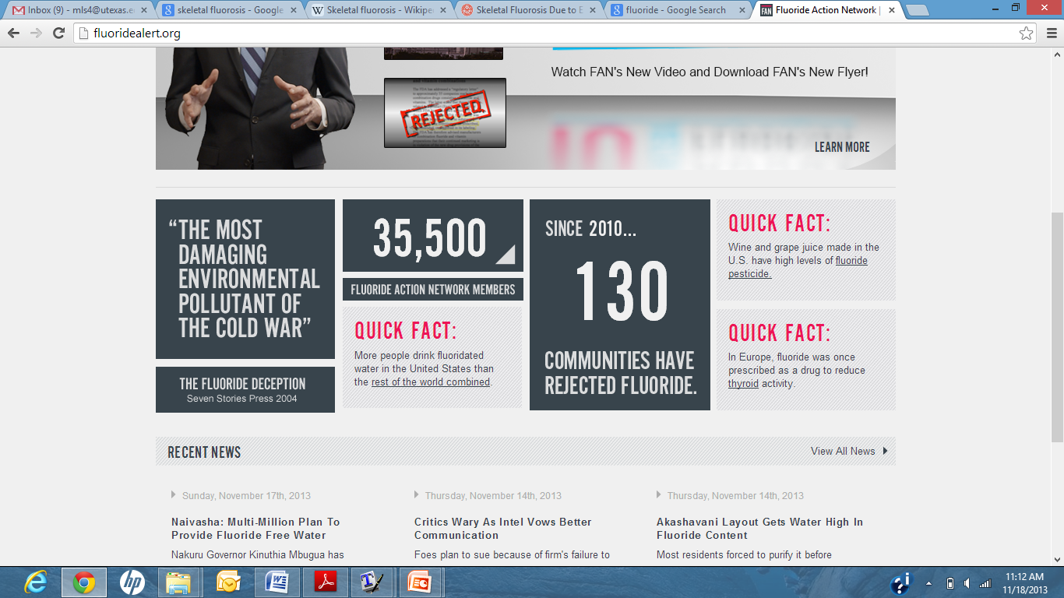
Fluoride in Water
Debunking controversy and conspiracy
EPA Limit [F] = 4 mg/L
Benefits [F] < 1.5 mg/L
  Tooth Development
  Cavity Prevention
Health Risks [F] > 2 mg/L
  - Pitting of teeth
  - Dental and/or skeletal fluorosis
CPHA. 2013.
Whyte et al. Amer. Jour. Med, 2005.
McGrady et al. BioMed Oral Health, 2012.
FluorideActionNetwork, 2013.

Slide 4
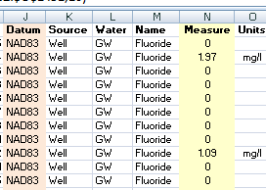
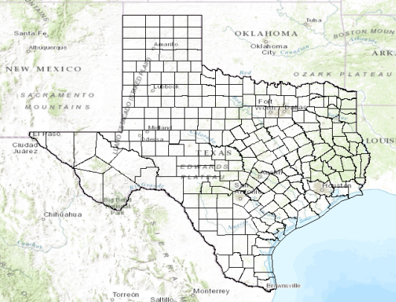
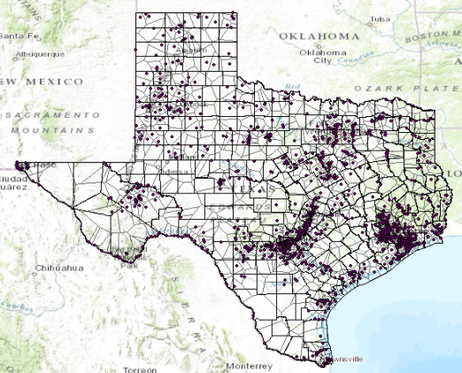
Mapping Fluoride through GIS
Fluoride Data
Mapping and Processing
Basemaps
Thematic Maps

Slide 5
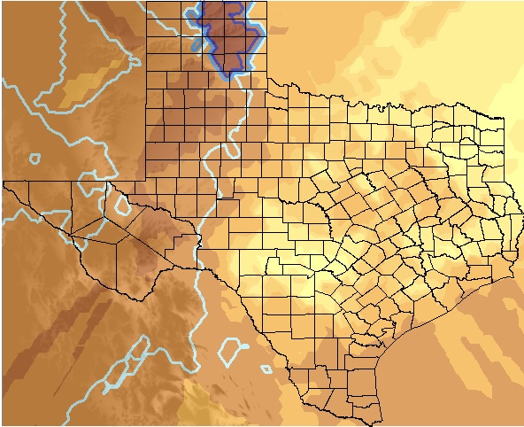
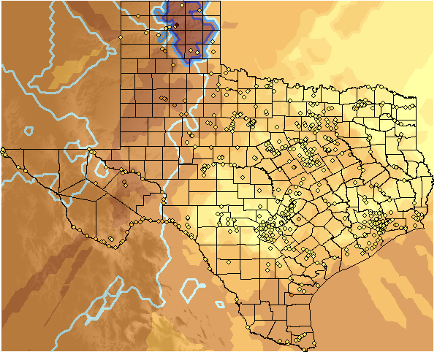
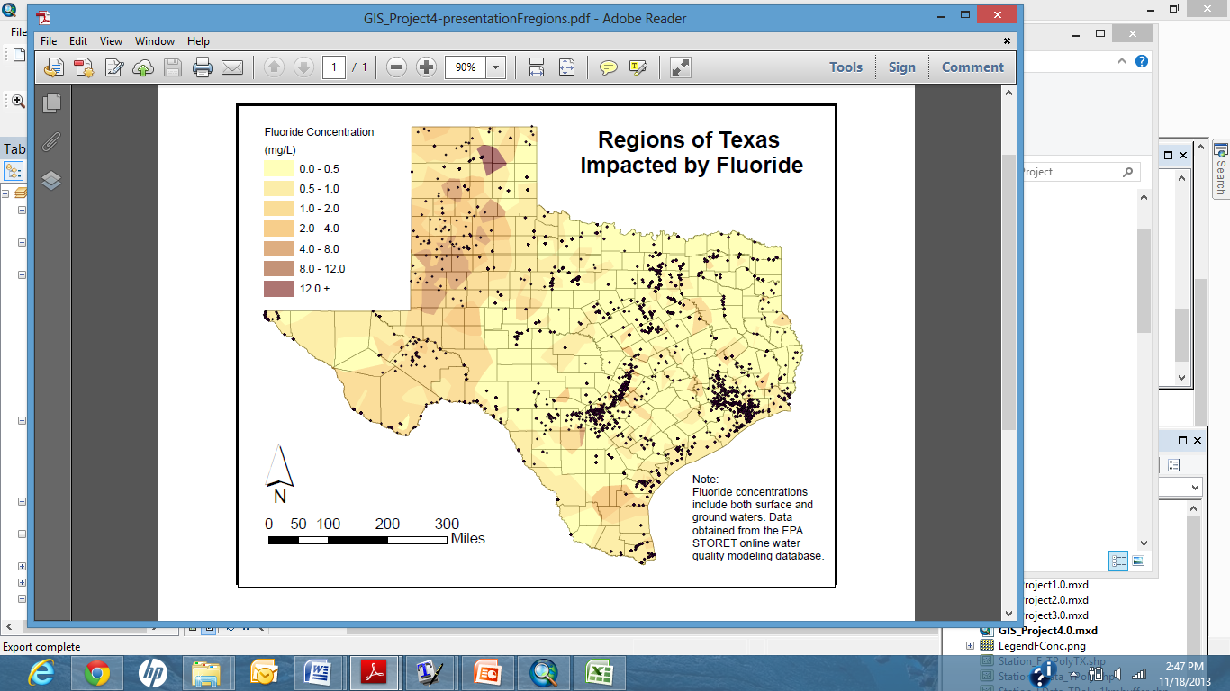

Fluoride in Surface Waters

Slide 6
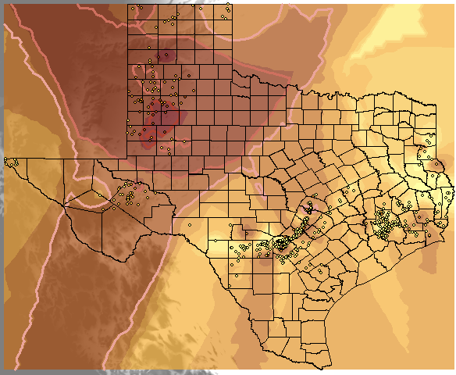
Fluoride in Surface Waters

Slide 7
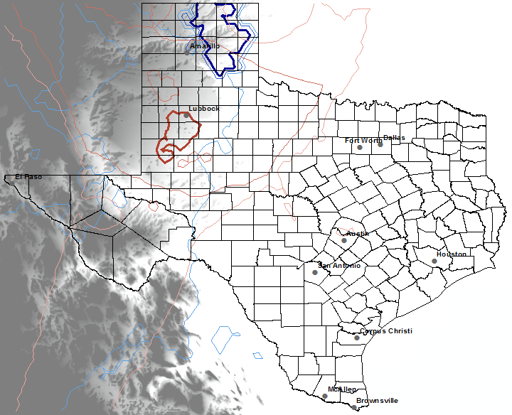
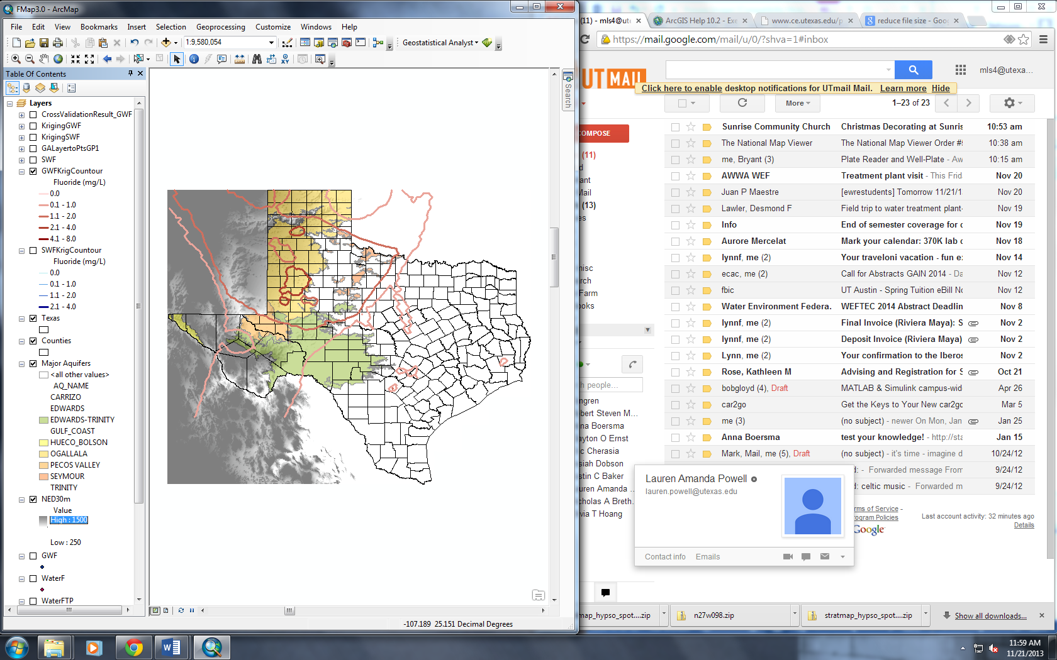
Fluoride Regions for Surface and Ground Waters

Slide 8
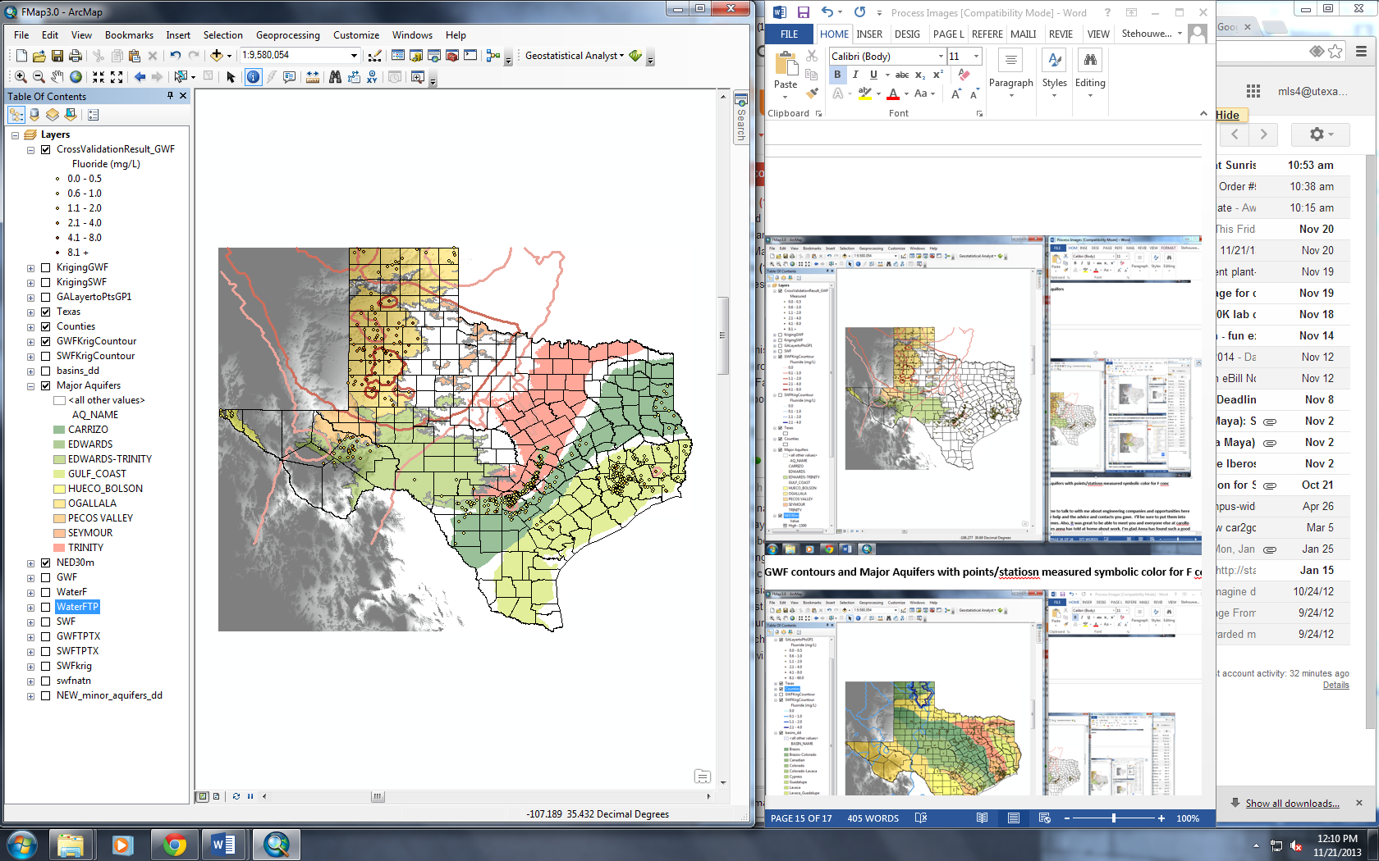
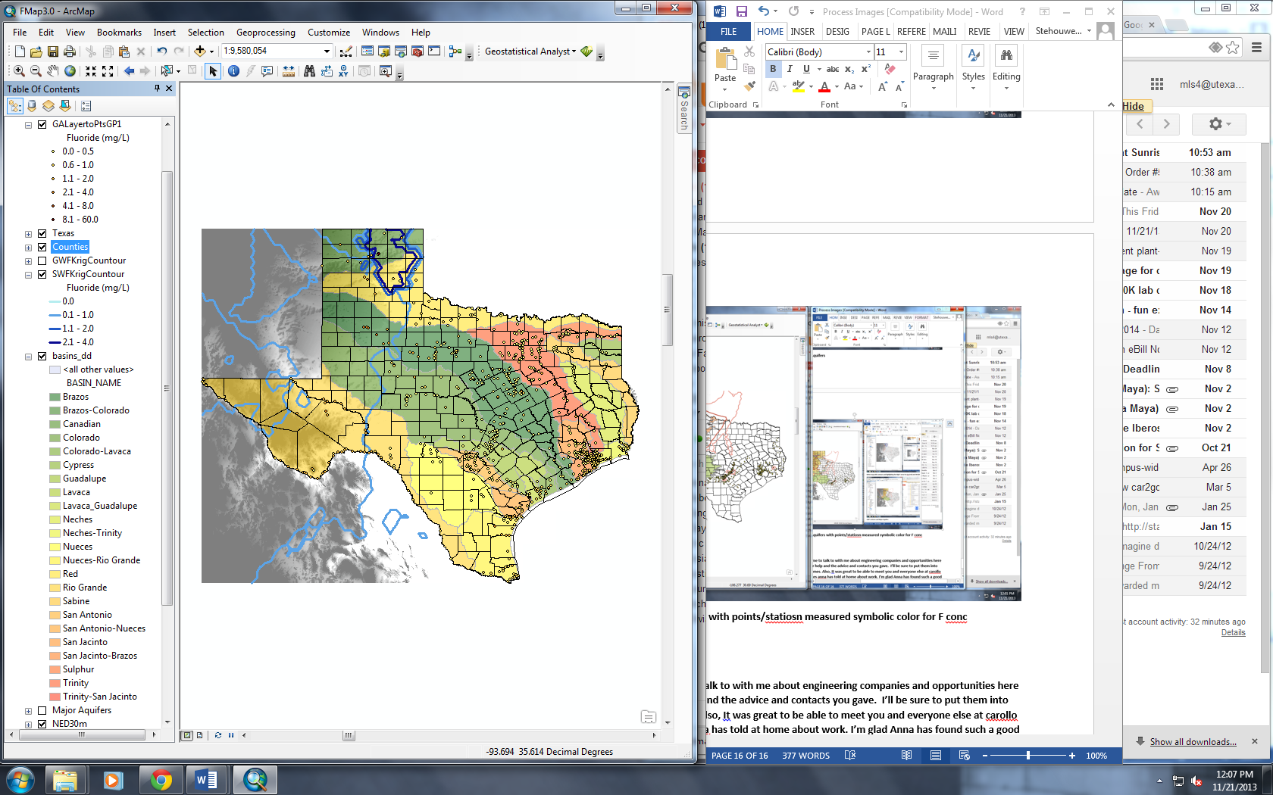
Hydrology Results
Regional ground water fluoride contours and major aquifer overlay
Regional surface water fluoride contours and major basin overlay

Slide 9
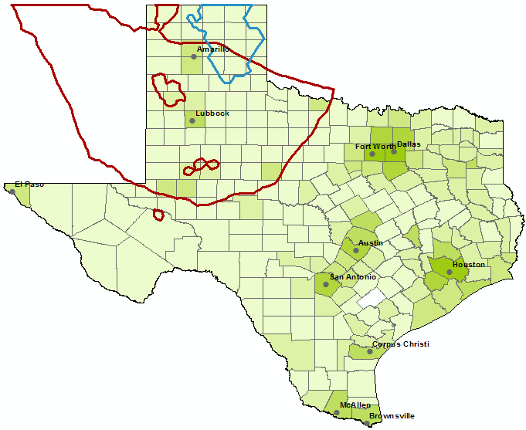
US Census Data
SW Fluoride > 2mg/L
GW Fluoride > 2mg/L
County Level Population Density and Impacted Regions
[F] > 2mg/L

Slide 10
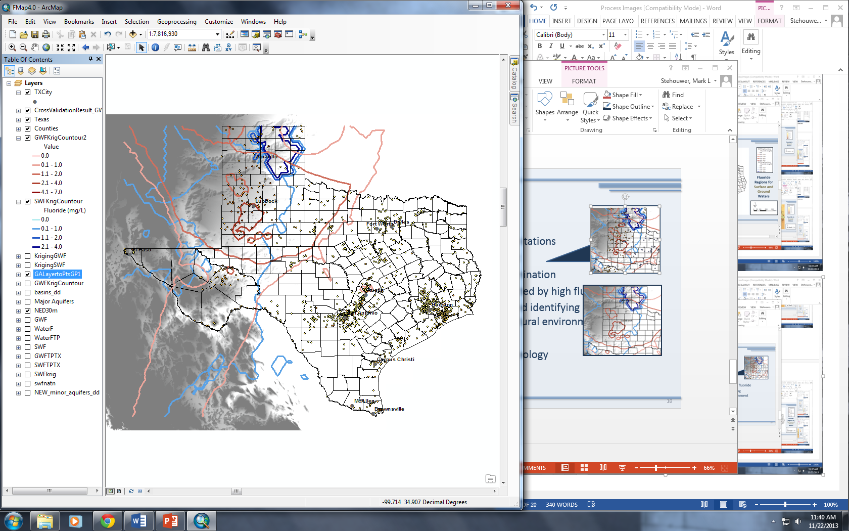
Project Extensions and Conclusions
Northwest Texas has highest
potential for fluoride contamination
Station and fluoride data limitations
GIS provides framework for visualizing and identifying contaminant presence in natural environment
To do…
Find % Texas Population impacted by high fluoride

Slide 11

Questions

