Slide 1
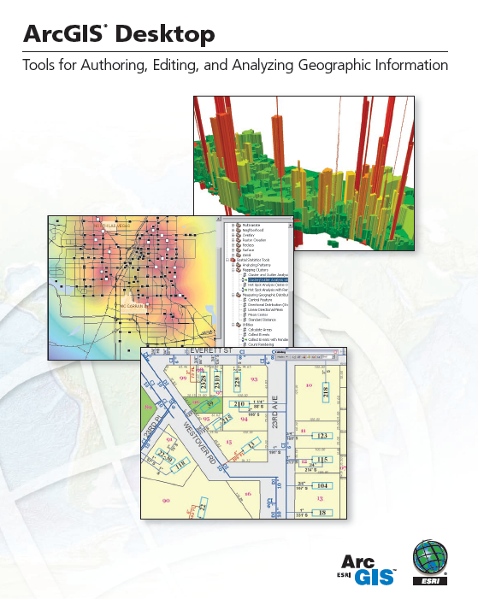
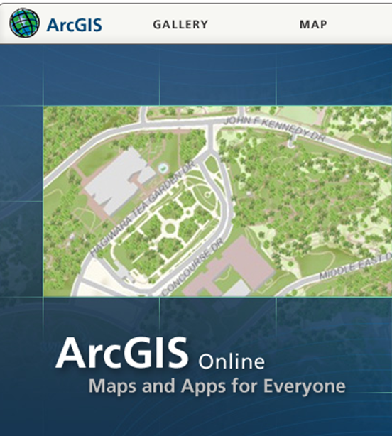
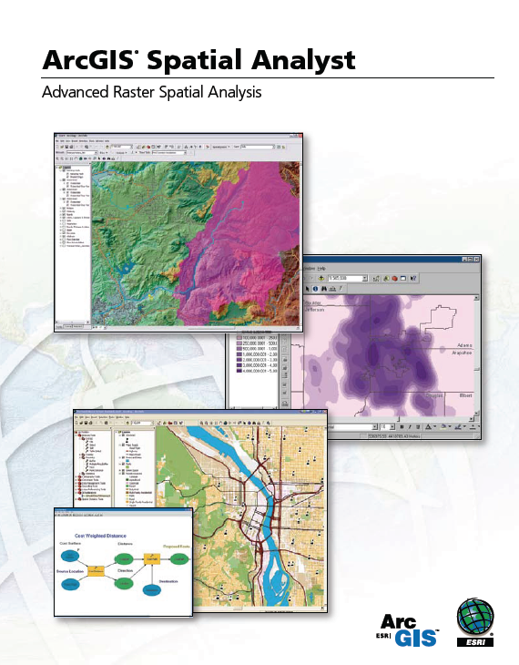
Introduction to ArcGIS Software

Slide 2
Readings
Geodatabase http://resources.arcgis.com/en/help/main/10.2/#/What_is_a_geodatabase/003n00000001000000/
  “What is a Geodatabase” to “Raster Basics”
ArcMap http://resources.arcgis.com/en/help/main/10.2/#/Mapping_and_visualization_in_ArcGIS_for_Desktop/018q00000004000000/
  “Introduction” to “Essential ArcMap Vocabulary”

Slide 3
Introduction to GIS Software
Conceptual framework of ArcGIS
How data are stored in ArcGIS
ArcGIS Desktop
Extensions of ArcGIS – spatial analyst, 3D analyst

Slide 4
Introduction to GIS Software
Conceptual framework of ArcGIS
How data are stored in ArcGIS
ArcGIS Desktop
Extensions of ArcGIS – spatial analyst, 3D analyst

Slide 5

Jack Dangermond, President, ESRI
Article from NY Times:
http://www.nytimes.com/2011/07/10/business/esris-chief-on-tending-his-plants-and-his-company.html?_r=2

Slide 6
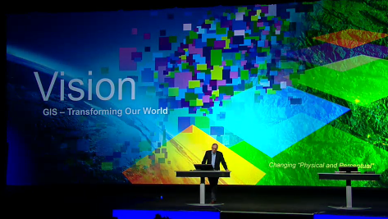
Videos: ESRI International User Conference
http://www.esri.com/events/user-conference
Watch Plenary Session attended by 12,000 people

Slide 7





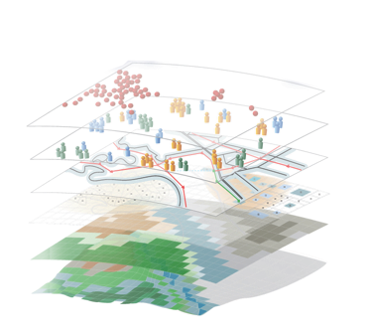


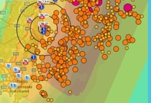

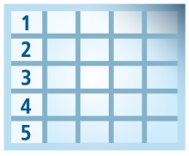
Geospatial Systems Are Helping Us Understand
Understanding
Sharing and Collaboration
Knowledge
Information
Integration
Mapping
Data
. . . Helping Us Make Better Decisions

Slide 8



Good GeoInformation Products Require Good Design
Understanding Issues
Appropriate Data
Analysis & Manipulation
. . . And A Compelling Graphic Design
Good Products Help Us Understand . . .
. . . And Support Action

Slide 9
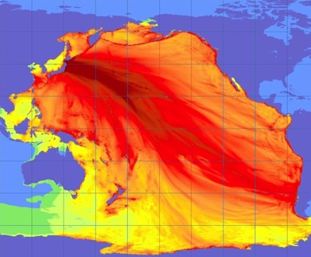
Good Information Products Are Timely
Tsunami Forecast
Help Us Understand . . .
. . . And Support Action

Slide 10
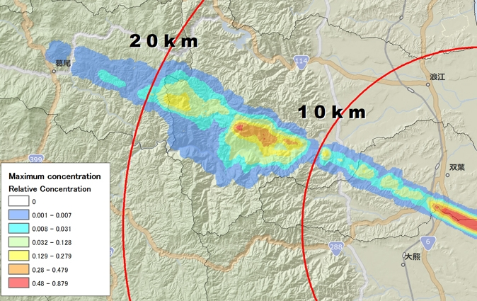
Good Information Products Disseminate Knowledge . . .
Fukushima Radiation Exposure
Help Us Understand . . .
. . . And Support Action

Slide 11
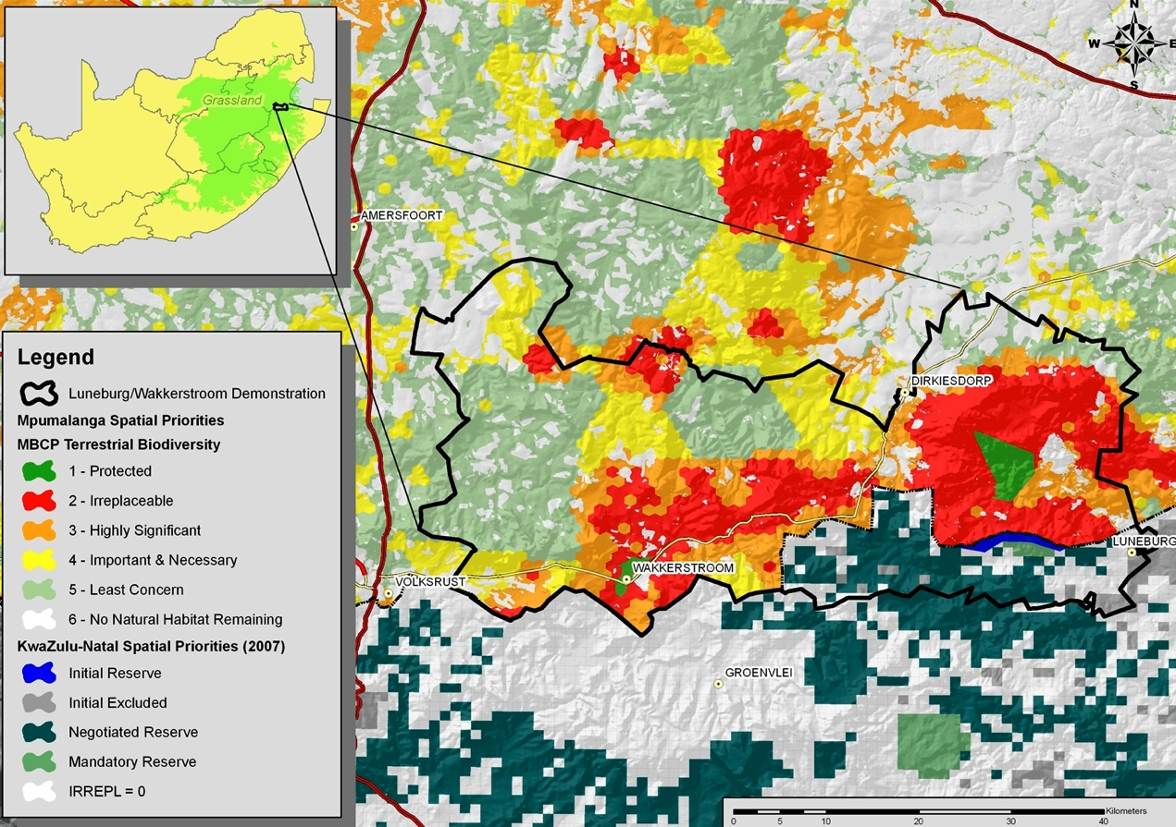
Good Information Products Communicate Importance
Suitability For Conservation
Help Us Understand . . .
. . . And Support Action

Slide 12
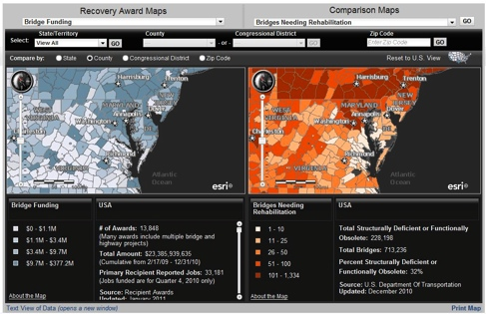
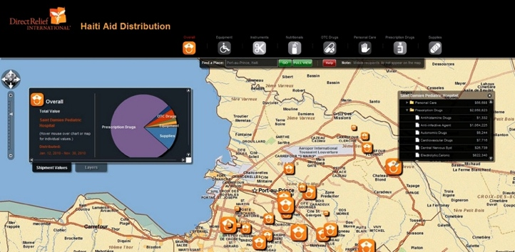
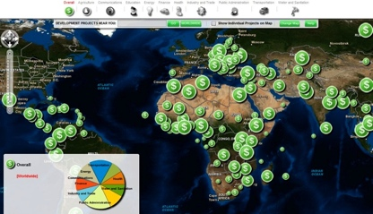
Good Information Products Show Status
Government Expenditures vs. Need
Situation Awareness
Haiti AID Funding
CGI Grants
Help Us Understand . . .
. . . And Support Action

Slide 13
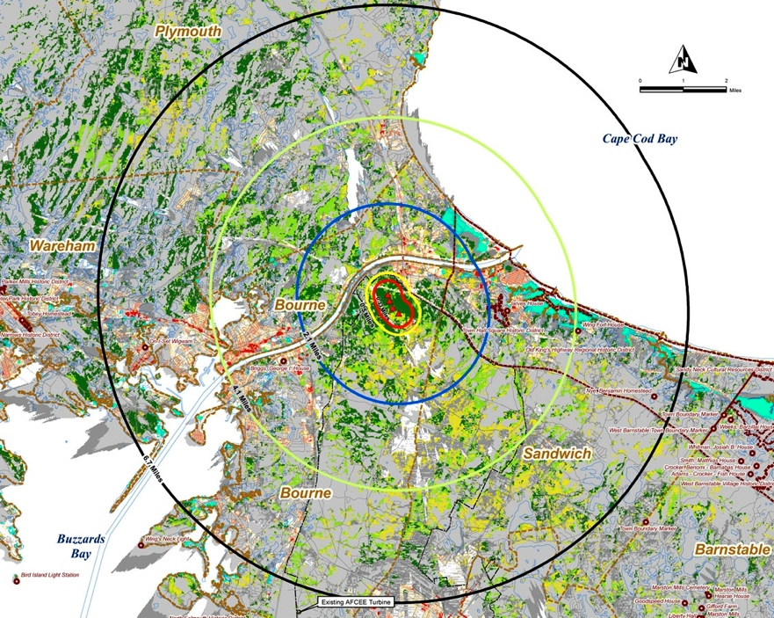
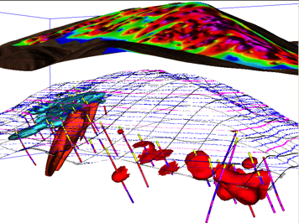
Good Information Products Support Decision Making
Wind Turbine Suitability
Hydrocarbons
Help Us Understand . . .
. . . And Support Action
Leveraging Spatial Analysis

Slide 14
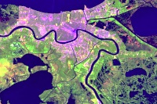
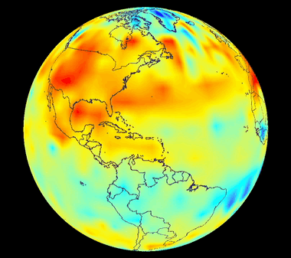
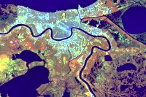
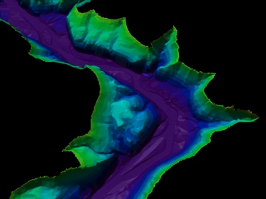
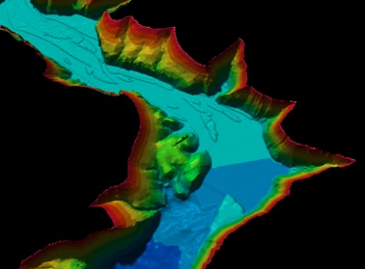
Good Information Products Illustrate Change
Urbanization – Landsat
Temperature
Sedimentation
Help Us Understand . . .
. . . And Support Action

Slide 15
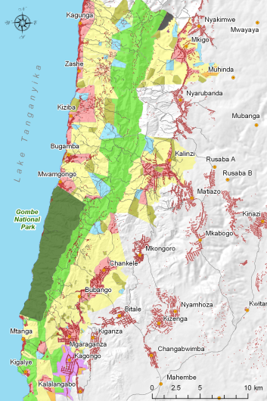
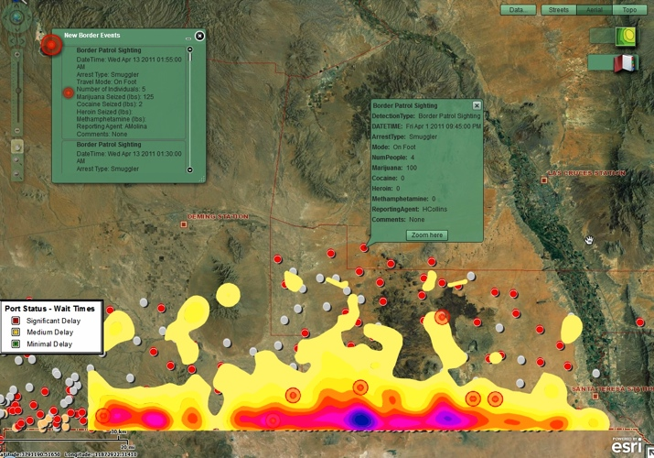
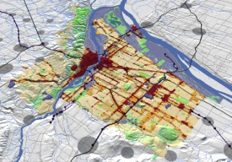
Good Information Products Can Show The Future
Gombe, Tanzania
Texas Border
CGI Grants
Oregon
Help Us Understand . . .
. . . And Support Action

Slide 16

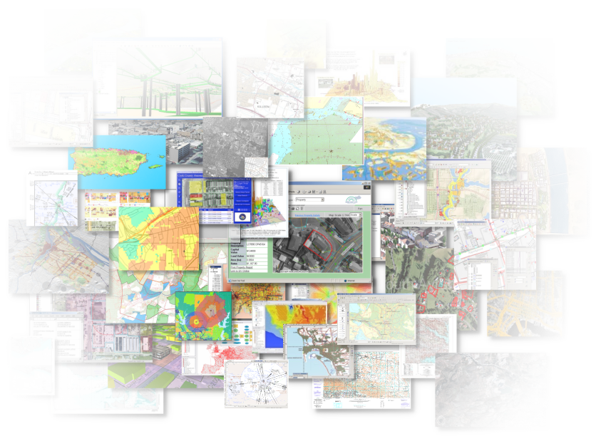

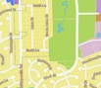

Good GeoInformation Products
Provide Timely Information
Disseminate Knowledge
Communicate Importance
Show Status and Performance
Support Decision Making
Illustrate Change
Show The Future
Effectively Telling a Story . . .
Helping Us Understand . . .
. . . And Make Better Decisions

Slide 17
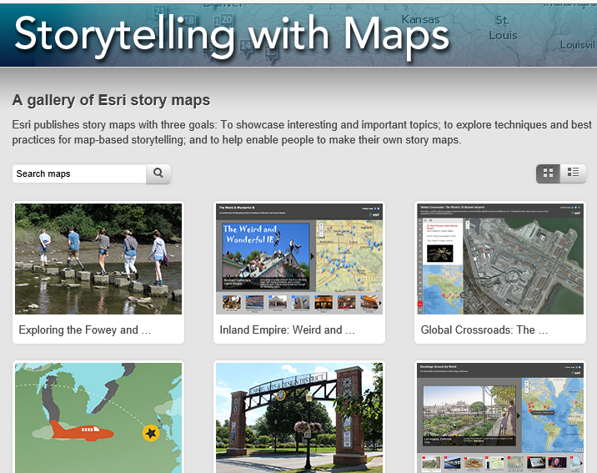
Storytelling With Maps
An Old Discipline, Needing To Be Applied With Today’s Technology
http://storymaps.esri.com

Slide 18
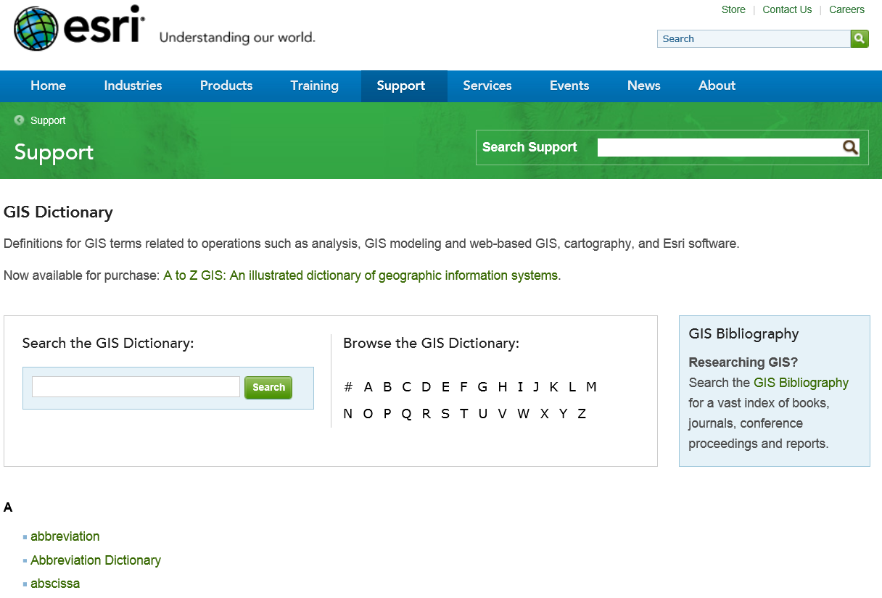
GIS Dictionary
http://support.esri.com/en/knowledgebase/Gisdictionary/browse

Slide 19
Introduction to GIS Software
Conceptual framework of ArcGIS
How data are stored in ArcGIS
ArcGIS Desktop
Extensions of ArcGIS – spatial analyst, 3D analyst

Slide 20
Geographic Data Models
All geographic information systems are built using formal models that describe how things are located in space. A formal model is an abstract and well-defined system of concepts. A geographic data model defines the vocabulary for describing and reasoning about the things that are located on the earth. Geographic data models serve as the foundation on which all geographic information systems are built.
Scott Morehouse, Preface to “Modeling our World”, First Edition

Slide 21
ESRI GIS Development
Arc/Info (coverage model)
Versions 1-7 from 1980 – 1999
Arc Macro Language (AML)
ArcGIS (geodatabase model)
Version 8.0, …, 10.2 from 2000 – Python scripting
ArcView (shapefile model)
Versions 1-3 from 1994 – 1999
Avenue scripting language

Slide 22
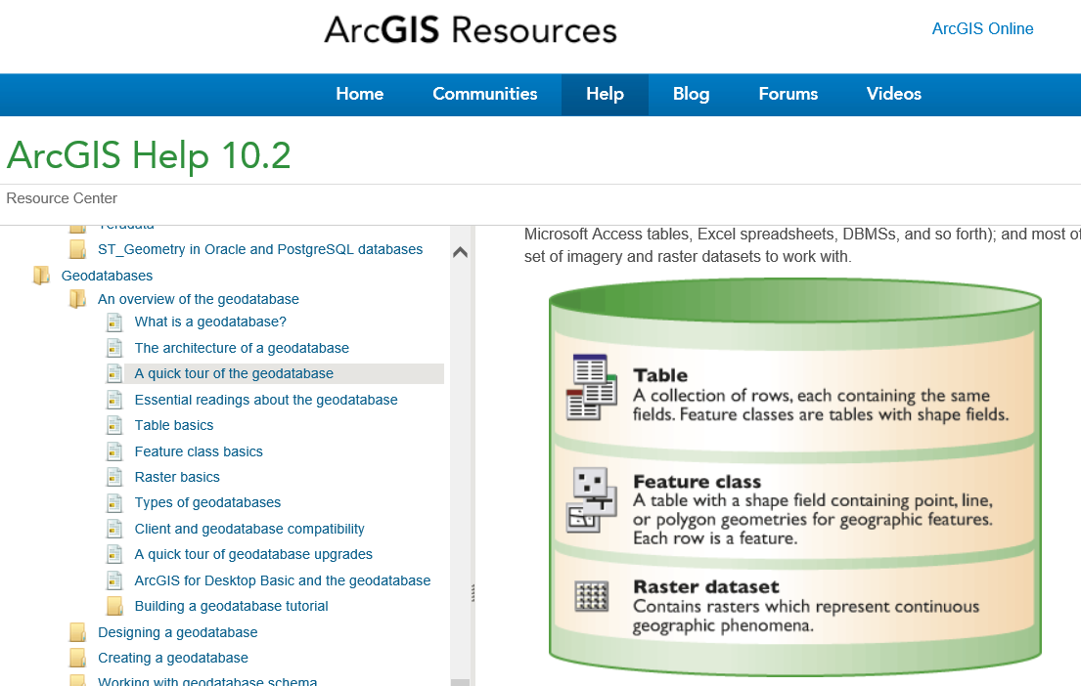
Geodatabase
http://resources.arcgis.com/en/help/main/10.2/#/What_is_a_geodatabase/003n00000001000000/

Slide 23
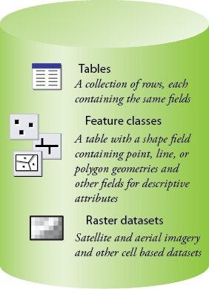
Common Geospatial Information Types
Image: Michael Zeiler, ESRI

Slide 24
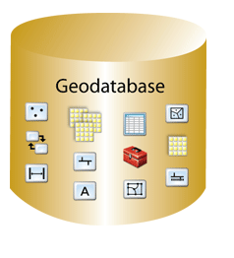
Geodatabase – a store for all types of geospatial information

Slide 25
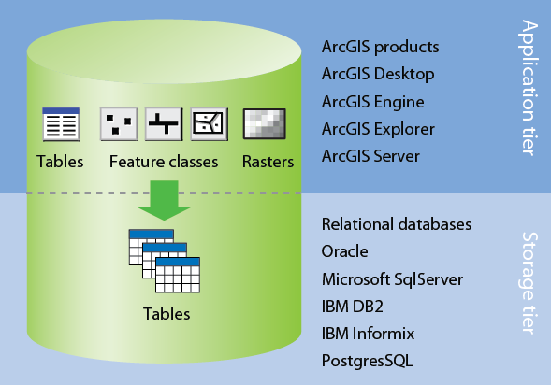
Application and Storage Tiers
Image: Michael Zeiler, ESRI

Slide 26
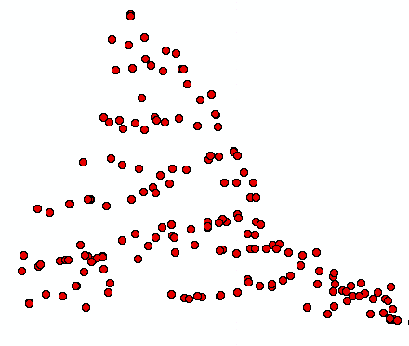
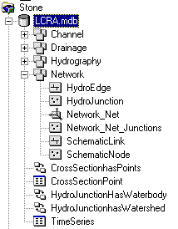
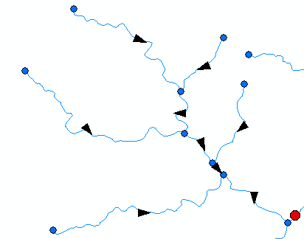
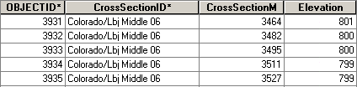
ArcGIS Geodatabase
Workspace
Geodatabase
Feature Dataset
Feature Class
Geometric
Network
Relationship
Object Class

Slide 27
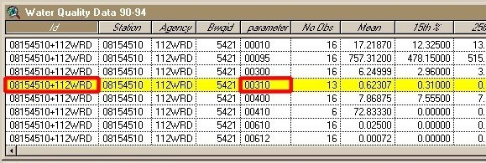
Object Class
An object class is a collection of objects in tabular format that have the same behavior and the same attributes.
An object class is a table that has a unique identifier (ObjectID)
for each record

Slide 28
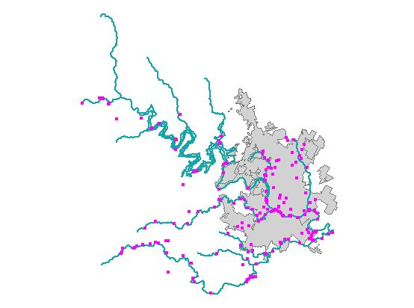
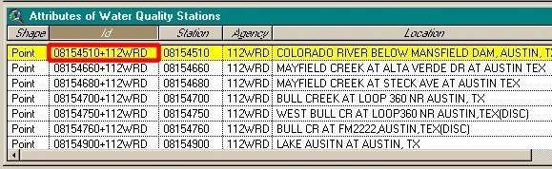
Feature Class
A feature class is a collection of geographic objects in tabular format that have the same behavior and the same attributes.
Feature Class = Object class + spatial coordinates

Slide 29
Relationship
A relationship is an association or link between two objects in a database.
A relationship can exist between spatial objects (features in feature classes), non-spatial objects (objects in object classes), or between spatial and non-spatial objects.

Slide 30
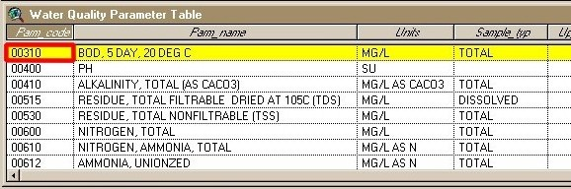
Relationship
Relationship between non-spatial objects
Water
Quality
Data
Water
Quality
Parameters

Slide 31
Relationship
Relationship between spatial and non-spatial objects
Water quality data
(non-spatial)
Measurement station
(spatial)

Slide 32
Introduction to GIS Software
Conceptual framework of ArcGIS
How data are stored in ArcGIS
ArcGIS Desktop
Extensions of ArcGIS – spatial analyst, 3D analyst

Slide 33
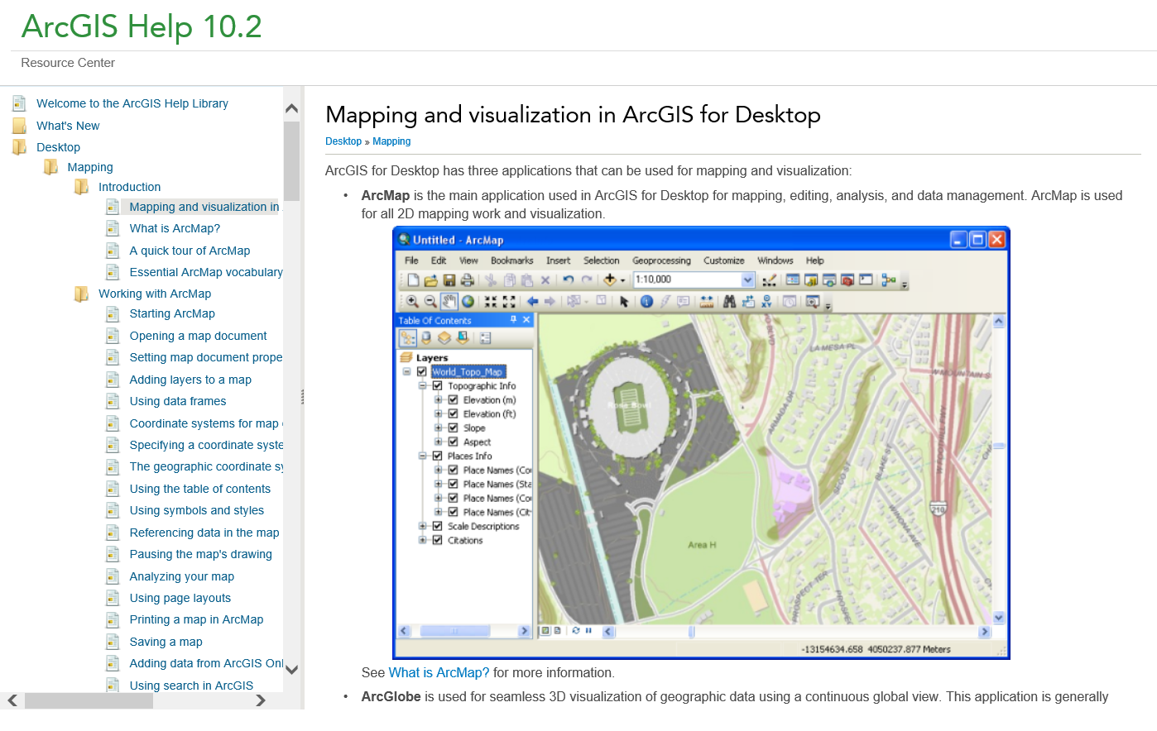
ArcMap
http://resources.arcgis.com/en/help/main/10.2/#/Mapping_and_visualization_in_ArcGIS_for_Desktop/018q00000004000000/

Slide 34
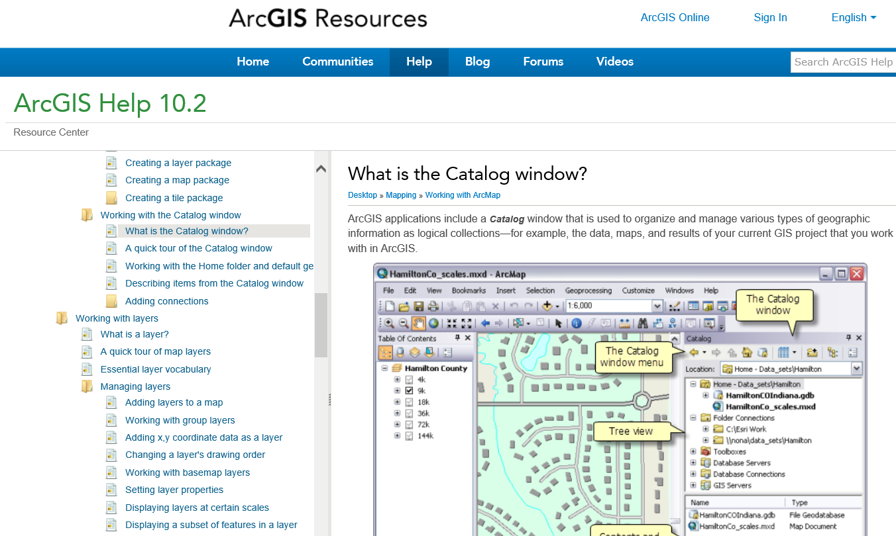
Catalog window in ArcMap
http://resources.arcgis.com/en/help/main/10.2/#/What_is_the_Catalog_window/006600000449000000/

Slide 35
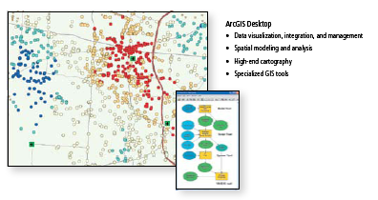
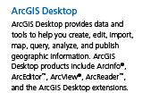
ArcGIS Desktop

Slide 36
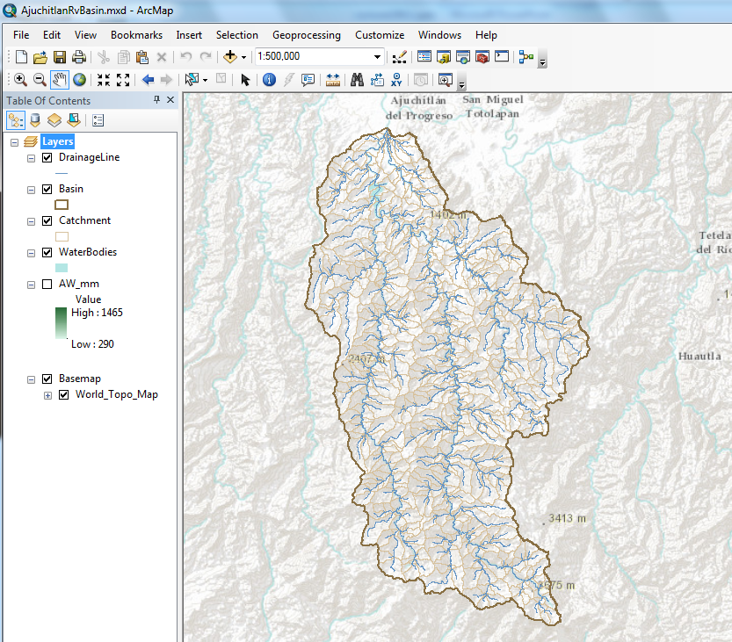
ArcMap – primary work interface

Slide 37
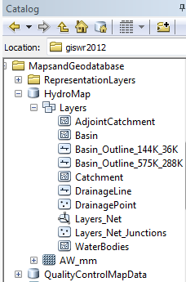
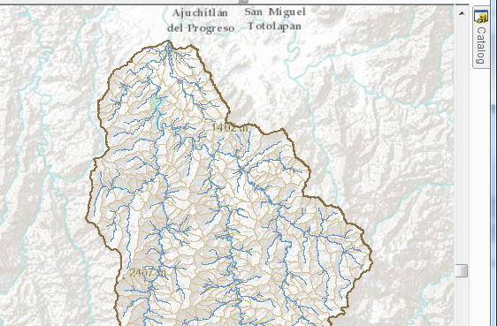
Arc Catalog – view the geodatabase

Slide 38
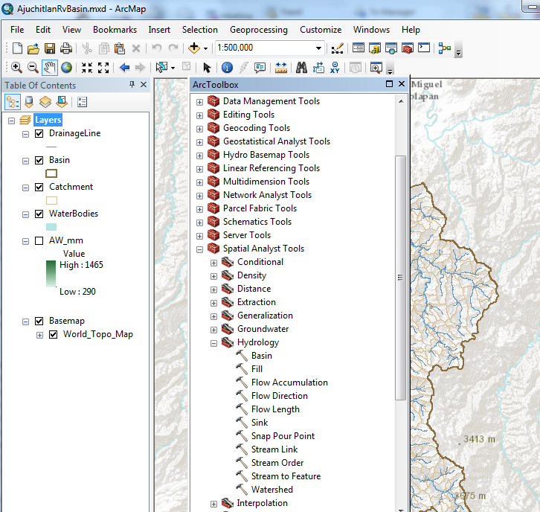
ArcToolbox – processing functions

Slide 39
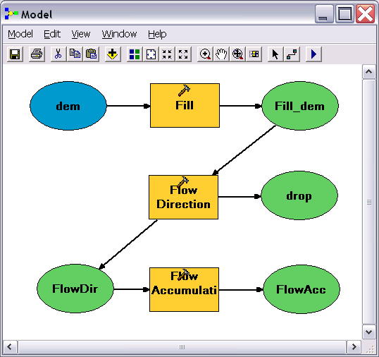
Geo-Processing
Toolbox tools linked together using the model builder to automate data processing

Slide 40
Introduction to GIS Software
Conceptual framework of ArcGIS
How data are stored in ArcGIS
ArcGIS Desktop
Extensions of ArcGIS – spatial analyst, 3D analyst

Slide 41
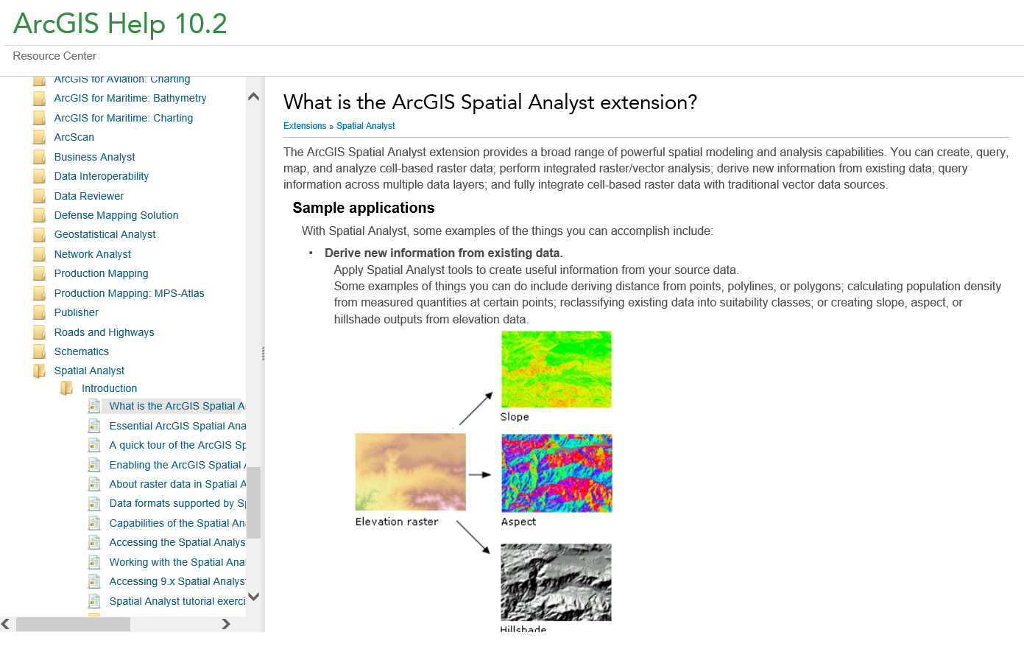
Spatial Analyst
http://resources.arcgis.com/en/help/main/10.2/#/What_is_the_ArcGIS_Spatial_Analyst_extension/005900000001000000/

Slide 42
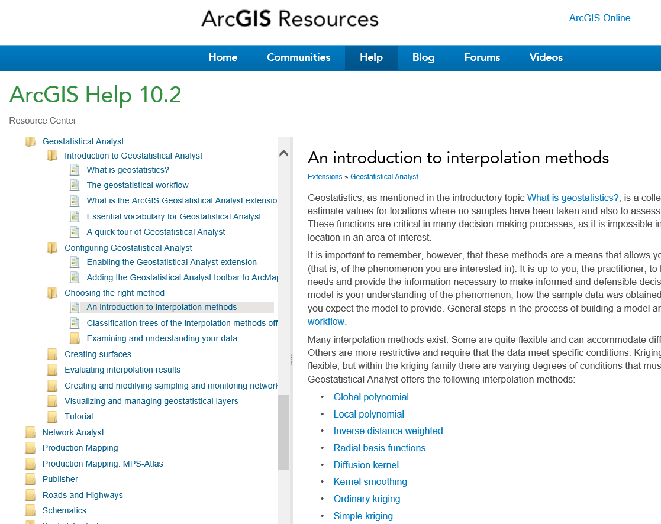
Geostatistical Analyst and Interpolation
http://resources.arcgis.com/en/help/main/10.2/#/An_introduction_to_interpolation_methods/003100000008000000/

Slide 43

Spatial Analyst
Analysis of land surface terrain as a grid
Key means of defining drainage areas and connectivity to stream network

Slide 44

Grid Datasets
Cellular-based data structure composed of square cells of equal size arranged in rows and columns.
The grid cell size and extension (number of rows and columns), as well as the value at each cell have to be stored as part of the grid definition.
Number of columns
Cell size
Number of rows

Slide 45


Grid Datasets
Grid datasets

Slide 46

Image Datasets
Digital Orthophotos and satellite imagery
Image datasets

Slide 47

3-D Analyst
Analysis of land surface terrain as triangulated irregular network (TIN)
Visualization in 3-D using Arc Scene
Stream channel of Pecan Bayou, TX

Slide 48


TIN Datasets
TIN datasets
Points and breaklines from which a TIN is constructed.

Slide 49

3D Analyst and ArcScene
http://resources.arcgis.com/en/help/main/10.2/#/3D_Analyst_and_ArcScene/00q8000000p0000000/

