Slide 1
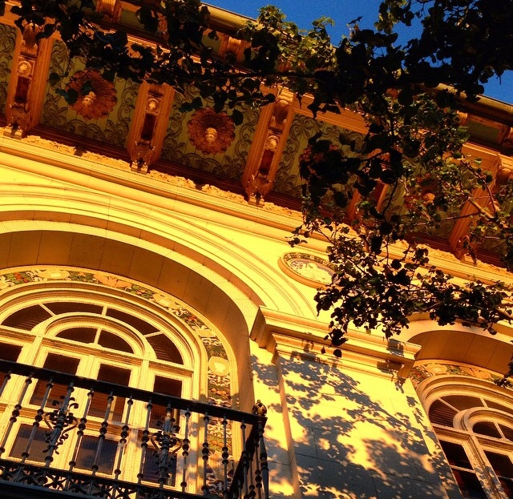
UT Austin Landscape Master Plan:
Evaluating Opportunities for Progressive Storm Water Management

Slide 2
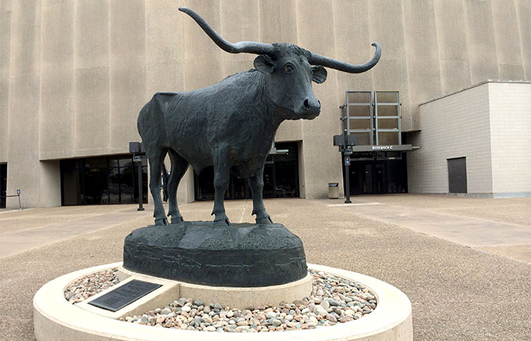
Spring 2013: Campus Master Plan
Spring 2014: Landscape Master Plan

Slide 3
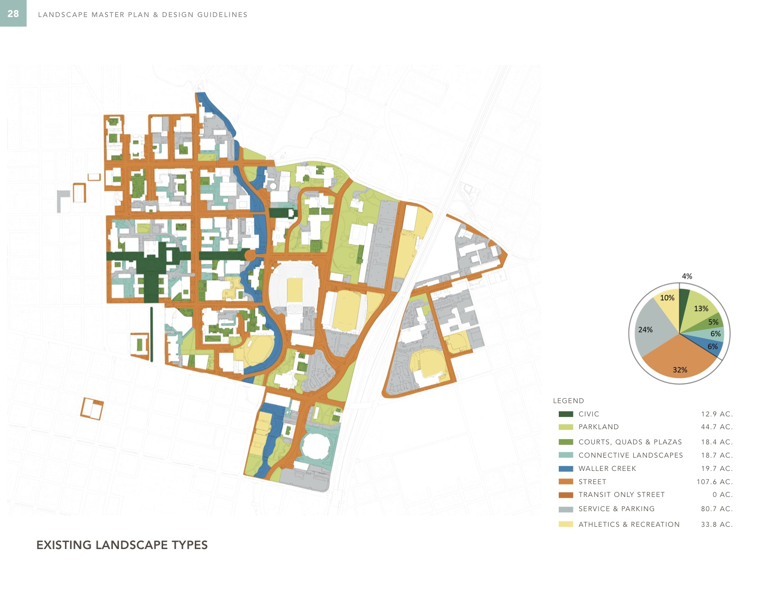
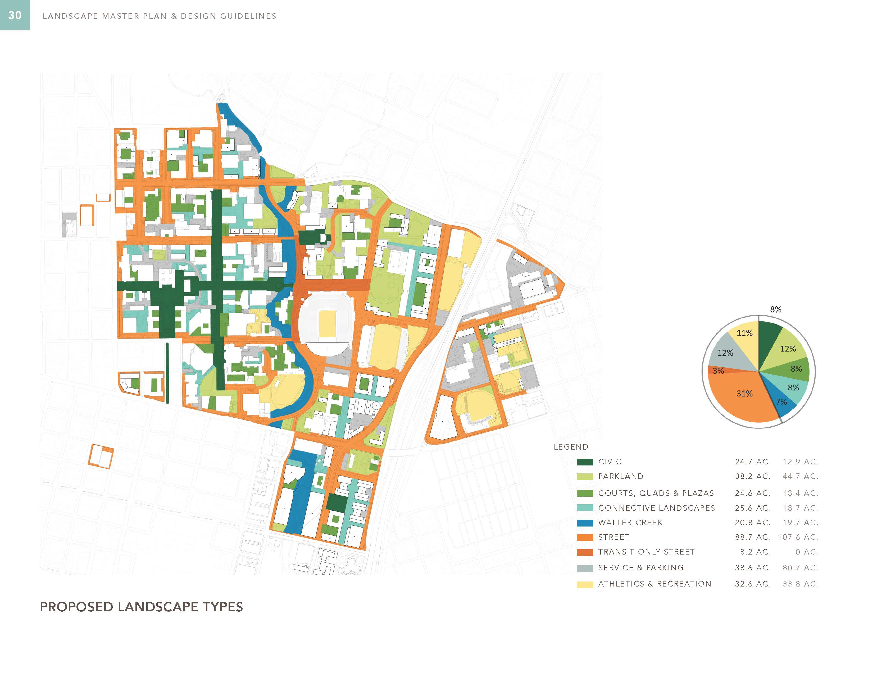

Slide 4
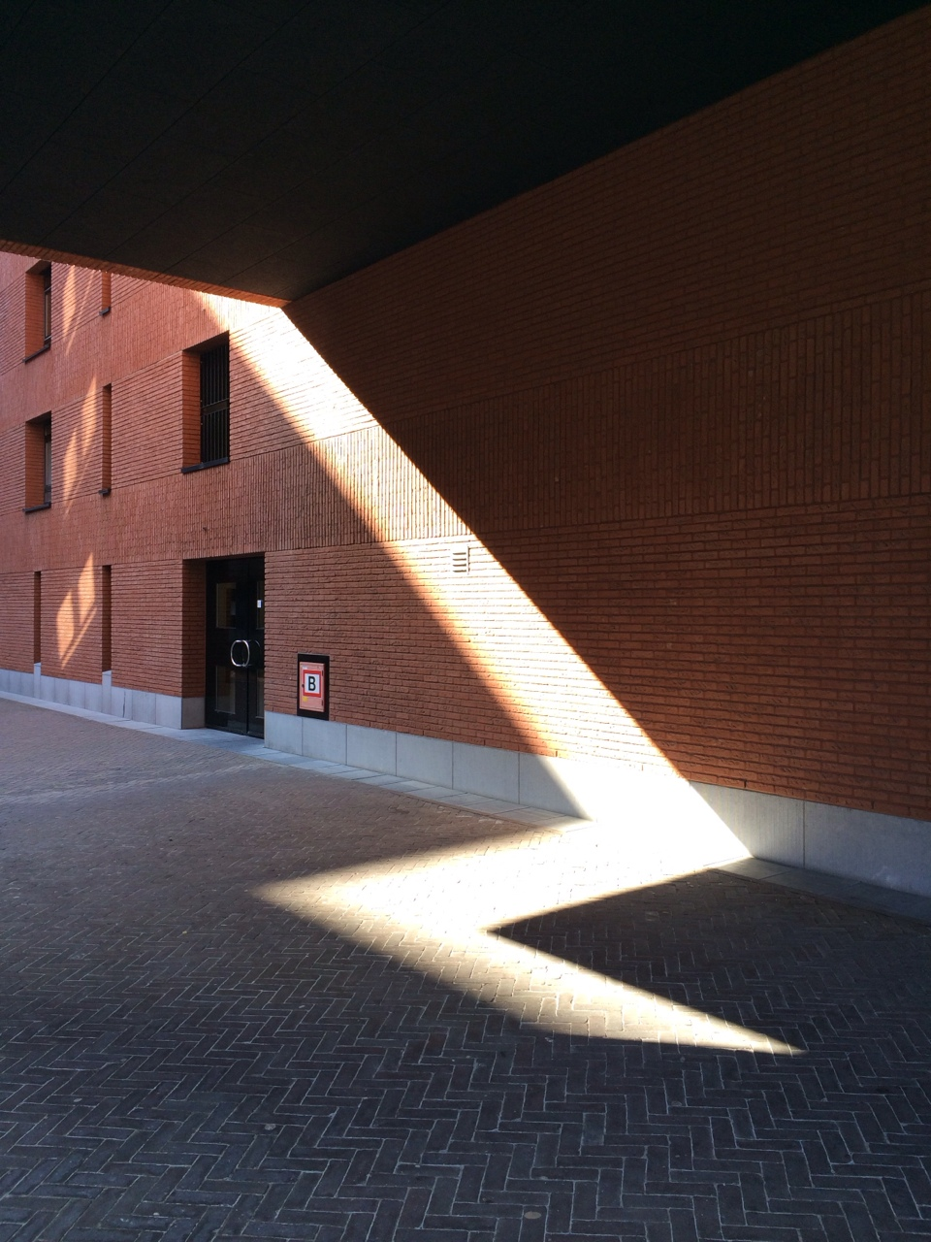
To what degree do aesthetic considerations limit progressive storm water management?
Where are opportunities for implementation?

Slide 5
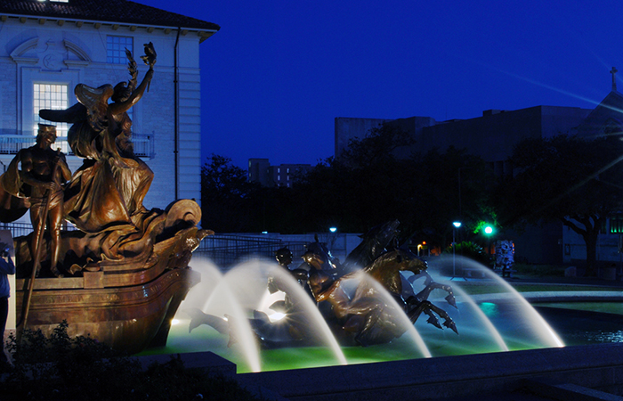
CIVIC SPACE
Foundation of campus identity; classical compositions
Iconic, institutional, and ceremonial references
Vegetation type is limited
Spaces experienced as single, non-segmented units
View sheds structured by high quality masonry

Slide 6
“…Opportunities to reduce water use and improve storm water management in existing Civic landscapes should be explored; however, human use should be prioritized in these important public spaces.”

Slide 7
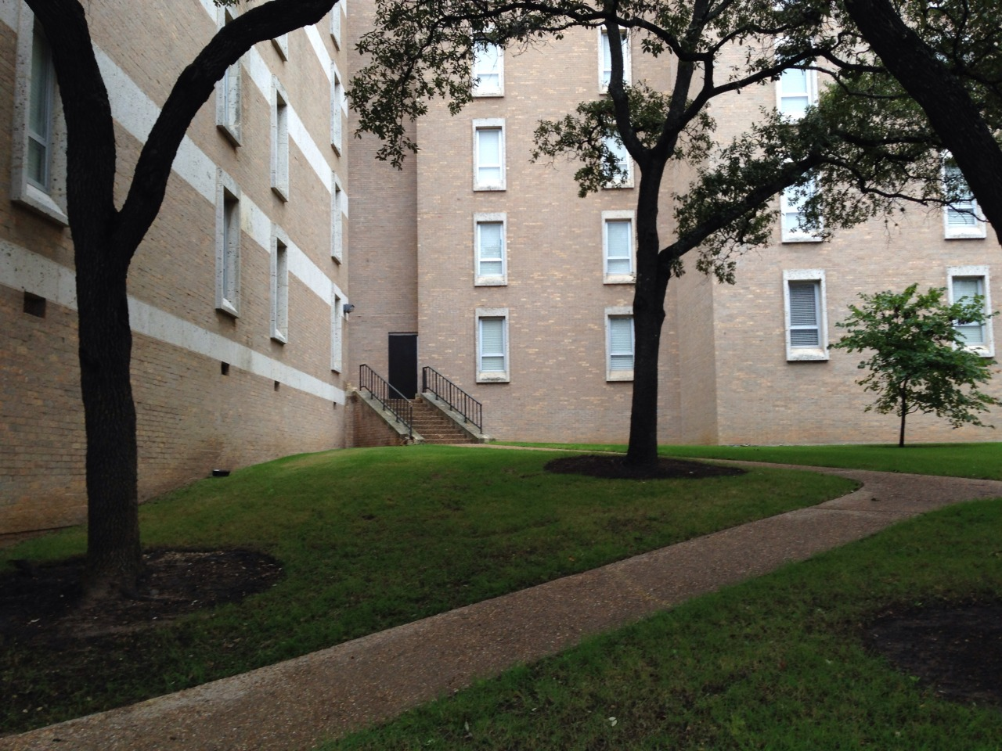
QUADS, COURTYARDS,
PLAZAS
Self-contained and noncontiguous
Structured by formal buildings and walls
Aesthetics are defined by adjacent architecture
Landscape as laboratory: specific materials and planting types are not explicit

Slide 8
Storm water “collection, detention and infiltration can be integrated as a design feature. Consideration should be given to storing the SITES Prerequisite Water Quality Storm Volume for each space’s immediate catchment area in a small wet-dry infiltration feature. If employed across the campus, this strategy would significantly reduce storm water runoff volume entering Waller Creek during storm events.”

Slide 9
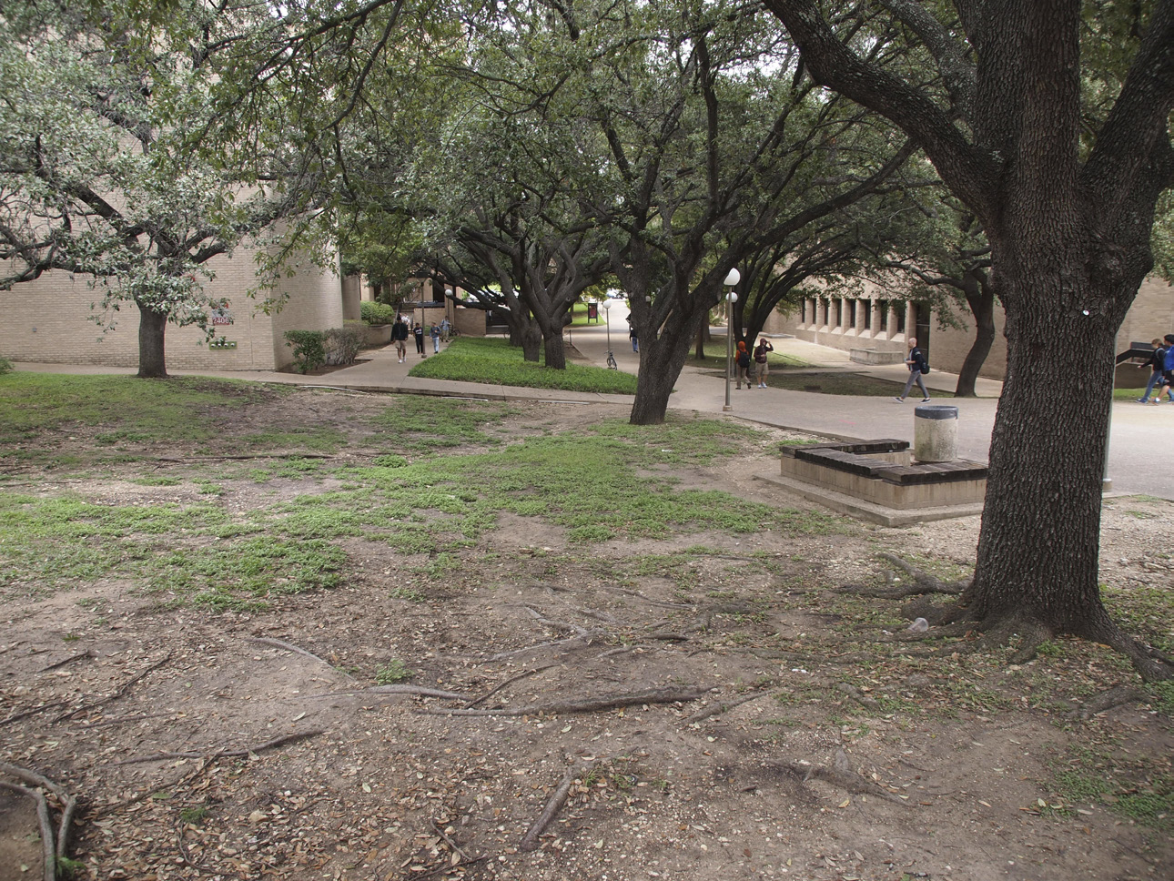
Compacted soil
Erosion
Water intensive and non-native landscaping
Degraded habitat value
Storm water runoff due to excess impervious cover
Impaired groundwater recharge
Minimal filtration opportunities

Slide 10
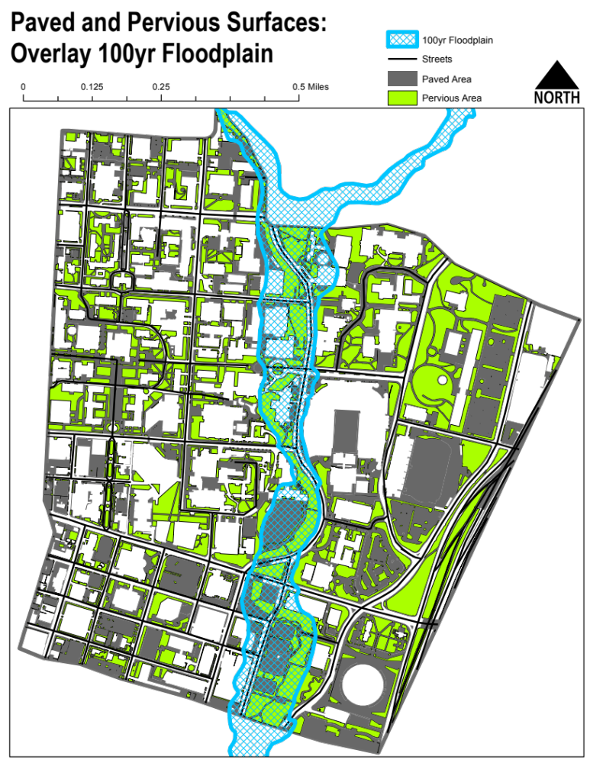
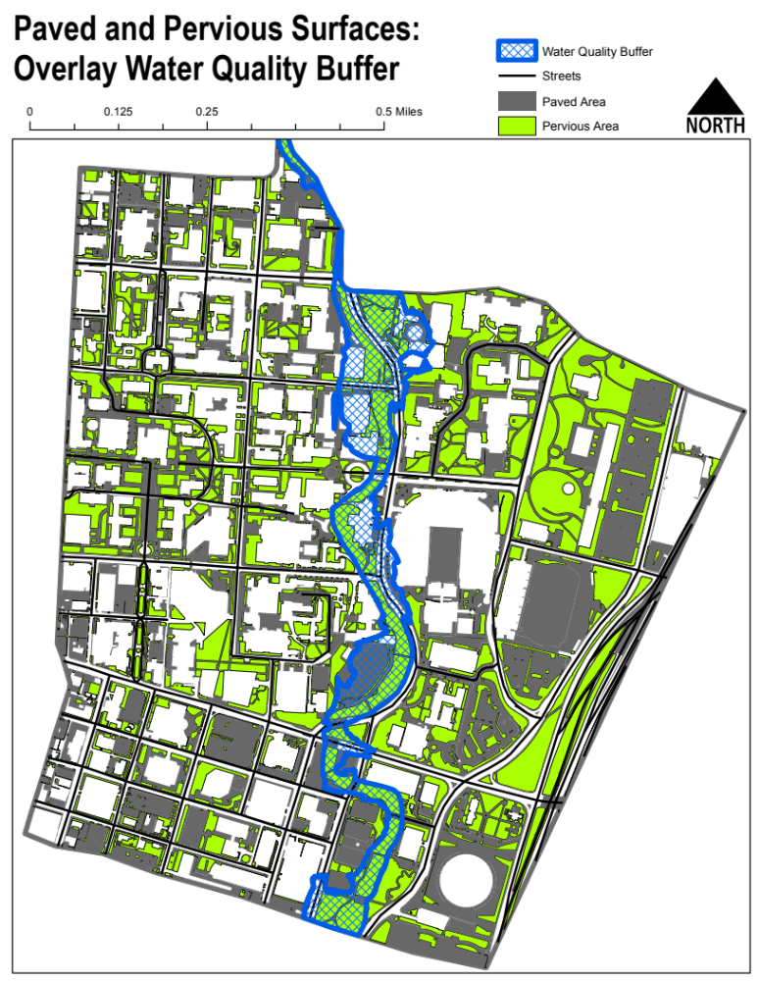

Slide 12
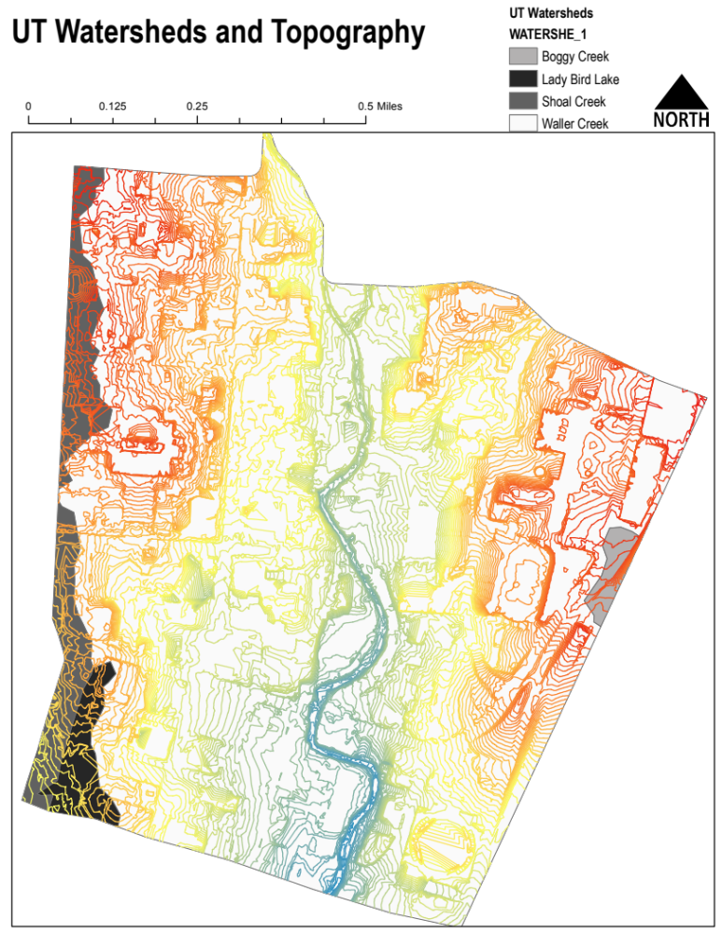

Slide 13
To what degree do aesthetic considerations limit progressive storm water management?
Where are opportunities for implementation?

Slide 14
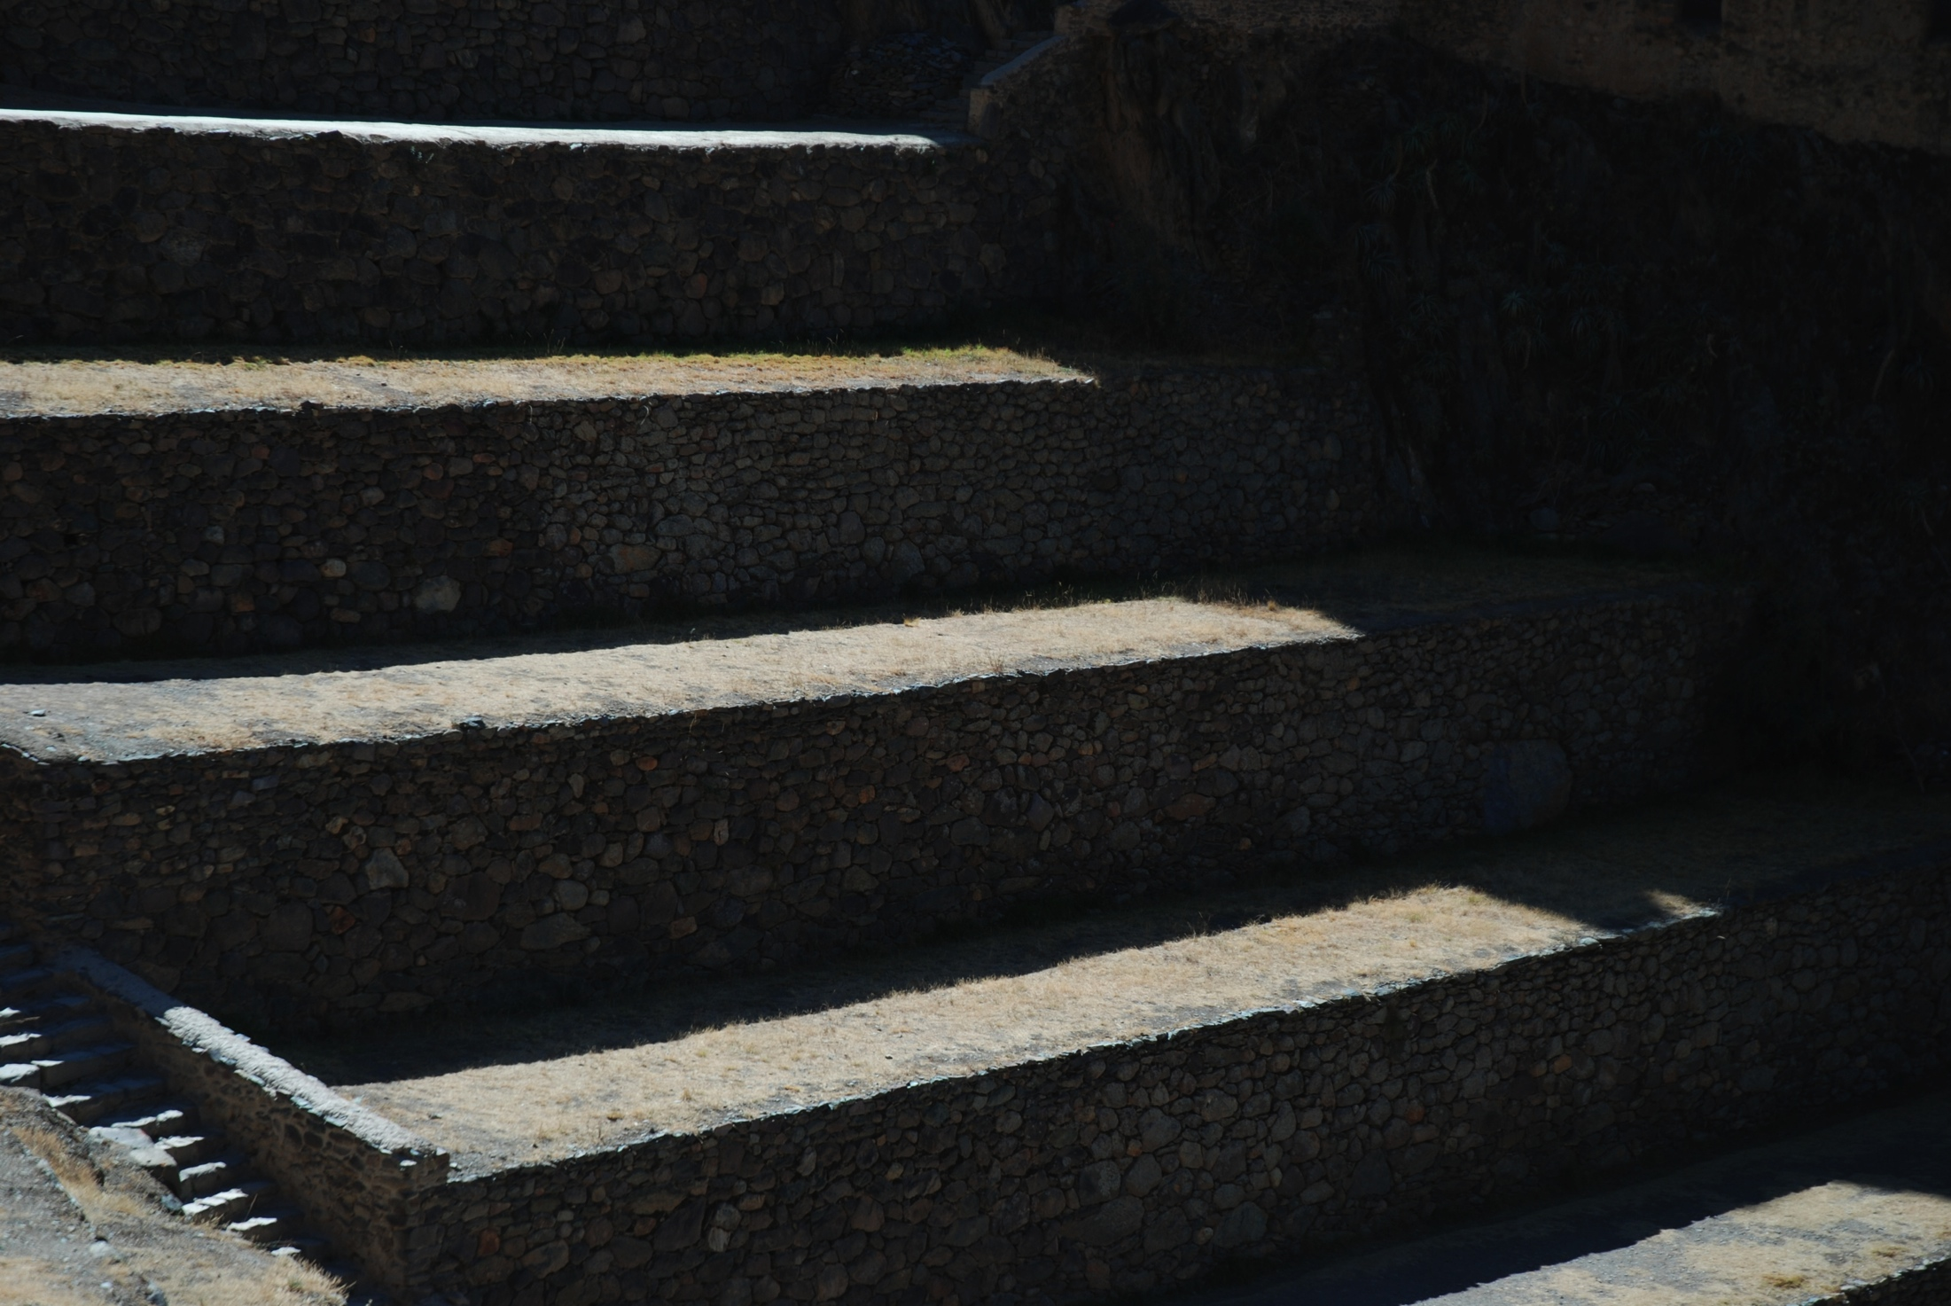
1. Identify most vulnerable areas on campus
2. Overlay water quality and floodplain buffers with specific landscape types
3. Overlay campus wide landscape types and opportunity areas

Slide 15
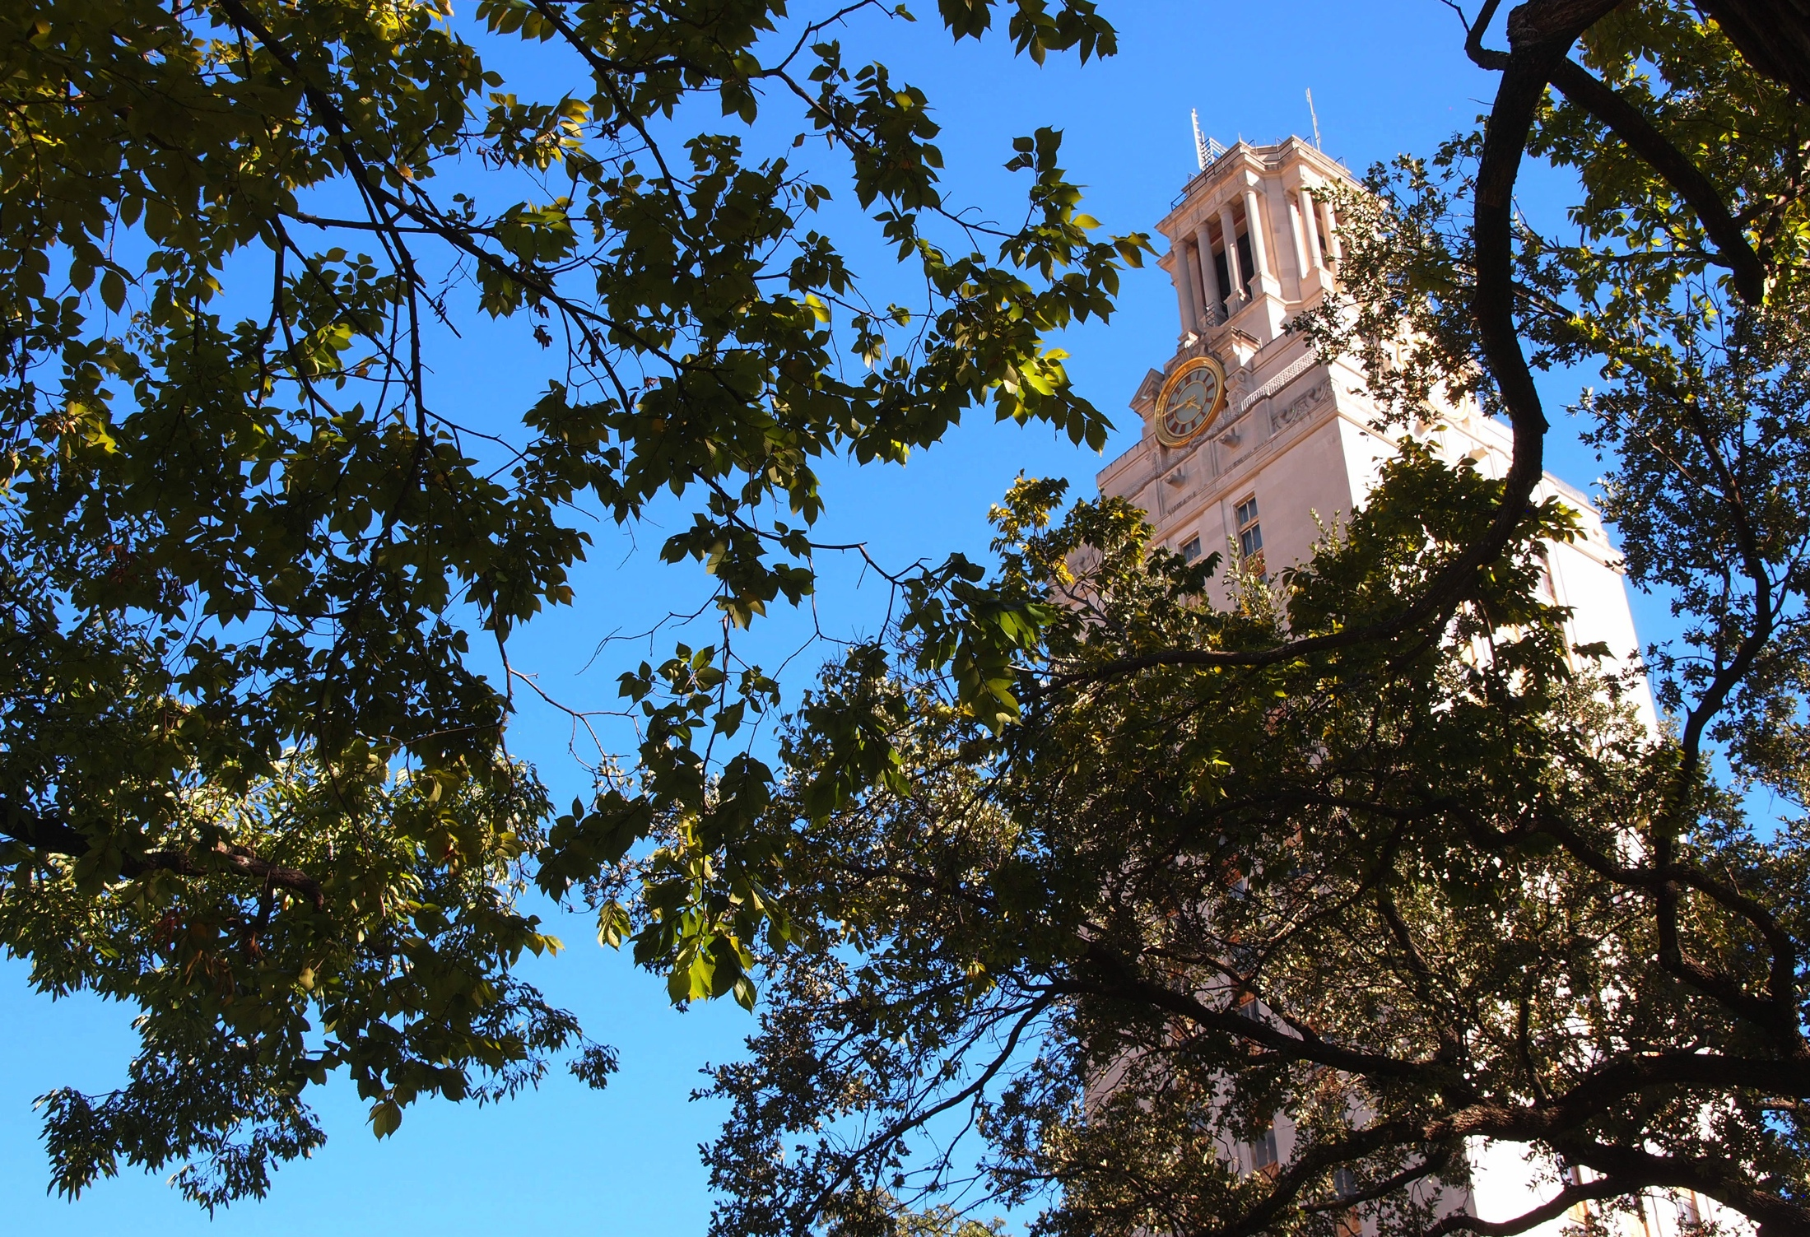
Texas Natural Resource Information System
Texas Water Development Board
City of Austin Data
USDA Soils Data (Statsogo)
National Hydrography Dataset (NHDPlus)
Texas Commission on Environmental Quality (TCEQ)
UT Landscape Master Plan
Carlos Galdeano, Campus DEM Model
Thank you to Dr. Maidment for direction and guidance

