Slide 1
Spatial Analysis Using Grids
Learning Objectives
By the end of this class you should be able to:
describe some ways continuous surfaces or spatial fields are represented in GIS
list and describe the data elements that comprise a grid data structure
describe how integer, categorical and real valued data fields are represented using grids
use map algebra to perform raster calculations on grids and explain the scale issues involved in raster calculations where grids may not have the same cell size
define interpolation and describe aspects to be considered in interpolating a spatial field
calculate the slope of a topographic surface represented by a grid using:
  ArcGIS method based on finite differences,
  D8 model in direction of steepest single flow direction,
  D∞ model in direction of steepest outward slope on grid centered triangular facets.

Slide 2
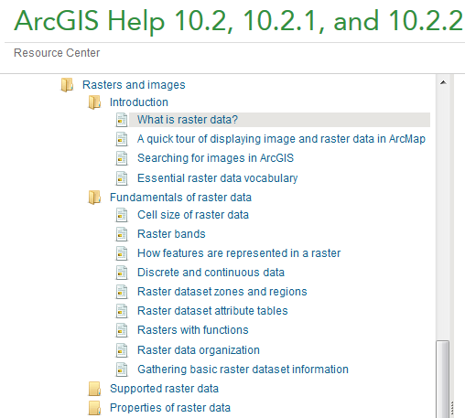
Readings – at http://resources.arcgis.com/en/help/
In Raster and Images, starting from "Introduction/What is raster data" to end of "Fundamentals of raster data/Rasters with functions" http://resources.arcgis.com/en/help/main/10.2/#/What_is_raster_data/009t00000002000000/

Slide 3
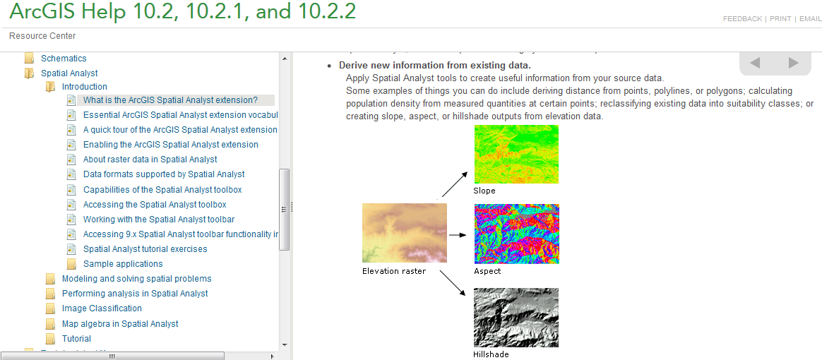
Readings – at http://resources.arcgis.com/en/help/
In Spatial Analyst Introduction, “What is the ArcGIS Spatial Analyst Extension?” to “About Raster Data in Spatial Analyst”
  http://resources.arcgis.com/en/help/main/10.2/index.html#/What_is_the_ArcGIS_Spatial_Analyst_extension/005900000001000000/

Slide 4
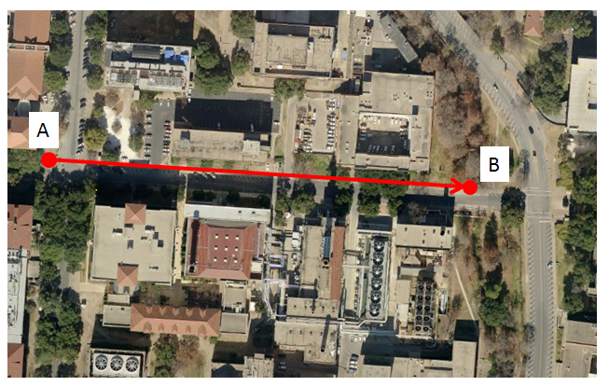
Slope Handout
http://www.neng.usu.edu/cee/faculty/dtarb/giswr/2014/Slope.pdf
Determine the length, slope and azimuth of the line AB.

Slide 5
Two fundamental ways of representing geography are discrete objects and fields.
f(x,y)
y
x
Notes:
DRM

Slide 6
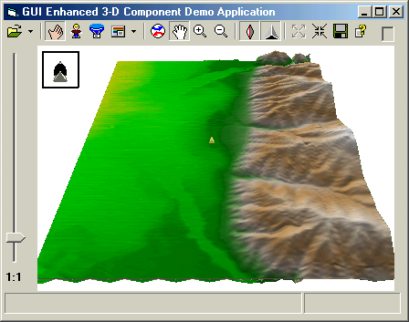
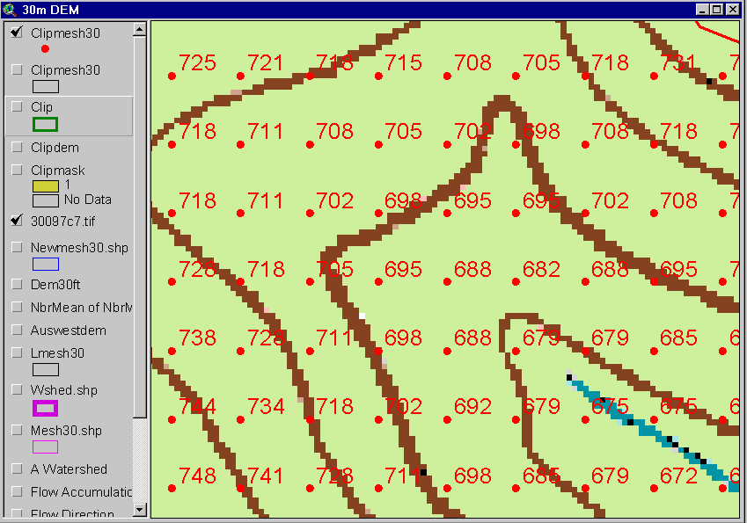
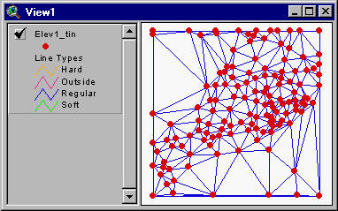
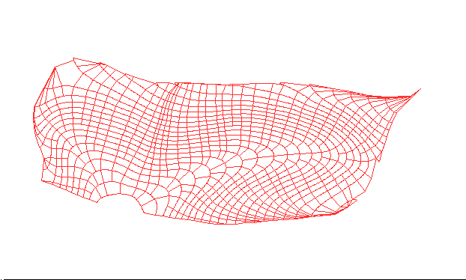
Numerical representation of a spatial surface (field)
Grid or Raster
TIN
Contour and flowline

Slide 7
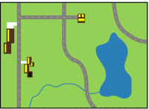
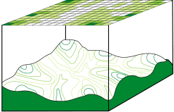
Discrete (vector) and continuous (raster) data
Images from http://resources.arcgis.com/en/help/main/10.1/index.html#/Discrete_and_continuous_data/009t00000007000000/

Slide 8
Raster and Vector Data
Raster data are described by a cell grid, one value per cell
Vector
Raster
Point
Line
Zone of cells
Polygon
Notes:
DRM

Slide 9
Line as a Sequence of Cells

Slide 10
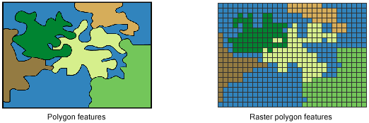
Polygon as Zone of Grid Cells
From: http://resources.arcgis.com/en/help/main/10.2/index.html#/How_features_are_represented_in_a_raster/009t00000006000000/

Slide 11
Raster and Vector are two methods of representing geographic data in GIS
Both represent different ways to encode and generalize geographic phenomena
Both can be used to code both fields and discrete objects
In practice a strong association between raster and fields and vector and discrete objects
Notes:
DRM

Slide 12
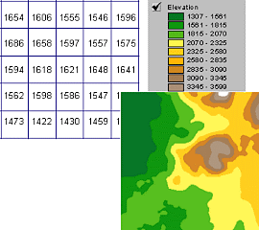
A grid defines geographic space as a mesh of identically-sized square cells. Each cell holds a numeric value that measures a geographic attribute (like elevation) for that unit of space.

Slide 13
The grid data structure
Grid size is defined by extent, spacing and no data value information
  Number of rows, number of column
  Cell sizes (X and Y)
  Top, left , bottom and right coordinates
Grid values
  Real (floating decimal point)
  Integer (may have associated attribute table)
Number of Columns
Number
of
rows
(X,Y)
NODATA cell
Cell size

Slide 14
NODATA Cells

Slide 15
Cell Networks

Slide 16
Floating Point Grids
Continuous data surfaces using floating point or decimal numbers

Slide 17
Integer valued grids to represent zones

Slide 18
Value attribute table for categorical (integer) grid data
Attributes of grid zones

Slide 19
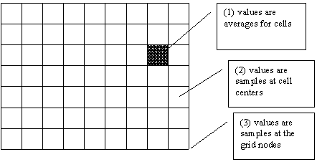
Raster Sampling
from Michael F. Goodchild. (1997) Rasters, NCGIA Core Curriculum in GIScience, http://www.ncgia.ucsb.edu/giscc/units/u055/u055.html, posted October 23, 1997

Slide 20
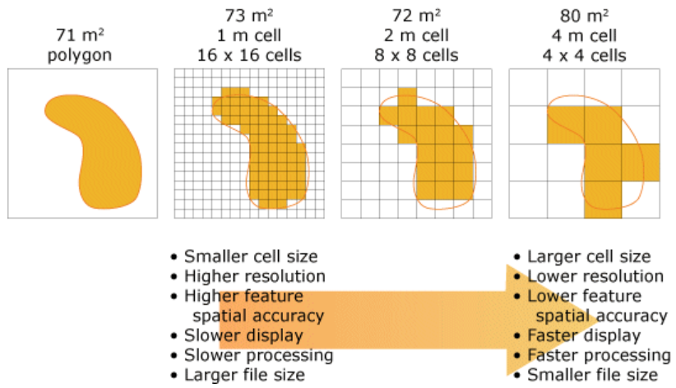
Cell size of raster data
From http://help.arcgis.com/en/arcgisdesktop/10.0/help/index.html#/Cell_size_of_raster_data/009t00000004000000/

Slide 21
Raster Generalization
Largest share rule
Central point rule

Slide 22
Map Algebra/Raster Calculation
Example
5
6
Precipitation
-
Losses (Evaporation, Infiltration)
=
Runoff
Cell by cell evaluation of mathematical functions
7
6
-
3
3
2
4
=
2
3
5
2

Slide 23
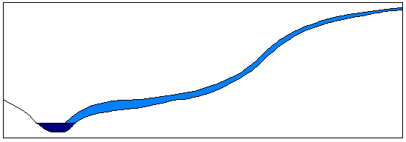
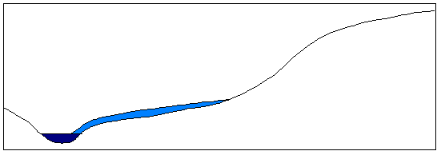
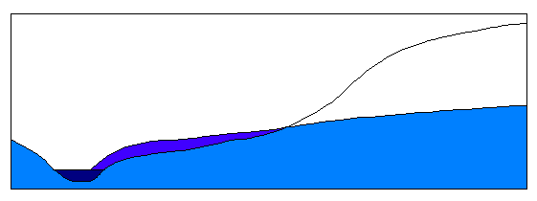
Runoff generation processes
P
Infiltration excess overland flow
aka Horton overland flow
P
f
P
q_{o}
f
Partial area infiltration excess overland flow
P
P
P
q_{o}
f
Saturation excess overland flow
P
P
P
q_{o}
q_{r}
q_{s}

Slide 24
Runoff generation at a point depends on
Rainfall intensity or amount
Antecedent conditions
Soils and vegetation
Depth to water table (topography)
Time scale of interest
These vary spatially which suggests a spatial geographic approach to runoff estimation

Slide 25
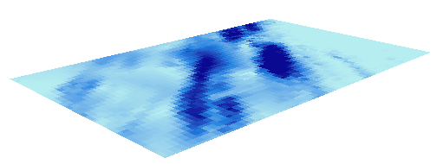
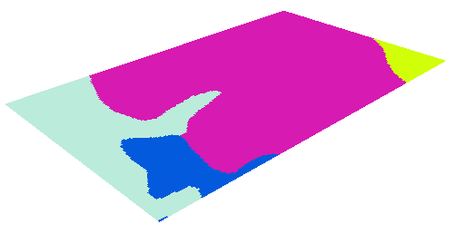
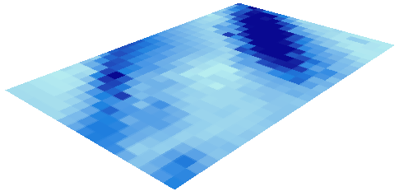
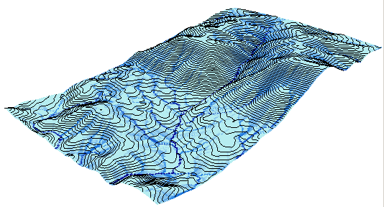
Cell based discharge mapping flow accumulation of generated runoff
Radar Precipitation grid
Soil and land use grid
Runoff grid from raster calculator operations implementing runoff generation formula’s
Accumulation of runoff within watersheds

Slide 26
Raster calculation – some subtleties
Resampling or interpolation (and reprojection) of inputs to target extent, cell size, and projection within region defined by analysis mask
+
=
Analysis mask
Analysis cell size
Analysis extent

Slide 27


Runoff Generation Raster Calculation Example
Precipitation, P cm/hr
Infiltration Rate, f cm/hr
150 m
100 m
150 m
100 m
2.2
3
4
4
6
1.8
2.5
3.5
3.1
4
1.5
2
2.7
Runoff R = P-f

Slide 28
Lets Experiment with this in ArcGIS
precip.asc
ncols 2
nrows 2
xllcorner 0
yllcorner 0
cellsize 150
NODATA_value -9999
4 6
3.1 4
infiltration.asc
ncols 3
nrows 3
xllcorner 0
yllcorner 0
cellsize 100
NODATA_value -9999
2.2 3 4
1.8 2.5 3.5
1.5 2 2.7

Slide 29

Example and Pixel Inspector

Slide 30
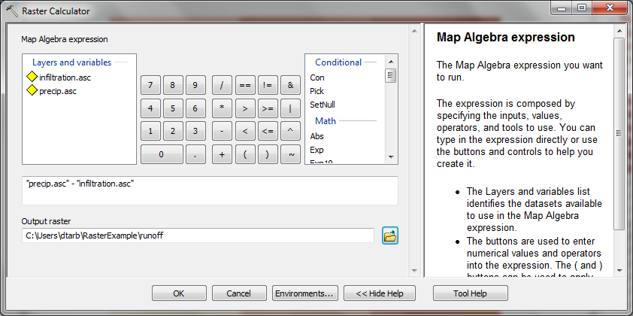
Runoff calculation using Raster Calculator
“precip.asc” - “infiltration.asc”

Slide 31
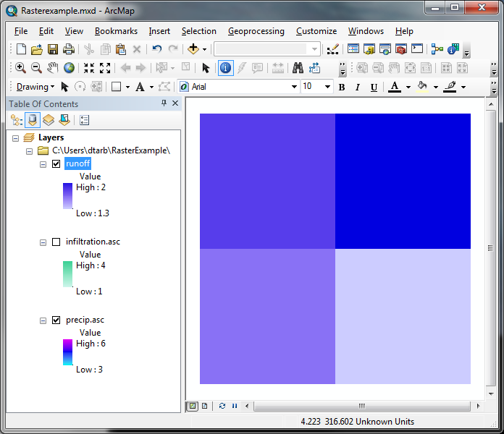
The Result
Outputs are on 150 m grid.
How were values obtained ?
1.8
2
1.6
1.3

Slide 32



Nearest Neighbor Resampling with Cellsize Maximum of Inputs
100 m
2.2
3
4
4 - 2.2 = 1.8
1.8
2.5
3.5
6 - 4 = 2
1.8
2
1.5
2
2.7
3.1 – 1.5 = 1.5
4 – 2.7= 1.3
1.5
1.3
150 m
4
6
3.1
4

Slide 33
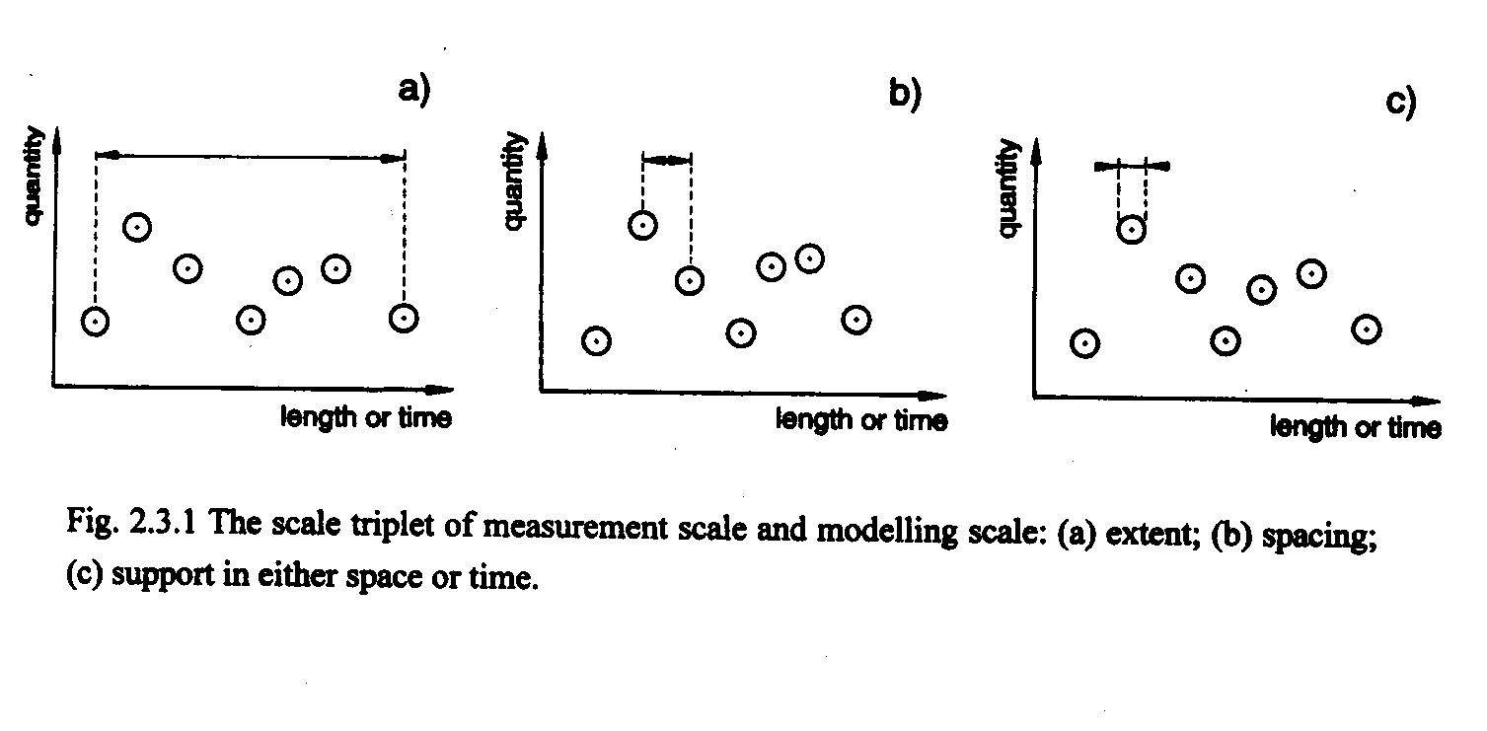
Scale issues in interpretation of measurements and modeling results
The scale triplet
a) Extent
b) Spacing
c) Support
From: Blöschl, G., (1996), Scale and Scaling in Hydrology, Habilitationsschrift, Weiner Mitteilungen Wasser Abwasser Gewasser, Wien, 346 p.

Slide 34
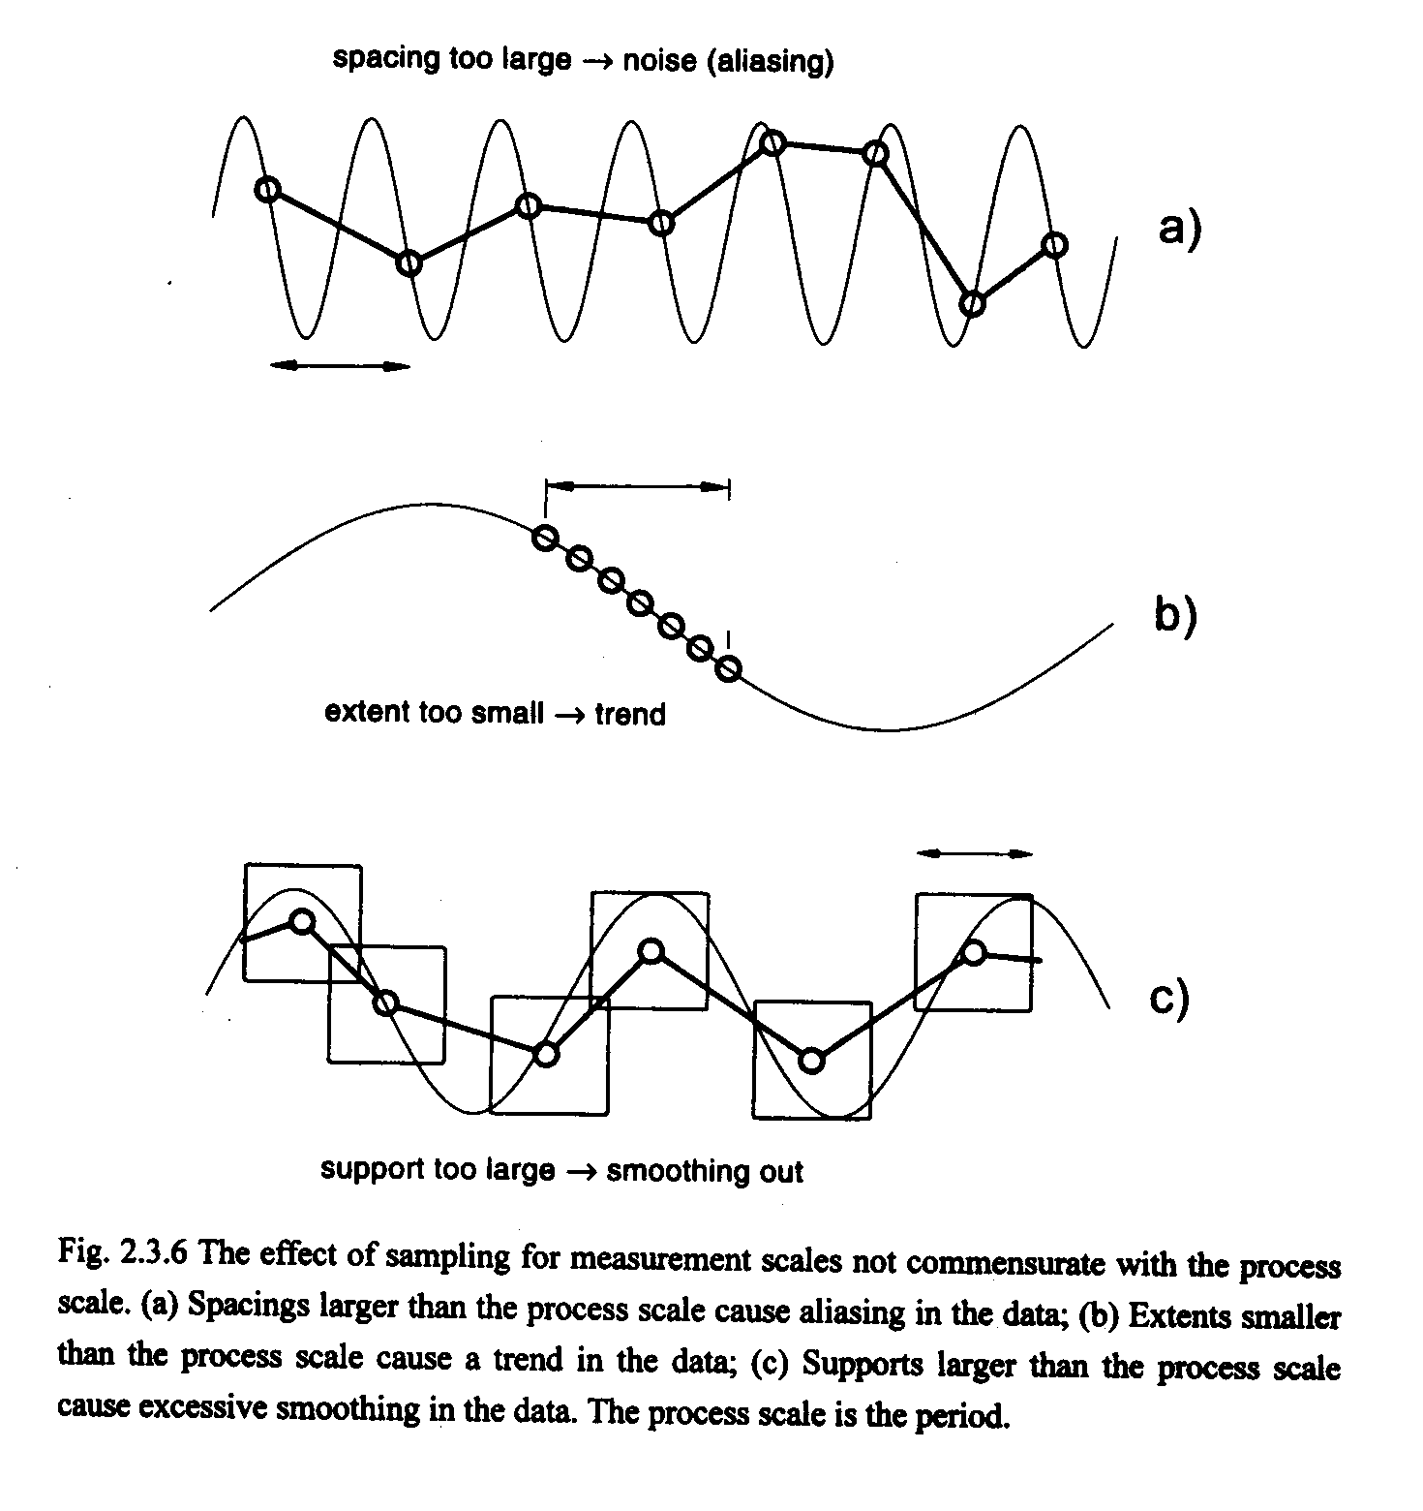
From: Blöschl, G., (1996), Scale and Scaling in Hydrology, Habilitationsschrift, Weiner Mitteilungen Wasser Abwasser Gewasser, Wien, 346 p.

Slide 35
Interpolation
Estimate values between known values.
A set of spatial analyst functions that predict values for a surface from a limited number of sample points creating a continuous raster.
Apparent improvement in resolution may not be justified

Slide 36
Interpolation methods
Nearest neighbor
Inverse distance weight
Bilinear interpolation
Kriging (best linear unbiased estimator)
Spline

Slide 37
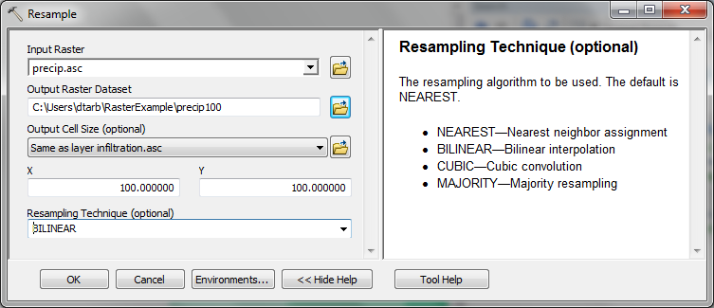
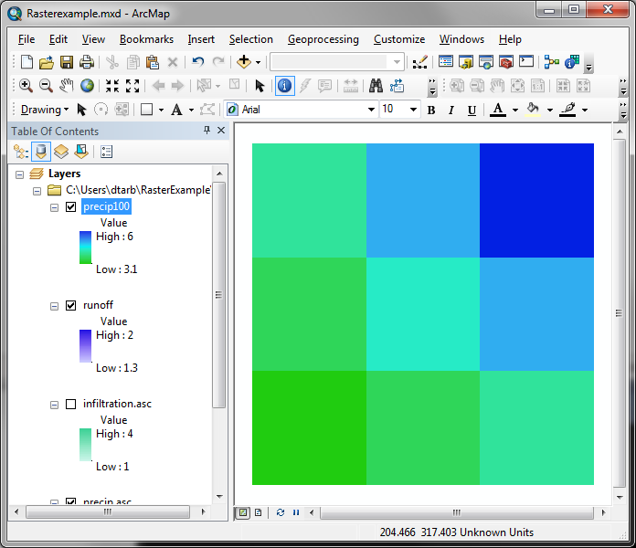
Resample to get consistent cell size
Spacing & Support
4
4
5
6
6
3.55
4.275
5
3.1
4
3.1
3.55
4

Slide 38
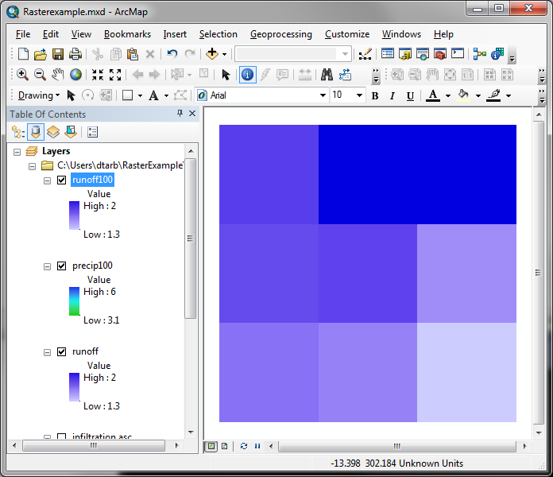
Calculation with consistent 100 m cell size grid
“precip100” - “infiltration”
Outputs are on 100 m grid as desired.
How were values obtained ?
1.8
2
2
1.75
1.775
1.5
1.6
1.55
1.3

Slide 39



100 m cell size raster calculation
4 – 2.2 = 1.8
100 m
4
5
6
5 – 3 = 2
6 – 4 = 2
3.55
4.275
5
3.55 – 1.8 = 1.75
1.8
2
2
3.1
3.55
4
4.275 – 2.5 = 1.775
5 – 3.5 = 1.5
1.75
1.775
1.5
3.1 – 1.5 = 1.6
100 m
2.2
3
4
3.55 – 2 = 1.55
1.6
1.55
1.3
4 – 2.7 = 1.3
1.8
2.5
3.5
1.5
2
2.7

Slide 40
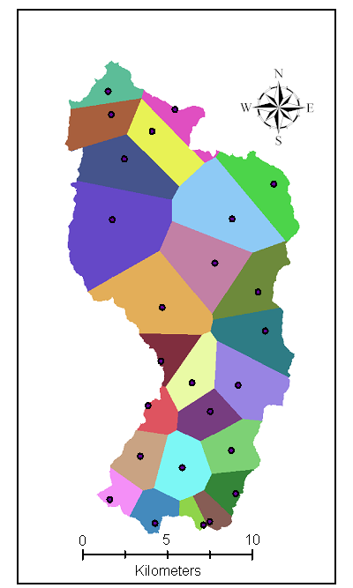
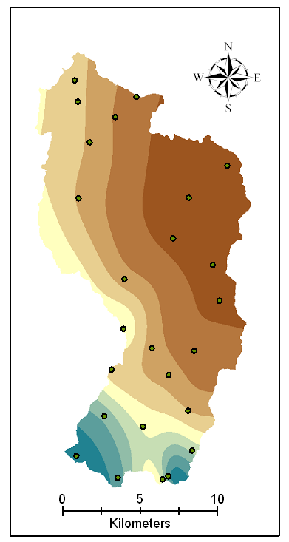
Nearest Neighbor “Thiessen” Polygon Interpolation
Point to Raster Interpolation
Spline Interpolation

Slide 41
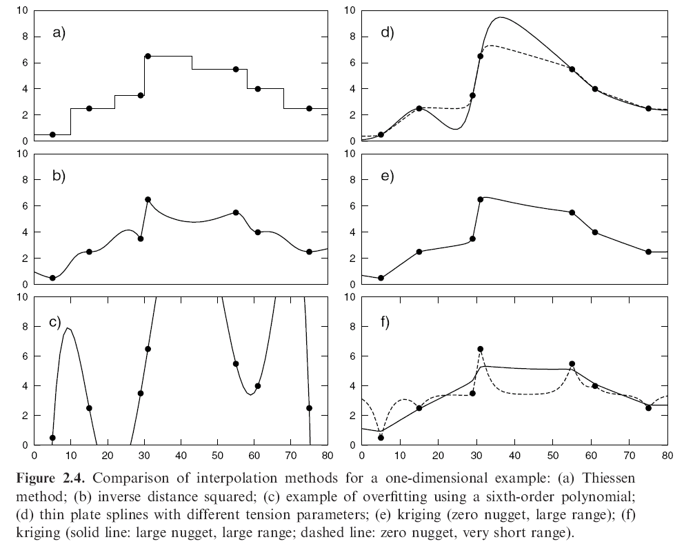
Interpolation Comparison
Grayson, R. and G. Blöschl, ed. (2000)

Slide 42
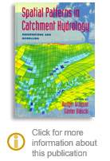
Further Reading
Grayson, R. and G. Blöschl, ed. (2000), Spatial Patterns in Catchment Hydrology: Observations and Modelling, Cambridge University Press, Cambridge, 432 p.
Chapter 2. Spatial Observations and Interpolation
Full text online at:
http://www.hydro.tuwien.ac.at/forschung/publikationen/engl-publikationen/spatial-patterns-in-catchment-hydrology.html

Slide 43
Spatial Surfaces used in Hydrology
Elevation Surface — the ground surface elevation at each point

Slide 44
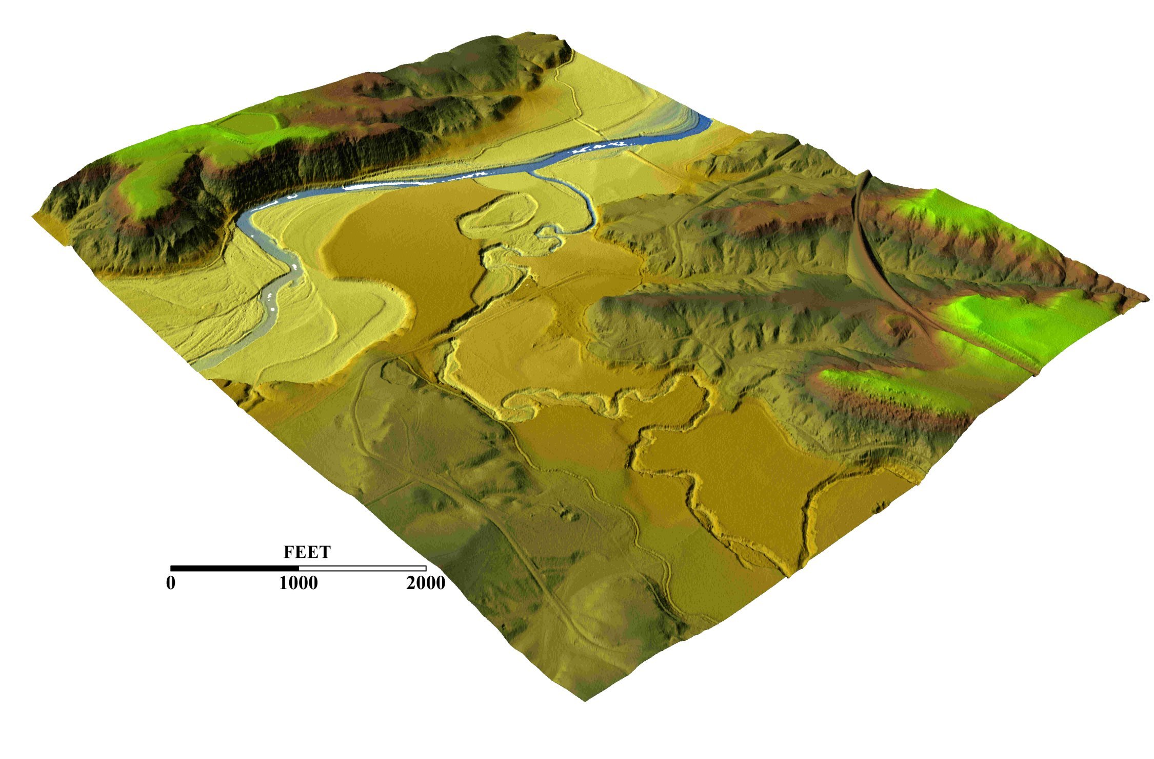
3-D detail of the Tongue river at the WY/Mont border from LIDAR.
Roberto Gutierrez
University of Texas at Austin

Slide 45
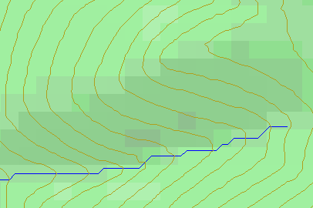
Topographic Slope
Defined or represented by one of the following
  Surface derivative ∇z (dz/dx, dz/dy)
  Vector with x and y components (S_{x}, S_{y})
  Vector with magnitude (slope) and direction (aspect) (S, α)
See http://www.neng.usu.edu/cee/faculty/dtarb/giswr/2014/Slope.pdf

Slide 46
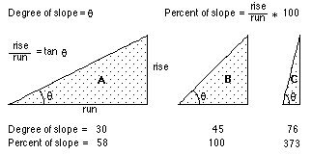

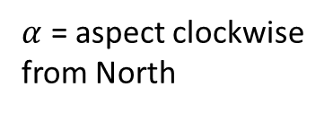




Slope and Aspect
$$y$$
$$Δx$$
$α$ = aspect clockwise from North
$$Δy$$
$$α$$
$$x$$

Slide 47

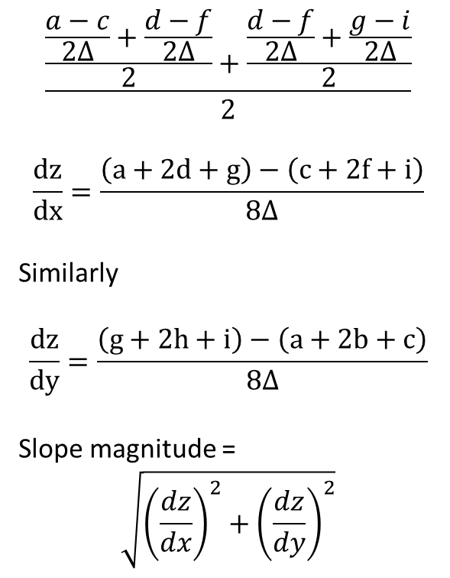


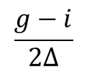
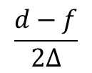
ArcGIS “Slope” tool
y
a
b
c
$$\frac{\frac{\frac{a−c}{2∆}+\frac{d−f}{2∆}}{2}+\frac{\frac{d−f}{2∆}+\frac{g−i}{2∆}}{2}}{2}$$
$$\frac{dz}{dx}=\frac{\left(a+2d+g\right)−\left(c+2f+i\right)}{8∆}$$
Similarly
$$\frac{dz}{dy}=\frac{\left(g+2h+i\right)−\left(a+2b+c\right)}{8∆}$$
Slope magnitude =
$$\sqrt{{\left(\frac{dz}{dx}\right)}^{2}+{\left(\frac{dz}{dy}\right)}^{2}}$$
d
e
f
g
h
i
x
$$\frac{a−c}{2∆}$$
$$\frac{d−f}{2∆}$$
c
$$\frac{g−i}{2∆}$$
$$∆$$
b
f
a
e
i
d
h
g
$$2∆$$
x
y

Slide 48





ArcGIS Aspect – the steepest downslope direction
$$Δy=$$
$$Δx=$$
$$Δx$$
Use atan2 to resolve ambiguity in atan direction
$$Δy$$
$$α$$
$$−Δx$$
$$−Δy$$
$$α+{180}^{o}$$

Slide 49
Example
30
a
b
c
80
74
63
d
e
f
145.2º
69
67
56
g
h
i
60
52
48

Slide 50
Hydrologic Slope (Flow Direction Tool)
- Direction of Steepest Descent
30
30
80
74
63
80
74
63
69
67
56
69
67
56
60
52
48
60
52
48
Slope:

Slide 51
Eight Direction Pour Point Model
32
64
128
16
1
8
4
2
ESRI Direction encoding

Slide 52
Limitation due to 8 grid directions.
?

Slide 53
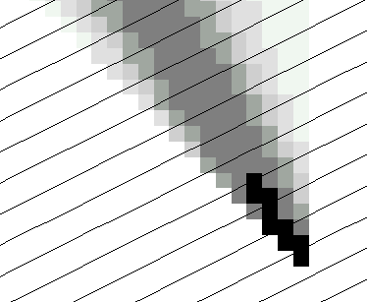
The D∞ Algorithm
Tarboton, D. G., (1997), "A New Method for the Determination of Flow Directions and Contributing Areas in Grid Digital Elevation Models," Water Resources Research, 33(2): 309-319.) (http://www.engineering.usu.edu/cee/faculty/dtarb/dinf.pdf)

Slide 54
The D∞ Algorithm
Δ
If α₁ does not fit within the triangle the angle is chosen along the steepest edge or diagonal resulting in a slope and direction equivalent to D8

Slide 55
D∞ Example
30
80
74
63
69
e_{o}
67
56
60
e₇
e₈
52
48
284.9º
14.9º

Slide 56
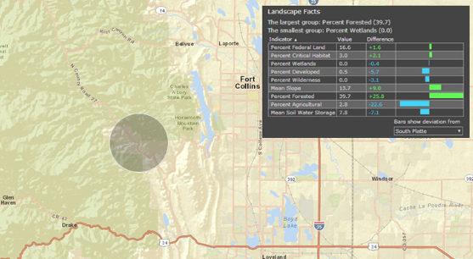
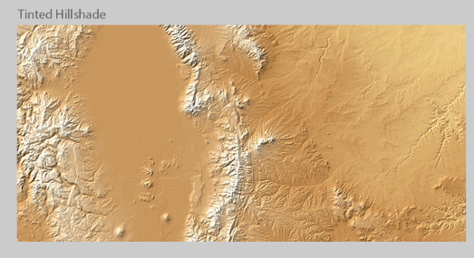
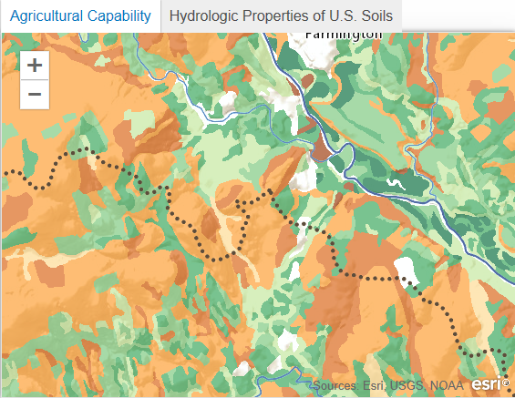
ArcGIS.Com ready to use maps including elevation services
http://www.arcgis.com/features/maps/earth.html
Land Cover
Elevation
Soils

Slide 57
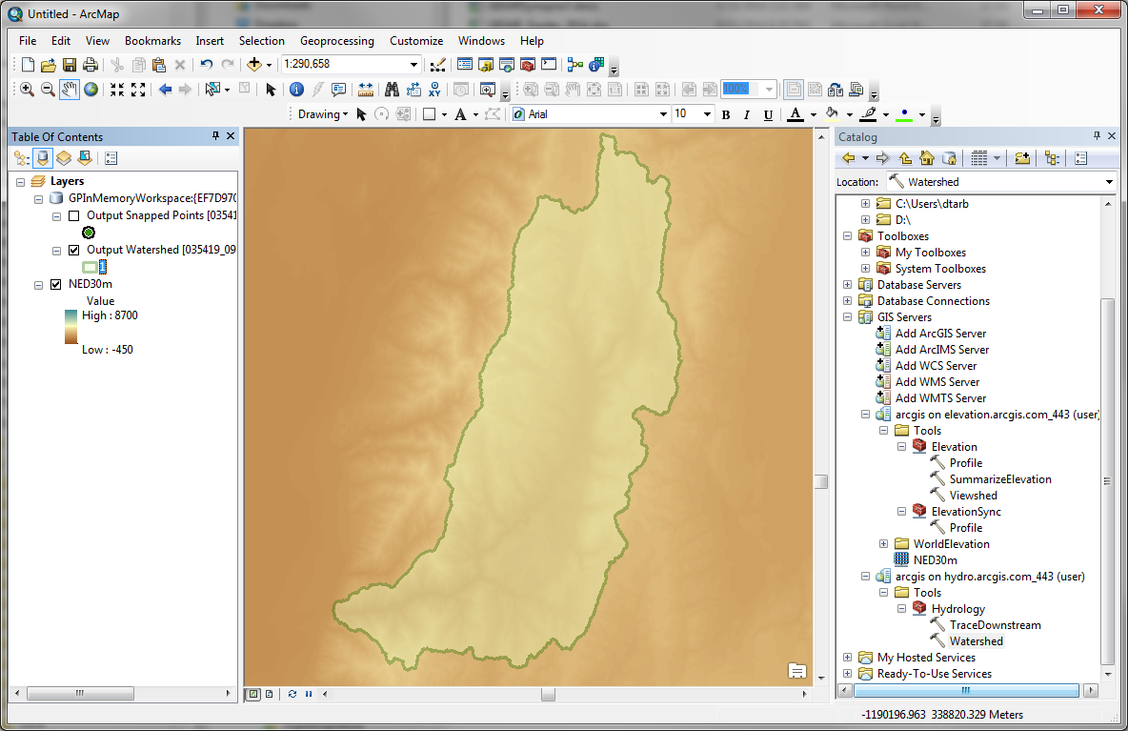
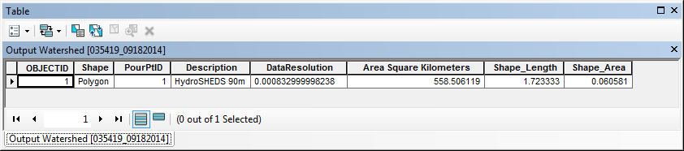
Elevation and Hydro Services
http://elevation.arcgis.com/arcgis/services
http://hydro.arcgis.com/arcgis/services

Slide 58
Summary Concepts
Grid (raster) data structures represent surfaces as an array of grid cells
Raster calculation involves algebraic like operations on grids
Interpolation and Generalization is an inherent part of the raster data representation

Slide 59
Summary Concepts (2)
The elevation surface represented by a grid digital elevation model is used to derive slope important for surface flow
The eight direction pour point model approximates the surface flow using eight discrete grid directions.
The D∞ vector surface flow model approximates the surface flow as a flow vector from each grid cell apportioned between down slope grid cells.

