Slide 1
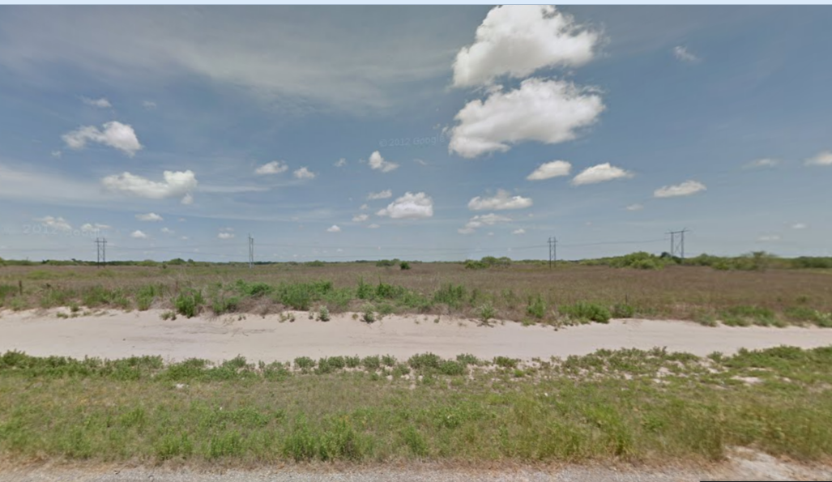
Streams in the Ranching Country of South Texas
Sandranell Moerbe
10 November 2015
CE394K

Slide 2
NFIE Region 12 : Texas-Gulf
Are there really no streams here?
(HUC 12110207)

Slide 3
Project Steps
Review NED - Is there elevation change?
Watershed Analysis – Process from Ex #4
Gather Landcover data
Gather Population data

Slide 4
DEM - There is Elevation Change

Slide 5
Watershed Analysis
PLAN- Three Easy Steps
  Generate catchments and flowlines
    HUC12110207 and surrounding watersheds
  Compare to NFIE model
  Adjust Flow Accumulation Threshold as needed
REALITY- Stuck before I began
  I need an outlet.

Slide 6
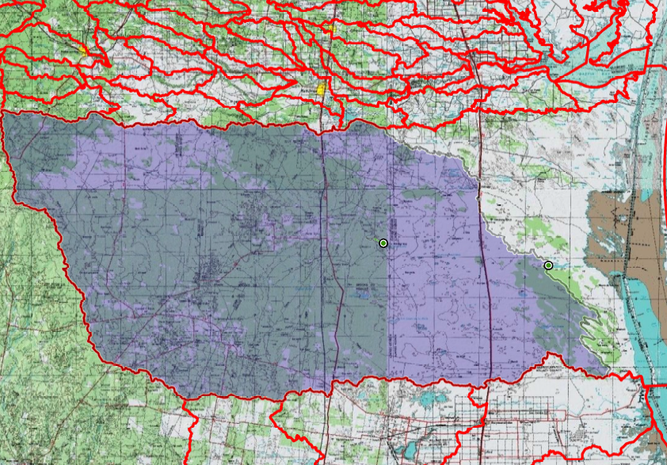
Outlet Location - Watershed Tool
Outlets were randomly selected.

Slide 7
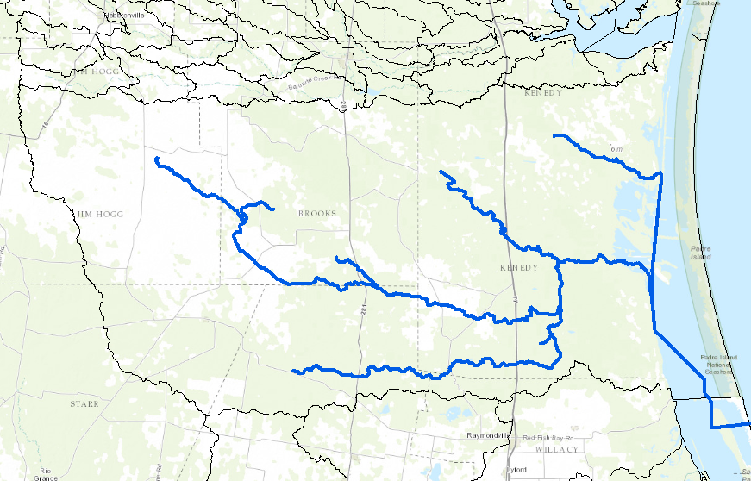
Outlet Location - Trace Downstream
Start Points were randomly selected

Slide 8
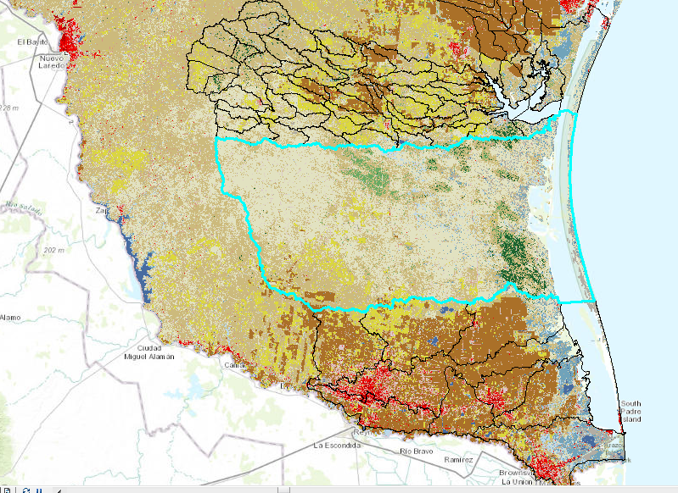
Landcover – Less than Neighbors

Slide 9
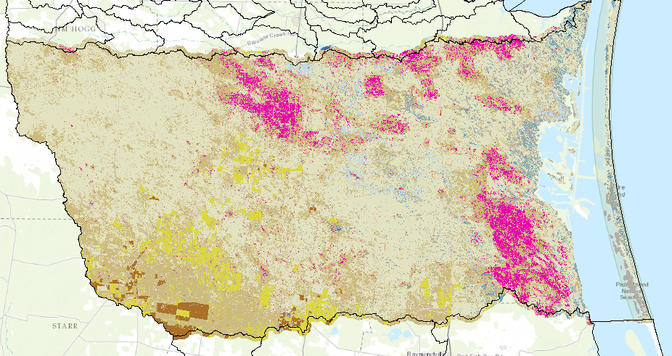

Landcover – But Forest??

Slide 10
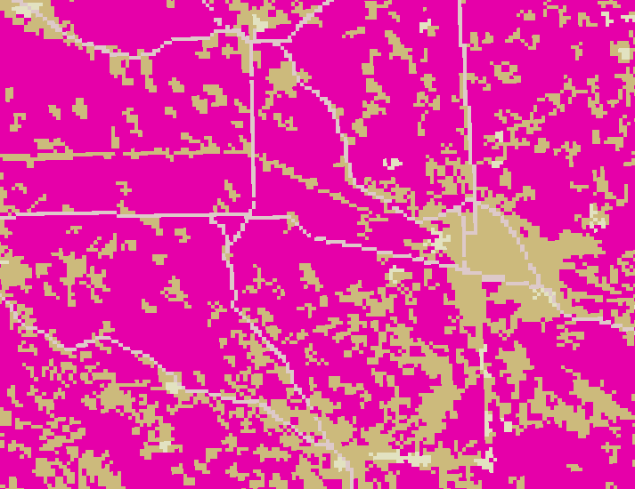
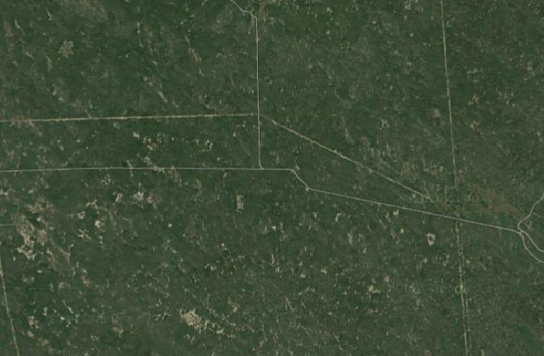
“Forests” – In Depth

Slide 11
Landcover – But Forest??

Slide 12
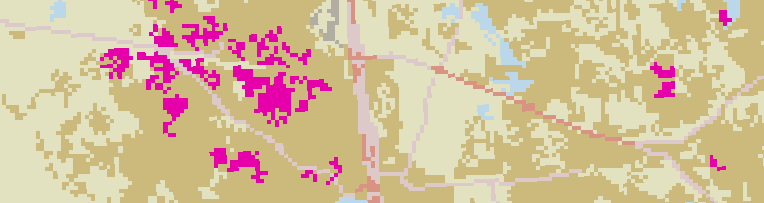
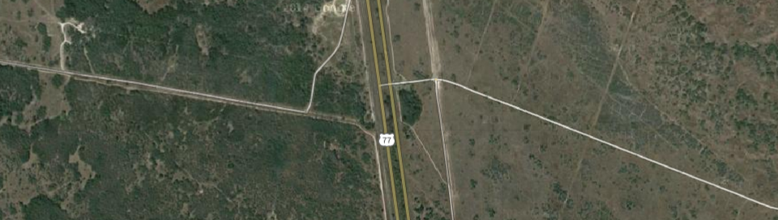
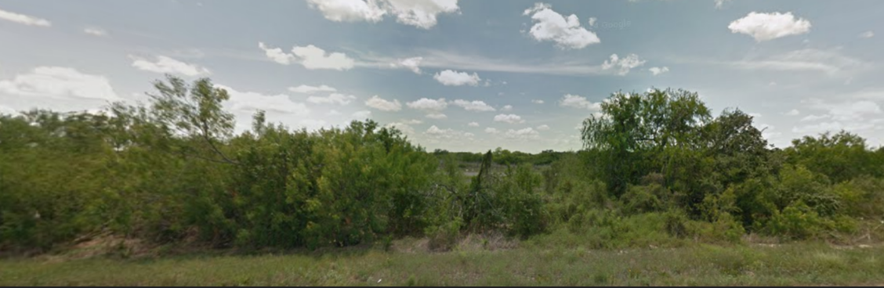

Slide 13
Conclusion
Watershed Analysis has barely begun
HUC 12110207 is similar to neighbors
  Elevation
  Land cover
Much work left to do

Slide 14
Questions?

Slide 15
BACKUP

Slide 16
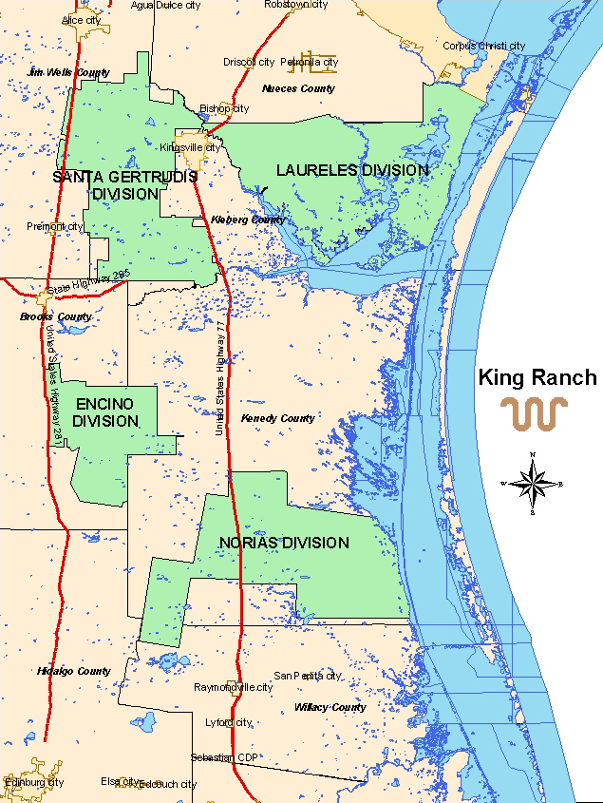

Slide 17
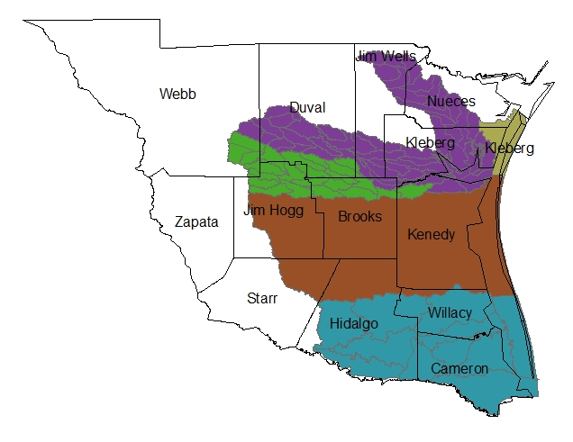
Ain‘t Nobody Much Livin’ Here
Kenedy Co. Pop - 416
Brooks Co. Pop – 7223*
* 6760 live in a city in the green watershed

