Slide 1
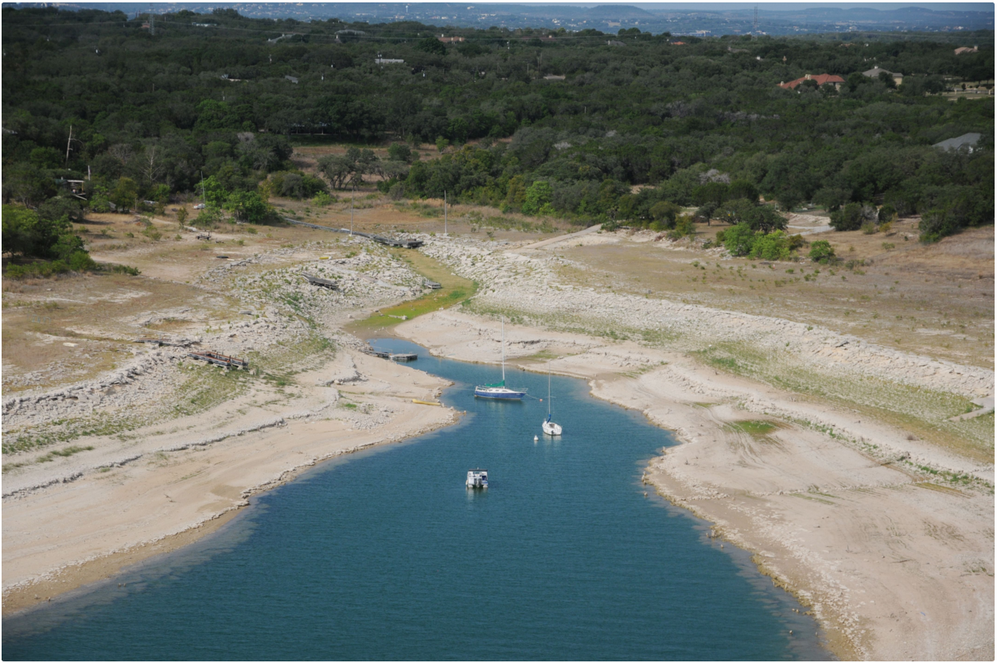
Lake Travis Drought
Katie Born

Slide 2
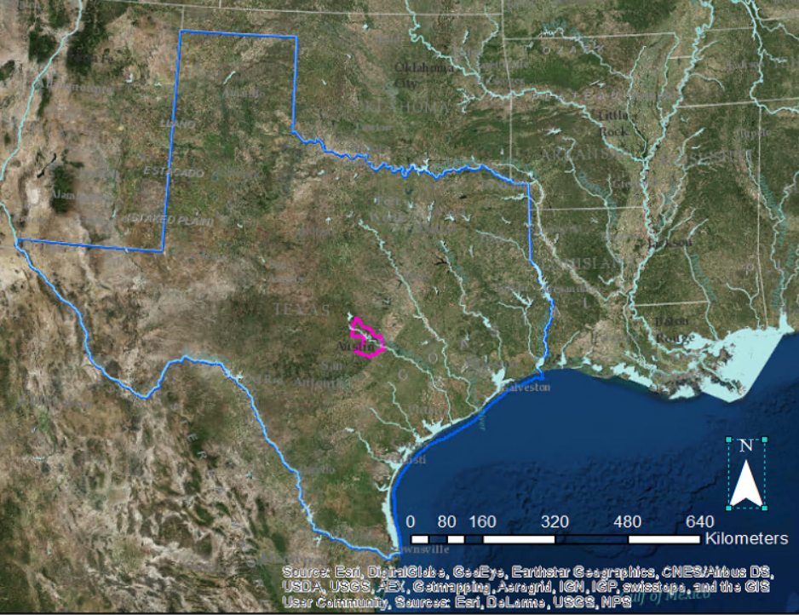
Goal
Map the drought severity in the Austin-Lake Travis Lakes Subbasin against the elevation of the Lake Travis reservoir
Notes:
The goal of my project is to map the drought severity in the Austin-Lake Travis Lakes Subbasin against the elevation of the Lake Travis reservoir.

Slide 3
Lake Travis
Reservoir created in 1942 with the construction of Mansfield Dam by the Lower Colorado River Authority
Full at elevation of 681.1 msl → 382,092,882,600 gallons of water
Historically lowest level of 614.2 msl on August 14, 1951
Water supply for Austin and surrounding areas
Lake Travis is the primary flood control reservoir for the Highland Lakes Chain
40% of the lake’s 1,950,000 acre-ft capacity is reserved for flood control
Notes:
Lake Travis was created in 1942 with the completion of the Mansfield Dam, after 6 years of construction. When the reservoir is full at 681 ft msl, it can hold almost 4 billion gallons of water. The lowest elevation since the completion of the dam was 614 ft msl during the drought of record in the early 1950’s.
This reservoir serves as water supply for Austin and surrounding areas, as well as the main flood control measure for the Highland Lakes Chain, which consists of 6 lakes.

Slide 4
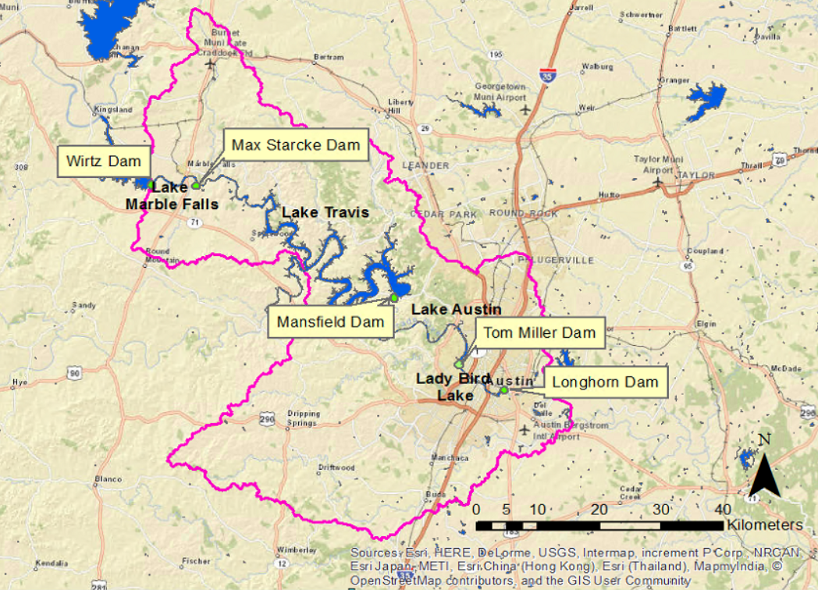
Notes:
As seen here, the subbasin in this study includes 3 of the 6 lakes in the Highland Lakes chain as well as Lady Bird Lake

Slide 5
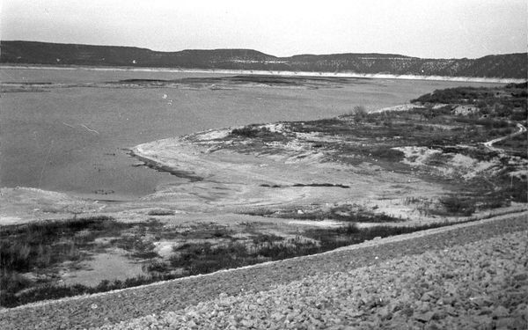
Texas Droughts
1940s – 1950s
1963 - 1964
1983 - 1984
1999 – 2000
2005 – 2006
2007 - 2009
2008 – 2015
1952
(Mashhood, 2011)
Notes:
Texas is know for its unpredictable weather so of course Lake Travis has plenty of ups and downs. Here are the 7 most major droughts this area has seen. Which is pretty significant, over half of my lifetime has been in a drought. This is a picture of the lake taken while at it’s lowest, during the drought of record.

Slide 6
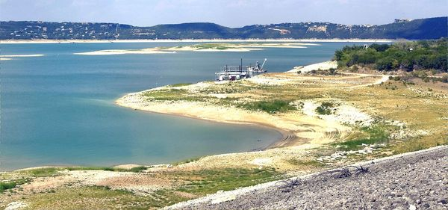
Texas Droughts
1940s – 1950s
1963 - 1964
1983 - 1984
1999 – 2000
2005 – 2006
2007 - 2009
2008 – 2015
2011
(Mashhood, 2011)
Notes:
Here is a picture of the same area in 2011, the lowest the lake level has dropped since the middle of the last century.

Slide 7
Why Droughts?
Reservoir levels
Wildfires
Crops
Electricity production
Groundwater
Notes:
These are some of the many concerning reasons that led me to choose drought as a topic.
As I showed with the last picture, in 2011, the elevation of Lake Travis elevation dropped to 618.66 msl, compared to 614 during the drought of record.
In September 2011, a series of wildfires spread across the state. The most remarkable of which was in Bastrop County, which scorched 34,000 acres and consumed over 1,000 homes. The more recent fires in Bastrop County were a fraction of what was seen in 2011.
In 2012, the LCRA began to cut off the water supply for Texas’s rice farmers. This gained a lot of media attention, but they were not the only farmers and ranchers affected by the drought.
Once the groundwater dried up in the area of Spicewood Beach, its residents had to depend on tanker trucks to deliver water to the town’s storage tank until a surface water treatment plant could supply water from Lake Travis.

Slide 8
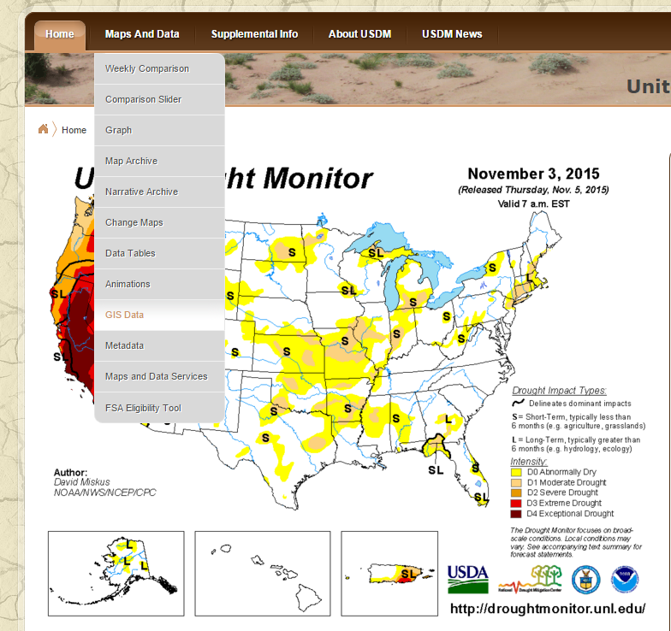
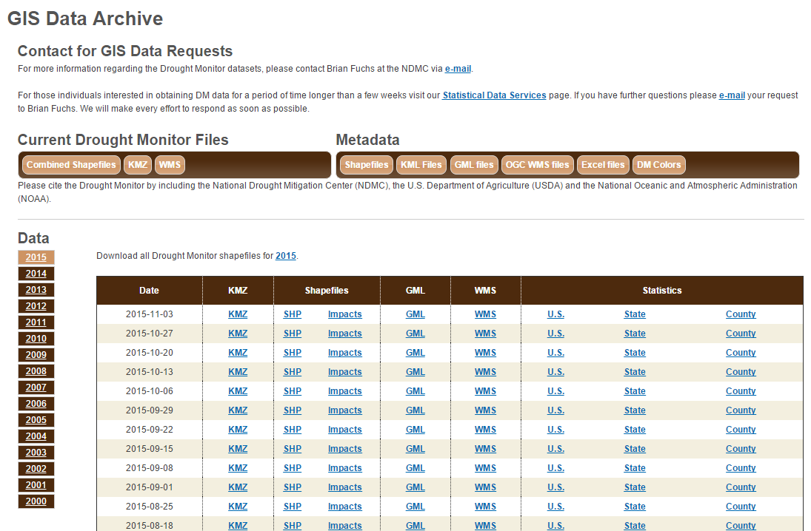
Drought Data
Notes:
Fortunately drought data was not too hard to find. There is a national database which has GIS data available for download. The real problem is there is too much data. I chose the most recent 10 years to include in my project. This still left me with almost 1,000 data sets on a national scale.

Slide 9
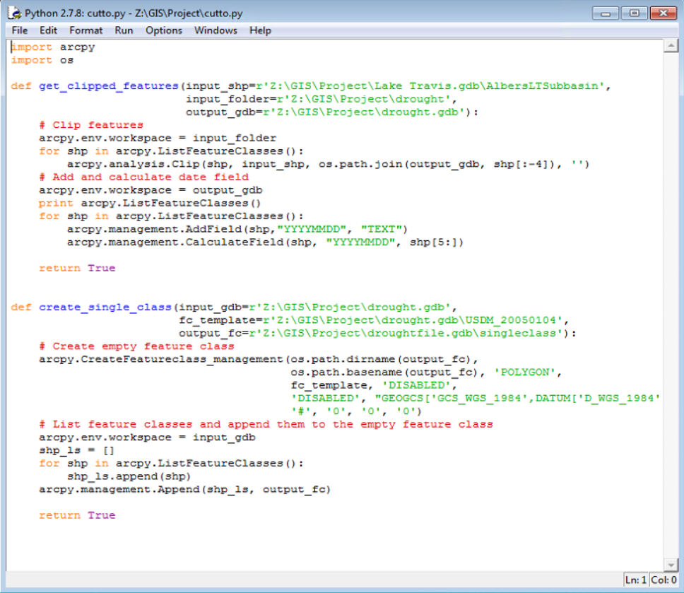
Dealing with Data
Cut to subbasin
Adding time field to data from file name
Compiling all data into one file
THANK YOU Gonzalo Espinoza!
Notes:
Luckily, Dr. Maidment pointed me to Gonzalo Espinoza who not only helped me figure out what to do with time series data, but wrote me a code which saved my project. There was no way I could have cut enough data down to the size of my subbasin to be worthwhile by hand. Gonzalo made me a code to cut all my data down to size, add a time field to the data from the file name, and compile every data point into one file. Once I got this to run through all the way successfully, I had my drought data.

Slide 10
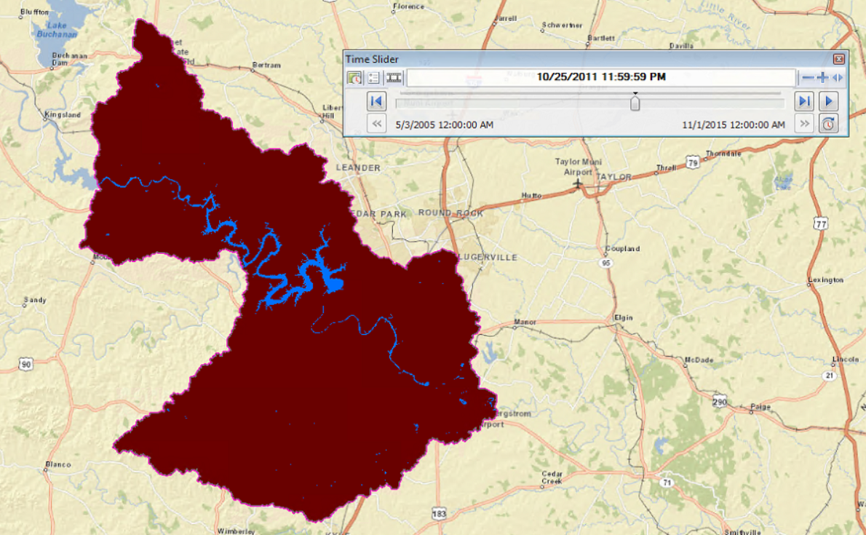
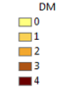
Drought in the Austin-Lake Travis Lakes Subbasin (2005 – 2015)
Notes:
On GIS, you can see the change in the drought severity from 2005 to 2015 with a time slider. To export this as a video turned out to be more complicated than expected, so here is a single frame of the data taken in October of 2011. Clearly, a pretty severe time in the drought.

Slide 11
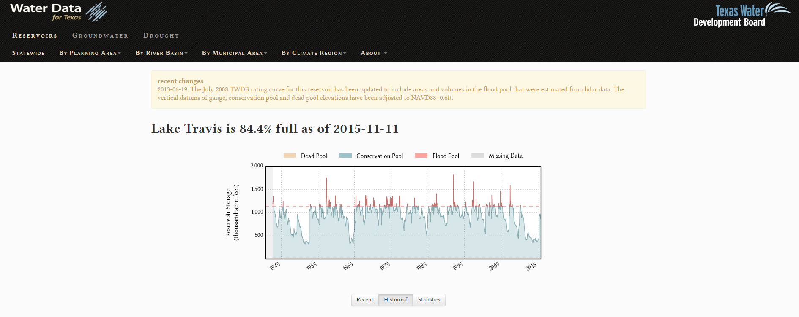
Future Work
Add the reservoir level data for Lake Travis to the current drought map
Notes:
I have only gotten the drought data onto my map thus far. I still need to add the reservoir levels and figure out how to even present that data. I plan on getting this from the Texas Water Development Board’s website, Water Data for Texas.

