Slide 1
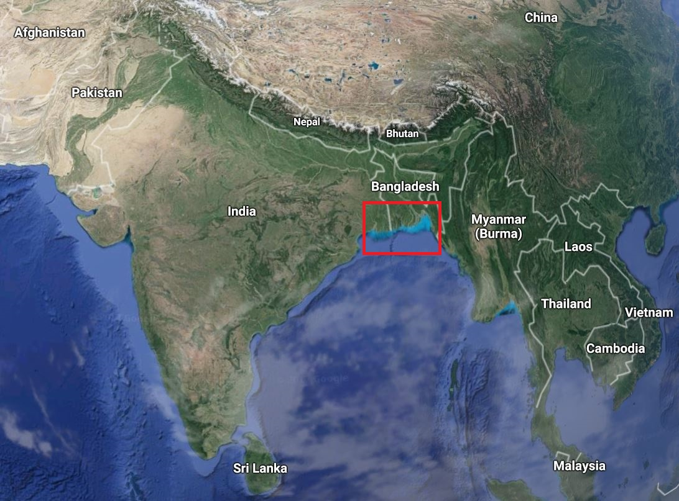
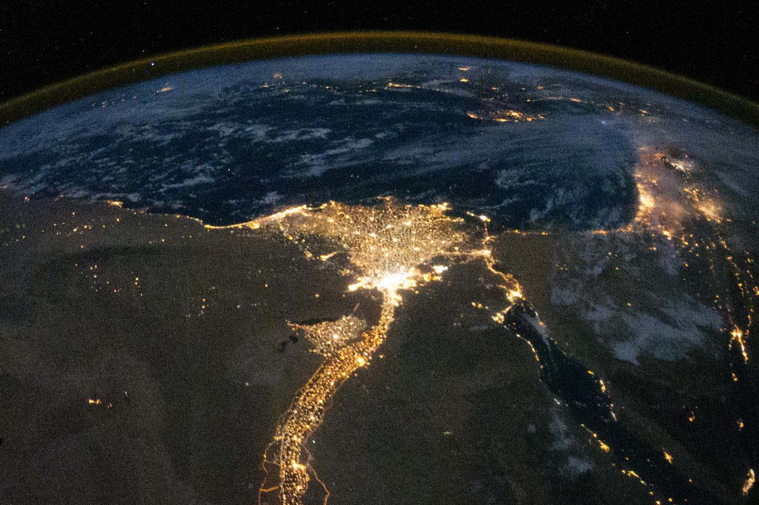
Human Impacts to Delta Morphology
GISWR Fall 2017
Jayaram Hariharan
Study area overview
https://www.google.com/maps
The Nile river delta at night
https://www.nasa.gov/multimedia/imagegallery/image_feature_1923.html

Slide 2
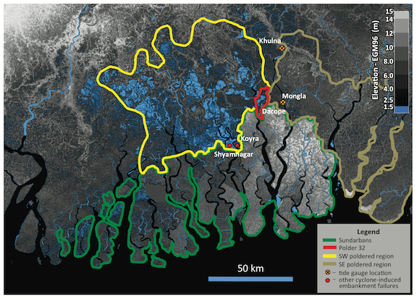
Study Area: Ganges-Brahmaputra-Meghna Delta
One of the largest river deltas in the world
Contains protected Sundarbans mangroves
Home to ~150 million people
Low lying coastal plains face flood risk and dangers of sea level rise
Sections of the delta
https://news.vanderbilt.edu/2015/01/05/flood-control-efforts-in-bangladesh-exacerbate-flooding-threaten-millions/

Slide 3
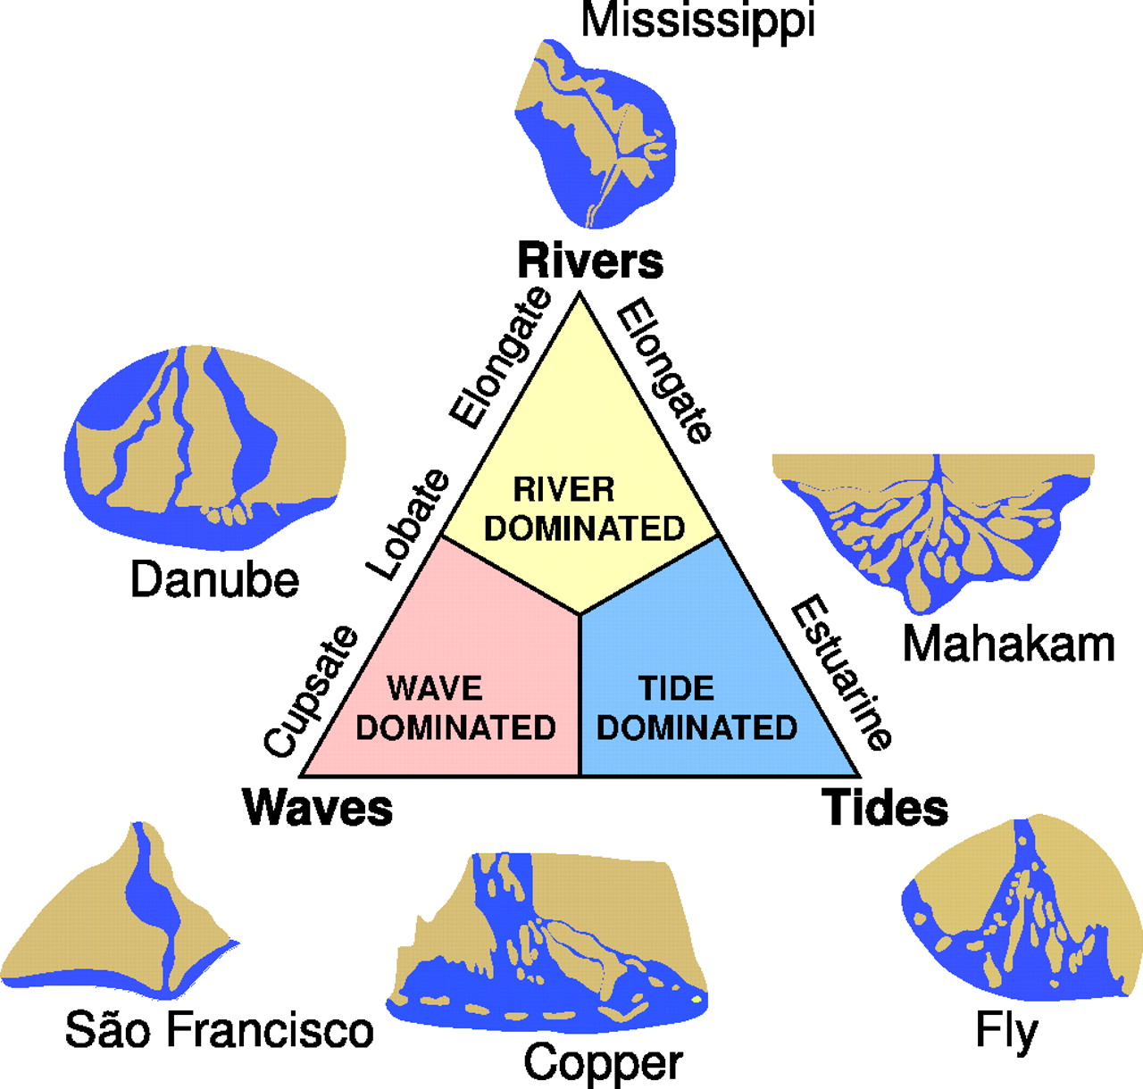
Types of Deltas
Galloway in 1975 developed delta classification triangle
The Ganges river delta is tide-dominated
Galloway's Triangle
http://www.pnas.org/content/104/43/16804/F1.expansion.html

Slide 4
Project Objectives
Develop a rough method to measure temporal change to delta morphology
Compare changes in developed areas to natural areas
Assess whether or not any observed morphologic changes would be expected in a tidally dominated delta
Portion of the Ganges Delta
http://www.riledupjournal.com/RiledUp/Article/TabId/204/ArtMID/641/ArticleID/2146/River-Deltashere-there.aspx

Slide 5
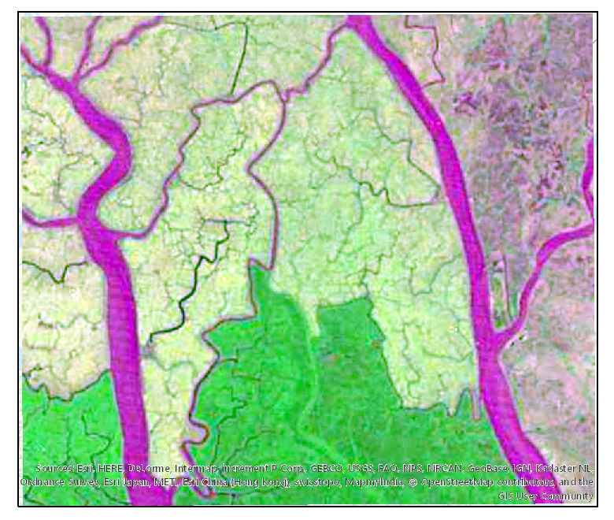
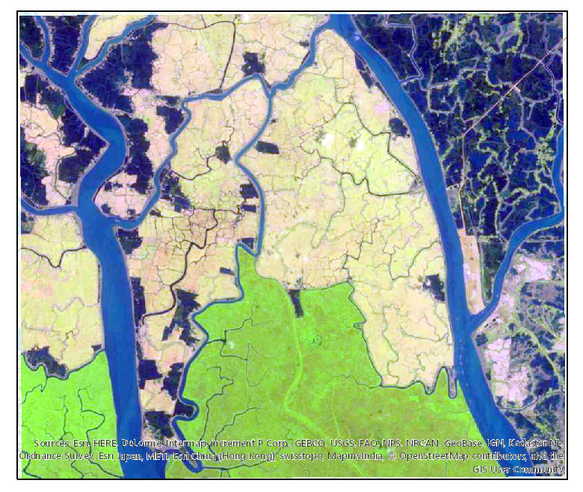
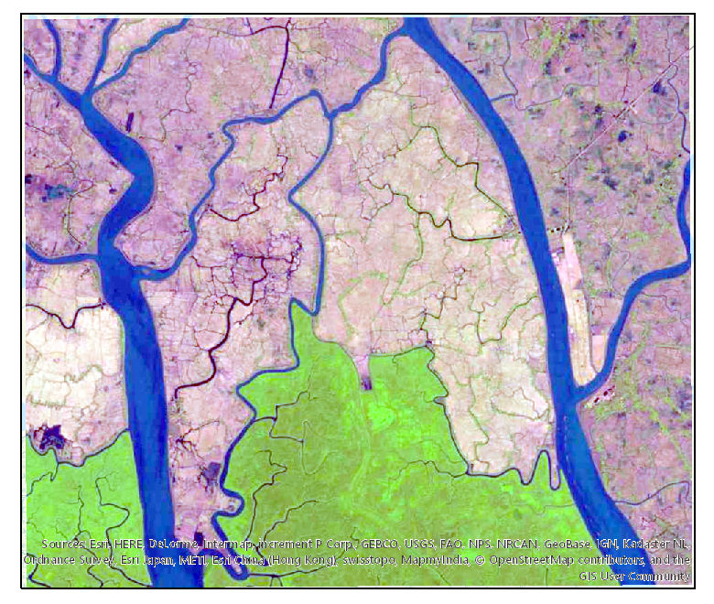
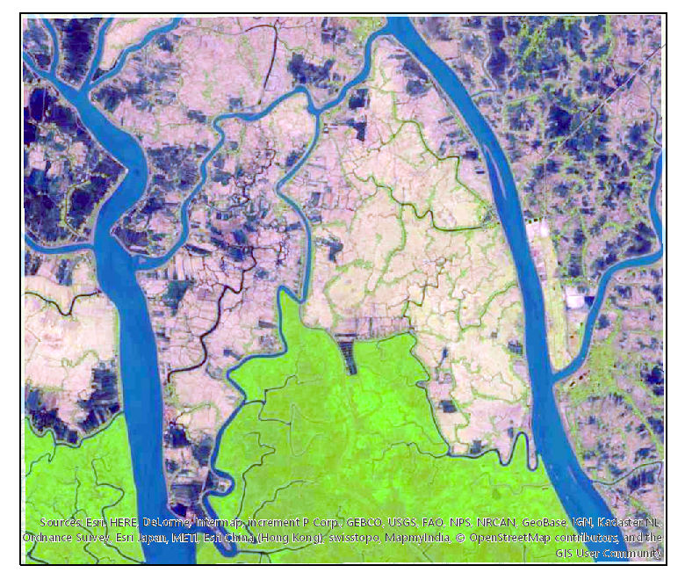
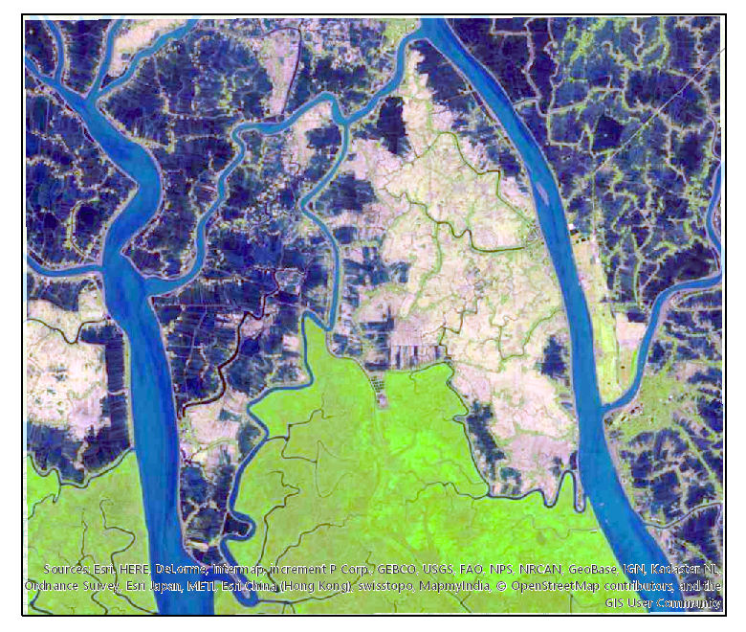
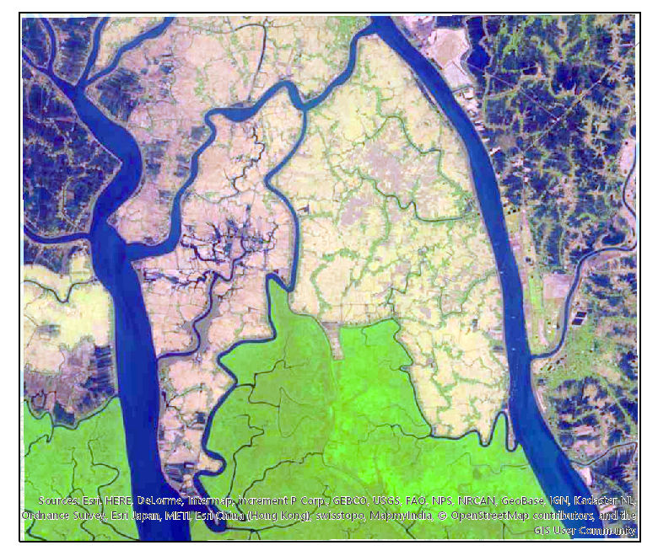
Landsat Imagery
Feb. 9 1977
May 4 1988
Jan. 5 1995
Landsat images courtesy of the U.S. Geological Survey
Feb. 1 2002
Feb. 23 2007
Feb. 18 2017

Slide 6
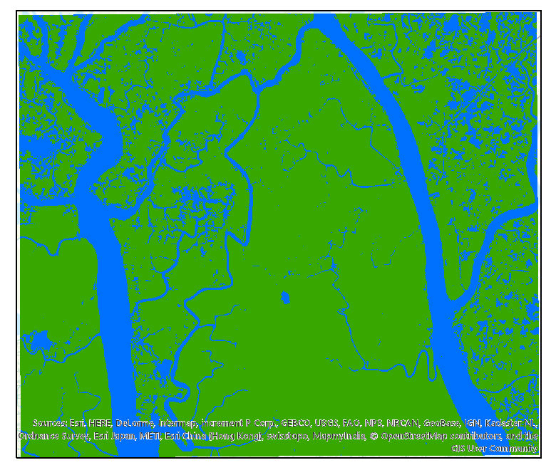
Analysis in ArcGIS
Jan. 5 1995 - RGB Image
Green Band Isolated and Classified
Cells with a value of 1 represent wet cells, and a value of 2 indicates a dry cell
In this example, 23.5% of the image is wet

Slide 7
Preliminary Analysis/Results
Feb. 9 1977
May 4 1988
Jan. 5 1995
Feb. 1 2002
Feb. 23 2007
Feb. 18 2017

Slide 8
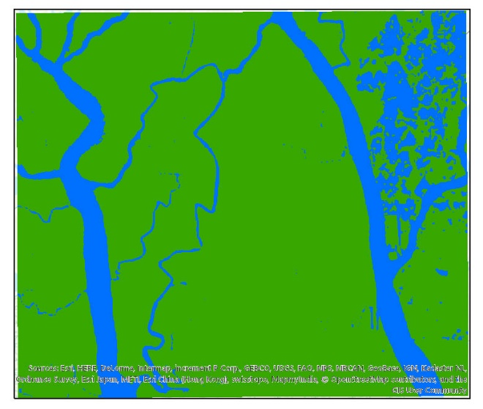
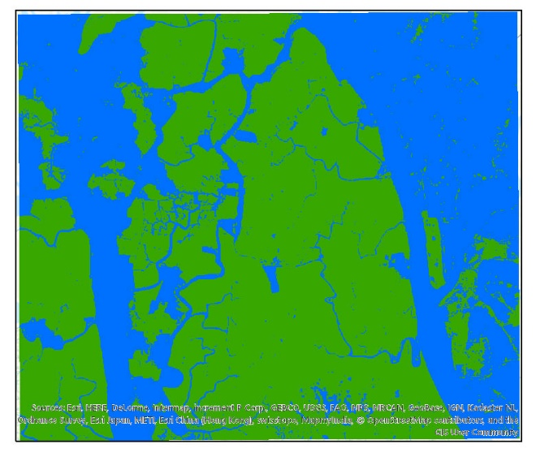
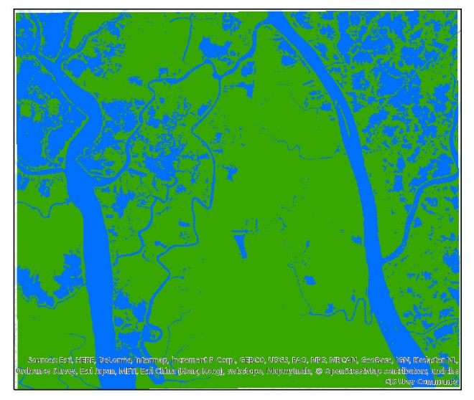
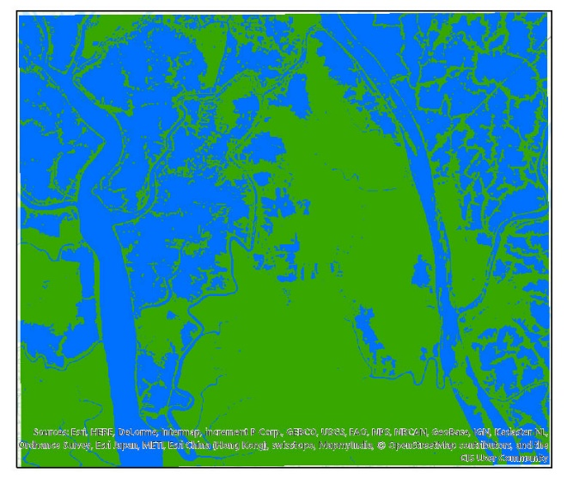
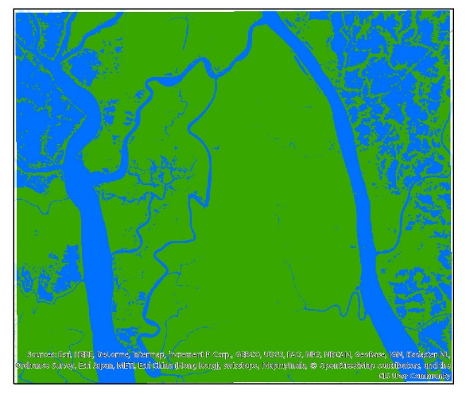
Preliminary Analysis/Results
Feb. 9 1977
May 4 1988
Jan. 5 1995
Feb. 1 2002
Feb. 23 2007
Feb. 18 2017

Slide 9
Preliminary Analysis/Results
18.9% Wet
44.3% Wet
23.5% Wet
Feb. 9 1977
May 4 1988
Jan. 5 1995
29.8% Wet
43.6% Wet
28.9% Wet
Feb. 1 2002
Feb. 23 2007
Feb. 18 2017

Slide 10
Initial Thoughts and Concerns
Results closer to inundation data than channel areas
Rainfall and flooding events will have greater impact on the results than changes to the delta geometry
Selection of threshold pixel values is arbitrary
Selection of the green band for testing should be challenged
Data may be more useful if combined with rainfall data

Slide 11
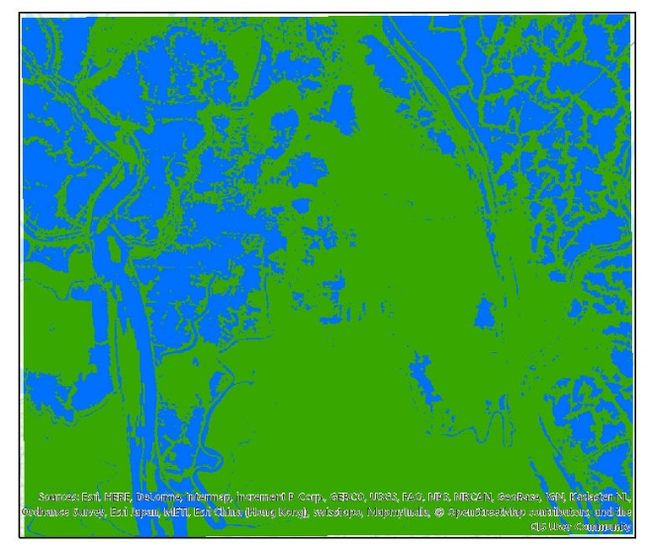
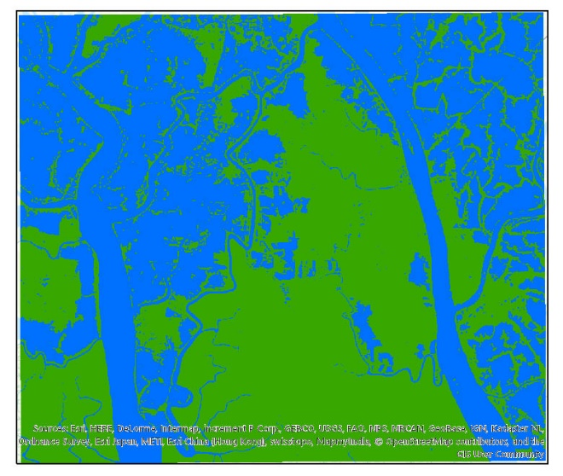
Image Sensitivity/Tolerance
Changing the pixel threshold value to differentiate wet pixels from dry ones impacts the results
Need to establish a method to standardize this threshold value for all images
Feb. 23 2007
Threshold Value = 65
33.2% Wet
Feb. 23 2007
Threshold Value = 70
43.6% Wet
Feb. 23 2007
Threshold Value = 75
50.1% Wet

Slide 12
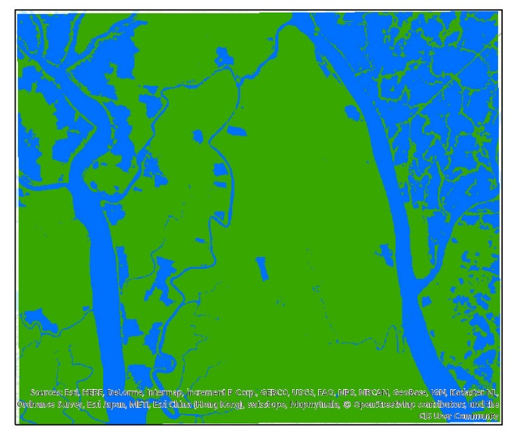
Alternative Options/Future Work
Explore the other bands of data available
Consider the red and blue visible bands
Infrared bands
NDWI – Normalized Difference Water Index
Expand analysis to other sections of the delta
May 4 1988 – Green Band
May 4 1988 – Red Band

Slide 13
References
Galloway, W. E. (1975). Process Framework for Describing the Morphologic and Stratigraphic Evolution of Deltaic Depositional Systems, 87–98. Retrieved from https://www.researchgate.net/publication/287828682_Process_framework_for_describing_the_morphologic_and_stratigraphic_evolution_of_deltaic_depositional_system
Auerbach, L. W., Goodbred Jr, S. L., Mondal, D. R., Wilson, C. A., Ahmed, K. R., Roy, K., … Ackerly, B. A. (2015). Flood risk of natural and embanked landscapes on the Ganges–Brahmaputra tidal delta plain. Nature Climate Change, 5(2), 153–157. https://doi.org/10.1038/nclimate2472
Ayers, J. C., Goodbred, S., George, G., Fry, D., Benneyworth, L., Hornberger, G., … Akter, F. (2016). Sources of salinity and arsenic in groundwater in southwest Bangladesh. Geochemical Transactions, 17(1), 4. https://doi.org/10.1186/s12932-016-0036-6
Falcini, F., Piliouras, A., Garra, R., Guerin, A., Jerolmack, D. J., Rowland, J., & Paola, C. (2014). Hydrodynamic and suspended sediment transport controls on river mouth morphology. Journal of Geophysical Research: Earth Surface, 119(1), 1–11. https://doi.org/10.1002/2013JF002831
Wilson, C. A., & Goodbred, S. L. (2014). Construction and Maintenance of the Ganges-Brahmaputra- Meghna Delta: Linking Process, Morphology, and Stratigraphy. https://doi.org/10.1146/annurev-marine-010213-135032
Hoitink, A. J. F., Wang, Z. B., Vermeulen, B., Huismans, Y., & Kästner, K. (2017). Tidal controls on river delta morphology. Nature Geoscience, 10(9), 637–645. https://doi.org/10.1038/ngeo3000
Passalacqua, P., Lanzoni, S., Paola, C., & Rinaldo, A. (2013). Geomorphic signatures of deltaic processes and vegetation: The Ganges-Brahmaputra-Jamuna case study. Journal of Geophysical Research: Earth Surface, 118(3), 1838–1849. https://doi.org/10.1002/jgrf.20128
Edmonds, D. A., Hajek, E. A., Downton, N., & Bryk, A. B. (n.d.). Avulsion flow-path selection on rivers in foreland basins. GEOLOGY, 44(9). https://doi.org/10.1130/G38082.1
Geleynse, N., Voller, V. R., Paola, C., & Ganti, V. (2012). Characterization of river delta shorelines. Geophysical Research Letters, 39(17), n/a-n/a. https://doi.org/10.1029/2012GL052845
Geleynse, N., Hiatt, M., Sangireddy, H., & Passalacqua, P. (2015). Identifying environmental controls on the shoreline of a natural river delta. Journal of Geophysical Research: Earth Surface, 120(5), 877–893. https://doi.org/10.1002/2014JF003408
Nienhuis, J. H., Ashton, A. D., & Giosan, L. (n.d.). What makes a delta wave-dominated? GEOLOGY, 43(6). https://doi.org/10.1130/G36518.1
Syvitski, J. P. M., & Saito, Y. (2007). Morphodynamics of deltas under the influence of humans. Global and Planetary Change, 57(3–4), 261–282. https://doi.org/10.1016/j.gloplacha.2006.12.001
https://www.nasa.gov/multimedia/imagegallery/image_feature_1923.html
https://www.google.com/maps
https://news.vanderbilt.edu/2015/01/05/flood-control-efforts-in-bangladesh-exacerbate-flooding-threaten-millions/
http://www.pnas.org/content/104/43/16804/F1.expansion.html
http://www.riledupjournal.com/RiledUp/Article/TabId/204/ArtMID/641/ArticleID/2146/River-Deltashere-there.aspx
Landsat images courtesy of the U.S. Geological Survey

Slide 14
End

