Slide 1
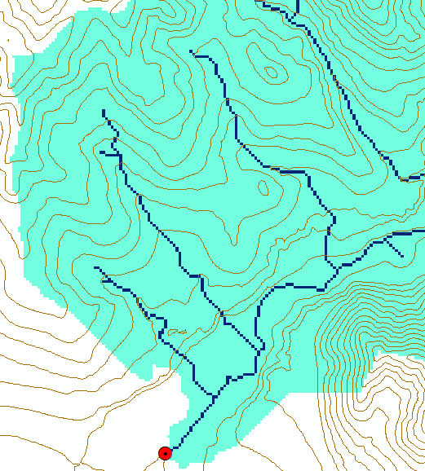
Extended Hydrologic Terrain Analysis
Watershed delineation
Channelization threshold?
Geomorphology
Dinfinity
Generalized flow accumulation
Parallel implementation
Programming

Slide 2
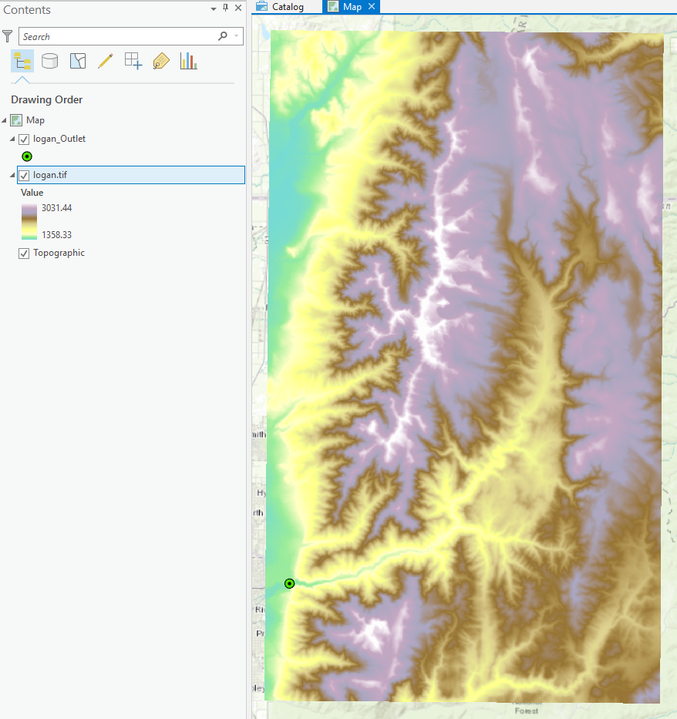
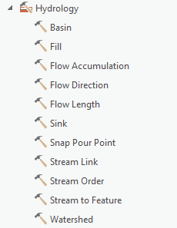
Watershed Delineation
[DEM Reconditioning]
Pit Removal (Fill Sinks)
Flow Direction
Flow Accumulation
Stream Definition
Stream Segmentation
Catchment Grid Delineation
Raster to Vector Conversion (Catchment Polygon, Drainage Line, Catchment Outlet Points)

Slide 3
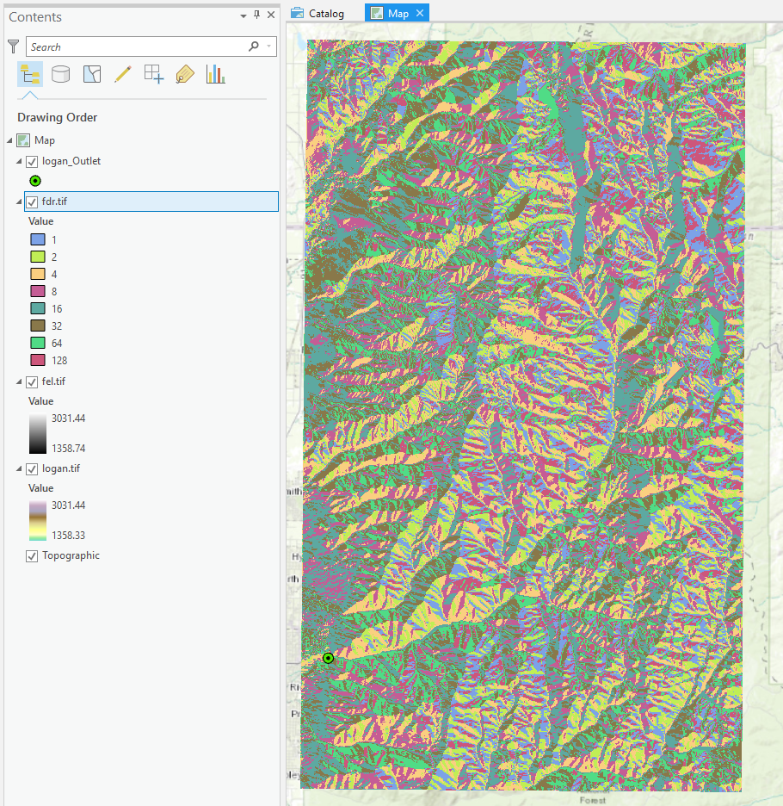
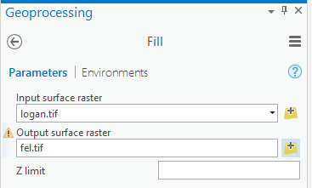
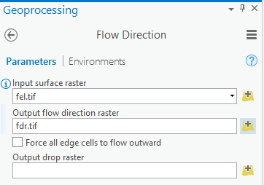
Fill and Flow Direction
1
2
32
64
128
16
1
8
4
2

Slide 4
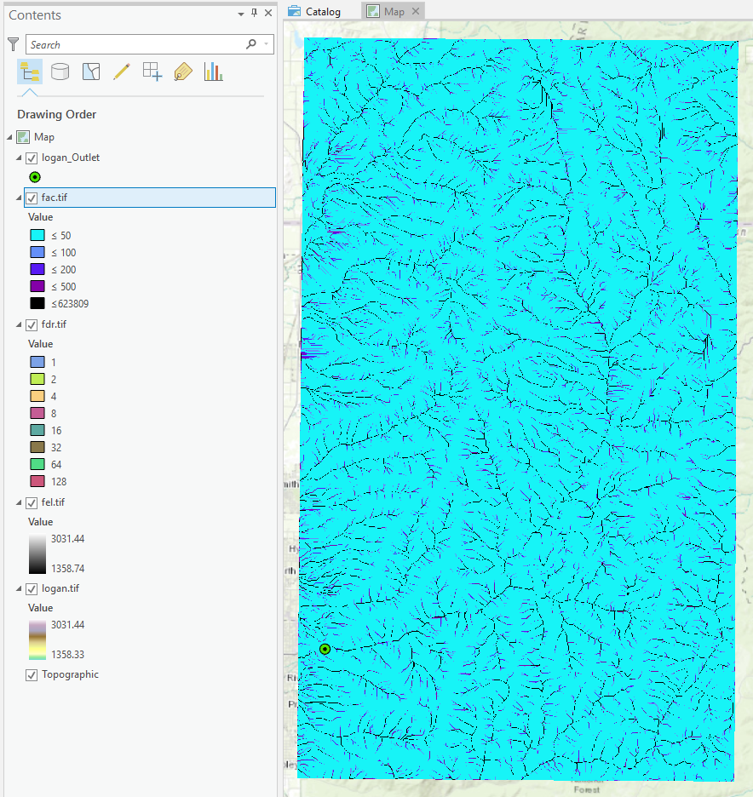
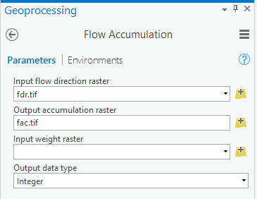
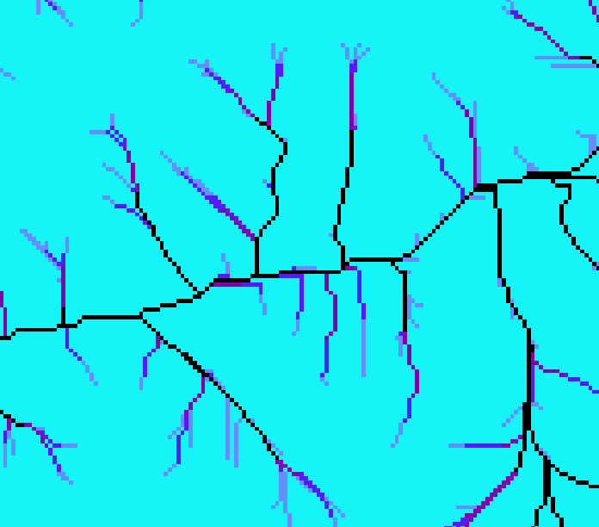
Flow Accumulation
3

Slide 5
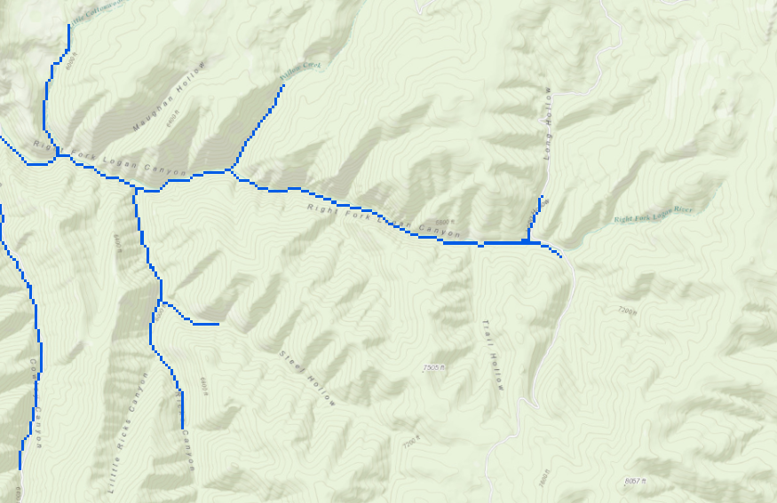

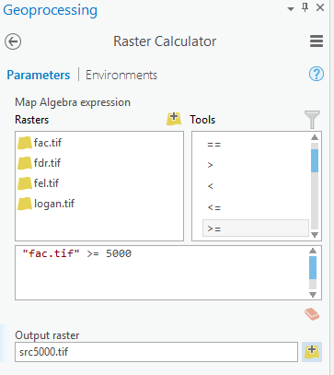
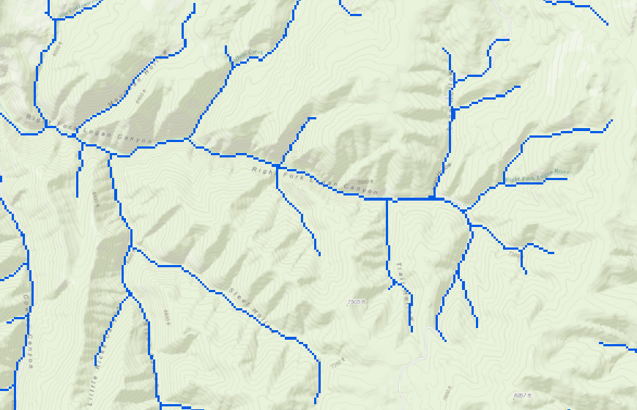
Stream definition by theshold
5000
4
500

Slide 6
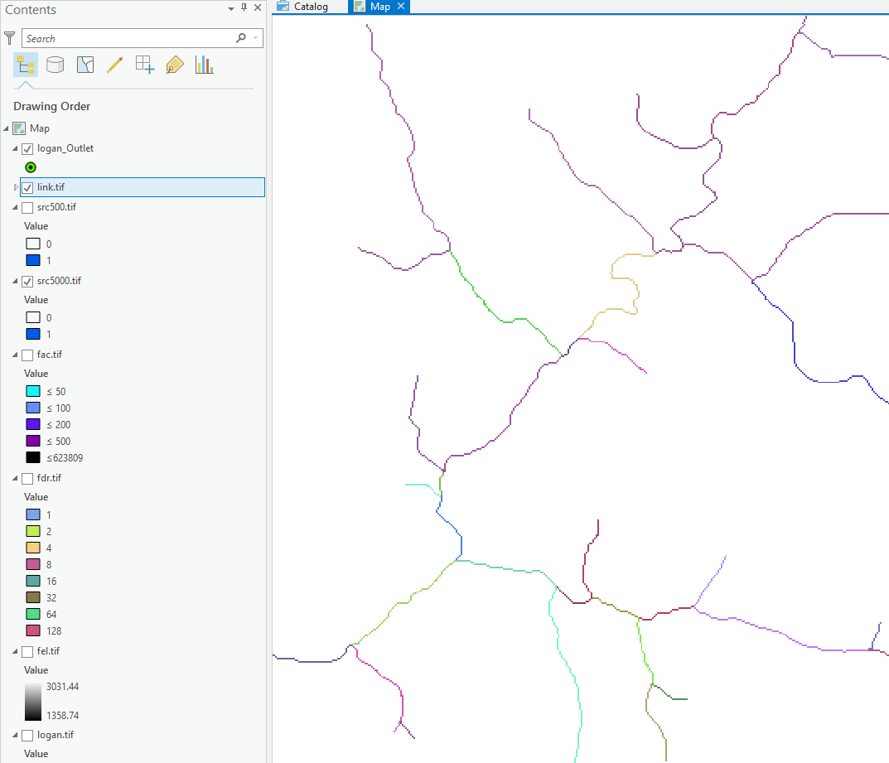
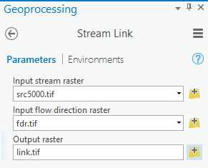
Stream Segmentation
5

Slide 7
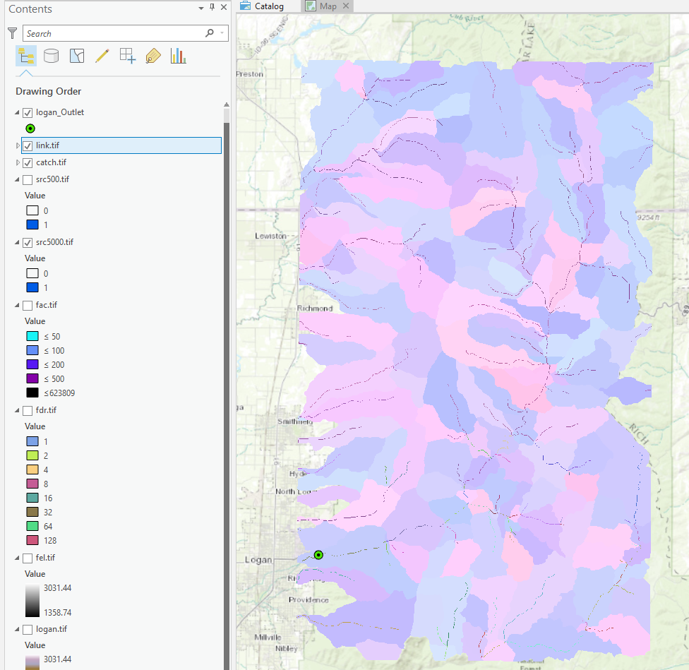
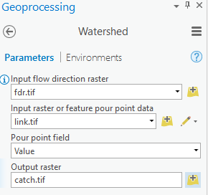
Catchment Delineation
6

Slide 8
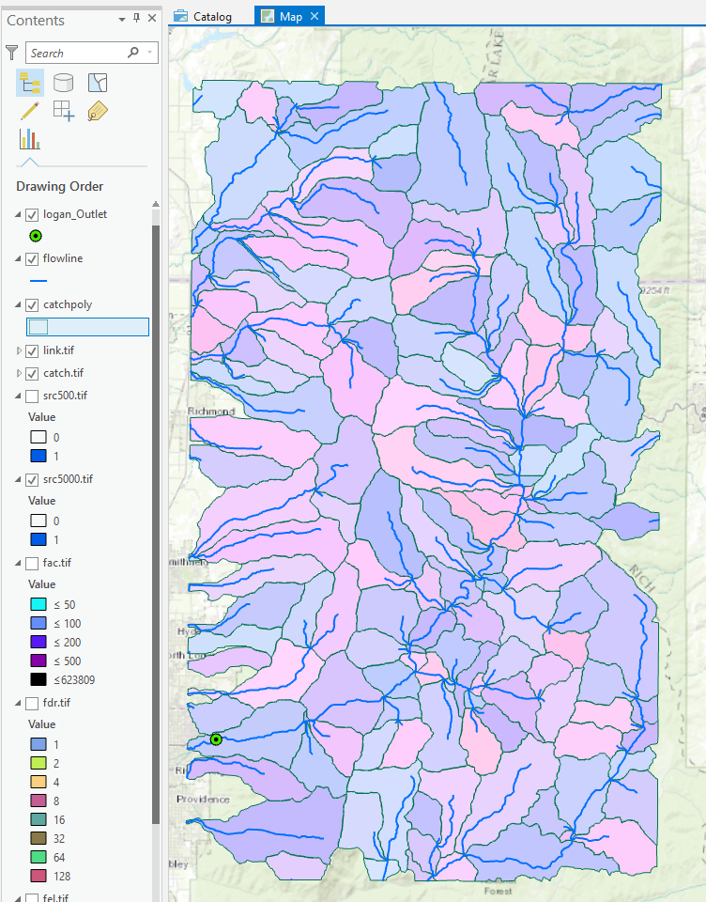
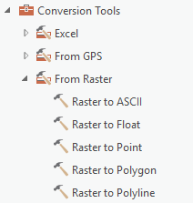
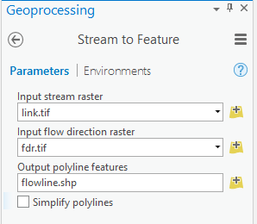
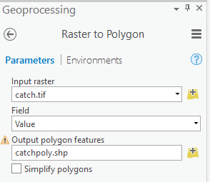
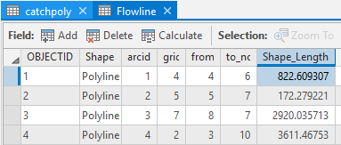
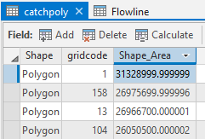
Conversion to Vector
8
7

Slide 9
How to decide on stream delineation threshold ?
AREA 2
3
AREA 1
12
Why is it important?

Slide 10
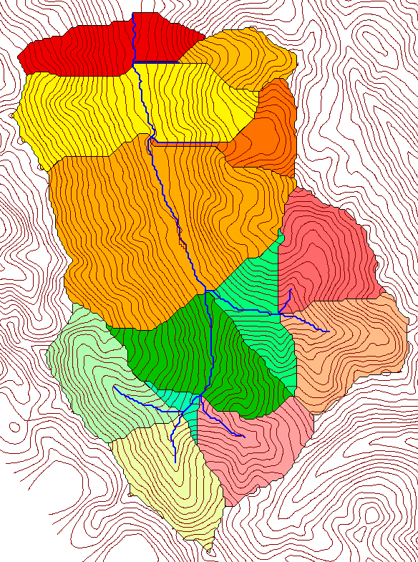
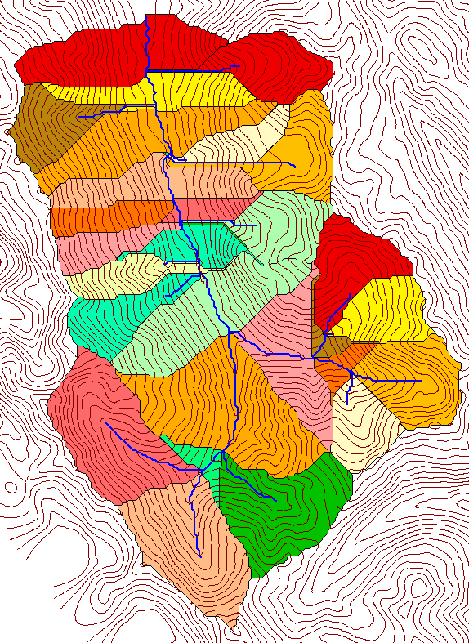
Delineation of Channel Networks and Catchments
500 cell theshold
1000 cell theshold

Slide 11
Hydrologic processes are different on hillslopes and in channels. It is important to recognize this and account for this in the delineation of streams.
Drainage area can be concentrated or dispersed (specific catchment area) representing concentrated or dispersed flow.

Slide 12
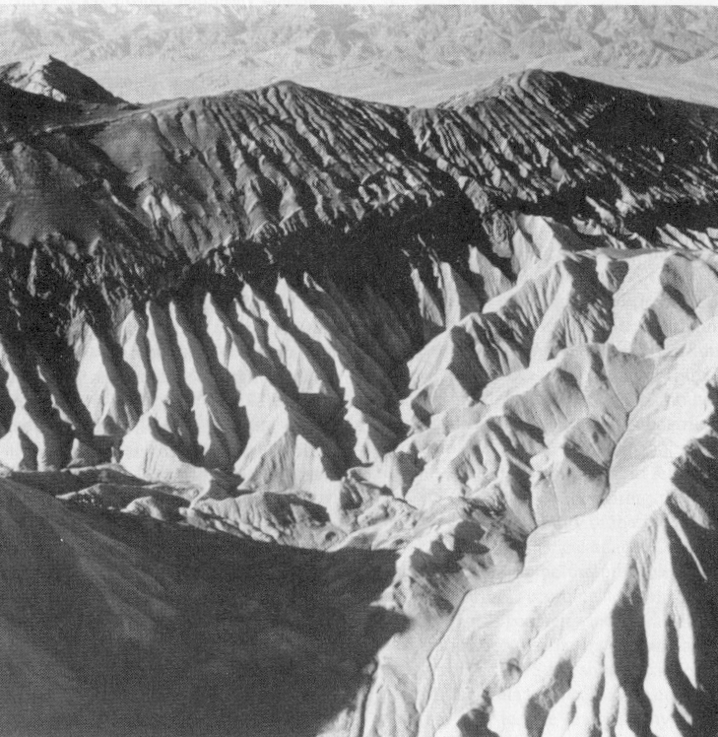
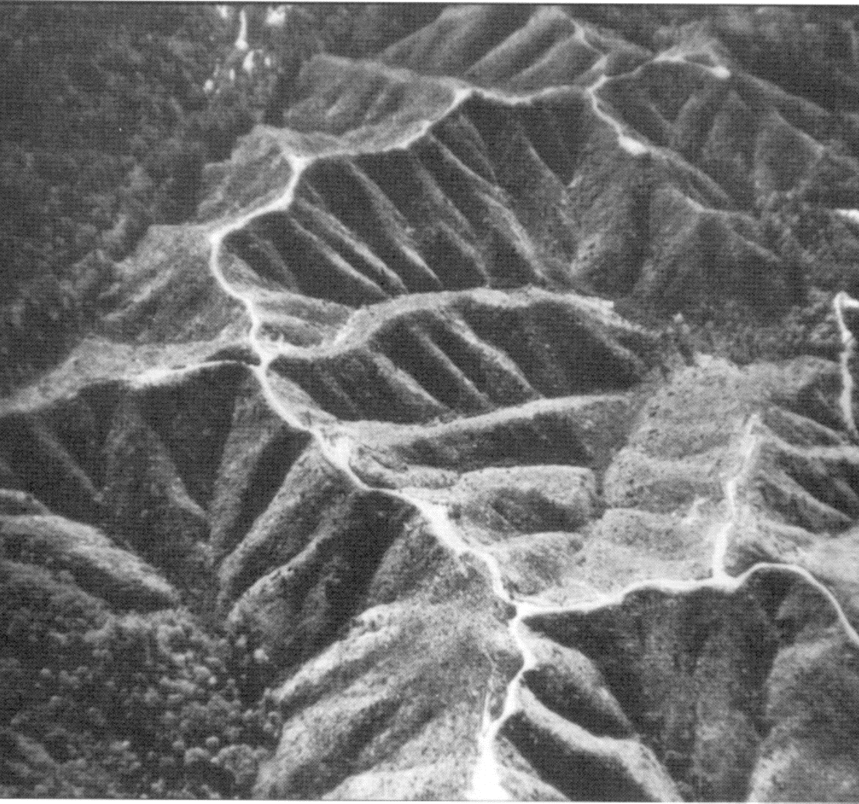
Examples of differently textured topography
Badlands in Death Valley.
from Easterbrook, 1993, p 140.
Coos Bay, Oregon Coast Range.
from W. E. Dietrich

Slide 13
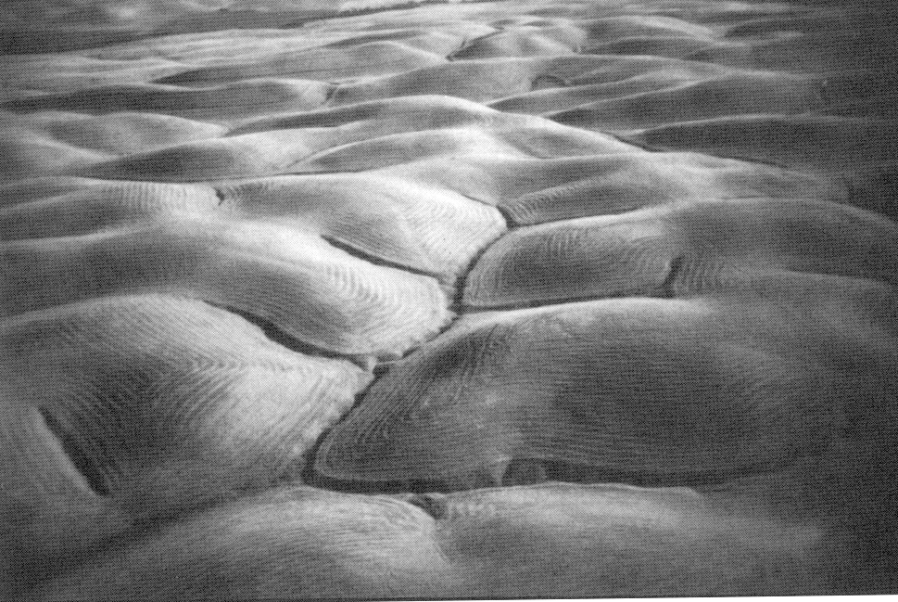
Gently Sloping Convex Landscape
From W. E. Dietrich

Slide 14
Topographic Texture and Drainage Density
Driftwood, PA
Same scale, 20 m contour interval
Sunland, CA

Slide 15
“landscape dissection into distinct valleys is limited by a threshold of channelization that sets a finite scale to the landscape.” (Montgomery and Dietrich, 1992, Science, vol. 255 p. 826.)
Suggestion: One contributing area threshold does not fit all watersheds.
Lets look at some geomorphology.
    Drainage Density
    Horton’s Laws
    Slope – Area scaling
    Stream Drops

Slide 16
Drainage Density
D_{d} = L/A
Hillslope length ≈ 1/(2D_{d})
B
B
Hillslope length = B
A = 2B L
D_{d} = L/A = 1/(2B)
∴ B= 1/(2D_{d})
L

Slide 17
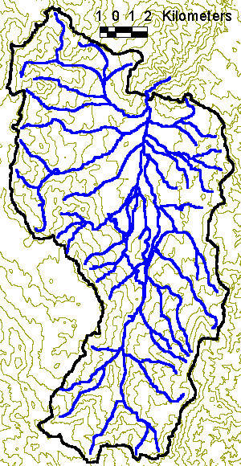
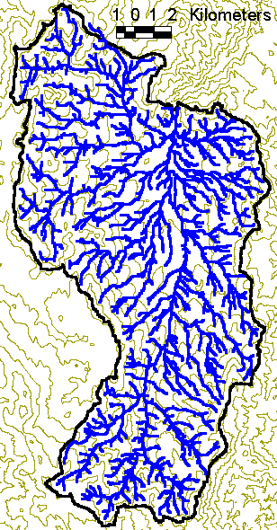
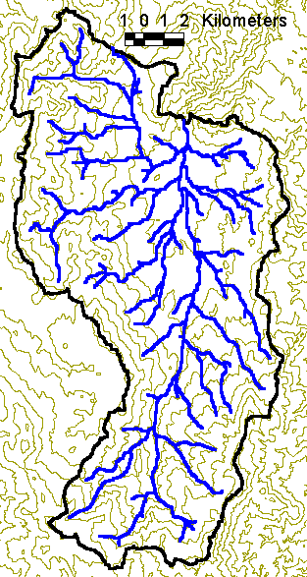
Drainage Density for Different Support Area Thresholds
EPA Reach Files
100 grid cell threshold
1000 grid cell threshold

Slide 18
Drainage Density Versus Contributing Area Threshold

Slide 19
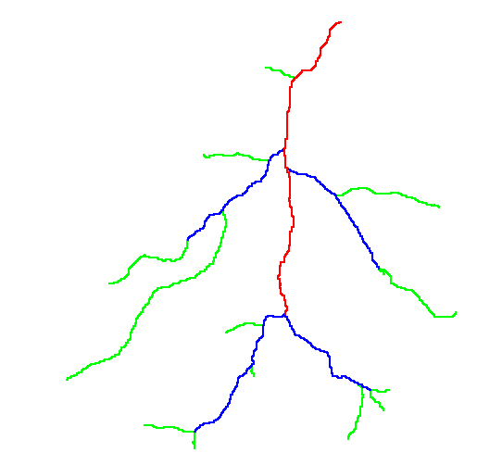
Hortons Laws: Strahler system for stream ordering
1
3
1
2
1
2
1
1
1
1
1
2
2
1
1
1
1
1
1

Slide 20
Length Ratio

Slide 21
Slope Ratio

Slide 22
Constant Stream Drops Law
Broscoe, A. J., (1959), "Quantitative analysis of longitudinal stream profiles of small watersheds," Office of Naval Research, Project NR 389-042, Technical Report No. 18, Department of Geology, Columbia University, New York.

Slide 23

Stream Drop
Elevation difference between ends of stream
Nodes
Links
Single Stream
Note that a “Strahler stream” comprises a sequence of links (reaches or segments) of the same order

Slide 24
Suggestion: Map channel networks from the DEM at the finest resolution consistent with observed channel network geomorphology ‘laws’.
Look for statistically significant break in constant stream drop property as stream delineation threshold is reduced
Break in slope versus contributing area relationship
Physical basis in the form instability theory of Smith and Bretherton (1972), see Tarboton et al. 1992

Slide 25
Statistical Analysis of Stream Drops

Slide 26
T-Test for Difference in Mean Values
0
72
130
T-test checks whether difference in means is large (> 2)
when compared to the spread of the data around the mean values

Slide 27
Objectively Selected Support Area Threshold

Slide 28
100 grid cell constant support area threshold stream delineation

Slide 29
200 grid cell constant support area based stream delineation

Slide 30
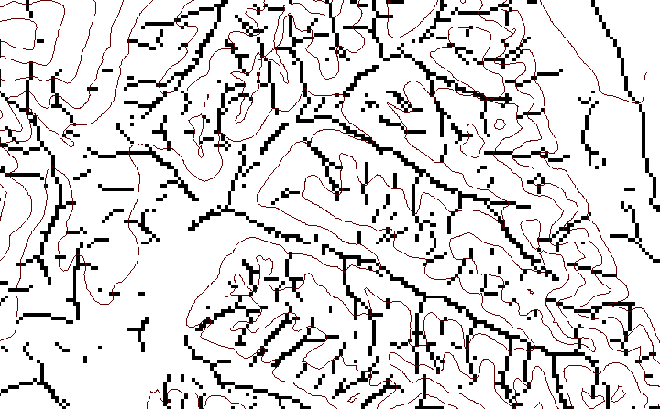
Local Curvature Computation
(Peuker and Douglas, 1975, Comput. Graphics Image Proc. 4:375)
43
48
48
51
51
56
41
47
47
54
54
58

Slide 31
Contributing area of upwards curved grid cells only

Slide 32
Upward Curved Contributing Area Threshold

Slide 33
Curvature based stream delineation

Slide 34
Channel network delineation, other options
4
3
2
5
1
6
7
8
Contributing Area
Grid Order
1
1
1
1
1
1
1
1
1
1
1
4
3
3
1
1
2
2
2
1
1
1
12
1
2
1
1
3
1
1
1
1
2
16
1
1
1
1
3
1
1
3
6
25
2
1
2
2
3
1

Slide 35
Grid network pruned to order 4 stream delineation

Slide 36
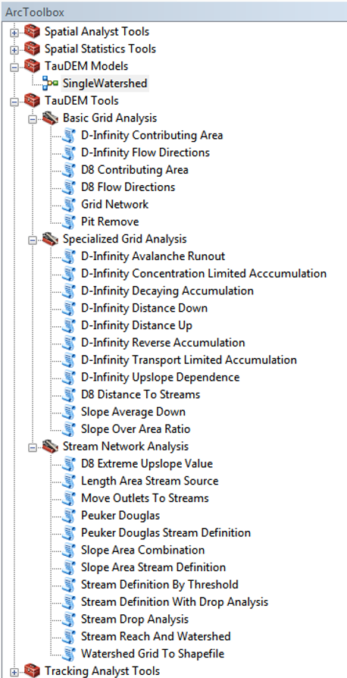


TauDEM
Stream and watershed delineation
Multiple flow direction flow field
Calculation of flow based derivative surfaces
MPI Parallel Implementation for speed up and large problems
Open source platform independent C++ command line executables for each function
Deployed as an ArcGIS Toolbox with python scripts that drive command line executables
http://hydrology.usu.edu/taudem/

Slide 37
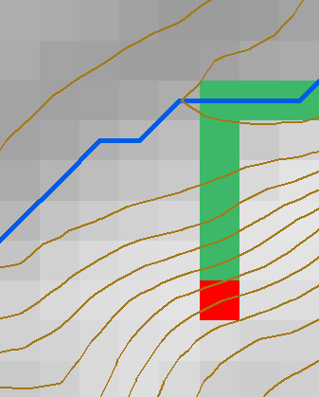
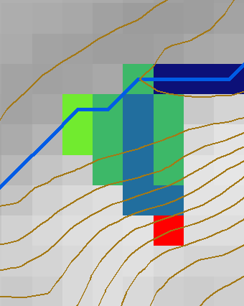
TauDEM Dinfinity Representation of Flow Field
D8
D∞
Tarboton, D. G., (1997), "A New Method for the Determination of Flow Directions and Contributing Areas in Grid Digital Elevation Models," Water Resources Research, 33(2): 309-319.)
http://hydrology.usu.edu/taudem

Slide 38

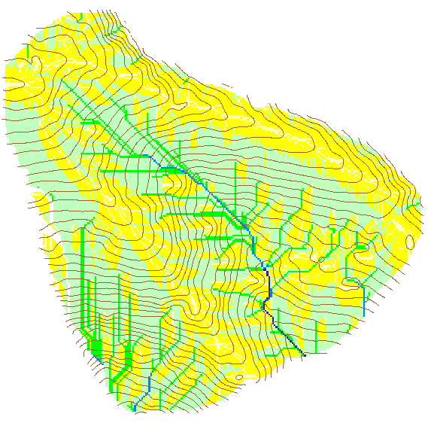
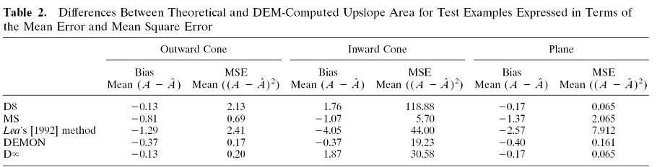
Contributing Area
D∞
D8

Slide 39
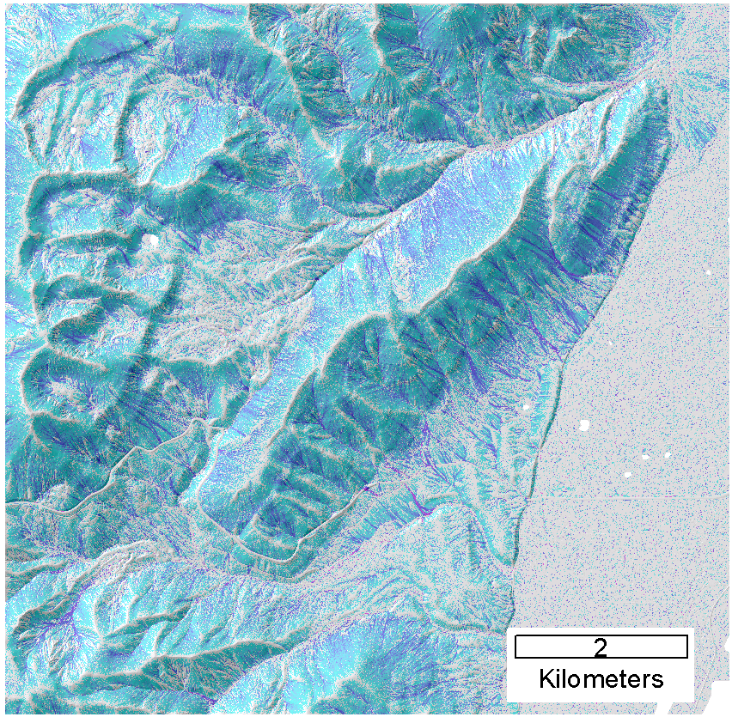
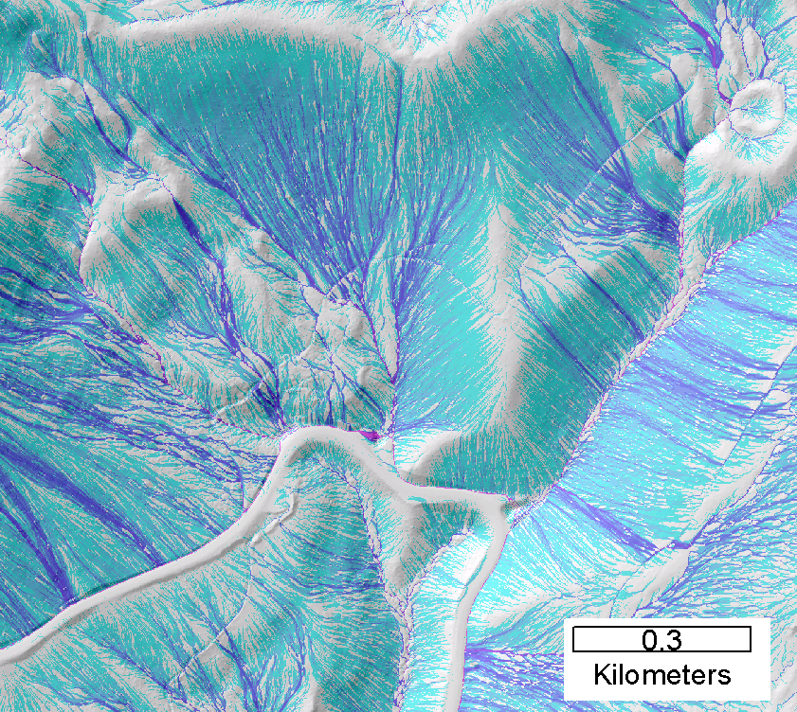
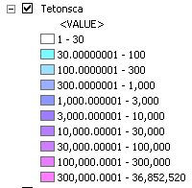
Contributing area from D-Infinity
Notes:
Note the detail in the representation of flow paths at features such as roads

Slide 40
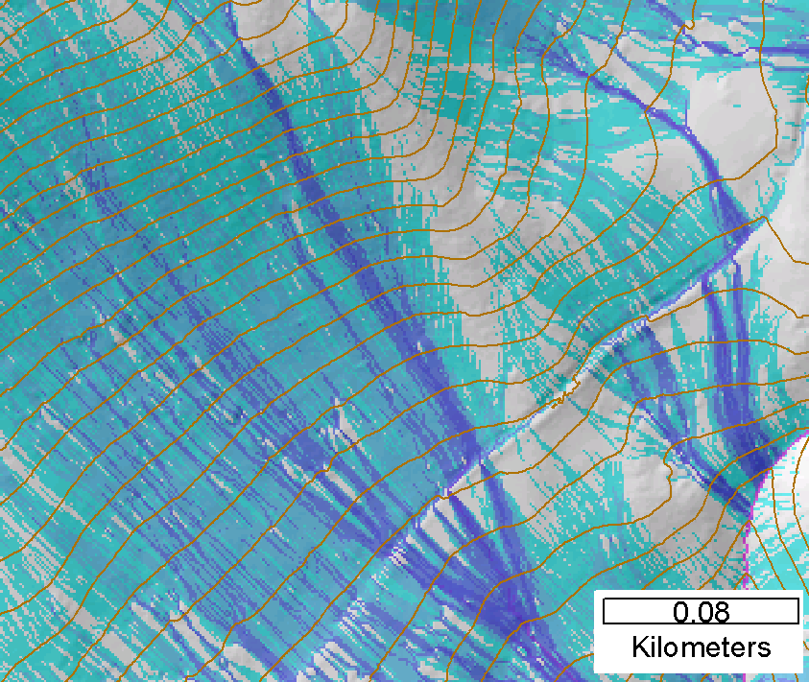
Contributing area from D-Infinity
Notes:
Note the detail in the representation of flow paths at features such as roads

Slide 41
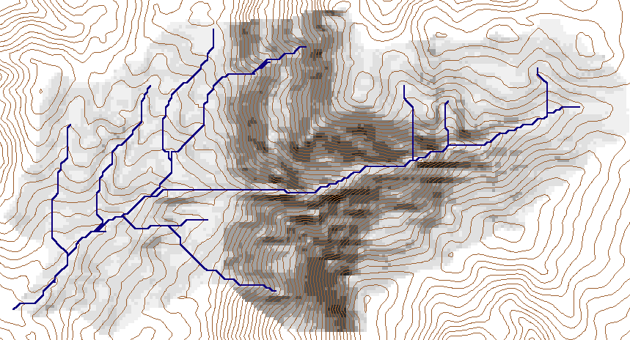
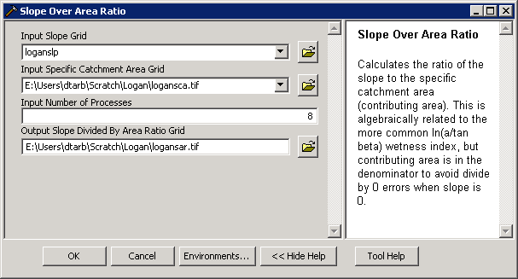
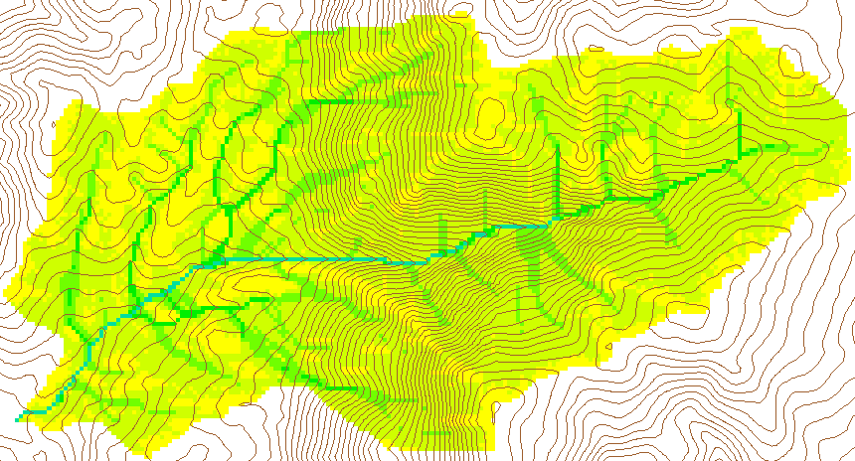
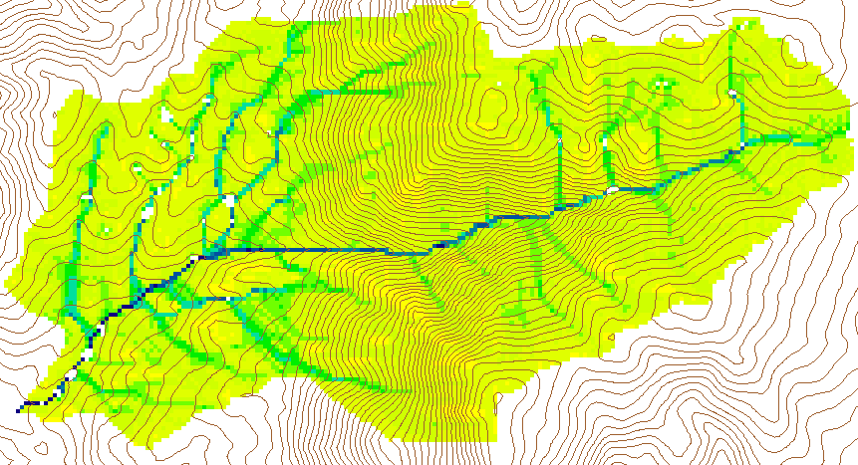
Wetness Index
Slope (S)
Specific Catchment Area (a)
Wetness Index ln(a/S)

Slide 42
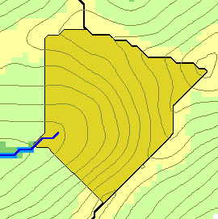
Generalized Flow Accumulation
w(x)
x

Slide 43
Generalization to Flow Algebra
Replace
P_{ki}
P_{ki}
P_{ki}
i
by general function

Slide 44
General Pseudocode Upstream Flow Algebra Evaluation
Global P, γ, θ FlowAlgebra(i) for all k neighbors of i if P_{ki}>0 FlowAlgebra(k) next k θ_{i} = FA(γ_{i}, P_{ki}, θ_{k}, γ_{k}) return
P_{ki}

Slide 45
Example: Retention limited runoff generation with run-on
Global P, (r,c), q FlowAlgebra(i) for all k neighbors of i if P_{ki}>0 FlowAlgebra(k) next k return
q_{k}
r
q_{i}
c

Slide 46
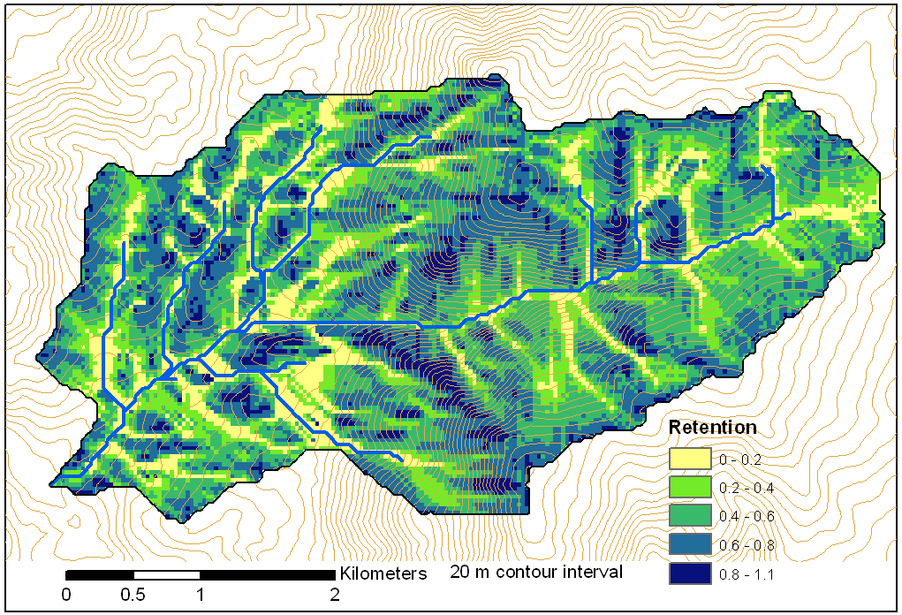
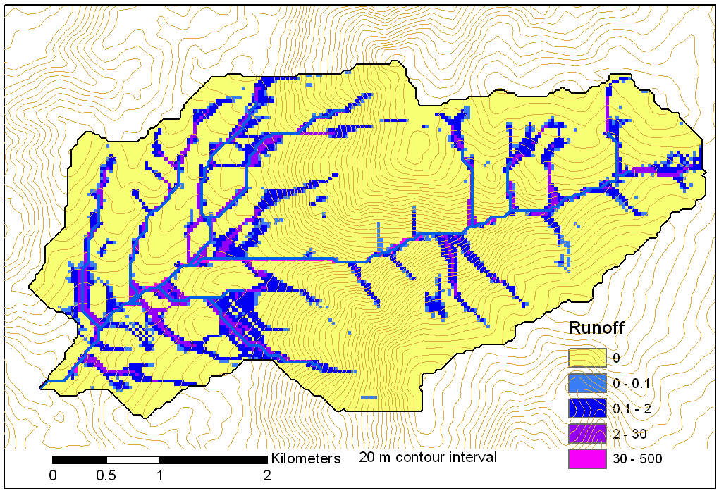
Retention limited runoff with run-on
Retention Capacity
A
C
r=5
c=6
q_{in}=1.8
q=0.8
r=7
c=4
q=3
0.6
1
Runoff from uniform input of 0.25
r=4
c=6
q=0
0.4
r=4
c=5
q_{in}=2
q=1
1
B
D
Notes:
Figure 2 illustrates the evaluation of infiltration capacity limited runoff generation with run on according to (5). Inputs are the r and c values indicated, with the proportional flow directions indicated by the arrows. Grid cells A and B on the left have no dependencies so may be immediately evaluated and using min(r-c,0) result in q=3 and 0 for grid cells A and B respectively. With these evaluated, the unevaluated dependencies of grid cell C become 0, so equation (5) can be evaluated for grid cell C. The inflow is q_{in}=0.6 x 3 = 1.8 from grid cell B. Then q=min(5-6+1.8,0)=0.8. Now all dependencies of D have been evaluated. Inflows from cells A, B, and C, accounting for the proportions are 3 x 0.4 + 0.8 = 2, so the runoff from D is q=min(4-5+2,0)=2.

Slide 47
General Pseudocode Downstream Flow Algebra Evaluation
Global P, γ, θ FlowAlgebra(i) for all k neighbors of i if P_{ik}>0 FlowAlgebra(k) next k θ_{i} = FA(γ_{i}, P_{ik}, θ_{k}, γ_{k}) return
P_{ki}

Slide 48
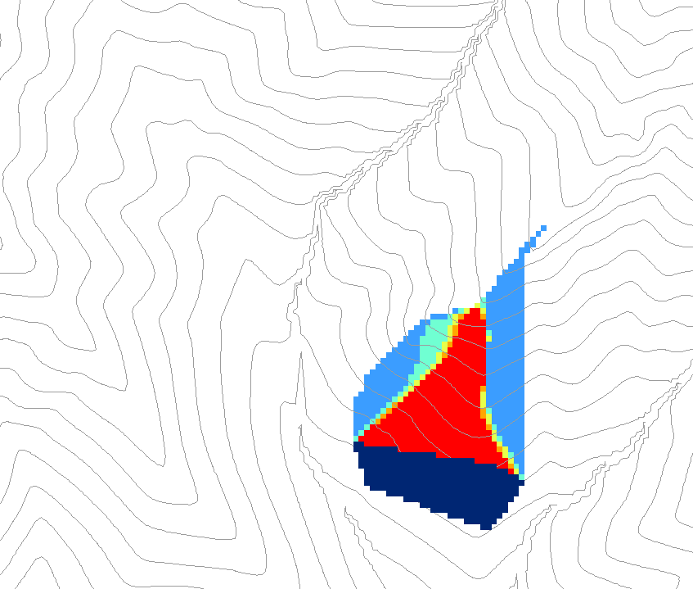
0.6
0
0
0.3
0.3
0
0
0.6
0
0
1
0
0
1
0
Grid cells y
Dependence function of grid cells y
Useful for example to track where a contaminant may come from

Slide 49
Weighted distance to target set
0
0
0
0
0
30*0.5/2
7.5
30
7.5+42.4*
(0.7+0.5)/2
32.9
38.2
38.2
38.2
38.2
38.2
To quantify effectiveness of riparian zone sediment capture based on buffer potential

Slide 50
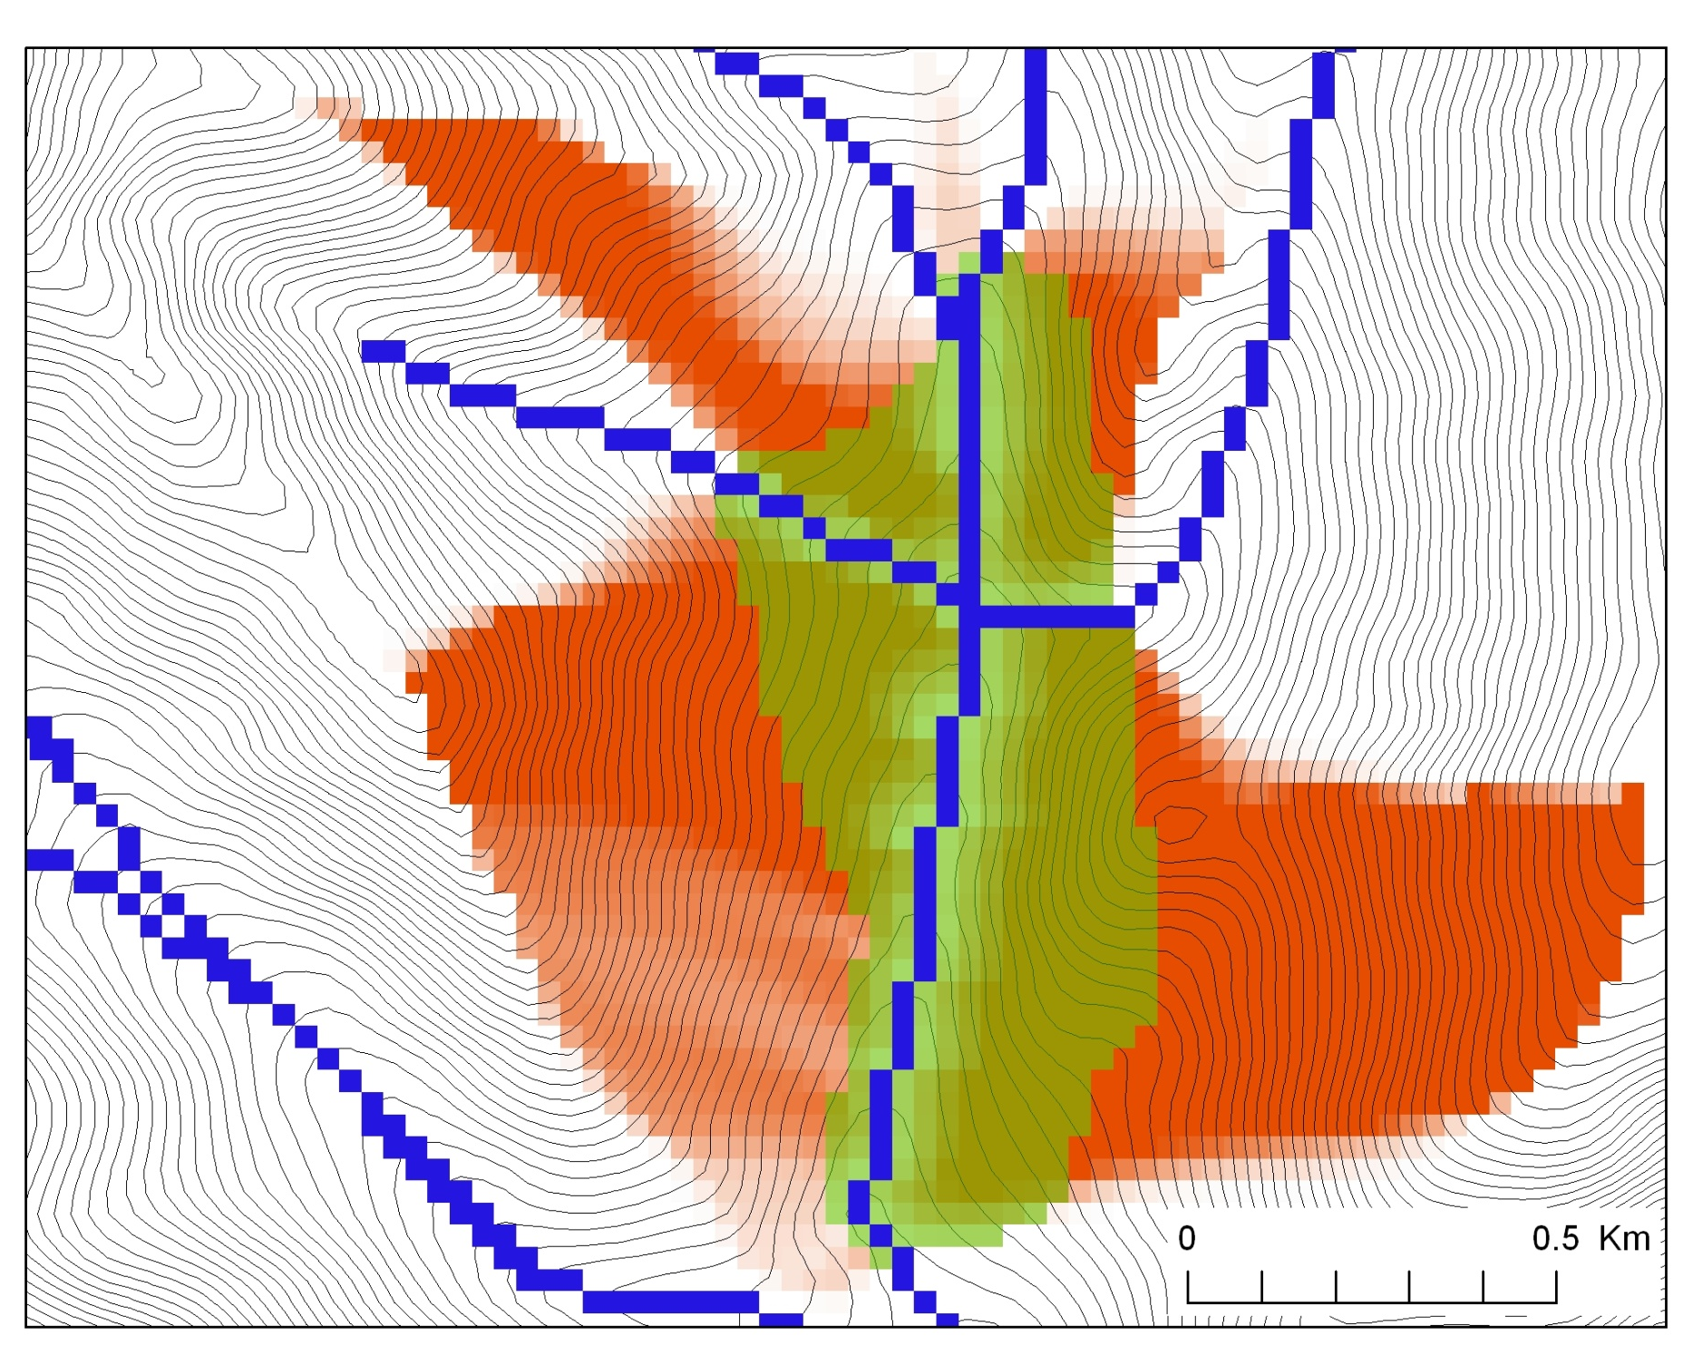
Buffer potential weighted distance to stream

Slide 51
Distance Down and Distance Up
Ridge
Ridge
sr
sr
pr
pr
vr
Point of interest
vr
Point of interest
Stream
Stream
ps
ps
vs
ss
vs
ss
hr
hs
hr
hs
Types of distance measurements possible in distance down and distance up functions.

Slide 52

Height above Nearest Drainage (HAND) evaluated using TauDEM Dinfinity Vertical Distance Down function
TauDEM Distance Down and Distance Up
Ridge
sr
sr
pr
pr
vr
Point of interest
Stream
ps
ps
ss
vs
ss
D∞
hr
hs
hr
hs
Vertical distance to stream evaluated as weighted average over multiple flow paths. This results in a “smooth” height above nearest stream layer
Tesfa, T. K., D. G. Tarboton, D. W. Watson, K. A. T. Schreuders, M. E. Baker and R. M. Wallace, (2011), "Extraction of hydrological proximity measures from DEMs using parallel processing," Environmental Modelling & Software, 26(12): 1696-1709, http://dx.doi.org/10.1016/j.envsoft.2011.07.018.

Slide 53
Useful for a tracking contaminant or compound subject to decay or attenuation

Slide 54




Transport limited accumulation
Supply
Capacity
Transport
Deposition
S
T
=
χa
2
tan(
b
)
2
T
=
min{
S
+
∑
T
,
T
}
D
=
S
+
∑
T
−
T
cap
out
in
cap
in
out
Useful for modeling erosion and sediment delivery, the spatial dependence of sediment delivery ratio and contaminant that adheres to sediment

Slide 55




The challenge of increasing Digital Elevation Model (DEM) resolution
1980’s DMA 90 m
10² cells/km²
1990’s USGS DEM 30 m
10³ cells/km²
2000’s NED 10-30 m
10⁴ cells/km²
2010’s LIDAR ~1 m
10⁶ cells/km²

Slide 56

TauDEM Parallel Approach
MPI, distributed memory paradigm
Row oriented slices
Each process includes one buffer row on either side
Each process does not change buffer row
Improved runtime efficiency
Capability to run larger problems

Slide 57
Some Algorithm Details
Pit Removal: Planchon Fill Algorithm
Initialization
1st Pass
2nd Pass
Planchon, O., and F. Darboux (2001), A fast, simple and versatile algorithm to fill the depressions of digital elevation models, Catena(46), 159-176.

Slide 58
Parallel Scheme
Communicate
Initialize( Z,F) Do for all grid cells i if Z(i) > n F(i) ← Z(i) Else F(i) ← n i on stack for next pass endfor Send( topRow, rank-1 ) Send( bottomRow, rank+1 ) Recv( rowBelow, rank+1 ) Recv( rowAbove, rank-1 ) Until F is not modified
Z denotes the original elevation.
F denotes the pit filled elevation.
n denotes lowest neighboring elevation
i denotes the cell being evaluated
Iterate only over stack of changeable cells

Slide 59
Parallelization of Contributing Area/Flow Algebra
1. Dependency grid
and so on until completion
resulting in new D=0 cells on queue
Queue’s empty so exchange border info.
Decrease cross partition dependency
Executed by every process with grid flow field P, grid dependencies D initialized to 0 and an empty queue Q. FindDependencies(P,Q,D) for all i for all k neighbors of i if P_{ki}>0 D(i)=D(i)+1 if D(i)=0 add i to Q next
A=1
A=1
A=1
A=1
A=1
A=1
A=1
A=1
D=0
A=1
A=1
A=1
A=1
D=0
D=0
A=1
A=1
A=1
D=0
D=0
A=1
D=0
A=1
A=1
A=1
A=1
A=1
A=1.5
A=1.5
A=3
D=0
A=1.5
A=1.5
D=1
D=0
D=1
D=0
D=0
A=3
D=0
D=3
D=2
D=1
D=0
D=0
D=1
D=1
A=1.5
D=1
A=1.5
A=3
A=3
A=1.5
A=1.5
2. Flow algebra function
B=-2
B=-1
Executed by every process with D and Q initialized from FindDependencies. FlowAlgebra(P,Q,D,θ,γ) while Q isn’t empty get i from Q θ_{i} = FA(γ_{i}, P_{ki}, θ_{k}, γ_{k}) for each downslope neighbor n of i if P_{in}>0 D(n)=D(n)-1 if D(n)=0 add n to Q next n end while swap process buffers and repeat
B=-2
B=-1
A=1
A=1
D=2
D=2
D=1
A=1
D=1
A=1
D=0
A=1
A=1
D=2
D=2
D=2
D=2
D=2
D=1
D=1
D=1
D=1
A=1
D=1
A=1
A=5.5
D=0
A=2.5
D=0
A=1
A=1
D=1
D=1
D=1
A=1
D=1
A=1
D=0
D=0
A=1
D=1
D=1
D=3
D=2
D=1
D=1
D=1
D=1
D=1
A=1
D=1
A=1
D=1
A=6
A=3.5
D=1

Slide 60

Able to run larger problems
Capability to run larger problems
 |  | Processors used | Grid size
 |  |  | Theoretcal limit | Largest run
2008 | TauDEM 4 | 1 | 0.22 GB | 0.22 GB
Sept 2009 | Partial implement-ation | 8 | 4 GB | 1.6 GB
June 2010 | TauDEM 5 | 8 | 4 GB | 4 GB
Sept 2010 | Multifile on 48 GB RAM PC | 4 | Hardware limits | 6 GB
Sept 2010 | Multifile on cluster with 128 GB RAM | 128 | Hardware limits | 11 GB
11 GB
6 GB
4 GB
1.6 GB
0.22 GB
Single file size limit 4GB
At 10 m grid cell size

Slide 61
Improvements in Flow Direction Computation
Built computation profile to be more fault tolerant
Accelerate D8 and Dinf → new parallel algorithms
New D8 (100 million cells)
Old Algorithm
250 times faster
New Algorithm
Survila, K., Yildirim, A.A., Li, T., Liu, Y., Tarboton, and D., Wang, S. 2016. “A Scalable High-performance Topographic Flow Direction Algorithm for Hydrological Information Analysis”. Proceedings of the 2016 Annual Conference on Extreme Science and Engineering Discovery Environment (XSEDE'16). July 17-21. Miami, Florida, USA

Slide 62

2nd HAND Map (May 29, 2016)

Slide 63
Programming
C++ Command Line Executables that use MPI
ArcGIS Python Script Tools
Python validation code to provide file name defaults
Shared as ArcGIS Toolbox

Slide 64
Q based block of code to evaluate any “flow algebra expression”
while(!que.empty())
{
//Takes next node with no contributing neighbors
temp = que.front(); que.pop();
i = temp.x; j = temp.y;
// FLOW ALGEBRA EXPRESSION EVALUATION
if(flowData->isInPartition(i,j)){
float areares=0.; // initialize the result
for(k=1; k<=8; k++) { // For each neighbor
in = i+d1[k]; jn = j+d2[k]; flowData->getData(in,jn, angle);
p = prop(angle, (k+4)%8);
if(p>0.){
if(areadinf->isNodata(in,jn))con=true;
else{
areares=areares+p*areadinf->getData(in,jn,tempFloat);
}
}
}
}
// Local inputs
areares=areares+dx;
if(con && contcheck==1)
areadinf->setToNodata(i,j);
else
areadinf->setData(i,j,areares);
// END FLOW ALGEBRA EXPRESSION EVALUATION
}
C++

Slide 65

Python Script to Call Command Line
mpiexec –n 8 pitremove –z Logan.tif –fel Loganfel.tif

Slide 66

PitRemove
Python

Slide 67
Summary Concepts
The GIS grid based terrain flow data model enables derivation of a wide variety of information useful for the study of hydrologic processes.
Knowledge from geomorphology enables objective selection of channel network delineation threshold
Terrain surface derivatives enhanced by use of DInfinity model.
Flow algebra a general “recipe” for terrain flow related modeling.
Parallelism required to process big terrain data.
Programming supports automation of repetitive tasks and implementation of functionality not available

