Slide 1


Central Texas HUB /
KISTERS TimeSeries HUB
WISKI
KiWIS

Slide 2
Common data exchange scenario
Each arrow means discussion & bi-lateral agreement
How do you call your variables
What formats can you deliver data to me
What software system do you use
What is the schedule of your data logger
What is the quality of your data
Do we need a contract
What do I get when I provide something
Global
Global
Global
Global
National
National
National
National
Regional
Regional
Regional
Regional
Local
Local
Local
Local

Slide 3
A KISTERS TimeSeries Hub with KiWIS...
… solves those problems because
It can be community based
It is highly configurable and can mediate terminology
It can easily generate new information products (e.g. 3hr moving totals, …)
Has state of the art interfaces (Authoring via Desktop app, Public interface via Browser, API via standard service types)
Is proven COTS software

Slide 4
KISTERS TimeSeries Hub
CORE ELEMENTS

Slide 5
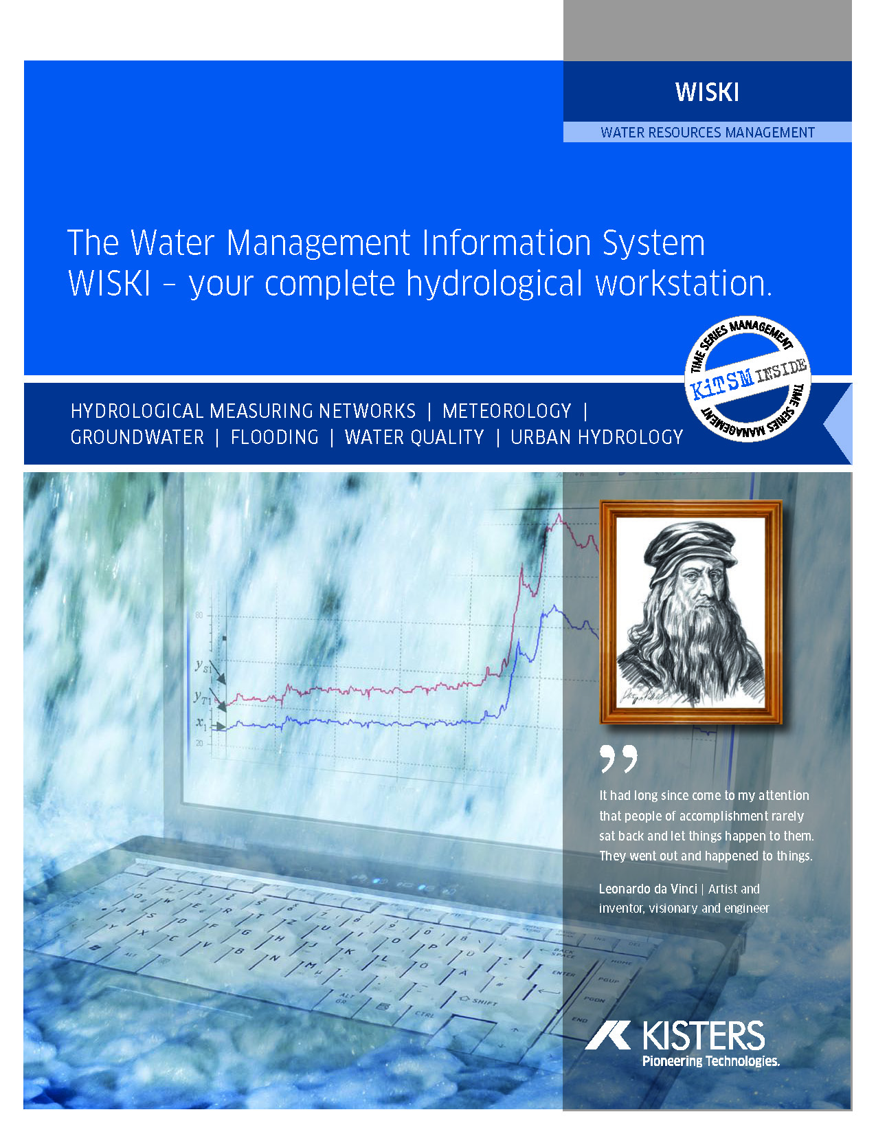
KISTERS TimeSeries Data Management System - WISKI
Scalable system of interpolation type and data type combination to express how the data is treated correctly between the time stamps
Hierarchical quality codes stored with every data point are access criteria for every WISKI calculation.
Free comments, standard remarks and data attributes are added to the data for better interpretation & documentation.
Advanced time series types combine multiple parameters in dedicated columns (discharge/runoff, wind direction/speed, relative/absolute etc).
Editing history keeps track of data changes.

Slide 6

KISTERS Web Interoperability Solution (KiWIS)
The first commercially available and robust software for consuming
and publishing real-time hydrological data to the Internet using open standards!
Utilizes applied open standards for sharing data from KISTERS water data management solutions
Eliminates issues surrounding complex data formats
Single API framework for multiple service types

Slide 7













KISTERS Hub Principles...
private
Local
Public
Local
Local
Global
emergency
Local
Local
Notification
Local
National
KISTERS HUB
Technology
Local
Services
OGC, CUAHSI,…
business
Local
Services
OGC, CUAHSI,…
Local
Services
OGC, CUAHSI,…
Regional
Services
OGC, CUAHSI,…
Local
university
Local
Local
Local
Professional
engineering
Data providing
Data consuming
Data mediation
Data validation
Information products
Data & Information dissemination
Data & Information consumption

Slide 8
Central Texas Implementation
private
Public
Local
Local
Local
Global
emergency
Notification
Local
Local
Local
USGS
KISTERS HUB
Technology
Services
OGC, CUAHSI,…
business
Services
OGC, CUAHSI,…
Services
OGC, CUAHSI,…
Local
Services
OGC, CUAHSI,…
Local
Local
LCRA
Moving totals Rate of Change Percentage Normal
university
Local
Professional
Local
Local
City of Austin
engineering
Data providing
Data consuming
Data mediation
Data validation
Information products
Data & Information dissemination
Data & Information consumption

Slide 9
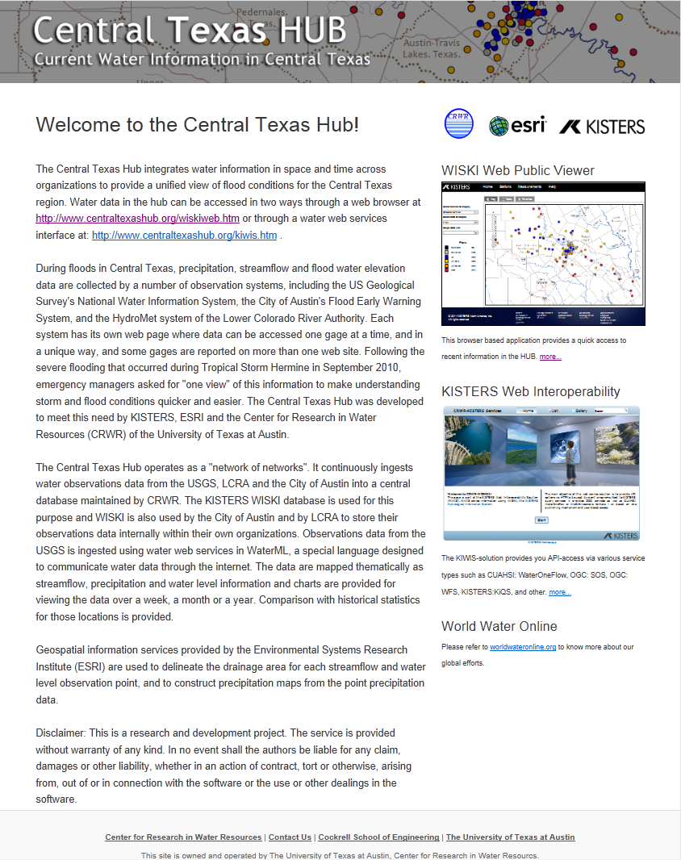
Combine data feeds from national, regional and local sources - USGS, Lower Colorado River Authority, and City of Austin
Display spatial information from ESRI and Time Series data from KISTERS WISKI
KISTERS TimeSeries HUB “in Action”
Flash flood situational awareness and drought contingency planning

Slide 10
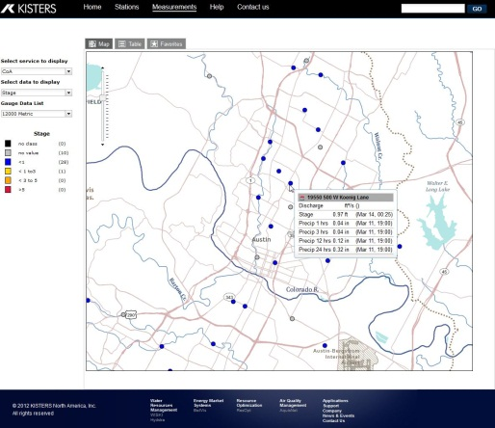
USGS
LCRA
COA
A behind the scenes look...
WISKI
How WISKI turns raw data into actionable information
Develop Derived Data Products
Move to ESRI for Mapping
Display on Webpage

Slide 11
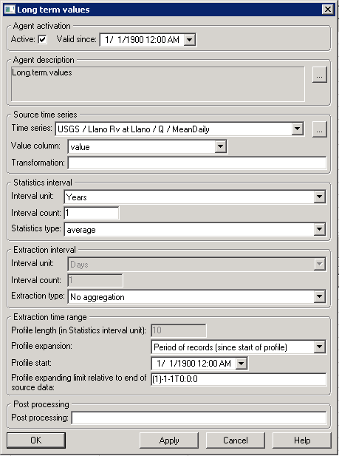
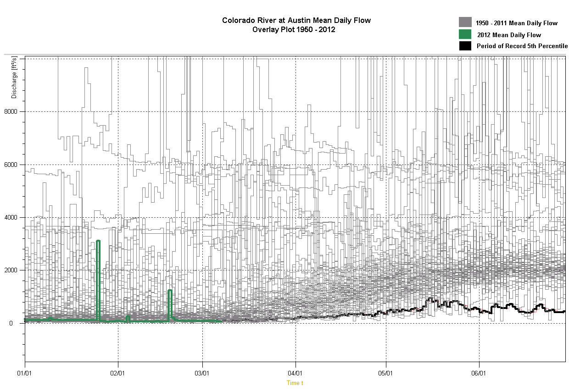
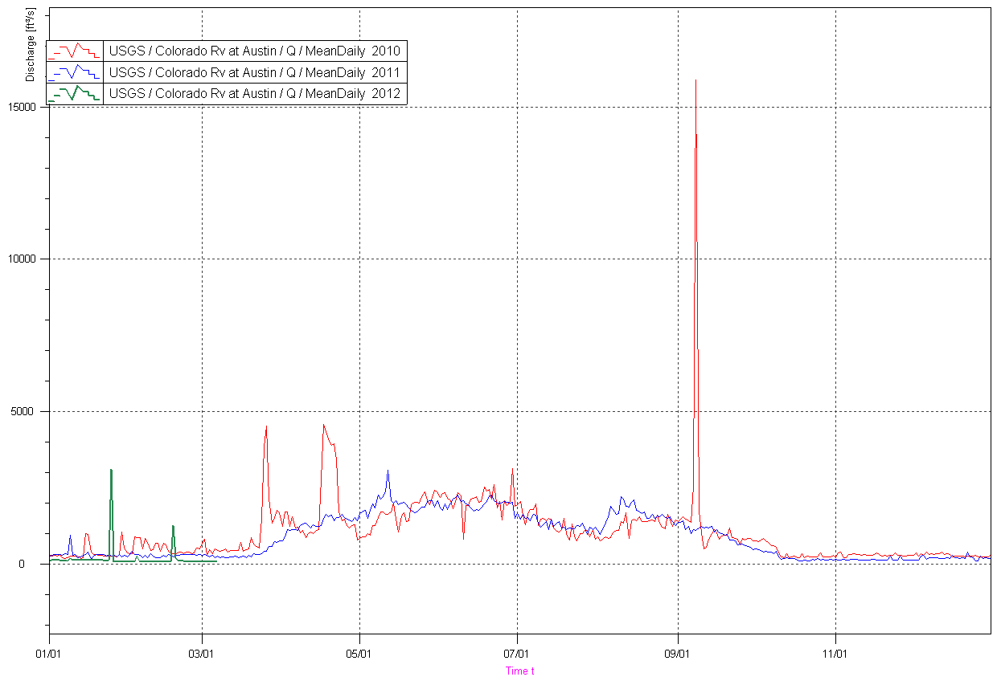
USGS
LCRA
COA
Derived Time Series...
WISKI
Using standard functions to create derived time series (eg. Long term values)
Raw Data
Develop Derived Data Products
Move to ESRI for Mapping
Display on Webpage

Slide 12
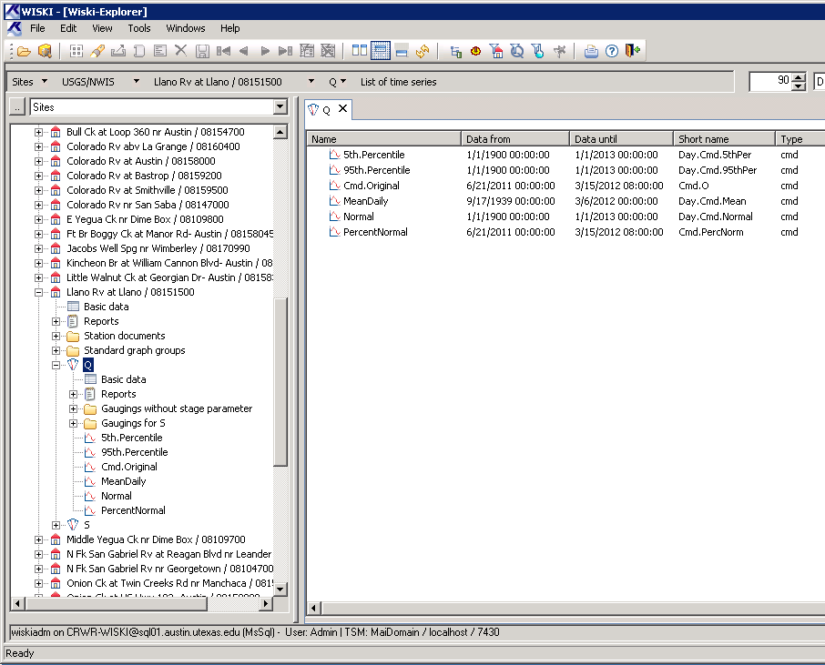
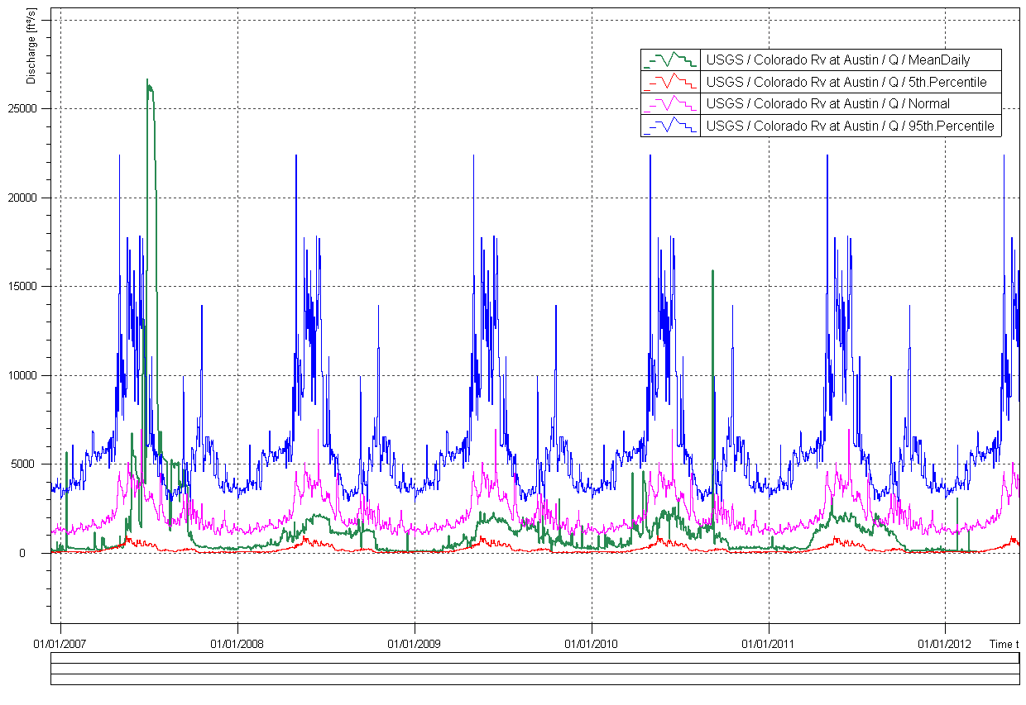
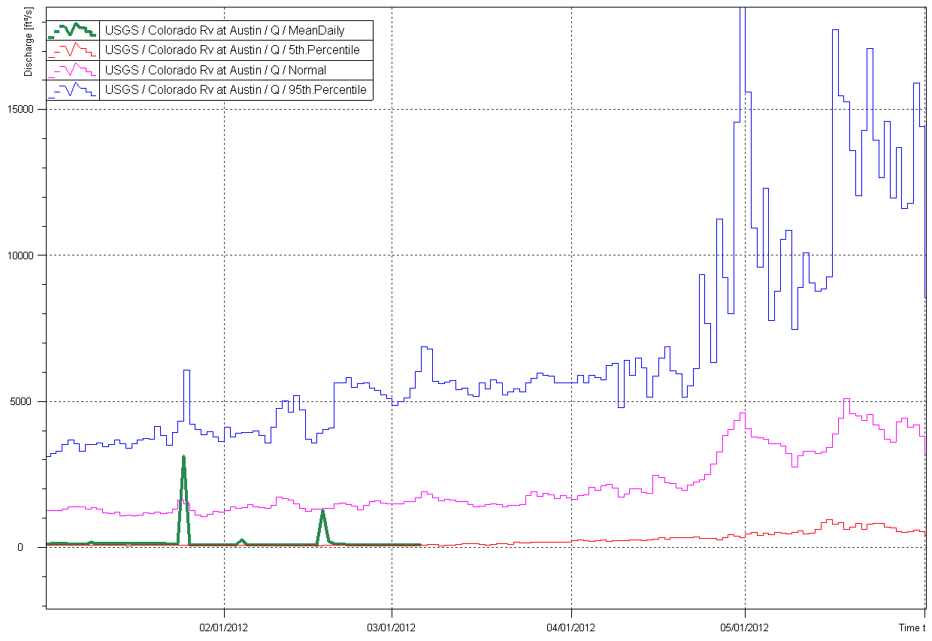
USGS
LCRA
COA
Derived Time Series...
WISKI
Develop Derived Data Products
Derived time series are now part of every station in the network
Move to ESRI for Mapping
Display on Webpage

Slide 13
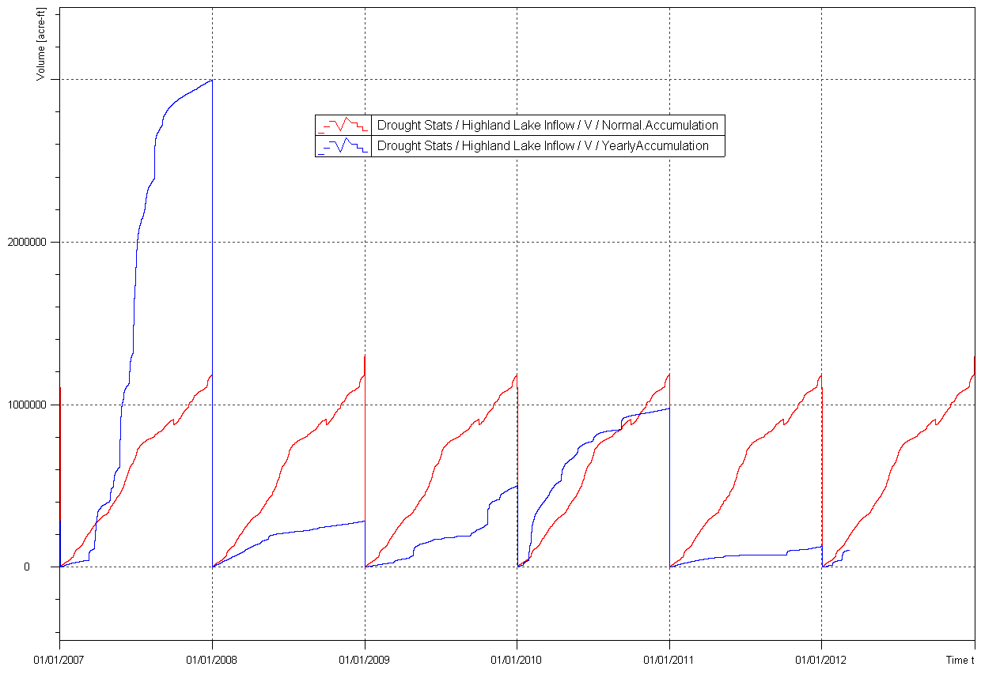
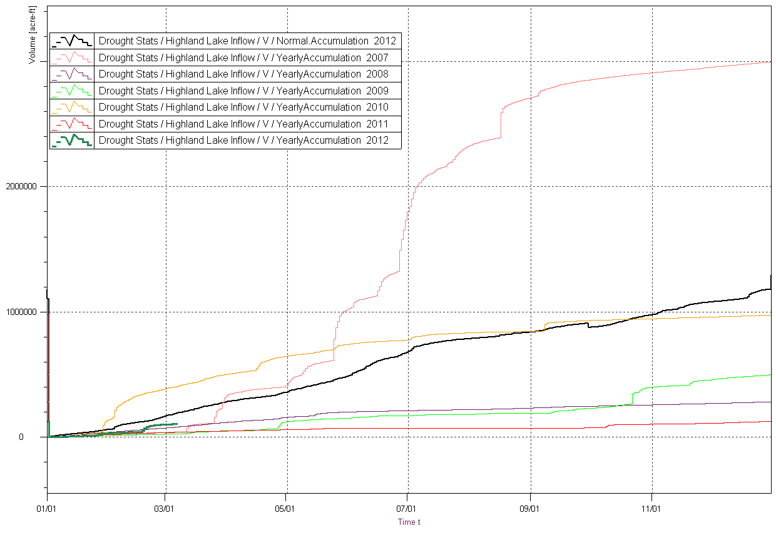
USGS
LCRA
COA
Derived Time Series...
WISKI
Develop Derived Data Products
Cumulative Lake Inflow
Normal Accumulation
Move to ESRI for Mapping
2012
Display on Webpage

Slide 14

USGS
LCRA
COA
Moving to ESRI for Mapping
WISKI
Develop Derived Data Products
Moving KISTERS derived time series data to ESRI’s spatial mapping products
Move to ESRI for Mapping
Display on Webpage

Slide 15



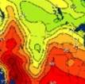

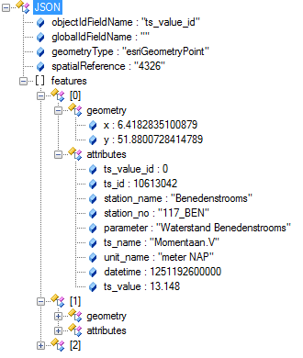
KISTERS / ESRI Integration
Browser
WebSolution
Station
pages
Time
Series
widget
REST/JSON services
Time Services
OGC, CUAHSI, REST…
GIS Services
ArcGIS Server
KISTERS Database
ArcGIS
Server

Slide 16
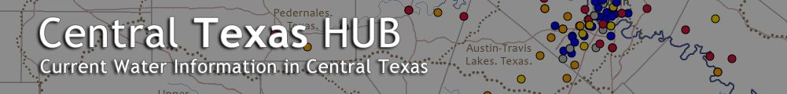
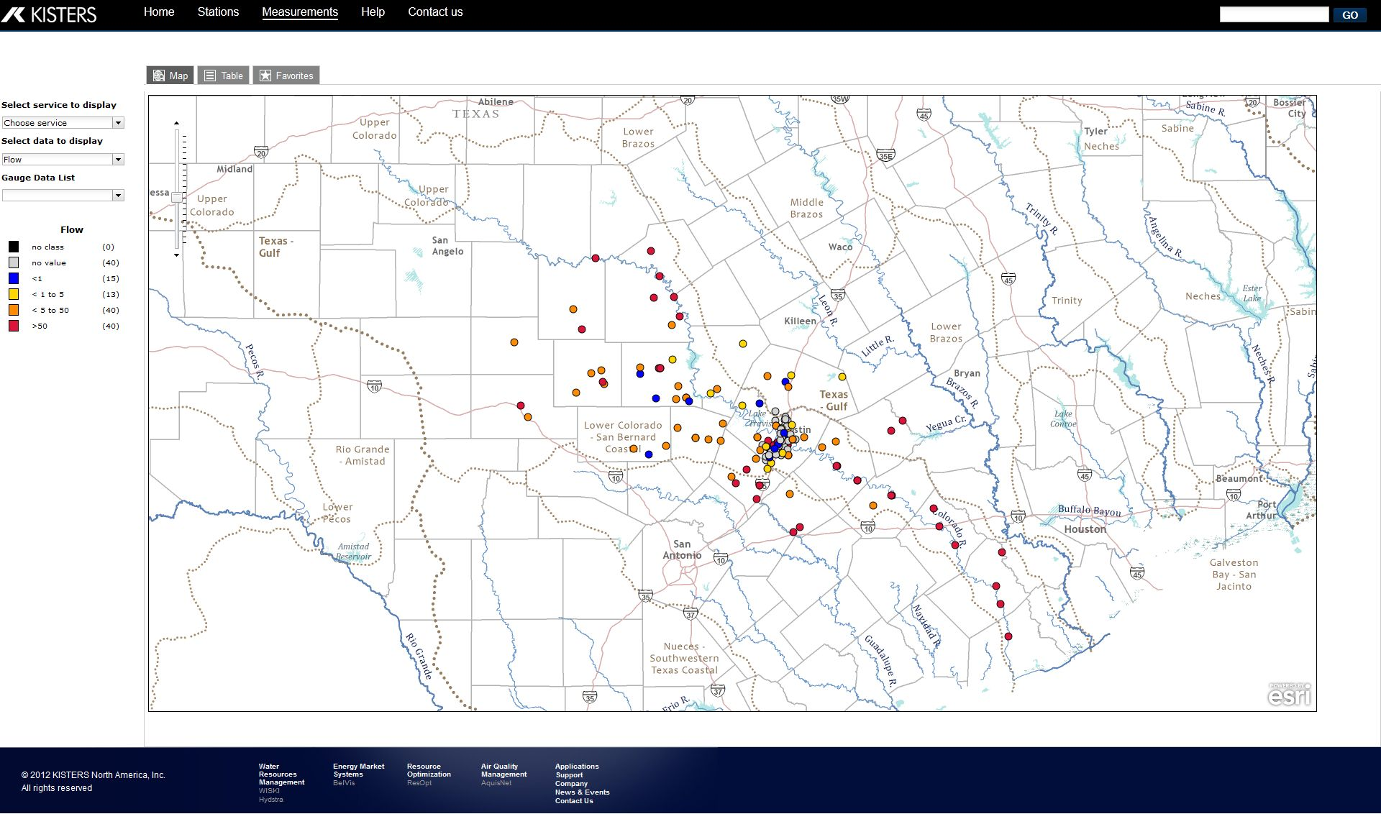
www.centraltexashub.org

Slide 17
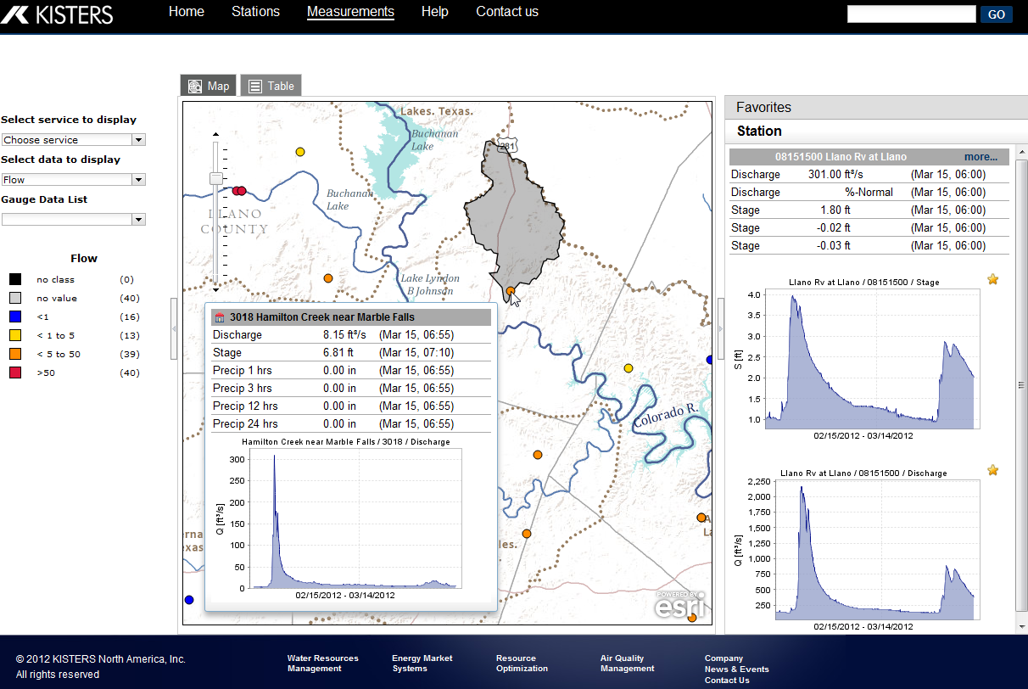
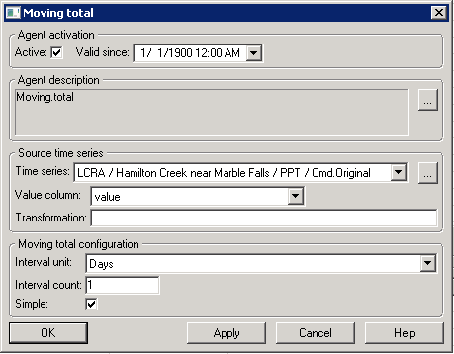
1, 3, 12 and 24 hour moving precipitation totals

Slide 18
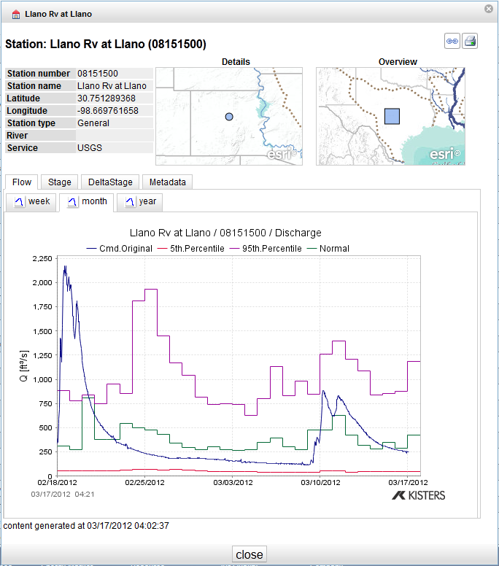
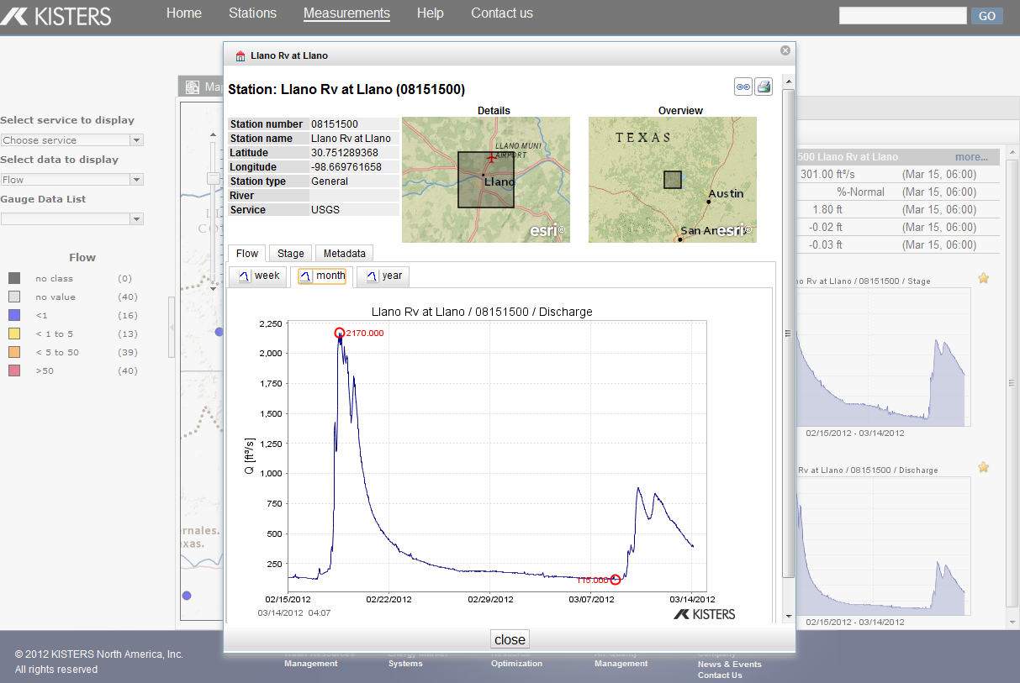
Reviewing Station details
and derived time series in a spatial context

Slide 19

Integrate, Standardize
and Share
Hydrological Data
KISTERS TimeSeries HUB with KiWIS integrates all forms of hydrological data from different sources, domains, formats and spatial and temporal resolutions. A robust set of timeseries authoring tools in WISKI enables users to develop a multitude of derived data sets that are then shared through a standardized view using web modules like WISKI Web Pubic/Pro.

Slide 20
KiWIS Features & Benefits
Service oriented architecture
KISTERS high speed data protocol
Supported standards: WaterML 2.0, WaterML1, SOS, WaterOneFlow
Command return formats: ASCII, HTML, CSV, XLS, JSON, GeoJSON and PNG/JPG
Service multiple data sources at once
KiWIS GUI: configurable, intuitive, easy to use
Integration with KISTERS time series archives

Slide 21
Building the synergy between Time and Space...

Slide 22
http://crwr-wisk03.crwr.utexas.edu:8080/KiWIS/KiWIS?datasource=0&service=kisters&type=queryServices&request=getgraph&datasource=0&format=png&ts_id=25085042,25084042,25083042,25082042,16754042&from=2012-03-19&to=2012-03-21&width=700&height=400&kiUser=&kiPassword=
http://crwr-wisk03.crwr.utexas.edu:8080/KiWIS/KiWIS?datasource=0&service=kisters&type=queryServices&request=getTimeseriesList&datasource=0&format=html&station_no=4519&kiUser=&kiPassword=

