Slide 1
Hydrologic Forecasting Interoperability Experiment
80th OGC Technical Committee
Austin, Texas (USA)
John Halquist
March 20, 2012

Slide 2
Hydrologic Forecasting IE
Introductions
Initiator Organizations
NOAA/NWS
Deltares USA
USGS
CSIRO
KISTERS
Participant Organizations
Aquatic Informatics
Water Survey of Canada / Cyber – Water and Environmental Hub
Saskatchewan Water Authority / Manitoba Water Stewardship
International Joint Commission / International Souris River Board
INCLAM / Water Idea (Spain)

Slide 3
Hydrologic Forecasting IE
Objectives
The aim of this IE is:
(1) Extend and complement the work already underway in the Groundwater and Surfacewater IEs, with the goal of advancing the development of WaterML 2.0 to the sub domain of hydrologic forecasting
(2) Test compatibility of WaterML 2.0 with modified and new services by NOAA/NWS, and USGS by implementation of the OGC SOS, SWE Notify, WFS, WMS standards;
(3) Test compatibility of WaterML 2.0 for use with hydrological forecasting systems.
(4) Establish a limited surface water feature model and vocabularies suitable for the provision of surface water forecast data using WaterML 2.0.
(5) The data will be served by all participants using WaterML 2.0 and OGC services (SOS, SWE Notify, WFS, WMS).
(6) Optional: Test compatibility of O&M based weather forecast information model for use with hydrological forecasting systems.

Slide 4
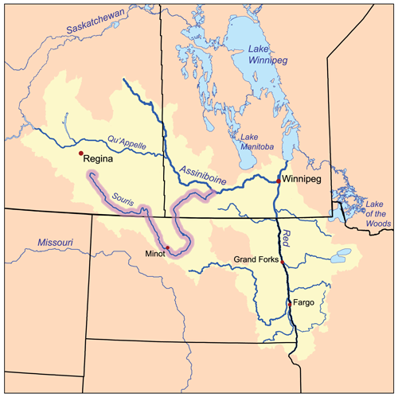
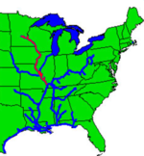

Slide 5
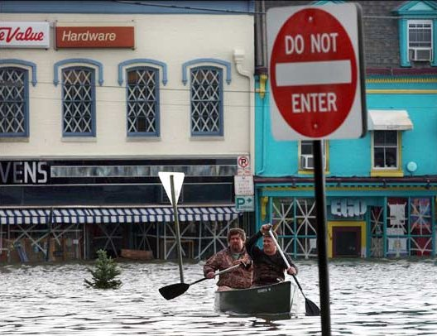
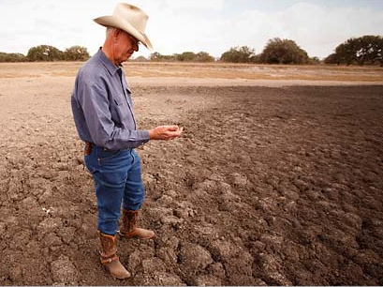

Integrated
Water Resources Science and Services (IWRSS)
TOO MUCH
TOO LITTLE
A New Partnership to Enhance Water Resources Science and Services
John Halquist
National Operational Hydrologic Remote Sensing Center
NOAA/NWS
POOR QUALITY
March 20, 2012

Slide 6








Growing Water Challenges
Population growth and economic development are stressing water supplies and increasing vulnerability
A changing climate is impacting water availability and quality, increasing uncertainty
An aging water infrastructure is forcing critical, expensive decisions
Socio-economic risks of floods and droughts are escalating
Blue Gold, “The New Oil”
Notes:
Unlike energy (oil, hydro, solar, wind) no alternative for water
Floods
The annual average damage due to flooding has risen each of the past three decades (costs adjusted for inflation)
1981-1990: $4.7 Billion
1991-2000: $7.9 Billion
2001-2010: $10.2 Billion
2011 combined flood losses along the Mississippi and Missouri Rivers are expected to exceed $6 Billion (USA TODAY; USACE)
Drought
2011 impacts in Texas alone are expected to exceed $9 Billion (Associated Press; Time Magazine)

Slide 7
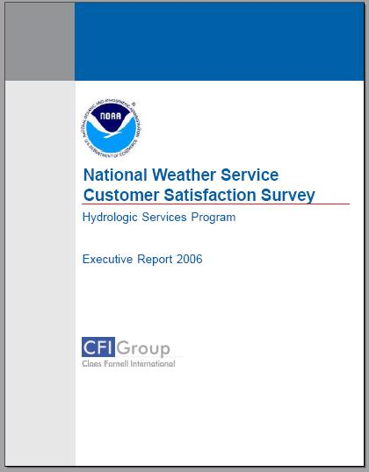
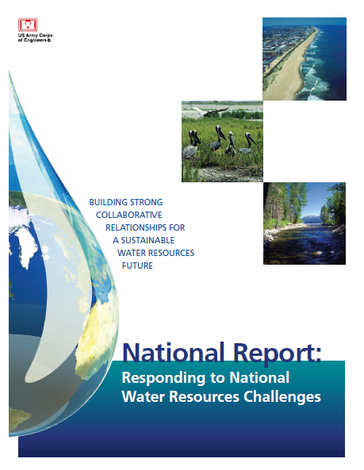
Stakeholders Needs
Expanded/new high resolution water information in space and time to inform decisions
Quantification of uncertainty to manage risk
Enhanced communication of flood risk using flood forecast maps
Simplified access to more comprehensive, integrated information
(Conducted in 2002, 2004, 2006, 2008, 2011)
NWS has completed extensive outreach to objectively define, validate and prioritize stakeholder needs
Corps of Engineers has conducted National Needs Assessment for all 50 States
August 2010
Notes:
Federal Imperative
Council on Environmental Quality (CEQ) National Action Plan:
Priorities for Managing Freshwater Resources in a Changing Climate, October 2011
National Goal
Government agencies and citizens collaboratively manage freshwater resources in response to a changing climate in order to ensure adequate water supplies, safeguard human life, health and property, and protect water quality and aquatic ecosystems.
Recommendations - Federal agencies should:
Improve Water Resources and Climate Change Information for Decision-Making
Strengthen Assessment of Vulnerability of Water Resources to Climate Change
Expand Water Use Efficiency
Support Integrated Water Resources Management
7

Slide 8
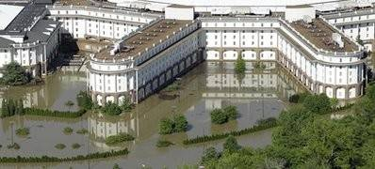
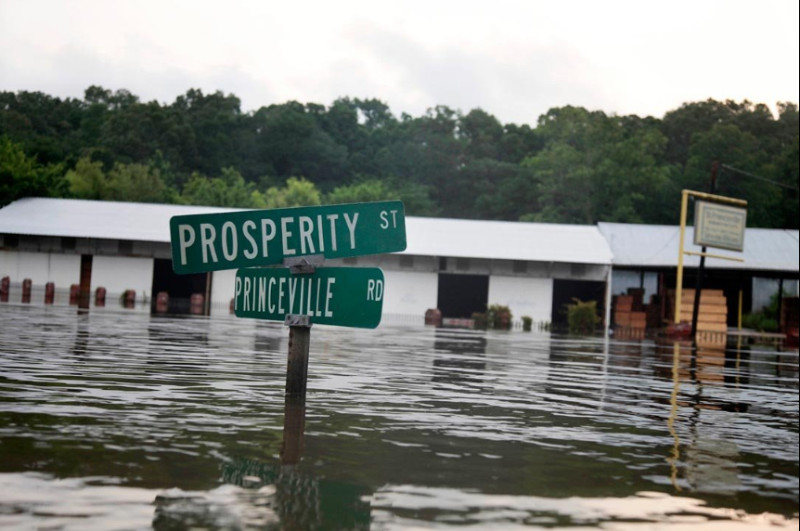
Recent Extreme Flood Events
Nashville May 2010
blog.printshiptn.com
St. Francisville, La May 2011
http://www.huffingtonpost.com
Common Service Assessment Recommendations:
Facilitate improved real-time data access to ensure Common Operating Picture
Implement comprehensive flood forecast inundation mapping system

Slide 9
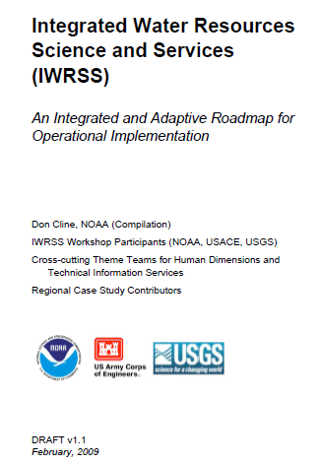



IWRSS Roadmap and MOU
Framework to align agencies with complementary water-related missions to accomplish operational goals.
MOU Signed May 11, 2011
“Collaborative Science, Services and Tools to Support Integrated and Adaptive Water Resources Management”
Signatories
Dr. Jane Lubchenco, Director of NOAA
Rock Salt for the Honorable Jo-Ellen Darcy, Assistant Secretary of the Army for Civil Works
Dr. Marcia McNutt, Director of the U.S. Geological Survey
Initial Focus Areas
High-Resolution Water Resource Forecasts and Flood Inundation Maps
System Interoperability and Data Synchronization
February 2009
http://www.nohrsc.noaa.gov/~cline/IWRSS/IWRSS_ROADMAP_v1.0.pdf

Slide 10




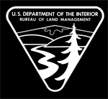





Innovative Federal Consortium
New business model for interagency collaboration
Share technology, information, models, best practices
Started with three agencies, designed to expand
Members agree to work towards:
Interoperability of key systems and data synchronization
Enhanced geospatial information and visualization
High-Resolution Summit to Sea Analyses and Forecasts
Common Operating Picture
Coordinated R&D portfolio investments
Leverage investments & multi-disciplinary skills to formulate effective solutions
One stop shopping for federal water data and information
Shared leadership model
Joint stakeholder outreach & education

Slide 11
Joint Operating Concept
Guide observing system investments
DATA
Coordinated Observing Systems
DATA
National Weather and Climate Forcings
DATA
USACE Corps Water Management System
Key
Enhanced Use of Surface Networks
Airborne Snow and Soil Moisture
Enhanced Use of Satellite Data
NCEP, ESRL
NOAA
CHPS/CWMS Interoperability
USGS
Coordinated National/Regional Workflow and Operations
USACE
National High-Resolution Modeling/Assim
Products
CHPS
New Science and Technology
Groundwater Modeling
Regional (RFC) High-Resolution Modeling/Assim
Coordination
CHPS/CWMS
MODEL REANALYSIS
CHPS
CWMS
Geo-Intelligence / eGIS
CHPS
District Modeling
Coordination
Community
USACE
USGS
NASA
NOAA
20-30 Years
Support calibration and bias adjustment for traditional river forecast models
Support consistent historical water budget analyses
Common Operating Picture
New water resources Information
Analyses and Forecasts
Weather and Climate Forecast Scales
Integrated with Coastal Environment
Regional Coordination
Uncertainty Estimates
Historical Water Budget Analyses
(USGS Water for America)
IWRSS
National Water Resources Nowcasts and Forecasts
Common Digital Database
Potential for Shared System-Level Services and Feedbacks
Common Digital Database
Federal Water Resources Information Systems
State/Local Water Resources Management Systems
NIDIS Drought Early Warning System
Public and Private Sectors

Slide 12
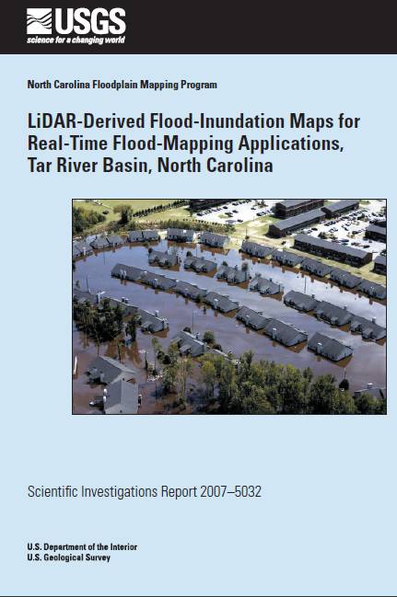
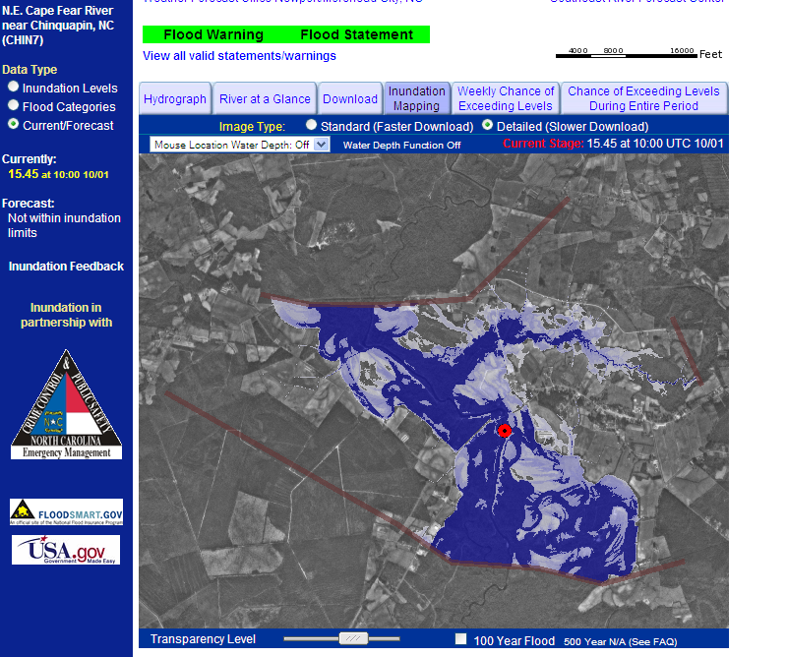
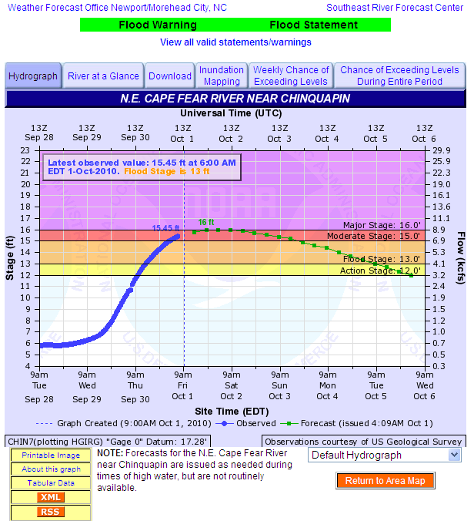
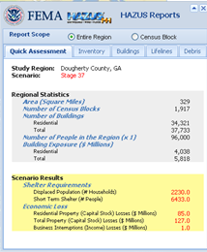
New Digital Information Products
Today: Flood Map Library Pilots
Maps display spatial extent and depth of flood water linked to NWS river forecast for levels ranging from minor through record flood
Better mitigate flood impacts, reduce repetitive flood losses, and build more resilient communities
Enhanced map viewer being developed jointly with USGS which links maps to HAZUS data
Planned for FY13-FY15:
Pilot dynamic flood forecast inundation maps for high-impact areas
water.weather.gov

Slide 13
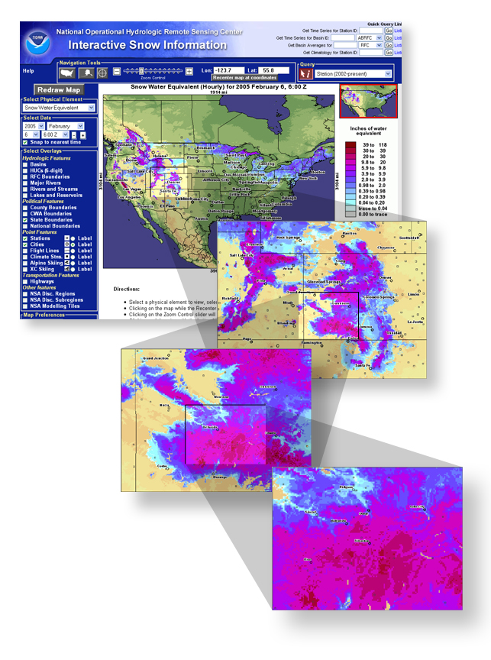
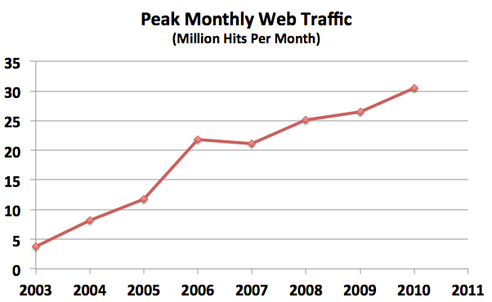
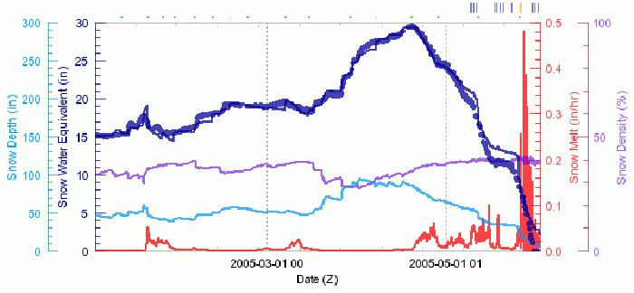
New Digital Information Products
Today: Summit-to-Sea Pilot
National
National Snow Analyses and Forecasts
Integrating Multi-Agency Data and Models to Provide Consistent Water Resource Information
Integrates all available snow data into state-of-the-art snow physics model from USACE
NWS operations and modeling framework incorporates NWS weather information
1-km, hourly resolution products (snow depth, water content, snowpack temperature, snowmelt rate, etc.) widely used in government, private and public sectors
State
CO
UT
Regional
San Juans
Watershed
Backyard
www.nohrsc.noaa.gov
13

Slide 14
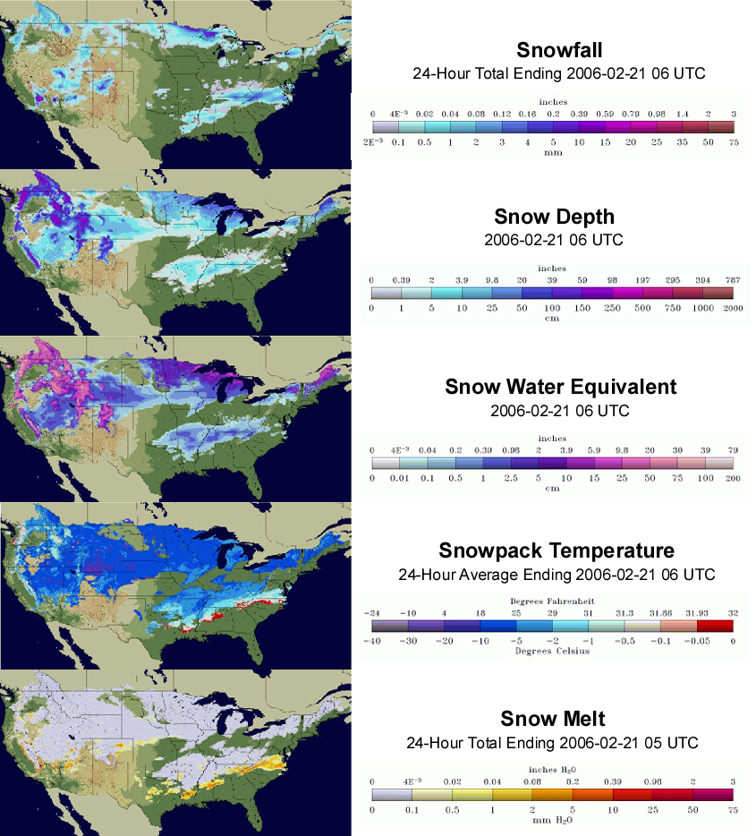
New Digital Information Products
Pilot Products - Snowpack
Planned for FY13 – FY15:
Soil Moisture and Evapotranspiration Added to Suite
Local Information (<1 km²)
Summit-to-Sea Water Resources Products
Snowfall
Precipitation
Snowpack
Soil Moisture
Snow Depth
Evapotranspiration
Groundwater
Water Content
River flow
Surface Storage
Water Quality
Snow Temperature
Watershed – to – National Information
Snowmelt
USGS WaterSMART
Initiative
IWRSS Forecasts
www.nohrsc.noaa.gov
Past
Present
Future
Notes:
We began making high-resolution summit-to-sea water resources products about 8 years ago as part of the NOHRSC National Snow Analyses Pilot (1km hourly resolution gridded snowpack information – www.nohrsc.noaa.gov). IWRSS will expand on this to include a comprehensive suite of water variables that span the past, present and future (predictions), at four times greater resolution (500m).
14

Slide 15

National Water Center
First national center for water forecast operations, research and inter-agency coordination
Routine generation of enhanced water resources forecasts and information (e.g., summit-to-sea, flood inundation maps) to:
More effectively manage the Nation’s increasing limited water supply
Inform stakeholder decisions which address competing demands (e.g., hydropower, flood mitigation, municipal water supply, agriculture, recreation, ecosystem management, commerce)
Better quantify and communicate risk, build resilient communities, and improve decision support for both high-impact events and routine high-value decisions
Facilitate adaptive planning and management
Groundbreaking Ceremony on February 21, 2012
Building Occupancy in June 2013
Size: 60,000 sq.ft.
Staff Capacity: 200
LEED Gold
15
Notes:
LEED, or Leadership in Energy and Environmental Design, is redefining the way we think about the places where we live, work and learn. As an internationally recognized mark of excellence, LEED provides building owners and operators with a framework for identifying and implementing practical and measurable green building design, construction, operations and maintenance solutions.

Slide 16
IWRSS Implementation Begins
IWRSS Teams now being formed (multi-agency)
Scope
Design
Implement
Initial Operating Capability (IOC)
1 year after opening of the NWC
National scale modeling w/ no coupling
Baseline Operating Capability (BOC)
Loosely coupled national modeling
Interoperability
Data
Models
Decision Support Systems
Policy
Full Capability
Earth Systems Modeling

Slide 17
Summary
TOO MUCH
IWRSS provides a framework for Federal agencies to enhance collaboration and address critical stakeholder needs
The NWC will be the first national center for coordinated operational water resources forecasts and decision support
TOO LITTLE
POOR QUALITY

