Slide 1

From Prototype to Service: A CUAHSI Datacenter for Hydroinformatics
Richard Hooper
Consortium of Universities for the Advancement of Hydrologic Science, Inc.

Slide 2
Web Paradigm
Catalog (Google)
Catalog harvest
Search
Web Server
(CNN.com)
Access
Browser
(Firefox)

Slide 3
Services-Oriented Architecture for Water Data
HIS Central
Service registration
Search
Catalog harvest
HydroServer
Data access
HydroDesktop

Slide 4
Today: Large-scale Prototype
CUAHSI HIS: open-source suite of software:
Community governed.
Standards for data exchange.
Wrappers that publish standard versions of non-standard data sources.
Software infrastructure, including:
HydroCatalog: a search-enabled catalog of hydrological time series sources.
HydroServer: a data source server.
HydroDesktop: a search/discovery client.

Slide 5
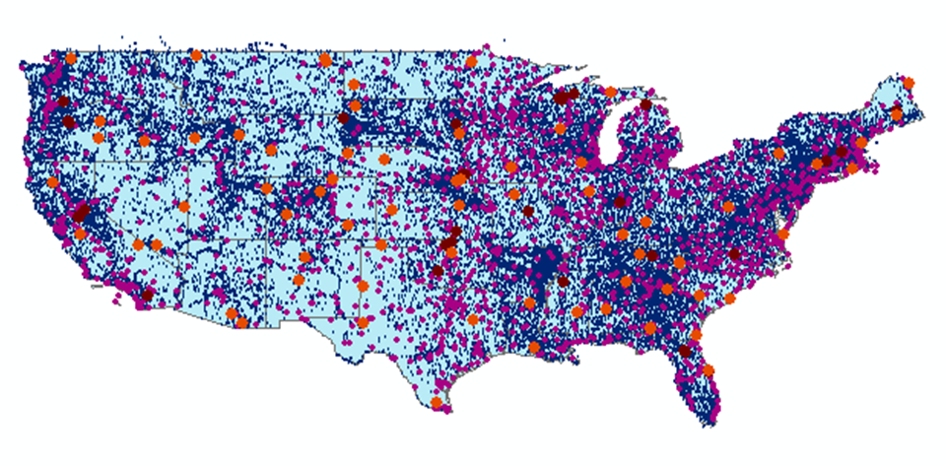
Metadata Catalog, Feb 2012
Map integrating NWIS, STORET, & Climatic Sites
79 public services
13,000+ variables
2.3+ million sites
23.3 million series
Referencing 100+ billion data values
Notes:
3000-5000 GetValues requests per day.

Slide 6
HIS Usage

Slide 7

Where we are going
A new “data facility” for the university research community (funded by NSF)
Continues affordable and useful activities of CUAHSI HIS.
Deprecates and replaces less affordable CUAHSI HIS activities.

Slide 8
Missions of the data center
To support use of hydrological data sources via:
Standards that foster information reusability and interchange.
Curation of data and catalogs that conform to and realize those standards.
Software that embodies these standards and empowers research.
Support that empowers researchers to utilize data and software for scientific inquiry.
Engagement with other data providers (local, state, federal government agencies, NGOs, and international bodies) to make their data available

Slide 9
Standards
For data access (e.g., WaterML).
For service design (e.g., WaterOneFlow).
For data discovery (e.g., search interfaces in HydroCatalog).
For semantic mapping (e.g., in WaterOneFlow-compliant wrappers).

Slide 10
Curation
Standards curation (e.g., WaterML 2.0).
Data catalog curation: ensuring that sources in the catalog are current and functional.
Data source curation: ensuring that data sources are protected from inadvertent loss.

Slide 11
Software
A new and improved HydroCatalog, that
Points to reliable data sources.
Includes a source curation interface.
A cloud-based replacement for HydroServer, that
Is easier and more affordable to maintain than a HydroServer instance.
Meets basic requirements for data management.
A new highly portable desktop client that:
Is portable to all target environments.
Includes web-based access.

Slide 12
Support
For users of HydroDesktop, the new search client, etc.
For users of HydroServer who wish to continue using it to publish their data.
For developers attempting to create standards-compliant software, utilizing the standards curated at the facility.
For developers proposing changes to the software curated at the facility.

Slide 13
Engagement
Working with OGC and other standards-setting bodies
Working with non-academic data providers to enable data sharing
Developing an extensible catalog

Slide 14
Metadata Catalog, Feb 2012
Map integrating NWIS, STORET, & Climatic Sites
79 public services
13,000+ variables
2.3+ million sites
23.3 million series
Referencing 100+ billion data values
Notes:
3000-5000 GetValues requests per day.

Slide 15
Questions?
More information:
http://his.cuahsi.org

