Slide 1
A Land of Droughts and Flooding Rains
Update from Australia
David Lemon| Research Stream Leader: Water Informatics
20 March 2012
Water for a Healthy Country Flagship

Slide 2
I love a sunburnt country, A land of sweeping plains, Of ragged mountain ranges, Of droughts and flooding rains.
Dorothea MacKellar

Slide 3
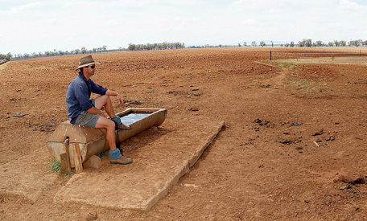
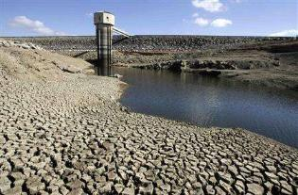
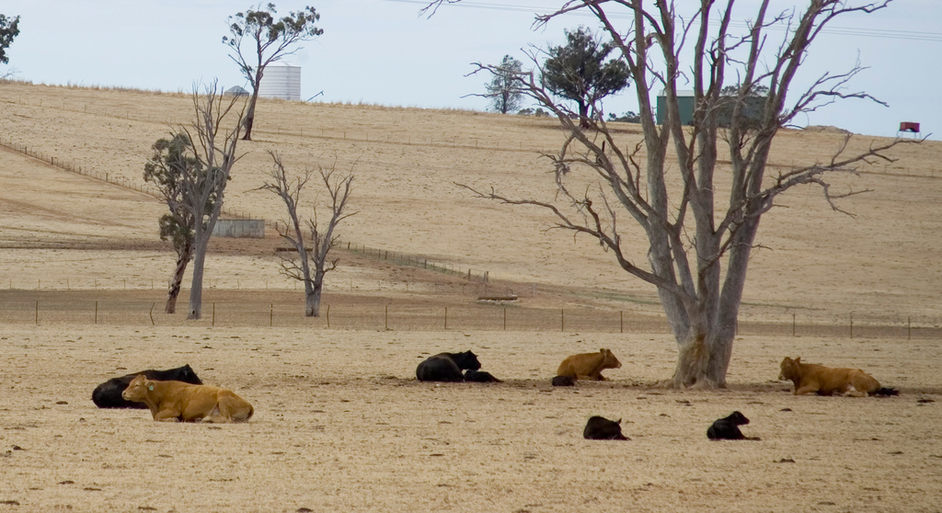
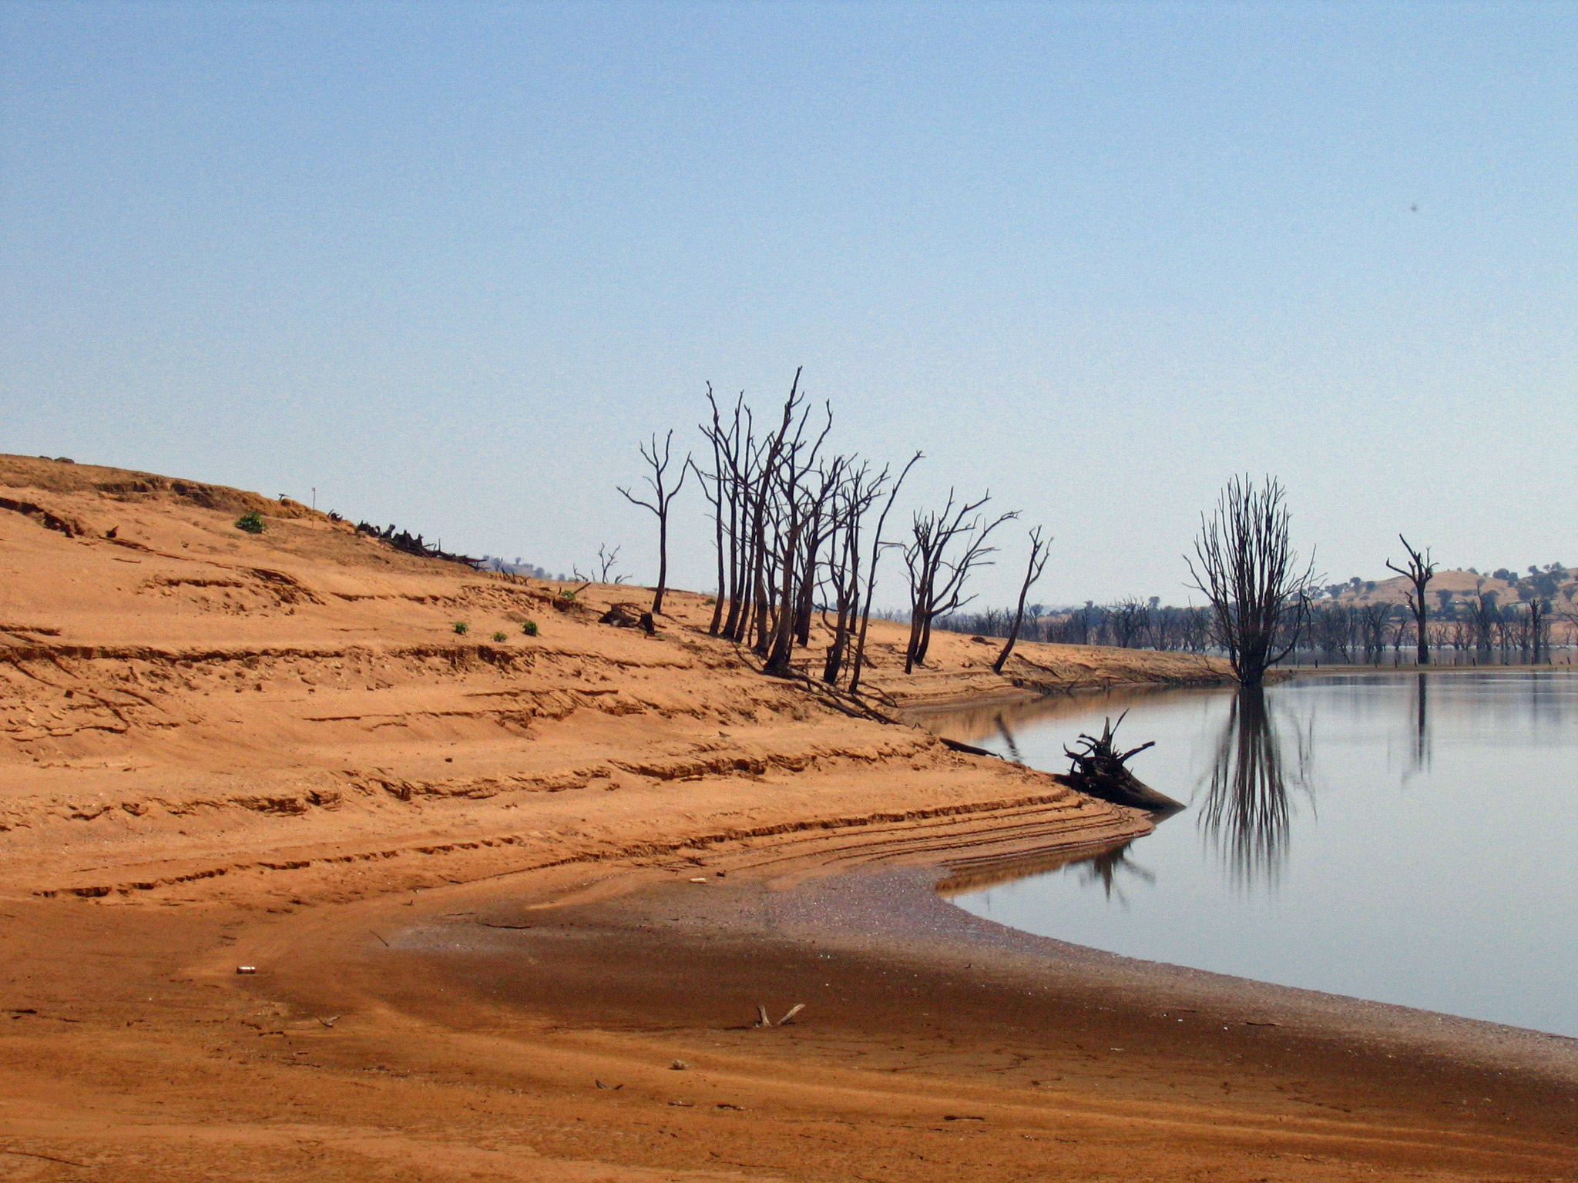
Australia’s water situation
3 Years ago

Slide 4
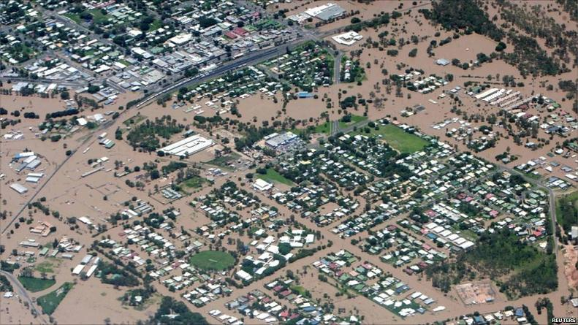
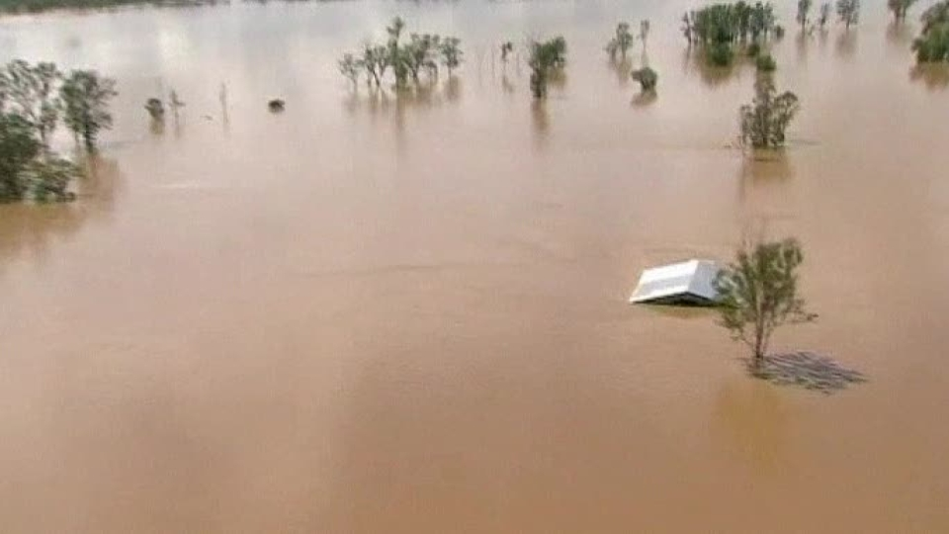
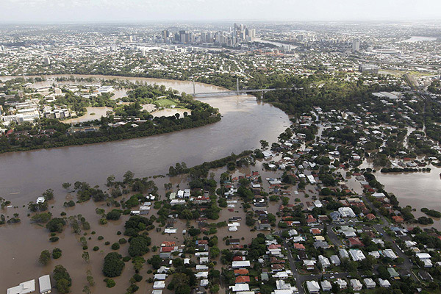
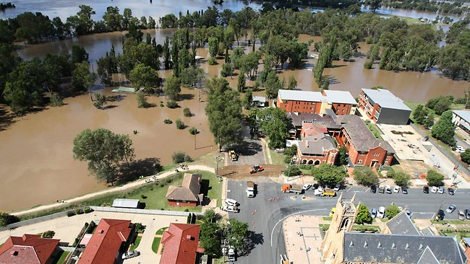
Australia’s water situation
Now

Slide 5
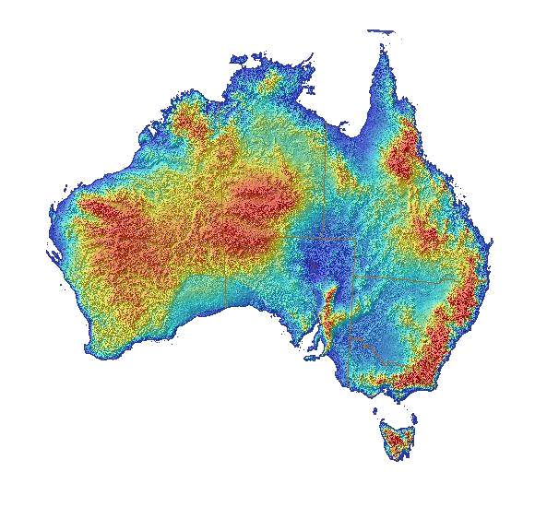
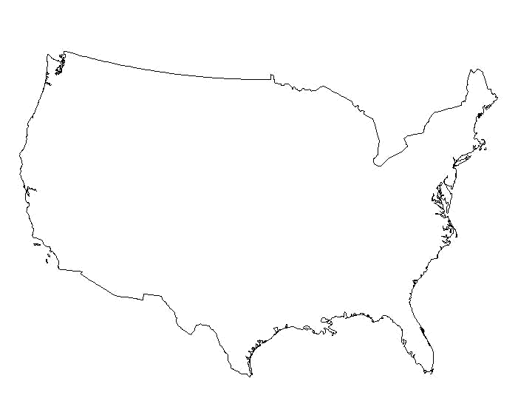
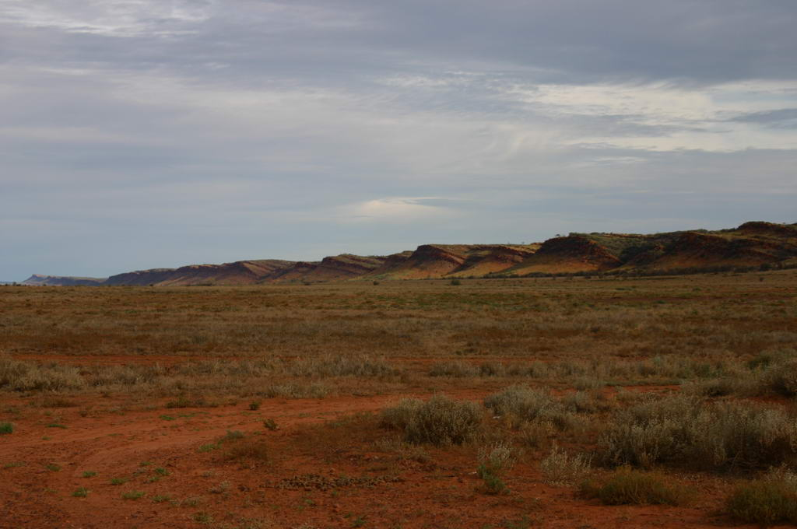
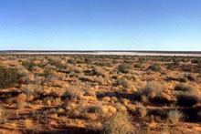
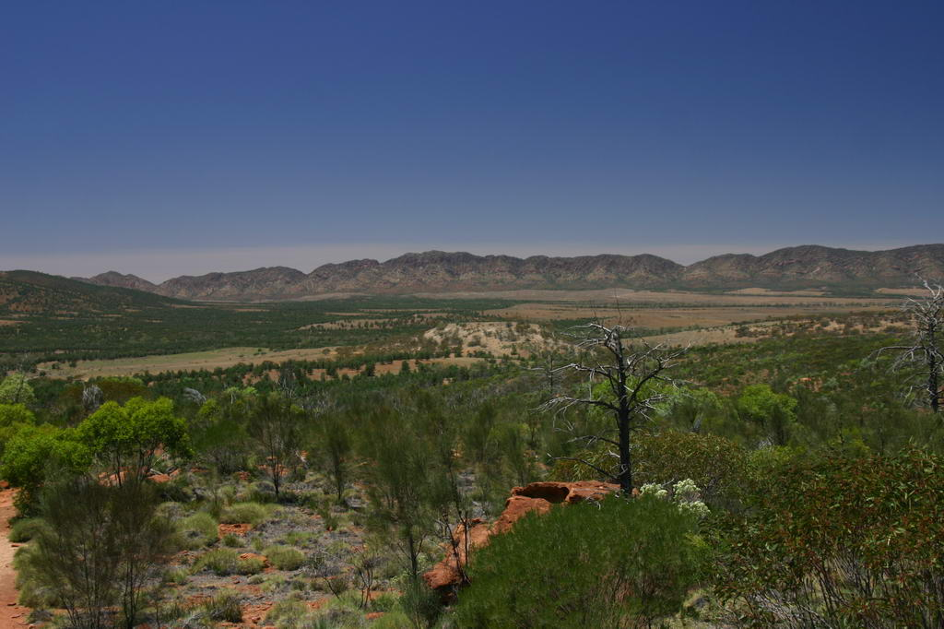
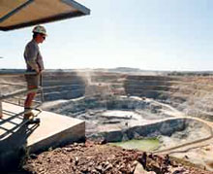
Introduction to geography of Australia
Desert
Notes:
Animate this with photos

Slide 6
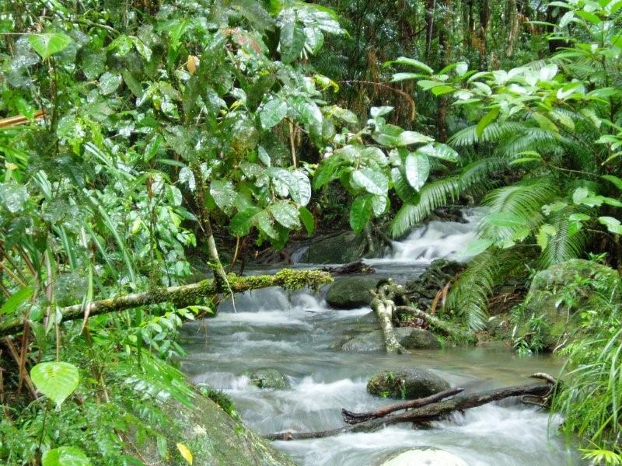
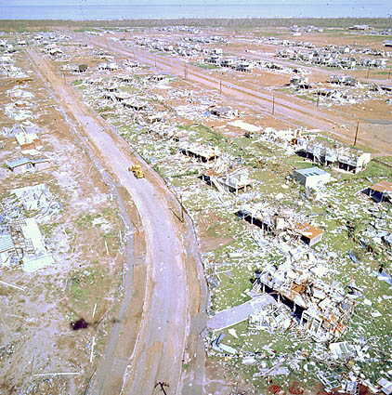
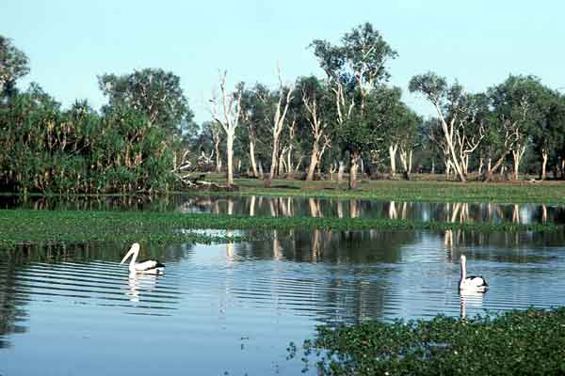
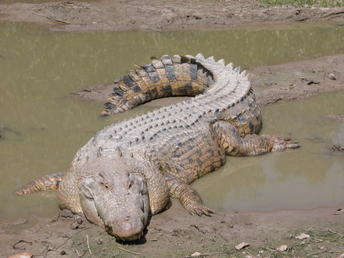
Introduction to geography of Australia
Tropics
Desert
Notes:
Animate this with photos

Slide 7
Introduction to geography of Australia
Tropics
Desert
Major water supply systems
People
Notes:
Animate this with photos

Slide 8
Water Information Research and Development Alliance (WIRADA)
5 year alliance between CSIRO and Bureau of Meteorology
Has focussed on:
Water information systems
Tools for exchanging water information
Tools for achieving interoperability between systems
New spatial products for Australia
Water Resources Assessment
AWRA
Water Forecasting
Short (7 day) and Medium (3 months).

Slide 9
WIRADA: Water Information Systems successes
Water Data Transfer Standards
Water Data Transfer Format
Used to deliver data to Bureau
Some looking to use beyond Bureau requirements
V2 will be based on WaterML 2.0 and mandated
WaterML2.0
Near completion
Ad-hoc tools
Use of semantic technologies to convert ad-hoc spreadsheets to WDTF
Provenance

Slide 10
WIRADA: Water Information Systems successes
Sustainable Water Information Models
SolidGround
Methods and Tools for creation and management of modular information models
Aimed at supporting interoperability
Australian Hydrological Geospatial Fabric (Geofabric)
Consistent underpinning spatial data products to support analysis and reporting
Built on a common conceptual model
HY_Features model

Slide 11
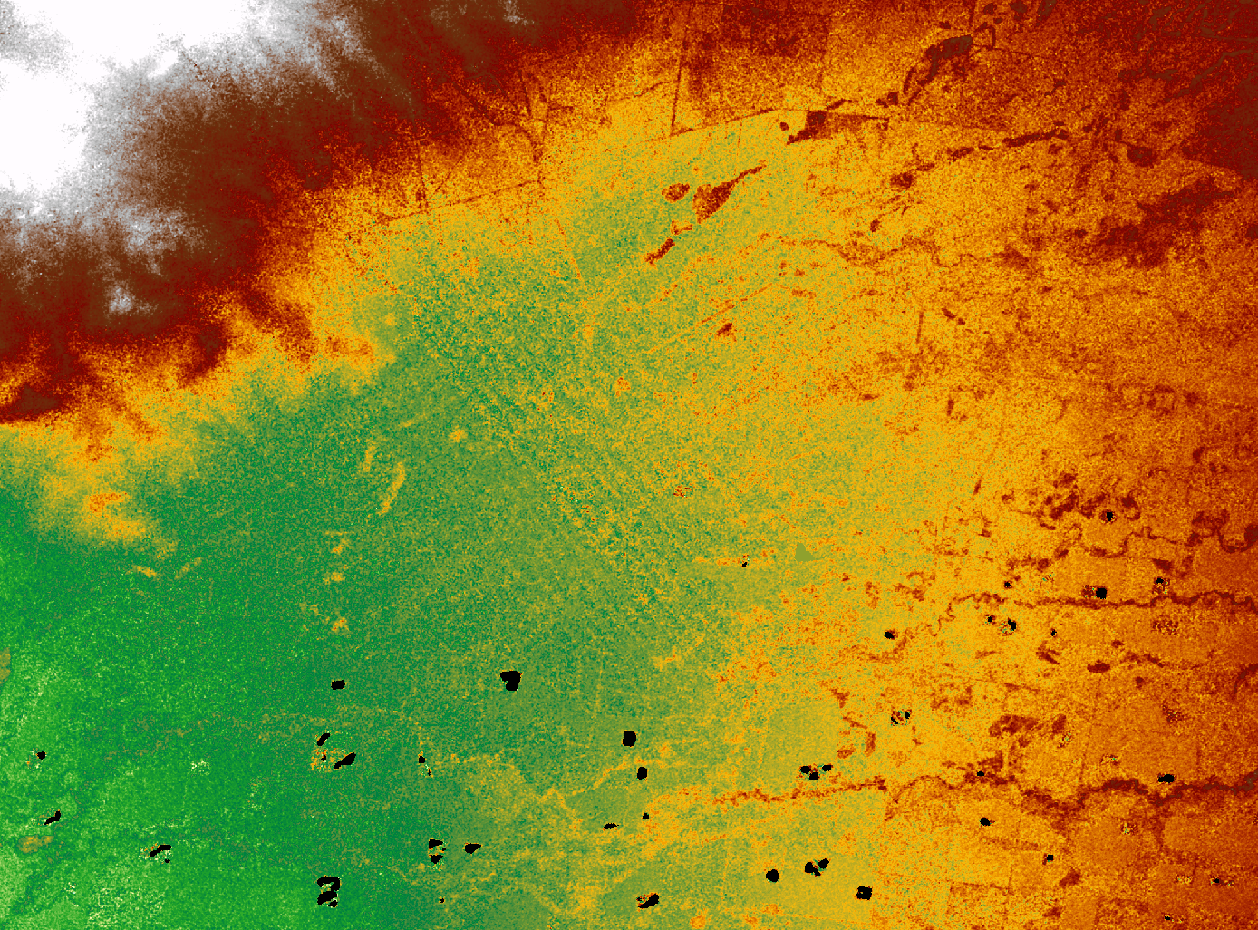
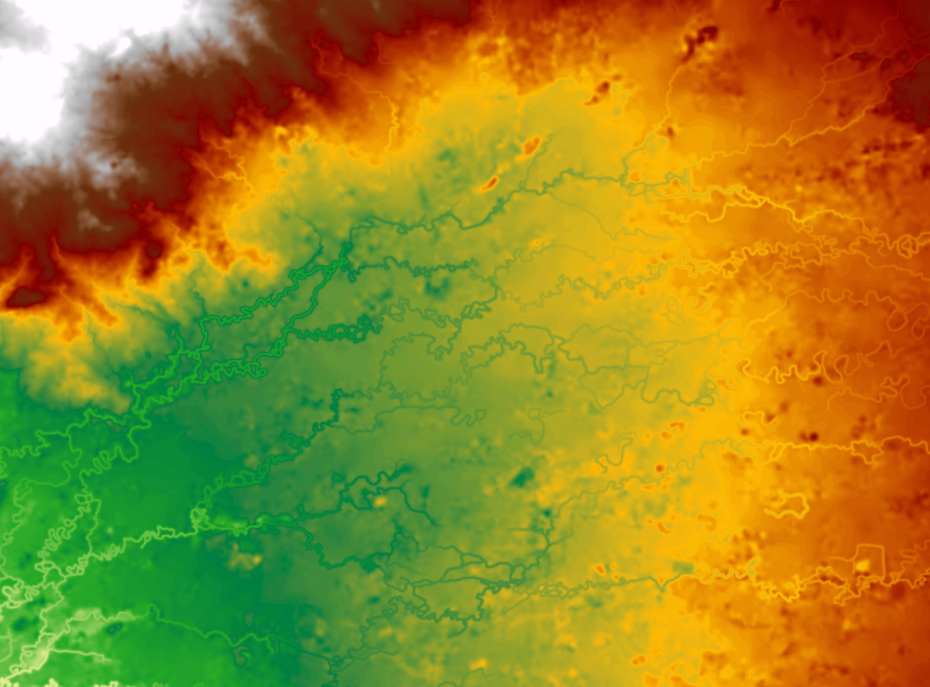
WIRADA: Water Information Systems successes
30 DEM
SRTM data cleaning
DSM, DEM, DEM-S, DEM-H products
Products now released publically
Conflation Tools
Conflating networks from multiple sources

Slide 12
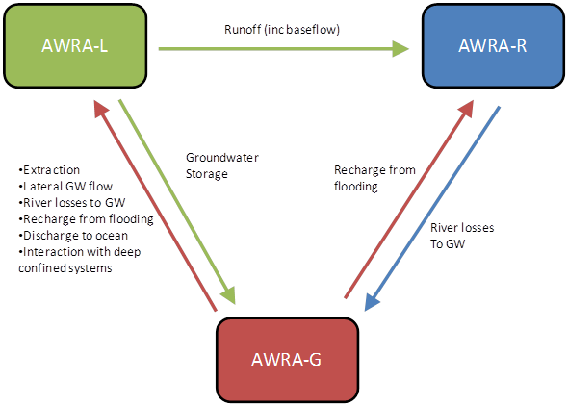
AWRA
Continental scale historical water balance system
Scientific workflow
Fusion of models and observation data
Makes strong use of remotely sensed observations
Designed to support two new nationally significant water information products from the Bureau of Meteorology
Comprised of model components, data streams, -pre -post processors, provenance system and orchestrated by a workflow engine (currently Delft-FEWS).

Slide 13
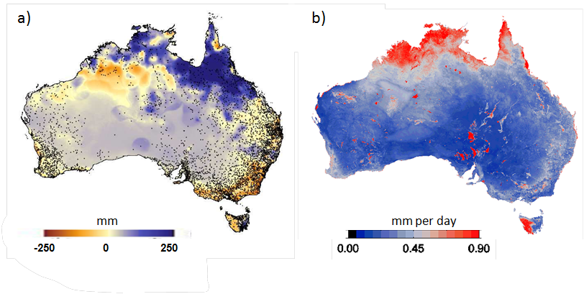
AWRA system Components
AWRA-L for landscape processes
A gridded hydrology model representing various landscape processes such as ET, groundwater and flow to river

Slide 14
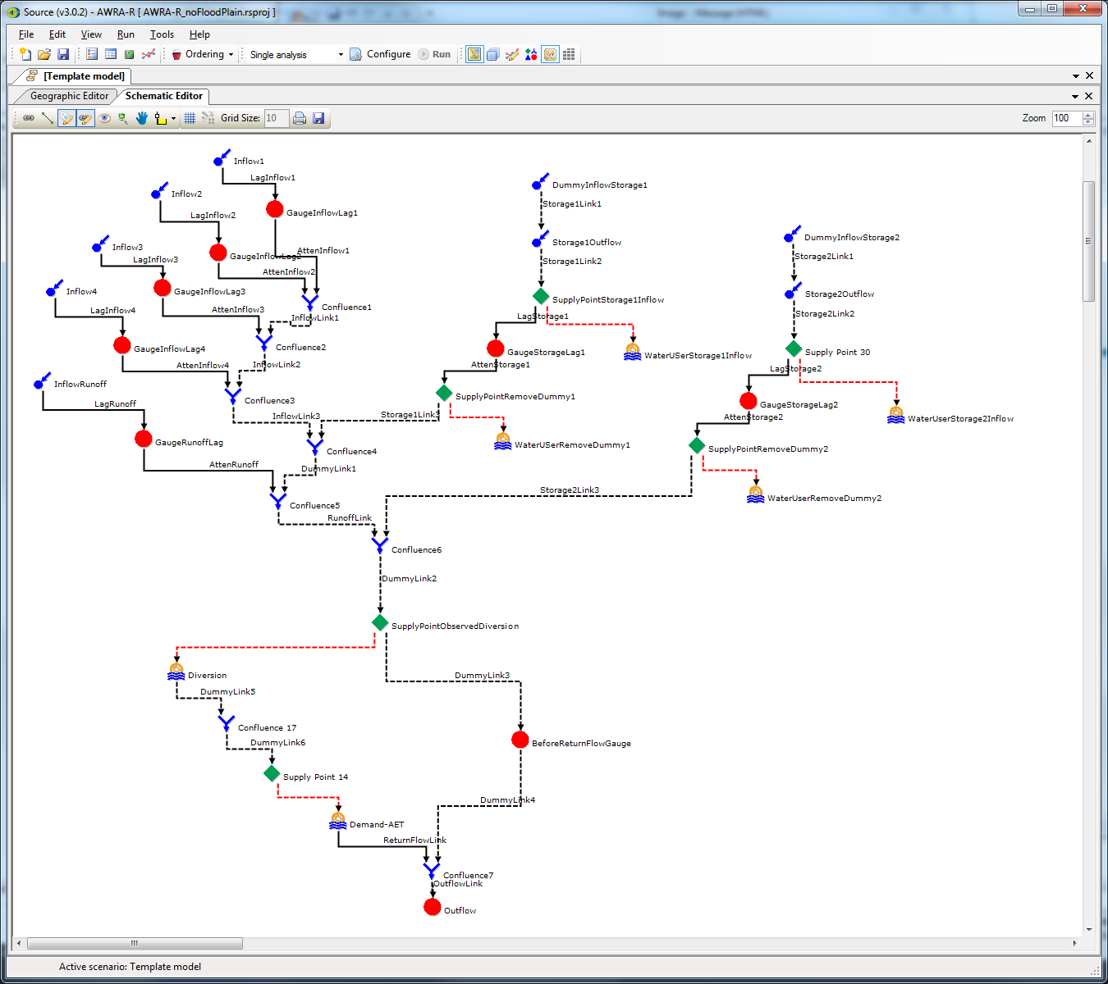
AWRA system Components
AWRA-R for river modelling
A river reach model representing inflows, storage, groundwater, exchanges, extractions and routing.
Each reach is represented by a template model

Slide 15
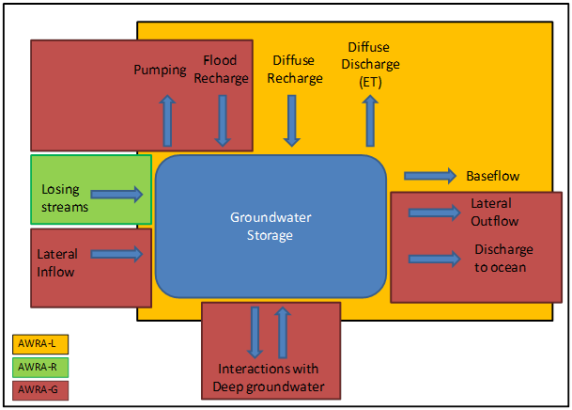
AWRA system Components
AWRA-G for groundwater interactions
Methods for better modelling groundwater in both AWRA-L and AWRA-R

Slide 16
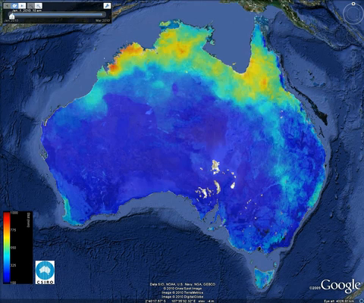
AWRA Outputs
Water storage over time in major hydrologic components
Long and shorter term trends
Large scale global water accounts
THREDDS Data Catalogue

Slide 17
Future, beyond WIRADA
Global water monitoring AWRA-L as a starting point
Hydrologic services using WPS
Major challenges;
Access to in situ water data
Scale versus computational load
Extensions to WPS?

Slide 18
WIRADA: What’s next?
One year left
Focus on transition to operations of research
No new work. Complete what we’ve done
WIRADA 2?
Yes ☺ but limited (if any) informatics ☹

Slide 19
National Plan for Environmental Information
National Environmental Information Infrastructure
Barely funded program to ‘do for all environmental information what has been done for water’
Will be built on using a Linked Data\SDI approach
Bioregional Assessments
Driven by expanding Coal Seam Gas industry
Tracking provenance vital

Slide 20
Thank you
Land and Water/Environmental Information Systems
David Lemon Research Stream Leader: Water Informatics
t +61 2 2646 5724
e David.Lemon@csiro.au
w www.csiro.au/clw
Water for a Healthy Country Flagship

