Slide 1
Texas Drought Assessment and Forecasting
David R. Maidment Center for Research in Water Resources University of Texas at Austin
Water Web Services Jamboree University of Texas at Austin
20 March 2012

Slide 2
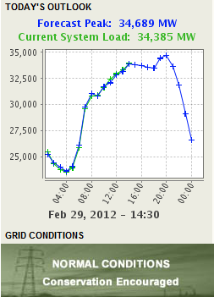
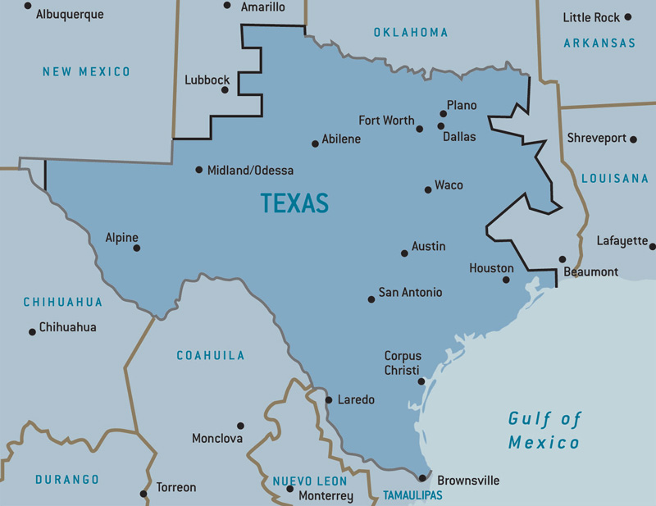
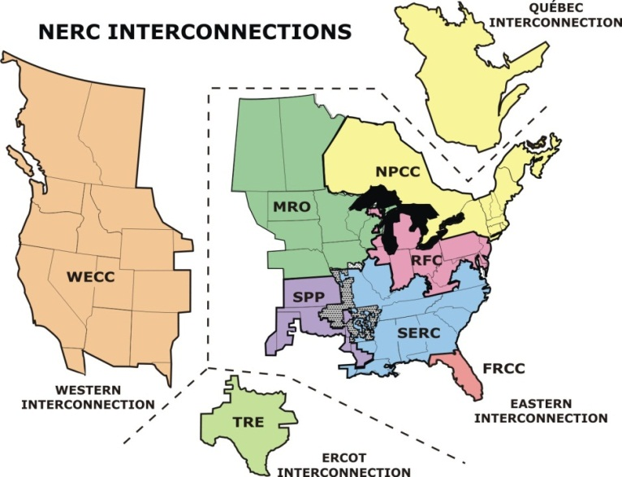
Electric Reliability Council of Texas (ERCOT)
http://www.ercot.com/news/mediakit/maps/

Slide 3
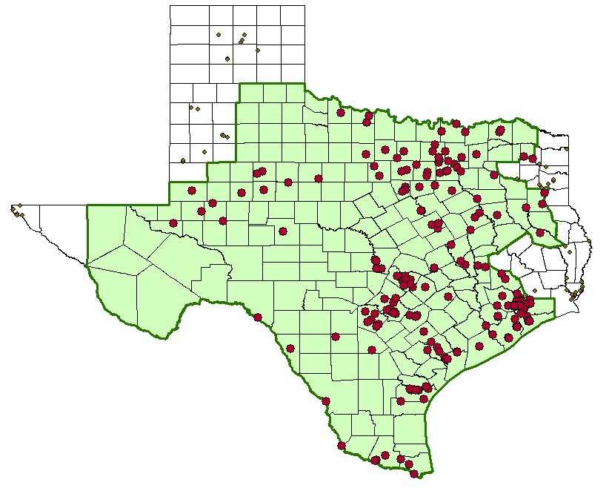
ERCOT Counties and Power Plants

Slide 4
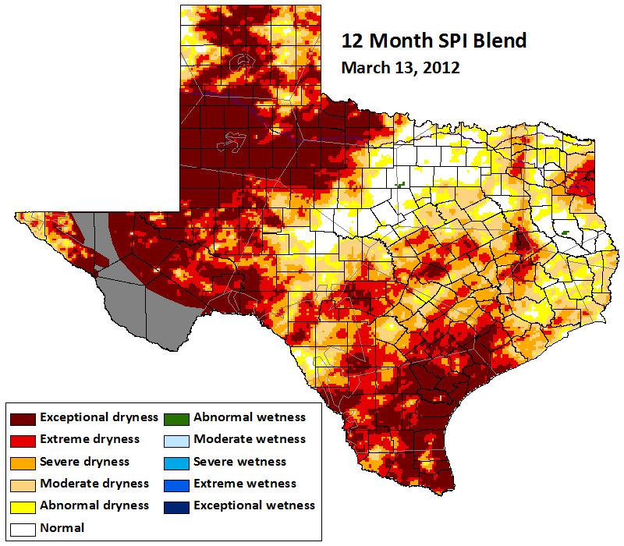
Standardized Precipitation Index (SPI)
Source: John Neilsen-Gammon, Texas A&M University

Slide 5
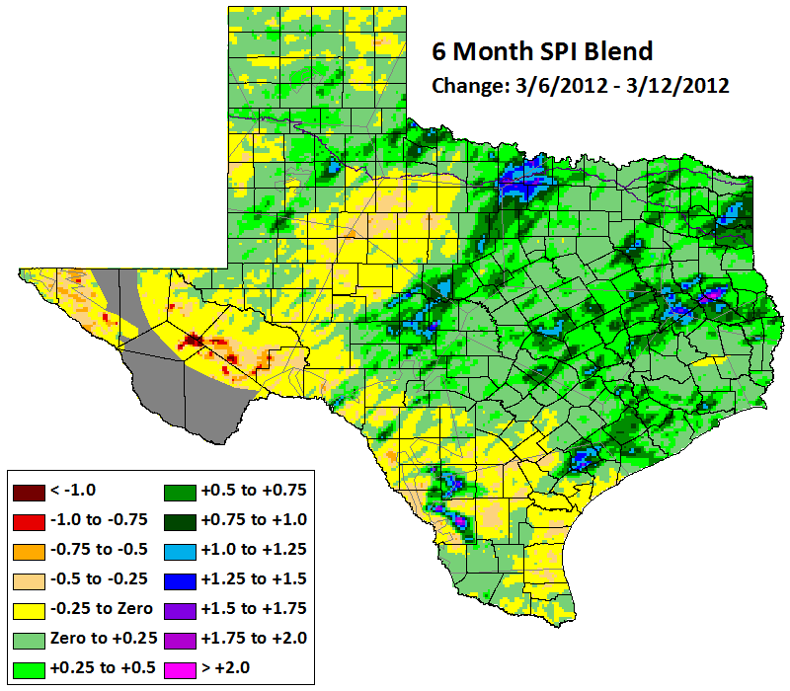
Weekly Change in SPI
Source: John Neilsen-Gammon, Texas A&M University

Slide 6
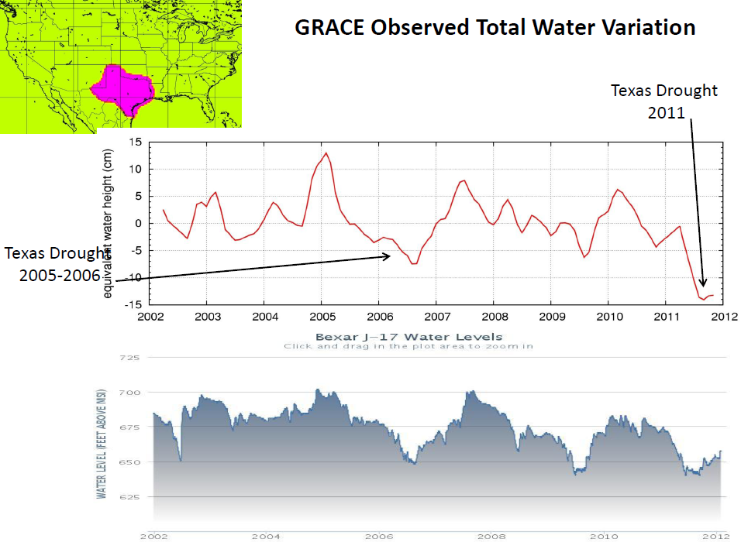
(Byron Tapley, UT Center for Space Research)
Source:
http://www.jsg.utexas.edu/ciess/files/Water_Forum_01_Tapley.pdf

Slide 7
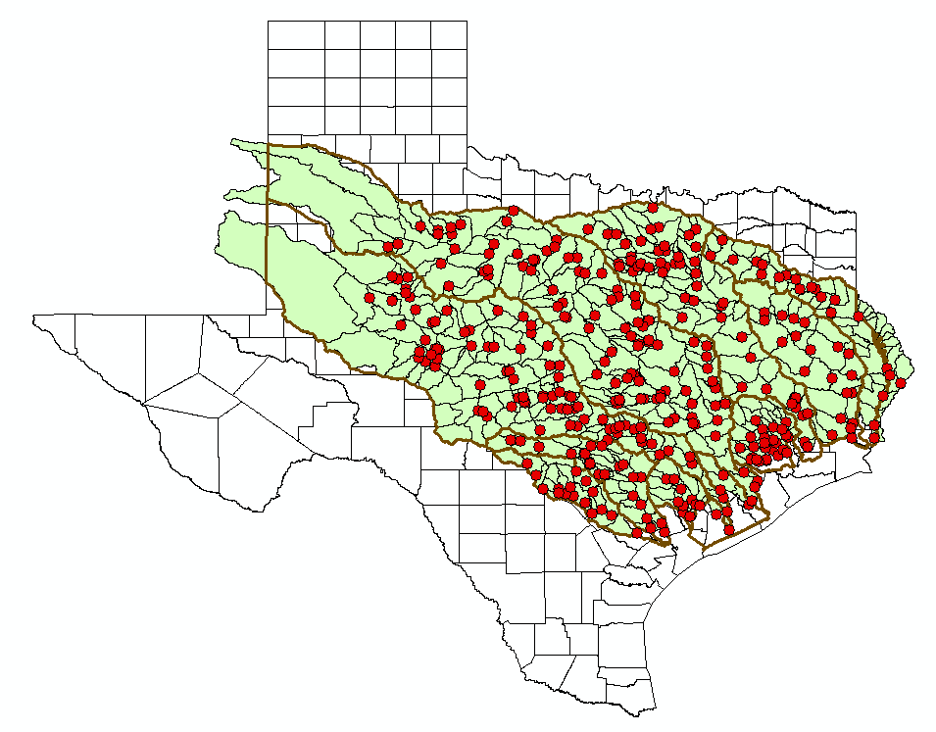
Ensemble Streamflow Simulations for 2012 Produced by National Weather Service, distributed by University of Texas at Austin and Kisters
348 forecast points
Including reservoir inflows
11 basins
Based on weather 1959-2009
50 scenarios of daily flows for each point generated from an NWS rainfall-runoff model (with reservoirs included)
90+ days horizon from today (to end of summer)
Updated weekly
Basins
Brazos
Brazos-Colorado
Colorado
Colorado-Lavaca
Guadalupe
Lavaca
Neches
Sabine
San Antonio
San Jacinto
Trinity

Slide 8
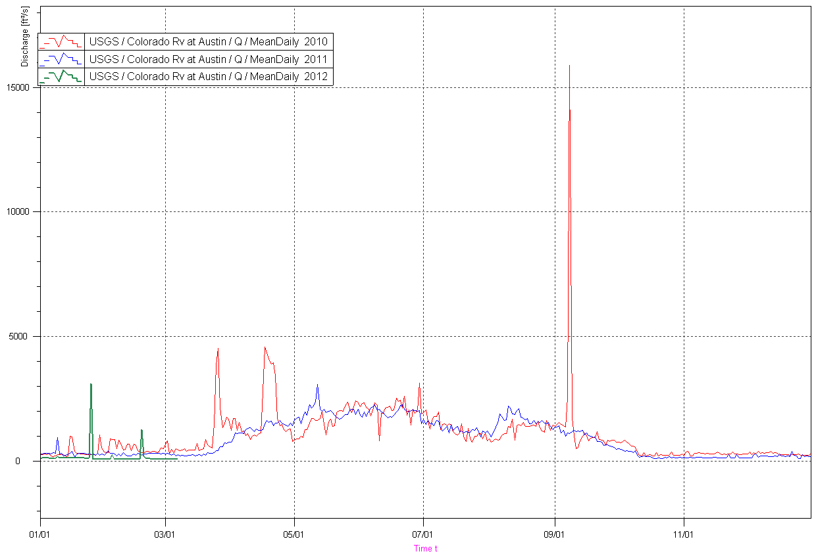
Overlay Plot of 2010, 2011, 2012 for Jan to December
Colorado River at Austin
Jan
July
Dec

Slide 9
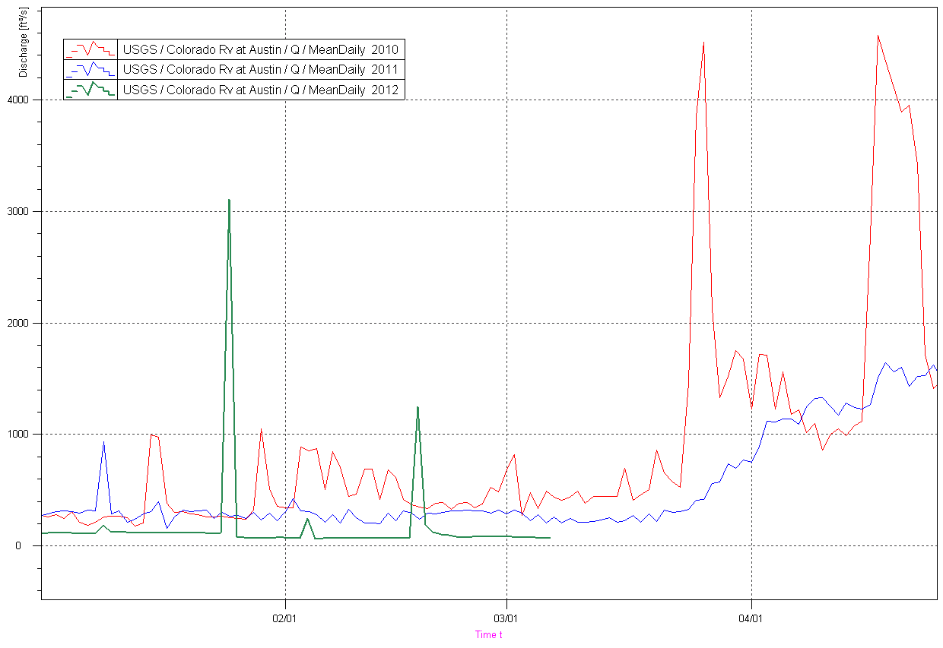
Overlay Plot of 2010, 2011, 2012 for Jan to May
Colorado River at Austin
Jan
March
May

Slide 10
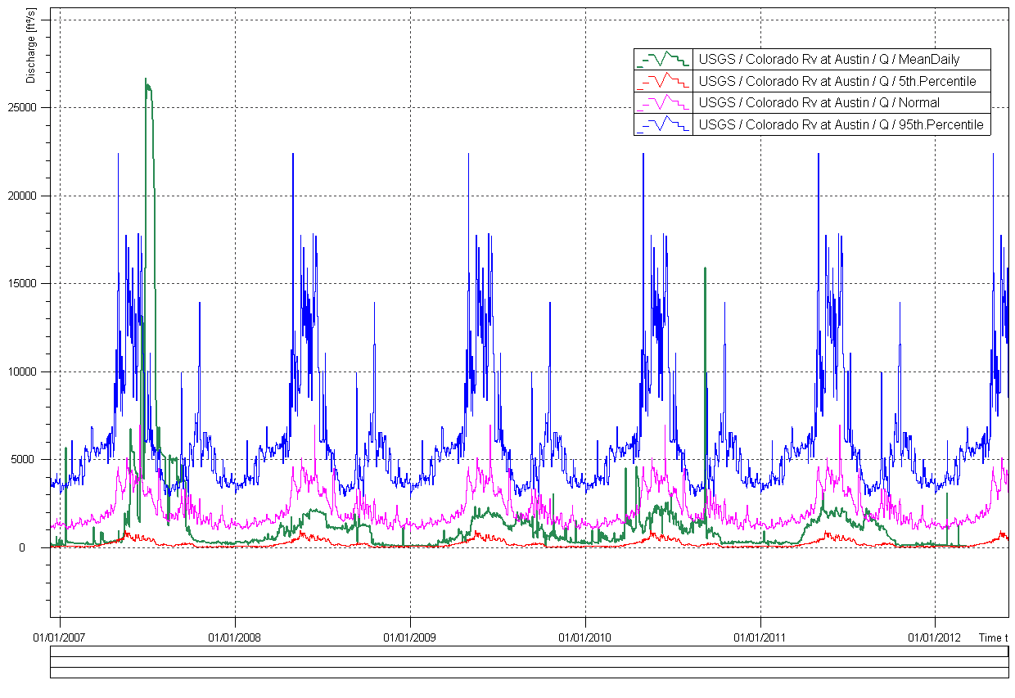
5%, 95%, Normal, and Observed Discharge, 2007 – 2012
Colorado River at Austin

Slide 11
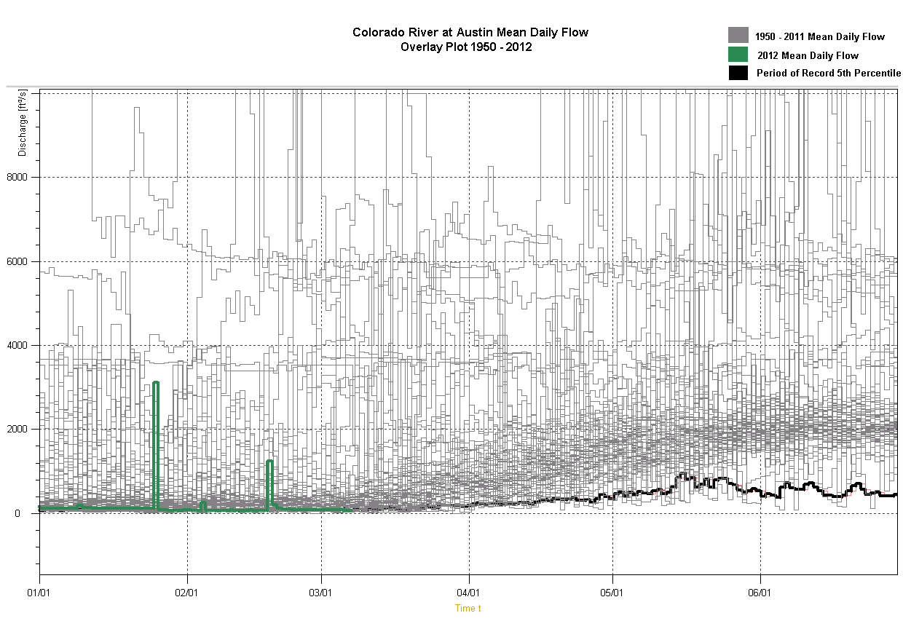

Slide 12
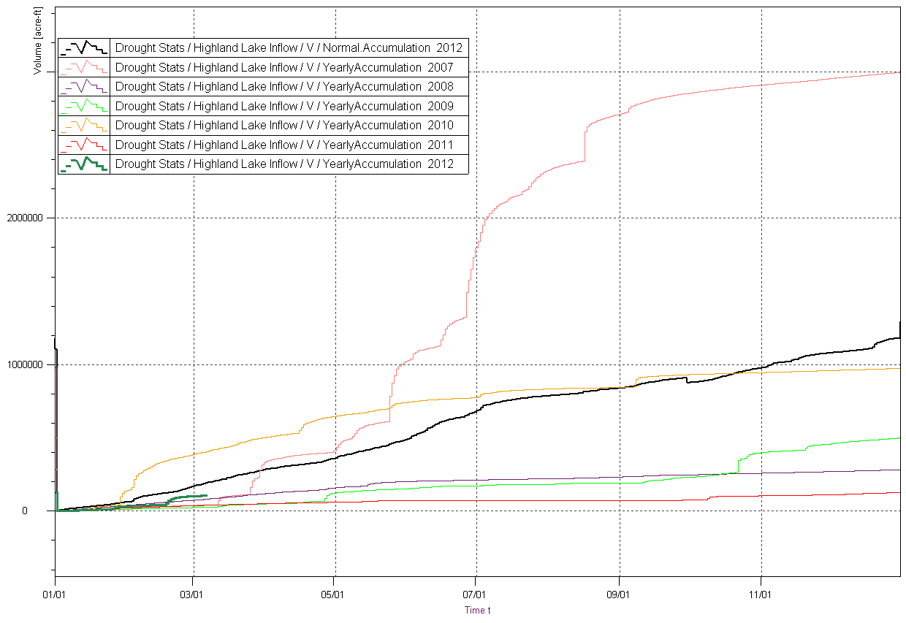
Accumulated Inflow, 2007 – 2012 Highland Lake System
Notes:
Matt Ables of Kisters says: The inflow volume is Llano at Llano, Colorado at San Saba, Sandy at Kingsland, and Ped at JC all with general basin factors applied. I then converted to AcFt and totalized on a yearly basis. This really lets you see the shortfall in the lakes. I added the 30 Year Normal lake inflow accumulation plot for reference. I am not sure how out of date my basin factors are... these are just what I remember from 2008, but you can see the general trend.

Slide 13
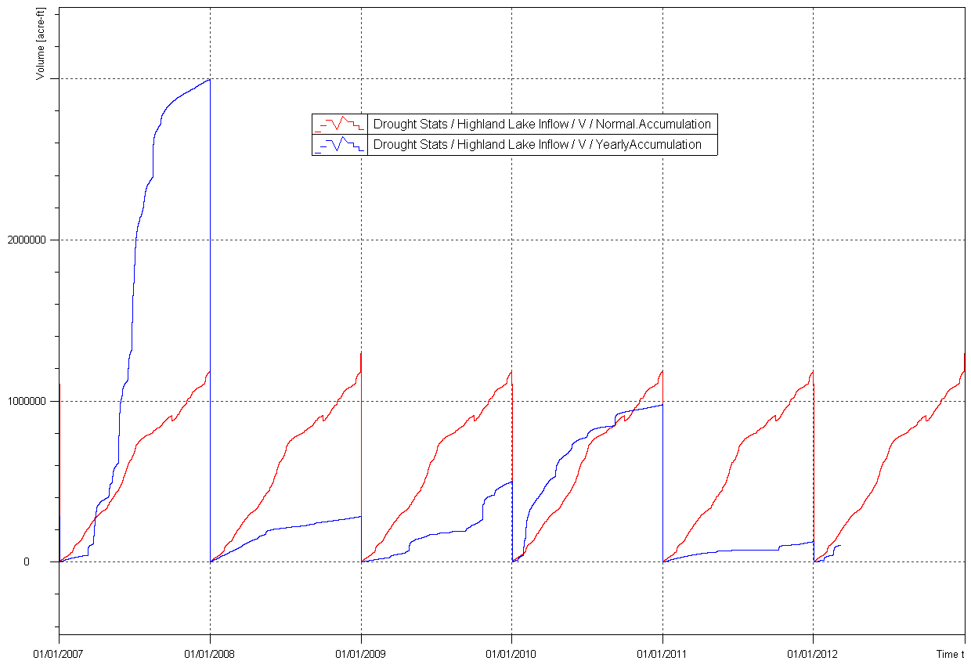
Accumulated Inflow, 2007 – 2012 Highland Lake System
30 year normal lake accumulation
actual lake accumulation

