Slide 1


Dharhas Pothina

Slide 2

Surface Water Resources Division
To aid water resources planning and management efforts by providing scientific and engineering expertise to ensure continued availability of water supplies and maintenance of the ecological health of Texas inland aquatic and coastal systems.
Data Consumer & Data Provider

Slide 3
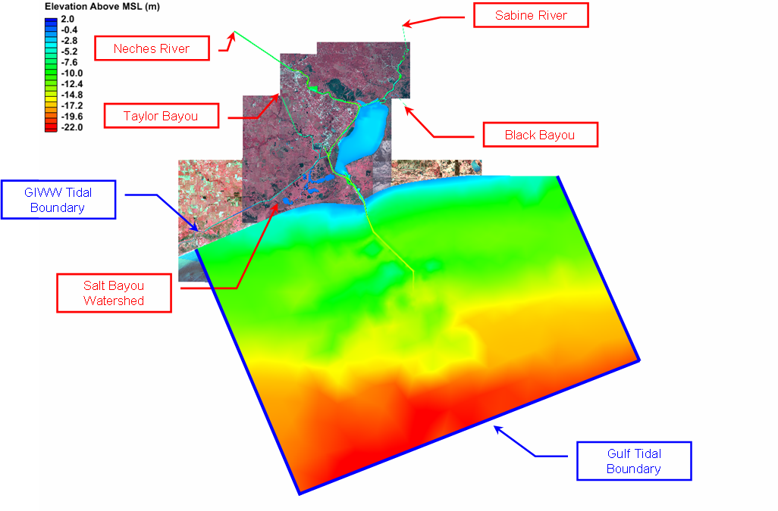
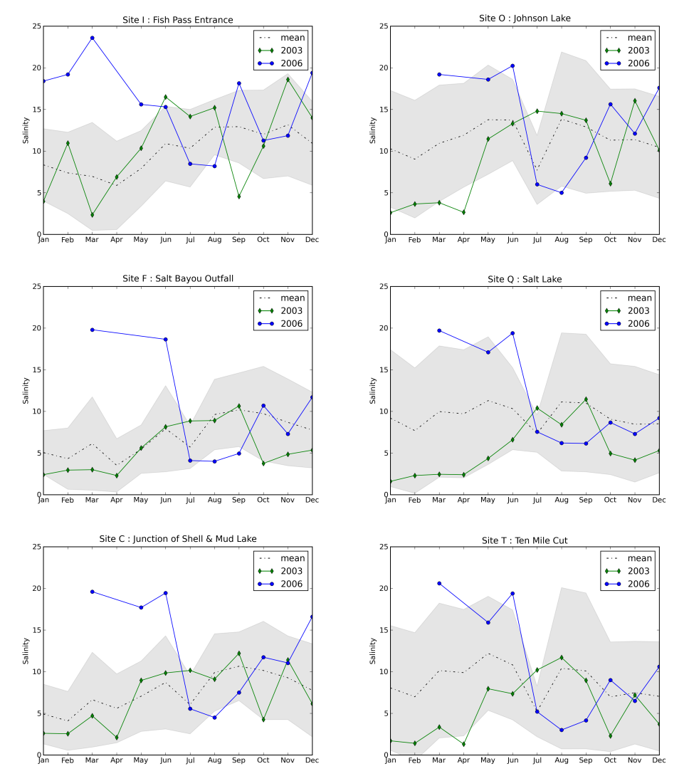
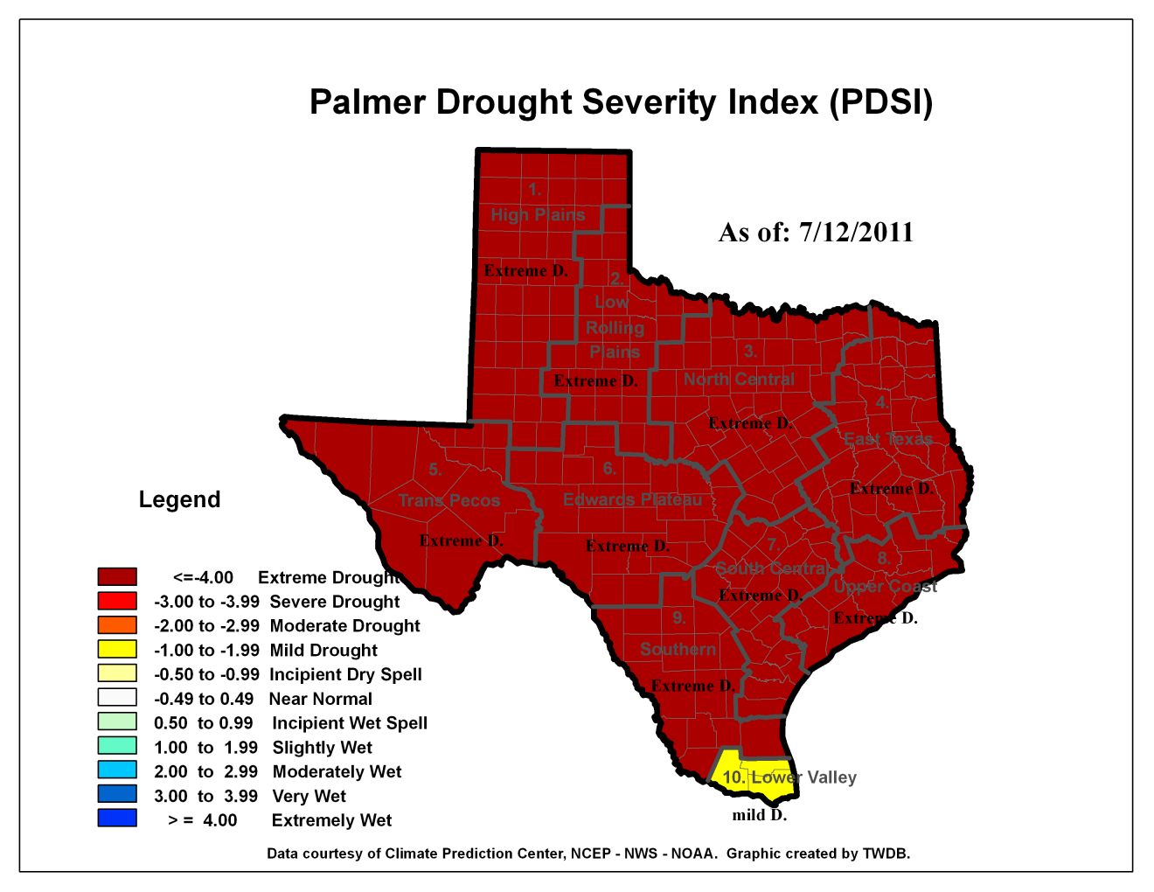
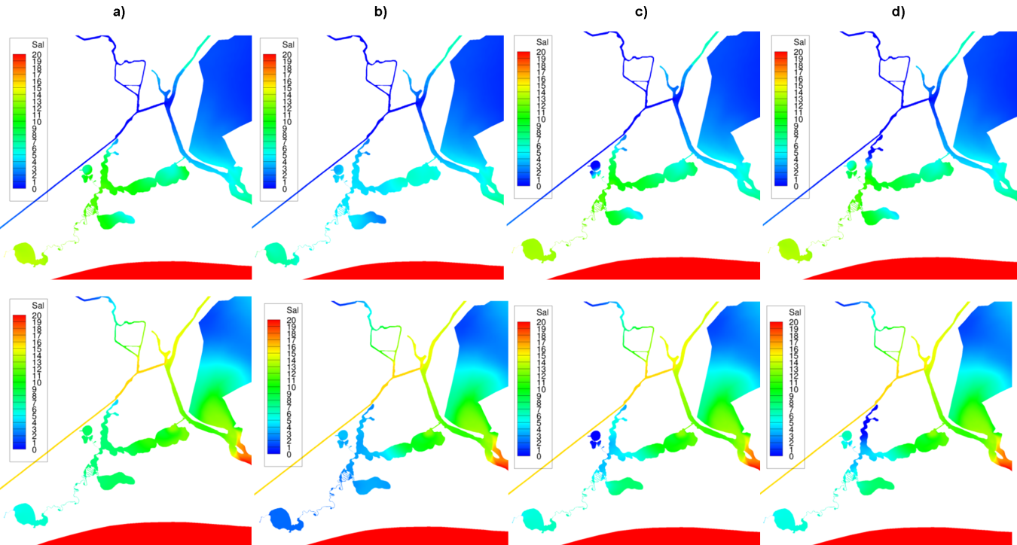
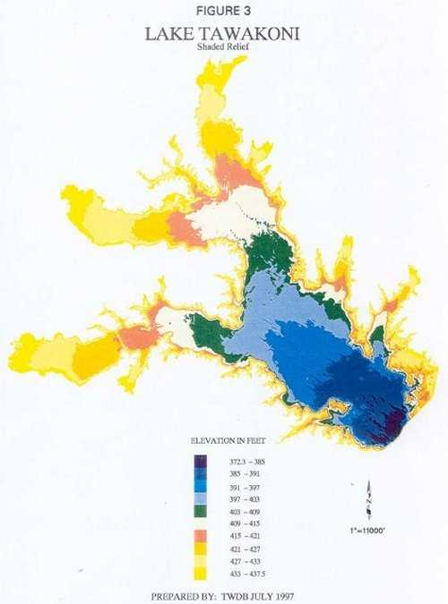

Slide 4
how did we get involved? – data!
Q. How can I get all the salinity data for Galveston Bay?
A. Not easily or quickly.
Data Providers:
TWDB
USGS
NOAA
TPWD
CBI/TCOON
TCEQ
Texas DSHS
University Research Groups
River Authorities
Environmental Consulting Companies
Discoverability
Access
Formats

Slide 5
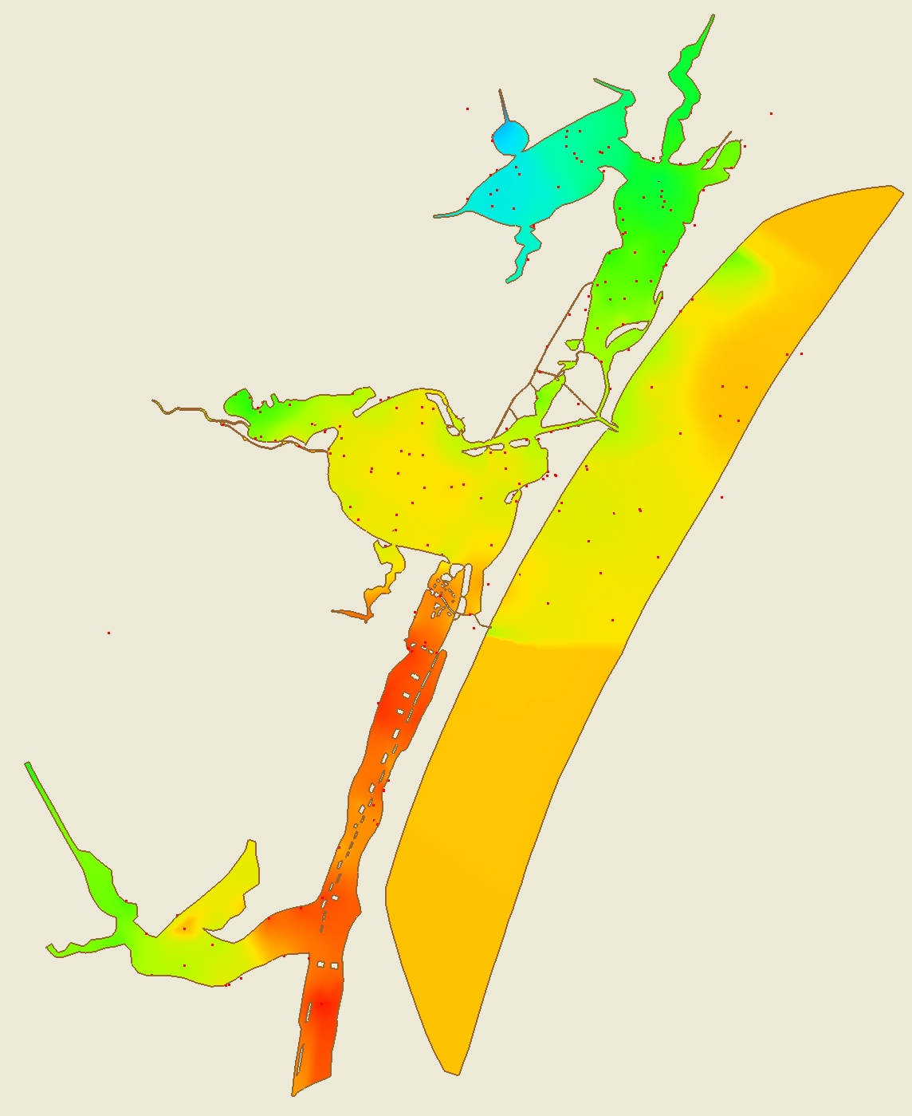
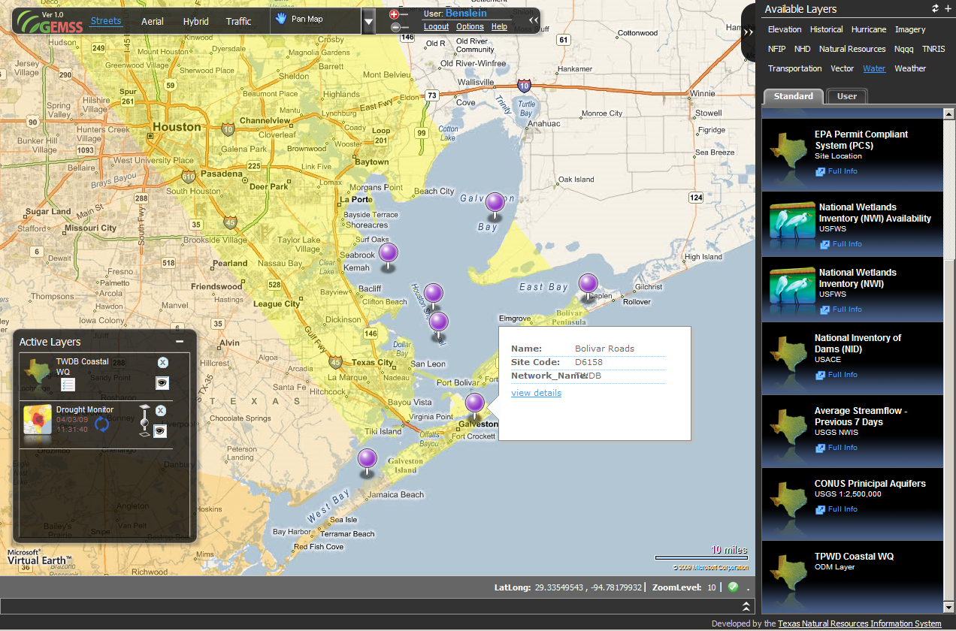
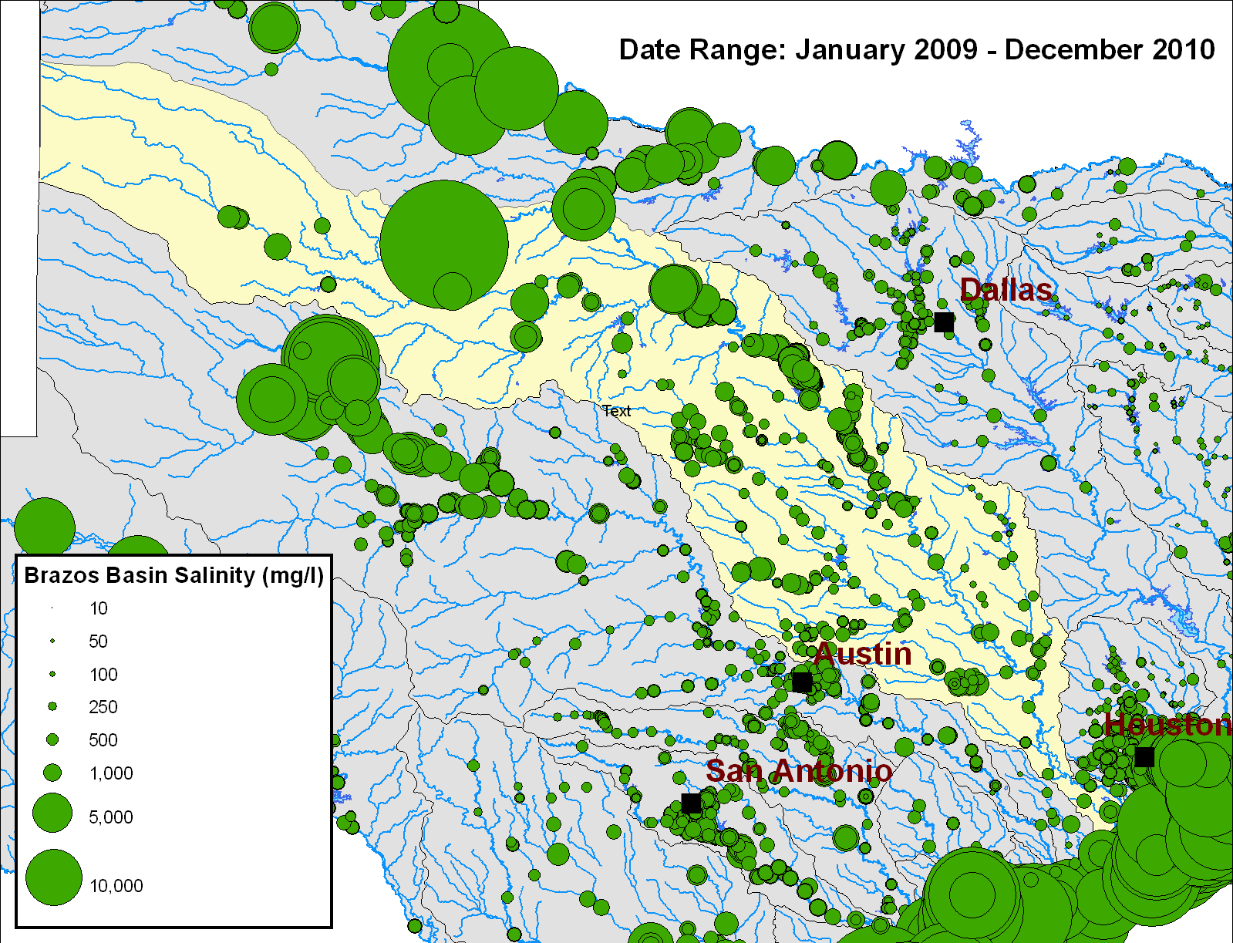
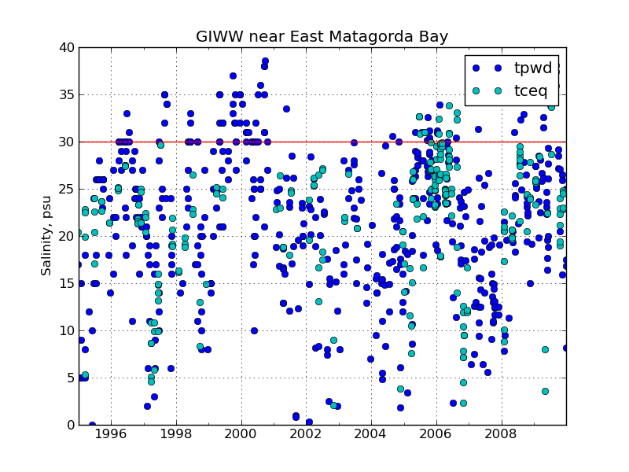
What have we done?
Partnered with UT to build open source cross platform tools
Used these tools to serve data from three other Texas agencies
TCEQ (Webscraping)
TPWD (twice a year email data dump)
CBI/TCOON (On the fly WOF-SOS reflection service)
Modernizing TWDB statewide Lake/Drought Data Hub
Used data services in production analyses

Slide 6
WOFpy
S
O
A
P
WOFpy
Your data
DAO
data
objects
wof
WaterML
R
E
S
T
The Data Access Object (DAO) links WOF to your data

Slide 7

PyHIS
HIS
We may need a better logo
HIS
PyHIS - A cross-platform Python toolkit to access HIS data
Can access CUAHSI HIS services as well as USGS NWIS REST Services
PyHIS uses Python to implement a medium-level access to HIS data
Low enough to build flexible workflows and scripts
and for use as a back end in larger applications
High enough to not have to know anything about:
Web Services/SOAP/XML/WOF/WaterML/@#!%$&
think of a Matlab or R type interface

Slide 8
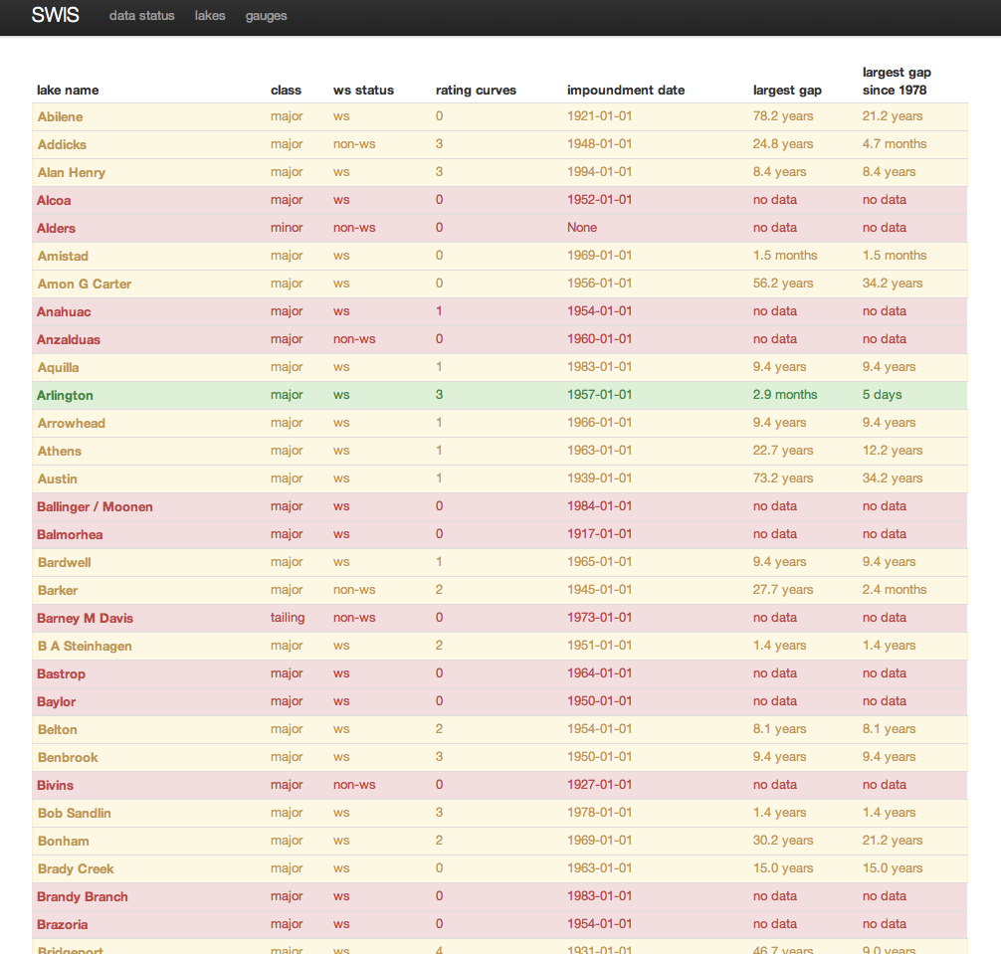
Lake and Drought Data Hub
Data from : TWDB, USGS, USACE, USBR, IBWC, LCRA, NCDC, TAMU, DRI
Pulling in offline historical data
Assembling ‘best available’ time series from date of reservoir impoundment
Compiling aggregate measurements (i.e. statewide percent full etc)
Data will be re-served as web services.

Slide 9
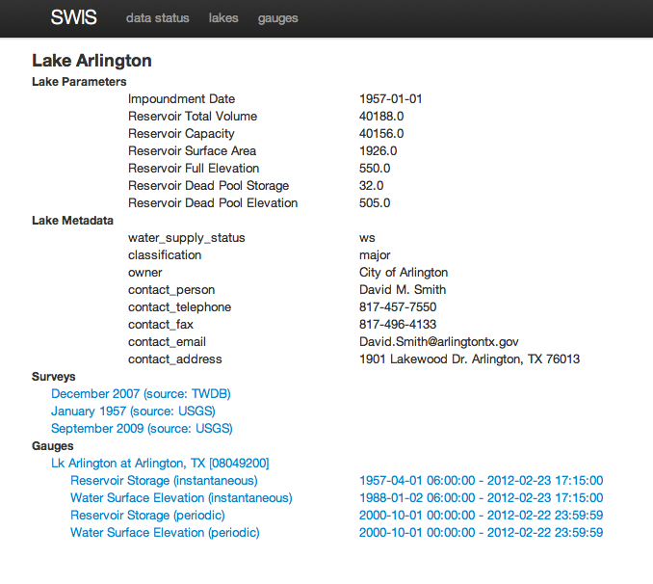
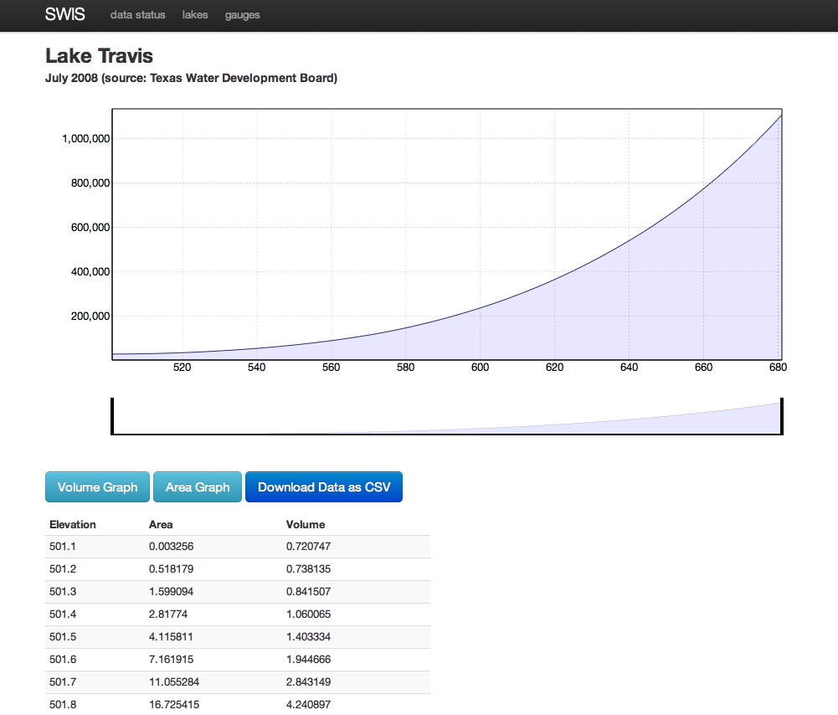
Data Objectives
data should have clear audit trails back to source
All changes to data must be tracked
Flexible enough to deal with changes over time in gauging locations and data providers and with multiple types of sources (csv, web services, pdf etc)
Aggregate datasets (i.e. statewide totals) should have clear trail back to components.

Slide 10
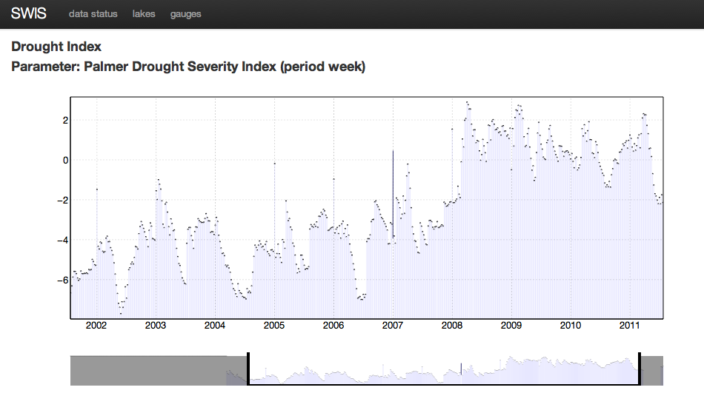
Drought Indices

Slide 11
observations
Data providers lack resources and expertise
Data providers already have their data in the format they need for the purpose the data was collected
Branding is important
sharing data needs to be as easy as possible.
Simple flexible tools are required for both sharing and access.
Pet peeve. Daylight Savings Time.

