Slide 1




World Water Online
WWO
A Distributed Global Water Information System
Presented by: Fernando R. Salas and David R. Maidment
Center for Research in Water Resources, University of Texas at Austin
Water Web Services Jamboree
March 20th, 2012

Slide 2
Water Problems to be Solved
Flooding – too much water
Dirty Water – water quality
Droughts – not enough water
Environmental Issues – aquatic life
Water Distribution – basic services

Slide 3
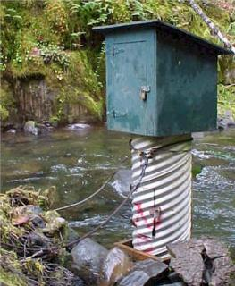
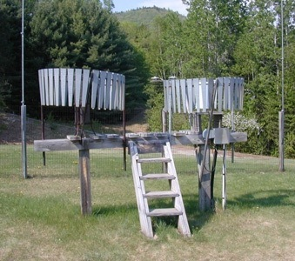
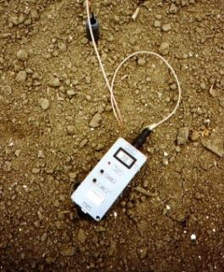
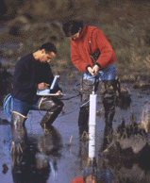
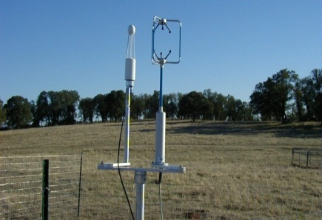
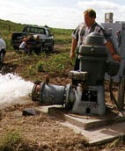
We Collect Lots of Observations Data in Hydrology
Water Quantity
Rainfall
Soil Water
Water Quality
Meteorology
Groundwater

Slide 4
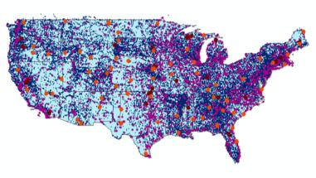

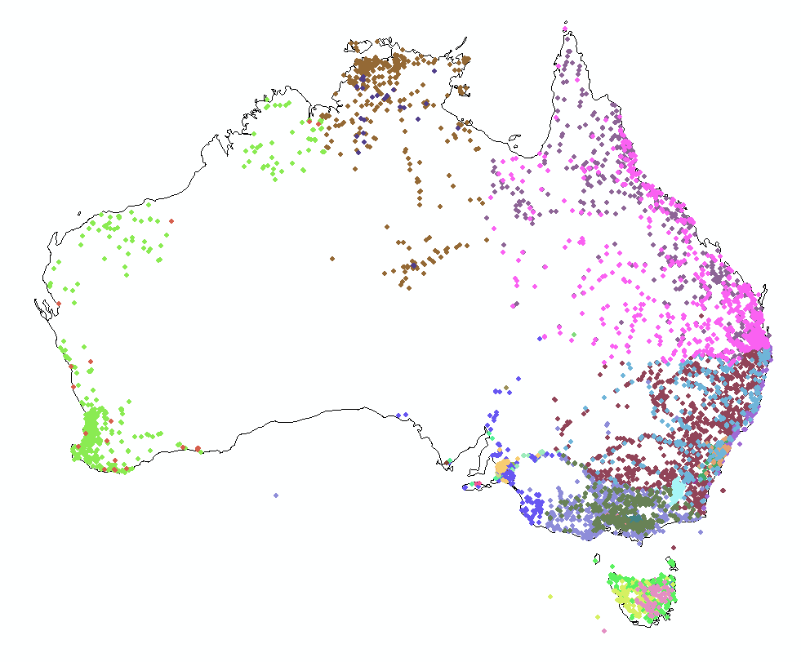
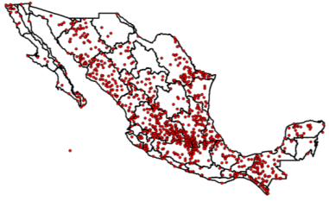
Every Country Collects These Data
United States
Australia
Mexico
We Lack a Global Water Information System!

Slide 5


How the Web Works
Catalog
Browser
Web Server
HTML – web language for text and pictures
Harvesting
Search
Access

Slide 6

How We Share Observations Data
World Water Online
Catalog
User
Server
WaterML Language
Harvesting
Search
Web Services
Access
Data Servers
Applications

Slide 7
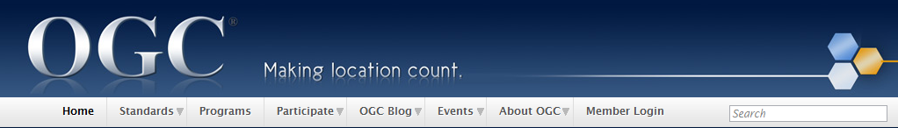
International Standards for Web Services
The Open Geospatial Consortium (OGC) develops interoperable solutions for sharing geospatial information via the “web”.
Hydrology Domain Working Group (HDWG) formed with World Meteorological Organization (WMO) to develop hydrology standards.
Catalog Services for the Web (CSW)
Web Feature Services (WFS)
Sensor Observations Services (SOS)
WaterML2 Encoding – Will become standard this year!
Web Coverage Services (WCS)

Slide 8

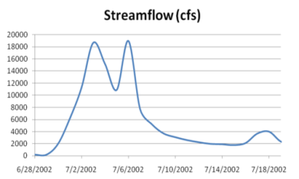
“Web Services Stack” for Time Series
OGC Catalog Service for the Web with standard metadata: ISO, Dublin Core, ..
Who? What?
Time Series Services
Catalog (CSW)
Metadata (WFS)
Where?
When?
Data (SOS)
Access Data

Slide 9


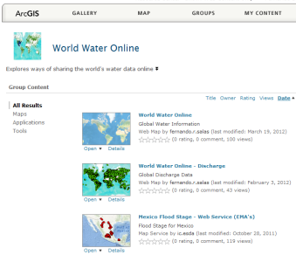
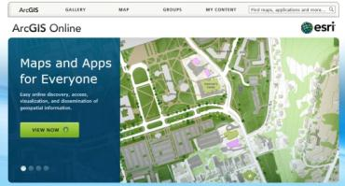
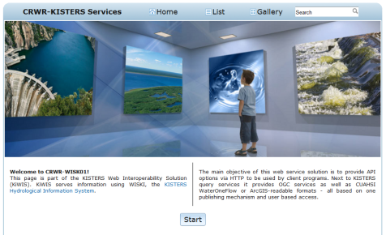
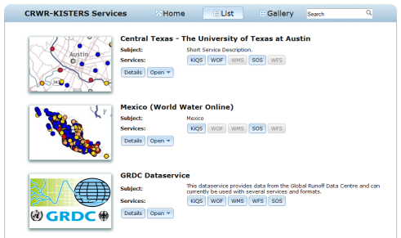
National Service Stacks
Catalog
Metadata
Data
USA
France
Australia
Mexico
World Water Online
Data, Maps, Services for the World!

Slide 10
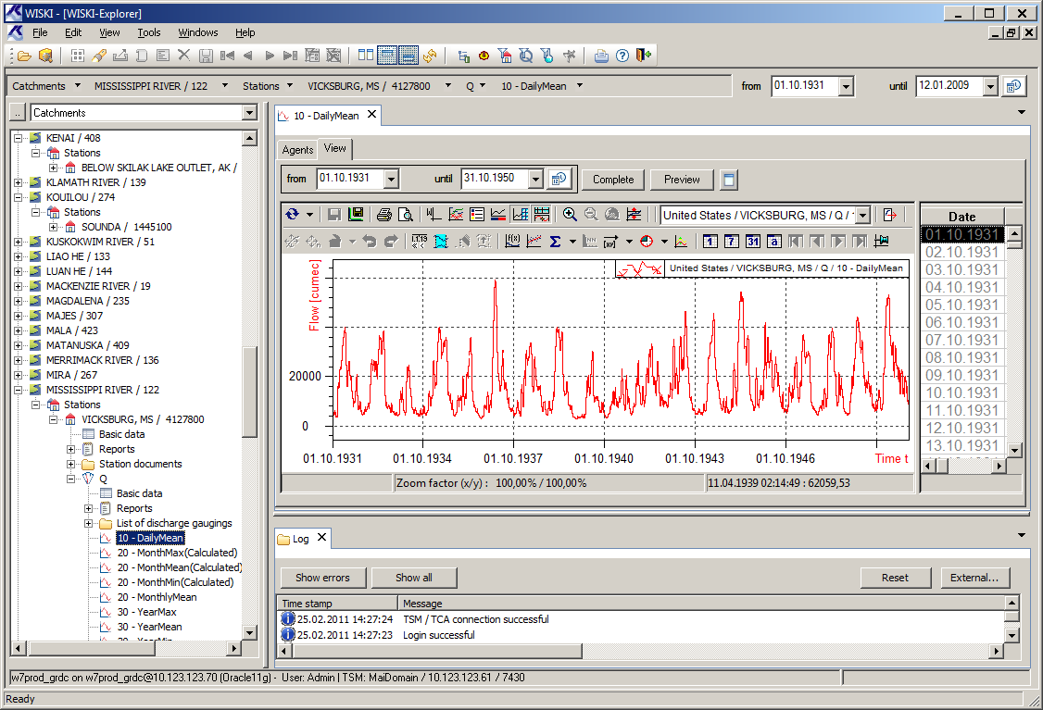
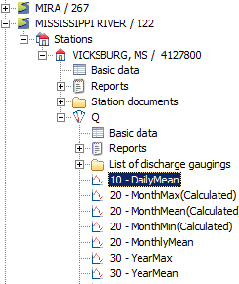
Water Information System Kisters (WISKI)
Database solution to managing observations data (i.e. time series)
Like a GIS but for WATER – data model operates on layers

Slide 11
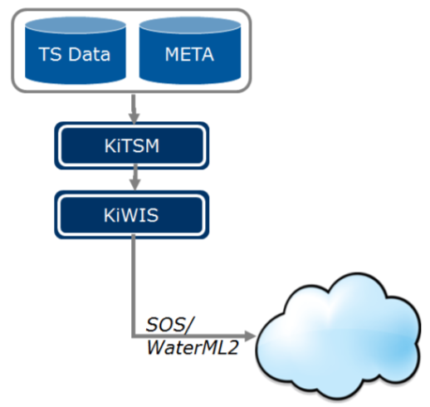
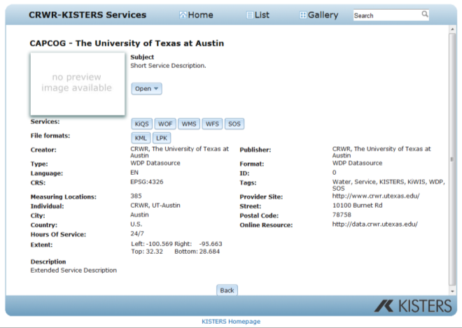
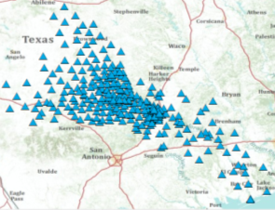


Kisters Web Interoperabilitiy Solution (KiWIS)
Web portal providing user access to observations data via a suite of web services
OGC Standards (SOS, WMS, WFS) → WaterML profile of SOS
WaterOneFlow (CUAHSI) and Kisters web services
ESRI Layer Package and Google Earth KML

Slide 12
World Water Online
Models
Flooding, Water Availability, Water Quality
World Water Online
Water
Observation Sites, Structures, Streamflow, Groundwater, Water Quality
Climate
Temperature, Evaporation, Precipitation, Soil Water, Solar Radiation
Geospatial
Elevation, River Networks, Watersheds, Land Cover, Land Use
Inspired by Rob Vertessy, CSIRO, Australia

Slide 13
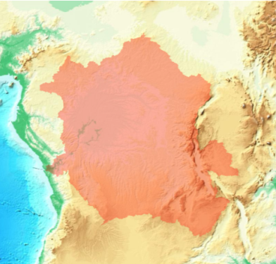
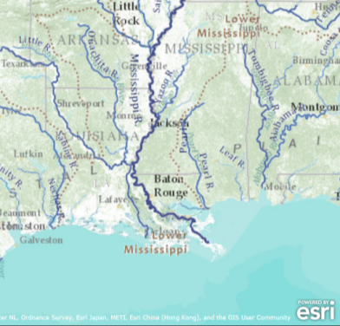
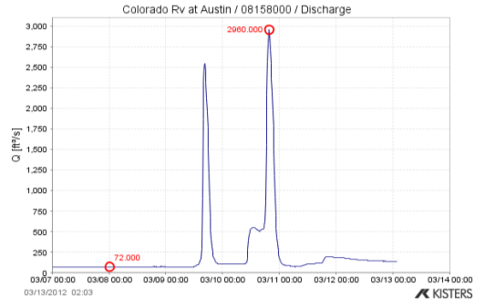
Linking Observations and GIS
Watershed Analysis
River Mapping
Observations

Slide 14
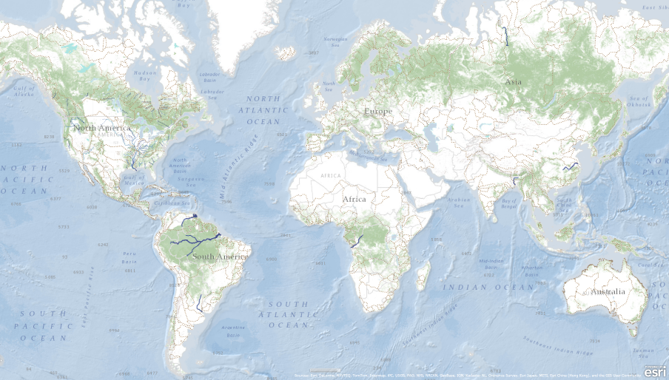
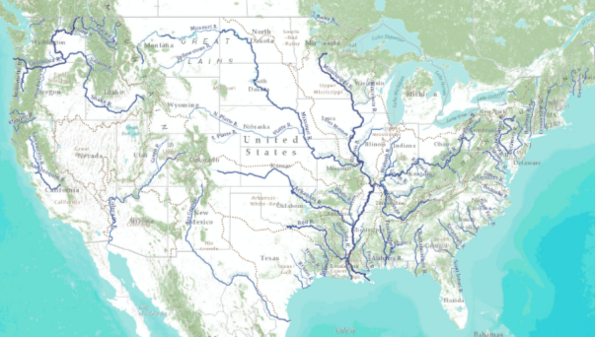
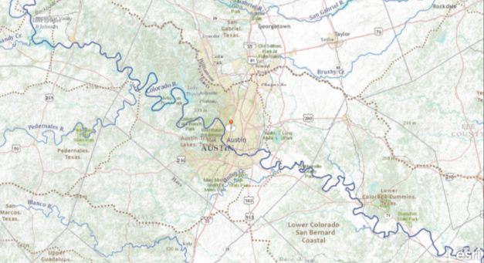
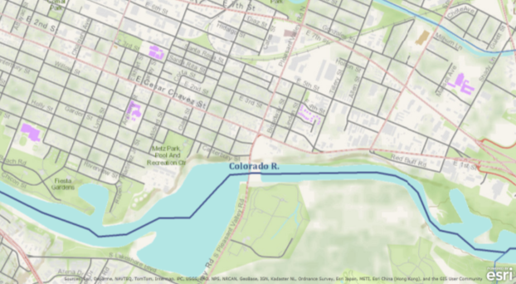
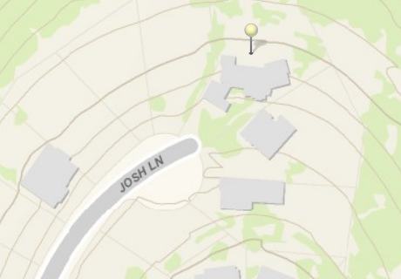
Providing Geospatial Context
World
National
Regional
City
Neighborhood

Slide 15
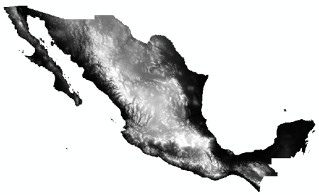
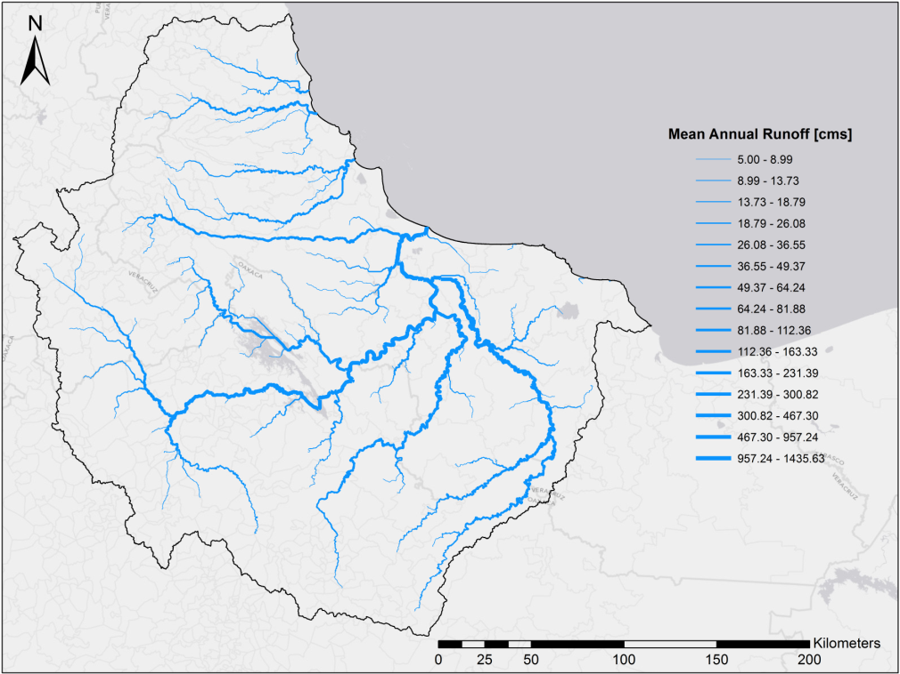
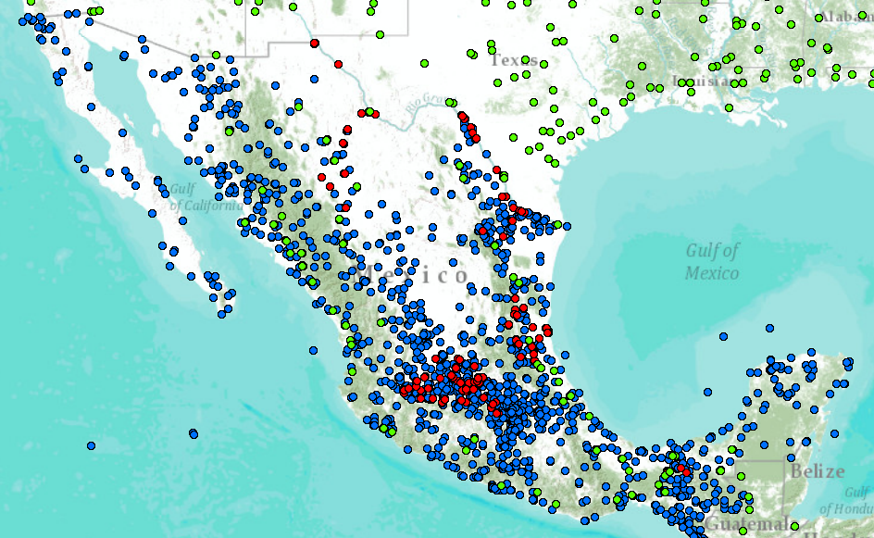
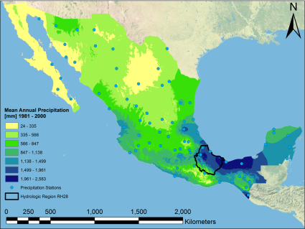
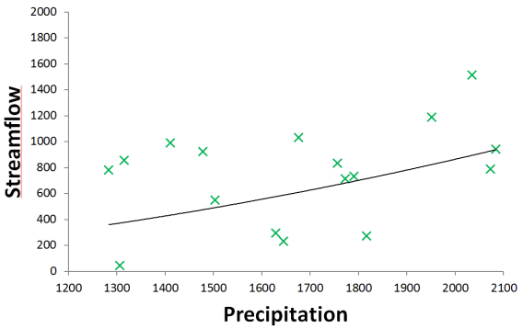
National Data Services
1
2
3
Source: Gonzalo Espinosa, CRWR

Slide 16
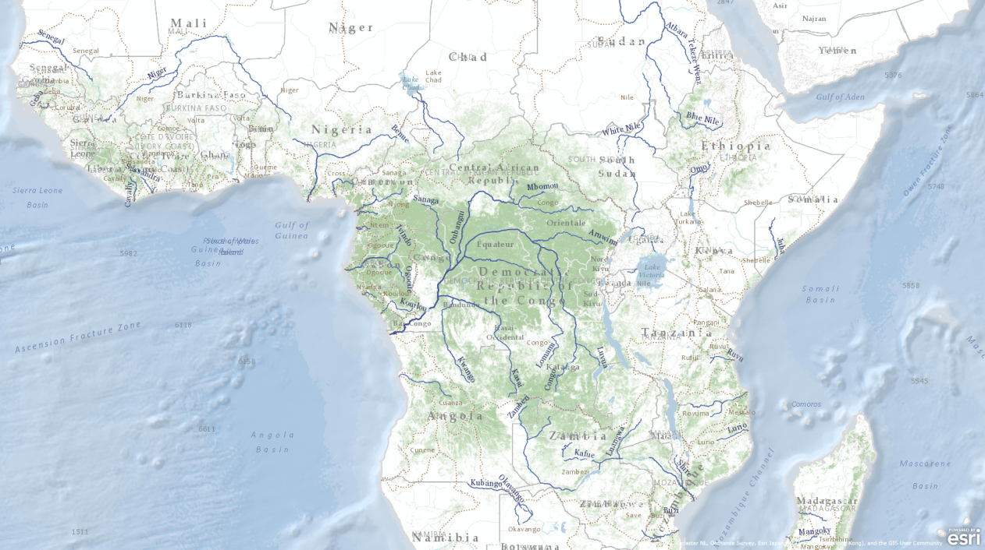
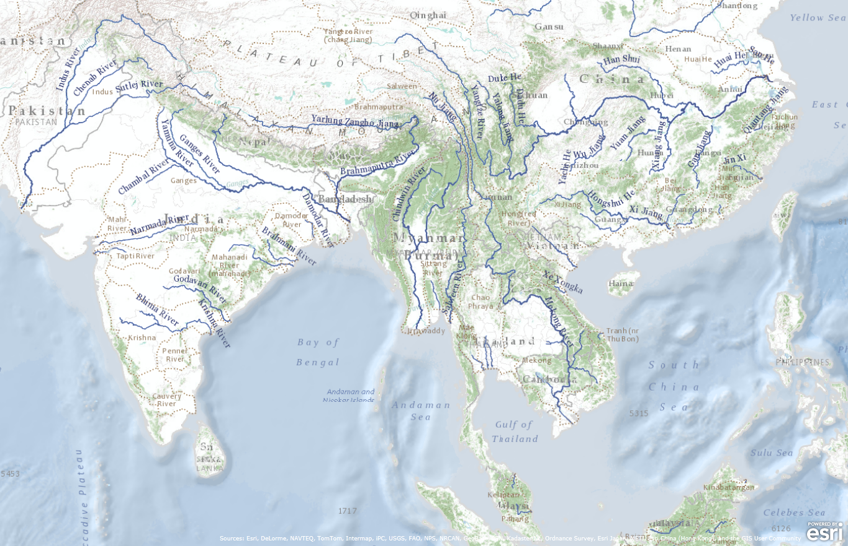
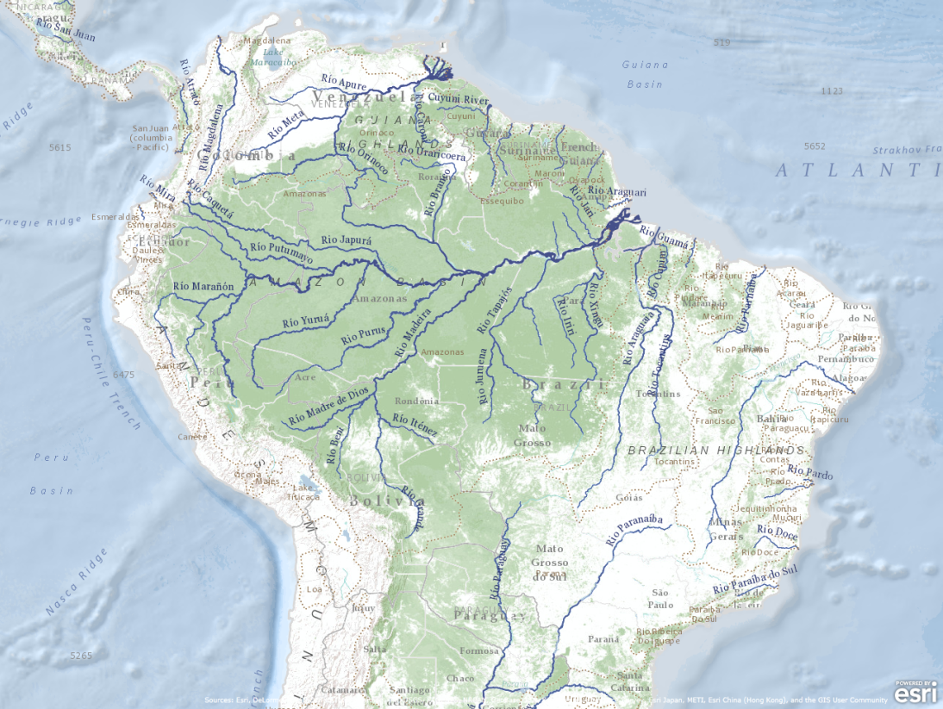
Global Streamflow Map

Slide 17
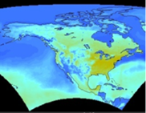

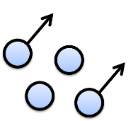
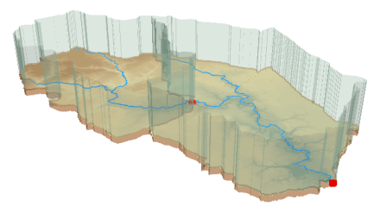
The Digital Divide
Observations and Time Series
Climate Observations and Grids
Geographic Information Systems (GIS)
Remote Sensing

Slide 18
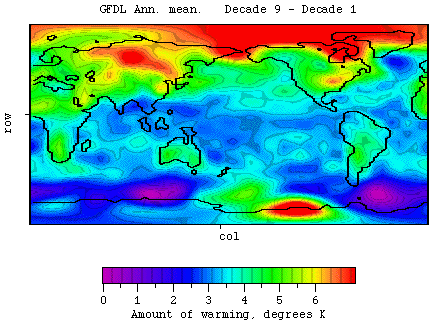
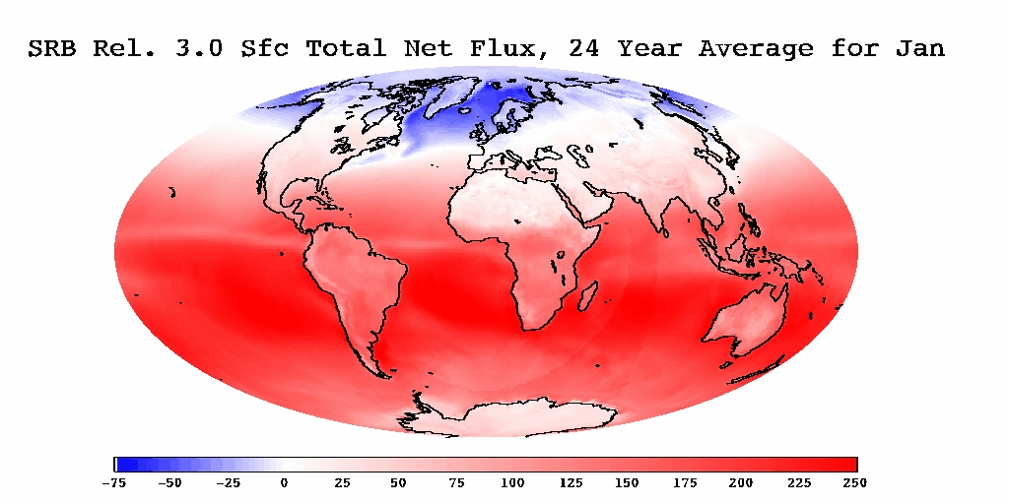
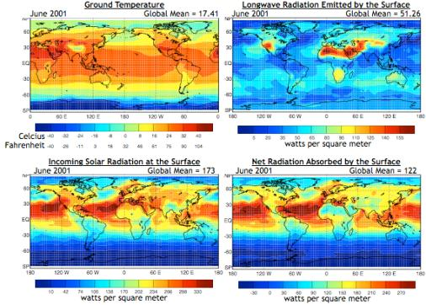
Climate Data
Many groups distribute climate data (national and global data)
Precipitation, Evaporation, Temperature etc.
Observations (i.e. GPCC), Remote Sensing, Models/Reanalysis (i.e. CFSR) and Predictions (i.e. IPCC)
Which products should be used within a global system?

Slide 19
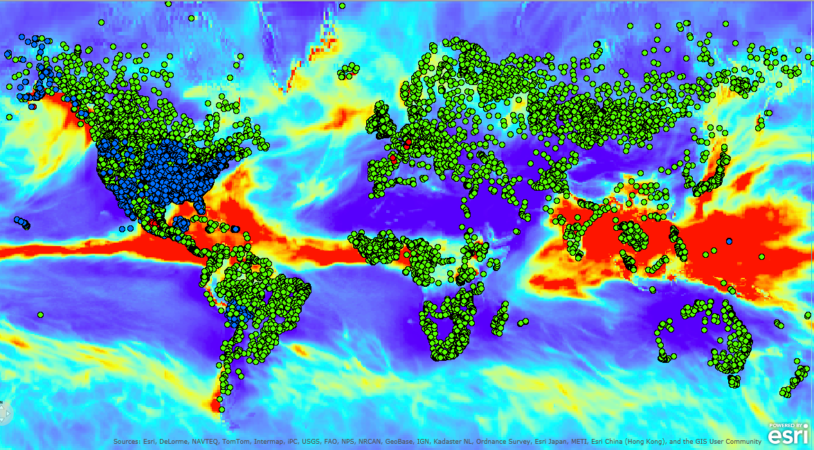
World Water Online
…facilitating the management and sharing of water data at the national level…

Slide 20
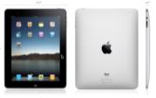

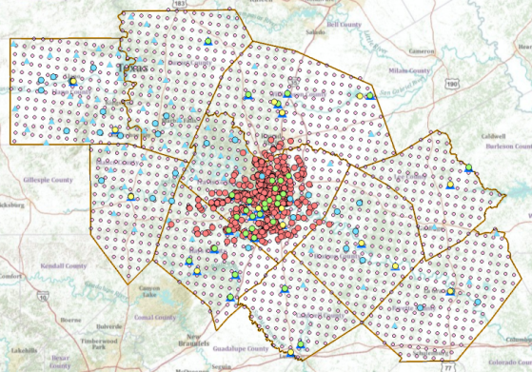








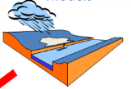
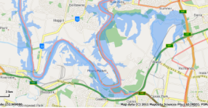
WATER WEB SERVICES HUB
Inputs
Outputs
Water Web Services HUB
Observation
Data
Services
(WaterML)
Observation
Data
Services
(WaterML)
USGS
LCRA
COA
H&H Data
Services
(WFS)
NWS
Mapping
Services
(WFS)
AHPS
Data
Services
(WFS)
Modeling
Services
Mapping
Services
(WFS)
Models
Maps

Slide 21
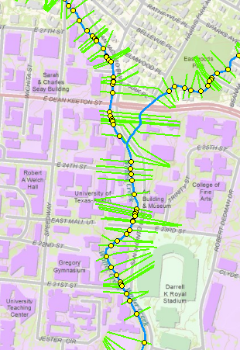
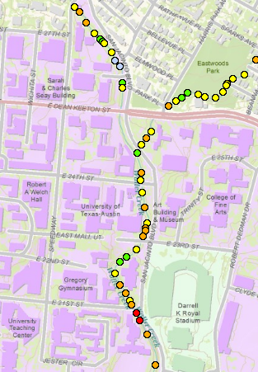
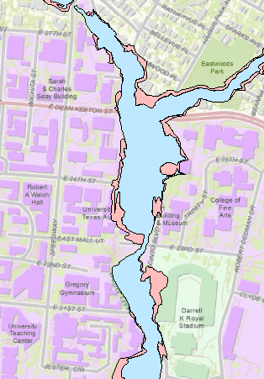
Modeling Services to Mapping Services
Virtual Gauge Network
Modeling Services
Mapping Services

Slide 22


Water Data via The Web

Slide 23

Hydrologic Observation Model
Courtesy of Irina Dornblut (GRDC)
and Rob Atkinson (CSIRO)

Slide 24

Common Hydrologic Feature Model
Courtesy of Irina Dornblut (GRDC)
and Rob Atkinson (CSIRO)

Slide 25
Linking Climate, Observations and GIS
Climate
SCALE
Watershed Analysis
River Mapping
Observations

Slide 26

GEOSS – Global Earth Observation System of Systems

Slide 27
Bringing it all Together
GEOSS
World Water Online
Agencies
Catalog of Systems
Catalog of Countries
Metadata
Catalog of Agencies within Country
Observation, Climate, Geospatial etc.
Data
Time Series, Coverages, Watersheds etc.

Slide 28

Thank You
Contact: David Maidment (maidment@mail.utexas.edu) and Fernando Salas (fernando.r.salas@utexas.edu)

