Slide 1

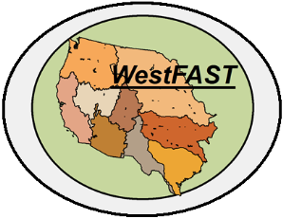
Water Use Data Exchange
Western States Water Council

Slide 2
What is the WSWC?
Affiliate of the Western Governors’ Association
Created in 1965 and consists of appointed representatives from 18 of the western states
Purposes include:
Promote effective cooperation among the western states on water management and water resources
Promote state prerogatives while accommodating federal interests
Provide a forum for the exchange of views/perspectives
Provide analysis of federal /state developments to assist member states in evaluating the potential impacts

Slide 3
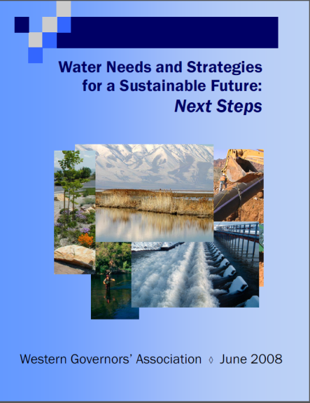
What is the WestFAST?
2008 Governors’ ‘Next Steps’ report suggested formation of a federal team to assist the coordination and implementation of the recommendations of the report
WestFAST is a collaboration of 11 Federal agencies with water management interests in the West
These 11 agencies fund a liaison position to work in the WSWC office

Slide 4






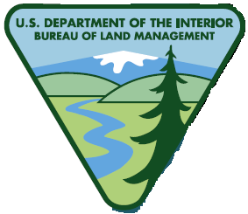



Who makes up WestFAST?
Senior-level staff from the following agencies:
Dept. of Energy
NASA
EPA
Forest Service
NRCS
NOAA
Army Corps of Engineers
Fish and Wildlife Service
BLM
USGS
Reclamation

Slide 5
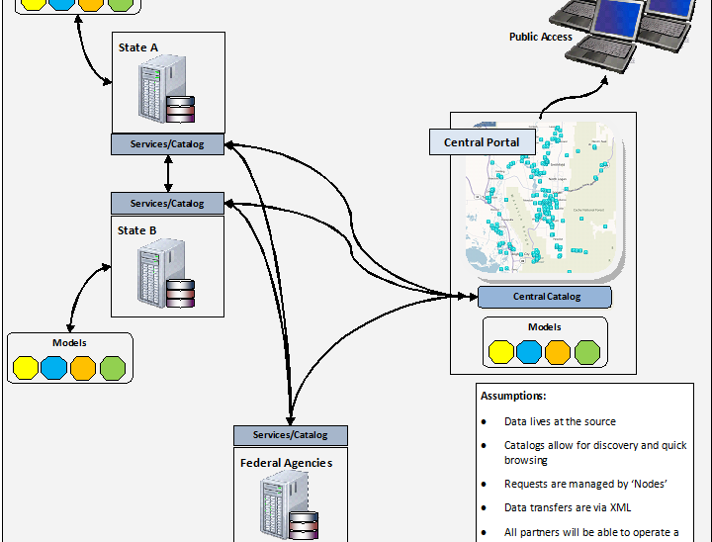
What is the Water Use Data Exchange?
The Water Use Data Exchange is a project that will focus on better enabling the western states to share water use, water allocation, and water planning data with one another and with the Federal Government. It will also seek to improve the sharing of Federal data that supports state water planning efforts.

Slide 6
Background
The Water Use Data Exchange is a collaborative effort between the WSWC and the Western States Federal Agency Support Team (WestFAST)
This project is in direct support of a study being conducted by the Sandia Labs, in cooperation with the Western Governors’ Association (WGA), to investigate water availability for potential energy generation.
The Project is being directed under the Water Information and Data Subcommittee within the WSWC
The subcommittee has established 4 workgroups to help guide the effort:
State Capabilities Assessment Workgroup
Methods Workgroup
Data Exchange Template Workgroup
Data Exchange Methodologies Workgroup

Slide 7
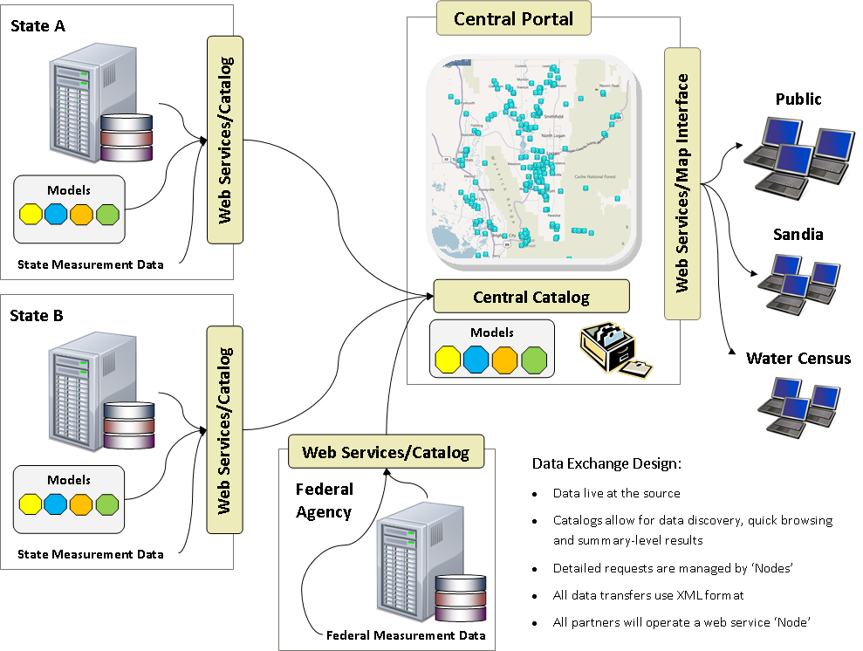

Slide 8
Goals
Gain a better understanding of the variability between state water planning programs.
Provide documentation for the various consumptive use and water availability estimation methods that the states currently use.
Develop a common ‘Schema’ or format that can be used for sharing these data.
Encourage the adoption of standard approaches for sharing ‘time-series’ data.
Assist ongoing efforts in gaining access to state data.

Slide 9
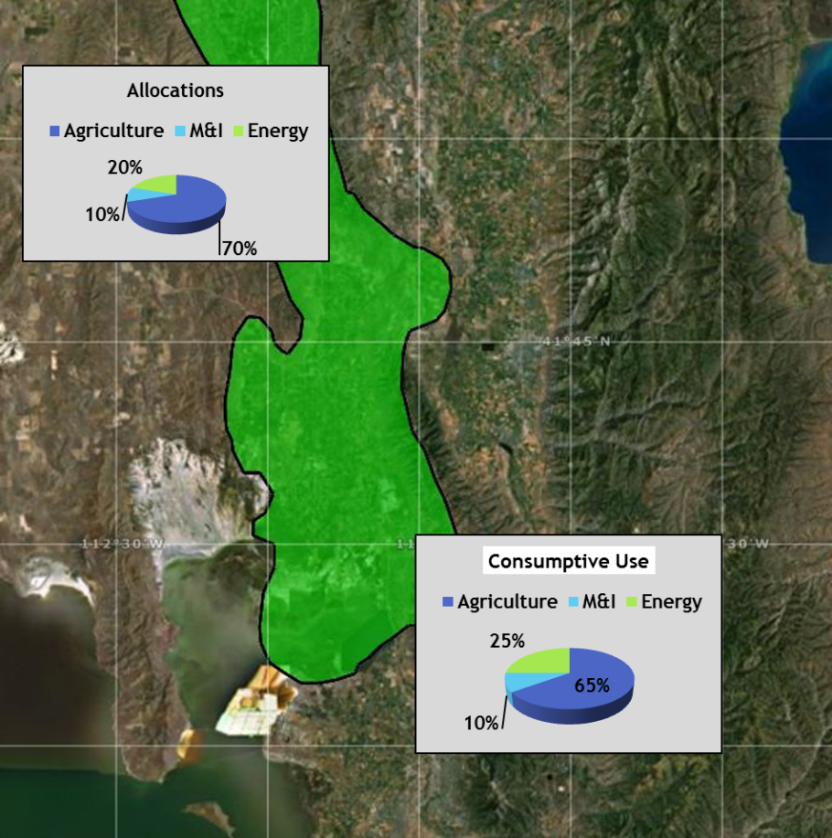
The Central Portal
The Central Portal would be a map-based interface that would compile data by 8-digit HUC and provide summary-level information for that HUC. Some things that it could show would be:
Water appropriations
Consumptive use
An indication of water availability
Provide access to the underlying data and methods used to make those determinations

Slide 10
Types of Data
Two Categories of Data:
Measured Data (i.e. streamgaging data)
Derived Data (i.e. water availability estimates)
We’re interested in both types of data
Measured data that we’re targeting include:
SNOTEL Data, Precipitation Data, Reservoir Height Data, Streamgage Data, and Groundwater Data
Derived data that we’re targeting include:
Information on water appropriations
Information on consumptive use
Information on water availability
The methods used to derive all this information

Slide 11
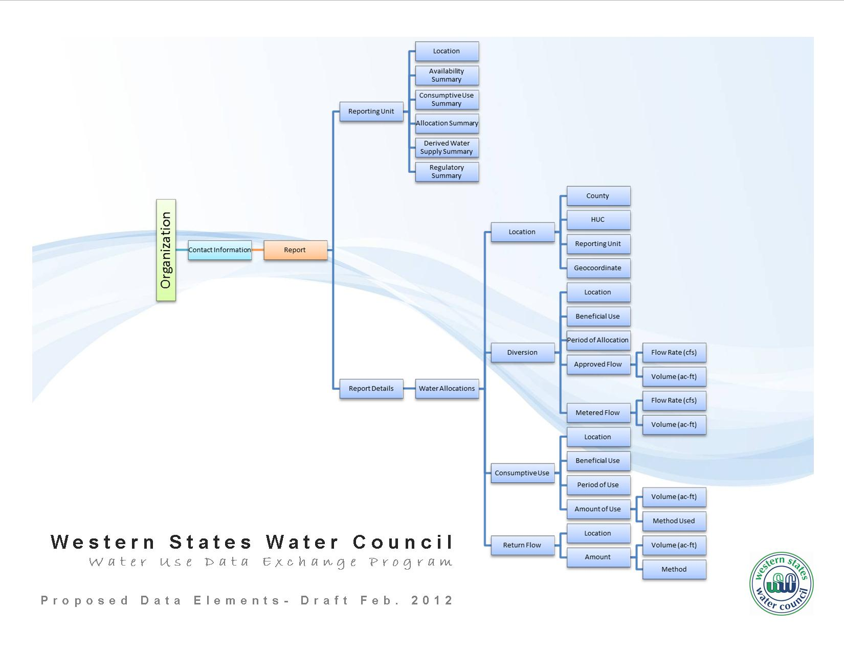

Slide 12

Schedule
Workplan Item | Schedule | Complete?
Establish Workgroups | Nov. 2011
Develop Survey | Jan. 2012
Develop Data Elements | Feb. 2012 | In Progress
Outreach to States | Feb. 2012 | In Progress
Develop XML Schema | Mar. 2012
Develop Draft Services | Oct. 2012
Beta Release of System | Jan. 2013
Initial Release | May 2013

Slide 13
For More Information
Water Use Data Exchange Project Website: http://www.westgov.org/wswc/wateruse
Contact: Dwane Young (dayoung@wswc.utah.gov) or
Sara Larsen (saralarsen@wswc.utah.gov)
Phone: 801-685-2555

