Slide 1
OGC/WMO Hydrology Domain Working Group
David Lemon (CSIRO)
Ulrich Looser (GRDC/WMO)
Ilya Zaslavsky (SDSC/CUAHSI)

Slide 2
Water - our most valuable asset but ...
In many places we can’t assess
  How much we have
  Where it is
  Who owns it
  What it is fit for
  How much we will have
  Where it will be

Slide 3
A common situation
Hydro Jack
Need flow data!
Don
Hmm maybe Don can help…
*RING RING*
Hi Don, I need some upper Derwent flow readings for my geochemical model. Any ideas?
To: Jack
01/02/09, 3.2, 3, 1
01/02/09, 3.1, 3, 1
Hmm, I’ve got one site. I’ll send it through…
*RING RING*
Ok. Got the data. Where is the site located?
10 minutes…
10 minutes…
Oh, it’s at laughing jack bridge.
Ummm. (papers shuffle)
147.123 -41.588
Coordinates?
What reference system??
I think it’s GDA94
Ok. What sensor is used?
It’s calculated from the stream gauge reading using a rating curve..
Oh…how accurate is that?
Umm......
DON?
*CLICK*
From Peter Taylor (CSIRO)

Slide 4
A brief history
April 2007 (Ottawa)
  CUAHSI submit WaterML as an OGC Discussion Paper
September 2007 (Canberra)
  Meeting coordinated by NR Canada and CSIRO
  34 participants, 18 organisations, (Oceania, North America, Europe)
  Looked at
    Current international activities
    Methodologies, patterns and technologies
    Futures
  Agreed time was right to move forward

Slide 5
Discussions get serious
Early 2008
  Much discussion between CUAHSI, OGC, CSIRO and WMO
OGC TC meetings
  September 2008 (Atlanta)
    Agreed to develop a charter for an OGC DWG
  December 2008 (Valencia)
  March 2009 (Athens)
    OGC\WMO Hydrology Domain Working Group formed.

Slide 6
Hydrology Domain Working Group
A joint working group of the OGC and WMO constituted as an OGC Domain Working Group.
Co-chaired by representatives nominated by the OGC TC and the World Meteorological Organisation’s (WMO) Commission for Hydrology (CHy).
    Current Co-Chairs: Ilya Zaslavsky (SDSC), Ulrich Looser (GRDC) and David Lemon (CSIRO)
    > 100 Participants, > 40 Organisations

Slide 7
Charter
To provide a venue and mechanism for seeking technical and institutional solutions to the challenge of describing and exchanging data describing the state and location of water resources, both above and below the ground surface.
The path to adoption will be through OGC papers and standards, advanced to ISO where appropriate, and also through the WMO’s CHy and WIS activities.
The Hydrology DWG will provide a means of developing candidate standards for adoption by CHy as appropriate.

Slide 8
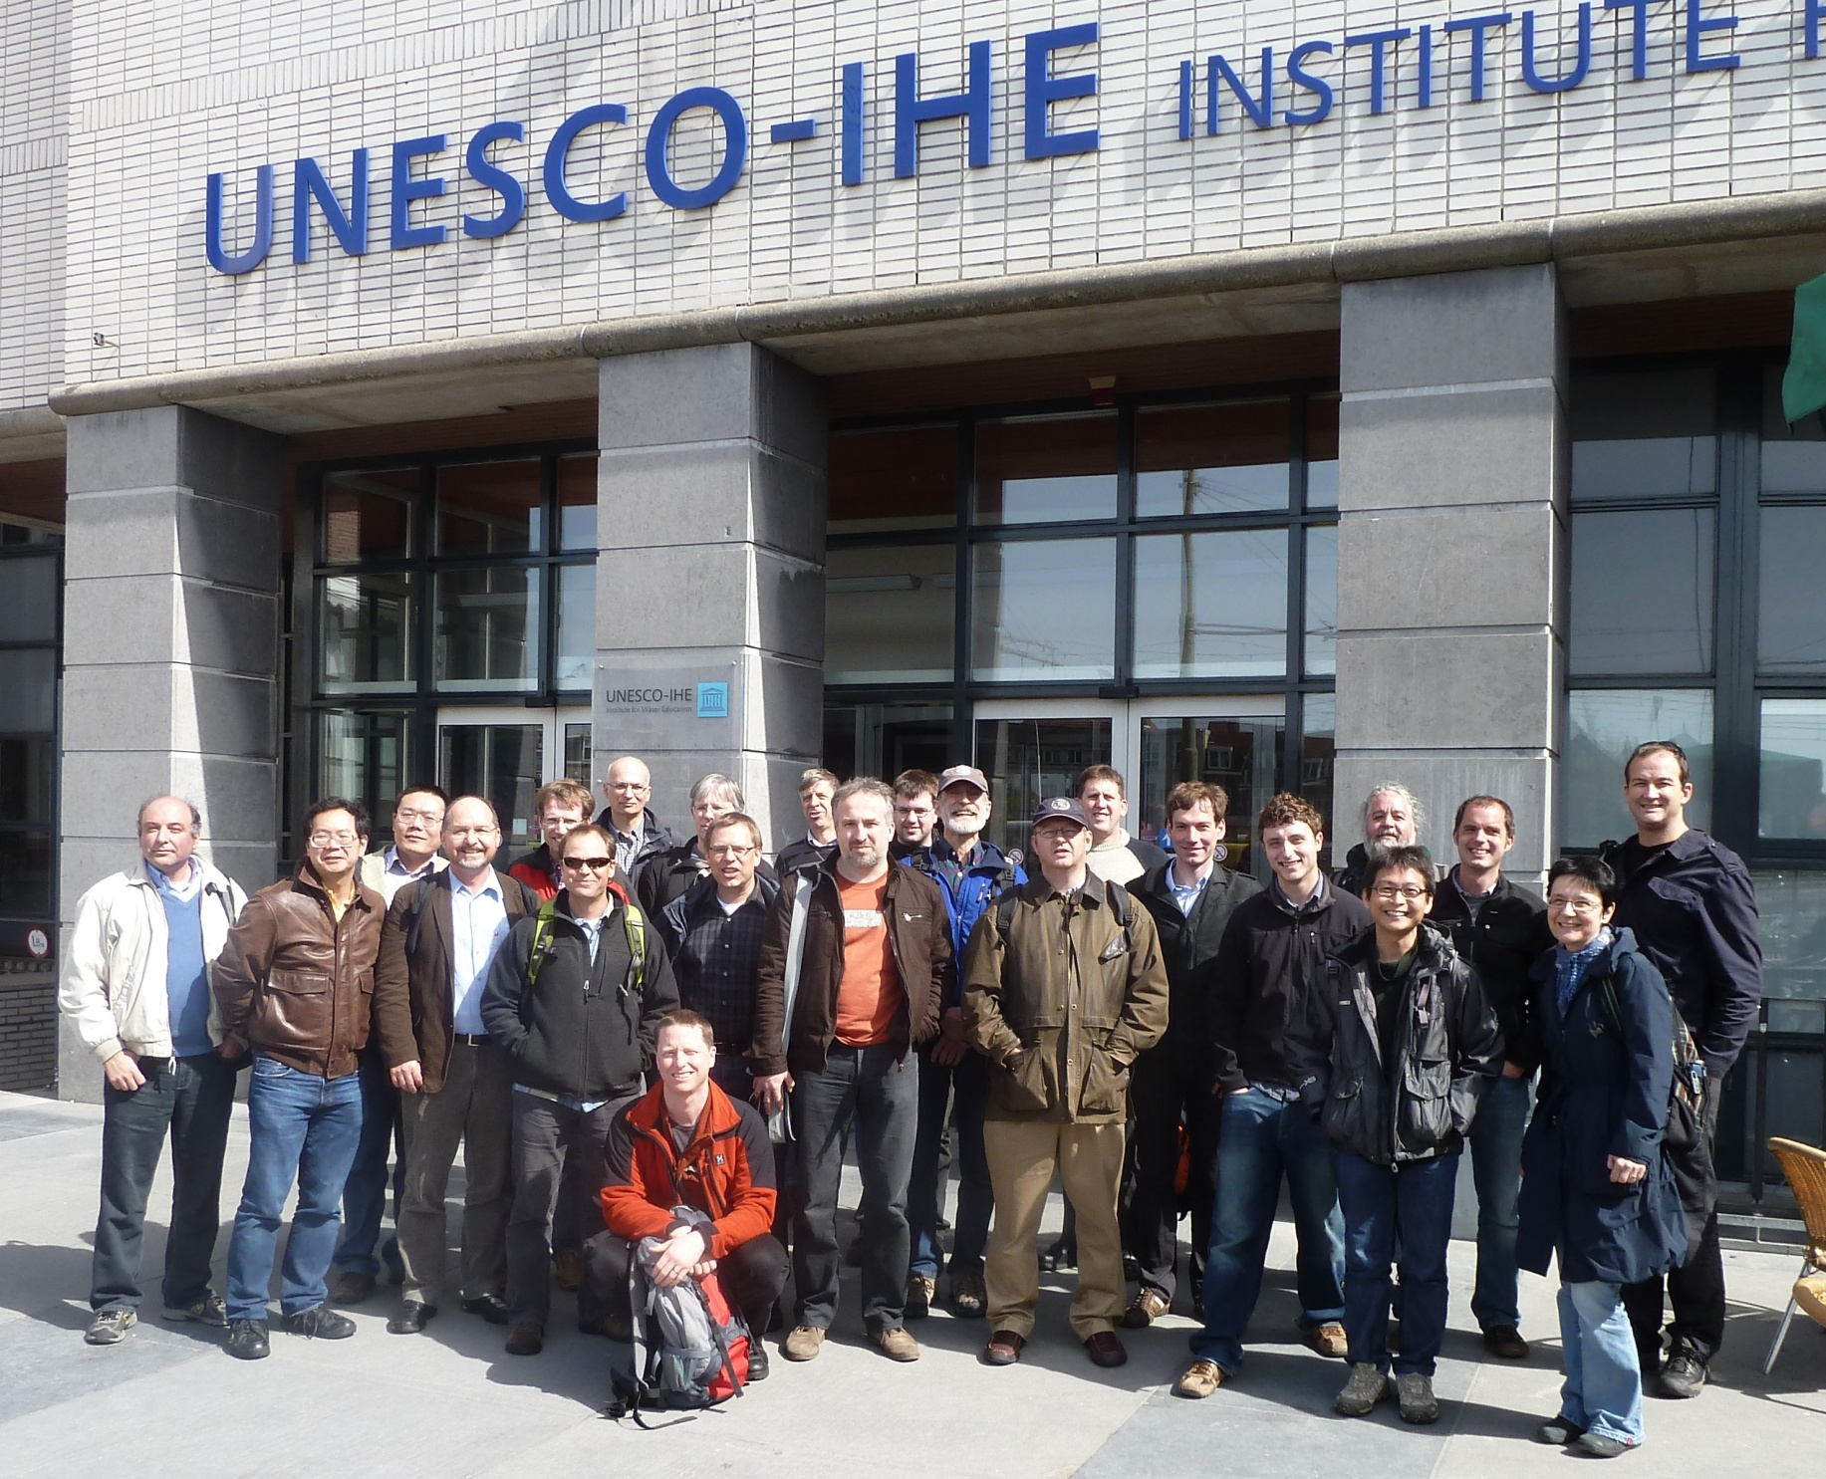
Annual Workshops
March 2010 (Ispra)
  24 participants, 19 organisations, (UN, Oceania, Nth America, Europe)
  Focussed on:
    Current activities
    WaterML2.0
    Groundwater IE and Surface Water IE planning
    Future planning
April 2011 (Delft)
  30+ participants, many organisations, (UN, Oceania, Nth America, Europe)
  Focussed on:
    Reference Architectures
    Feature Models
    WaterML2.0
    Interoperability Experiments
Next: Reading, June 2012

Slide 9
Activities
Analysis and harmonization of existing commonly used protocols and standards in the domain
Interoperability Experiments (IEs) focused on selected sub-domains of water data (e.g. surface water, groundwater, water quality, water use, hydrologic forecasts, real time data)
Participation in Pilots (Geo AIPs, OGC Pilots, etc), focused on broader scenarios within the entire domain and across domains
Submission of discussion papers and best practice papers to OGC TC
Collaboration with other DWGs, in particular ESS (on modeling), MetOcean (on handling gridded data), SWE (on real time data management)

Slide 10
Expected Outcomes
An agreed feature model
  what are the features of the hydrosphere (from an information perspective) and
  how are they related.
An agreed observation model.
Agreed vocabularies, endorsed by the community, and by WMO in particular.
Services carrying the above (where applicable)

Slide 11
Iterative Development
Feedback to standards and services
Hydro-DWG workplan priority
Development
Focus
Plan
Do
Demonstrate
Improve
Conclude IE
Demonstration
Observation Model
Develop
IE
Feature Model
Vocabularies
Services stack
Complete
IE
From Peter Fitch (CSIRO)

Slide 12
Interoperability Experiments: Timeline
Additional WaterML2 issues:
Rating curves
Rating measurements
Accuracy/quality/uncertainty
Lightweight encoding
Vocabularies
Access control
Hydrologic Features
Event mapping (peaks, etc.)
Groundwater
  GSC\USGS
  Dec 09 – Dec 10
Surface Water
  3 use cases
  Jun 10 – Sept 11
Forecasting
  Sep 11 – Sep 12
Water Quality
Water Use
… other?
WaterML 2
SWG
(Mar 2011)
2009
2010
2011
2012
2013

Slide 13
WaterML 2.0 SWG
GOALS:
Define a profile of Observations & Measurements 2.0 to support exchange of hydrological observations
Initial focus is in-situ monitoring producing time series: WaterML2 - Part 1
Participants: CSIRO, SDSC (CUAHSI), USGS, Australian Bureau of Meteorology, KISTERS, NOAA, Deltares, German Institute of Hydrology plus others..
STATUS:
Defined a conceptual model based on O&M 2.0; ISO19123 – Coverages
Defined XML encoding using: OMXML 2.0; GML 3.2; SWE Common 2.0
Currently: reviewing comments from the RFC period; preparing for 60-day adoption vote

Slide 14
WMO CHy Advisory Working Group: Findings
(From Ulrich Looser)
Addition of a new thematic area to CHy activities on:
“Data Operations and Management”
Revision of CHy structure to accommodate new thematic area
Resolution proposal for upcoming CHy session (Nov. 2012) on:
“Data Exchange and Protocols, and Information Management”
Suggested topics for the scientific programme of the next CHy session:
“Data exchange protocols (OGC, WaterML 2.0, etc.)”

Slide 15
GroundWater IE

Slide 16
Background
Development of WaterML2 by Hydro DWG
USGS and GSC seek to share groundwater data
Goals
Test WaterML2 with OGC services (WMS, SOS, WFS) and GWML1
US and Canada groundwater data interoperability
OGC standards comments/changes

Slide 17
Results
WaterML2 and GWML1 interaction successful
Cross-border data interoperability achieved
Feedback to OGC:
  SOS profile elements: 13
  WFS profile elements: 3
  WaterML2 profile elements: 7
  GWML profile elements: 1
  Standards recommendations: 9

Slide 18
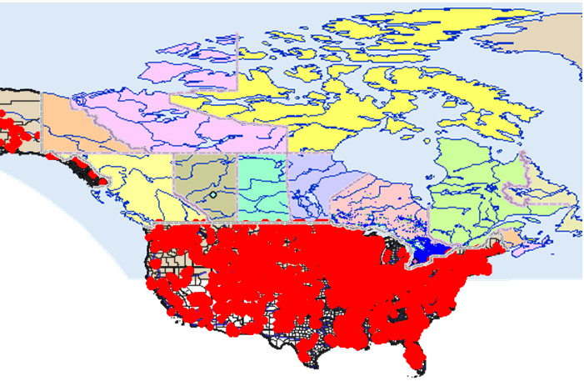
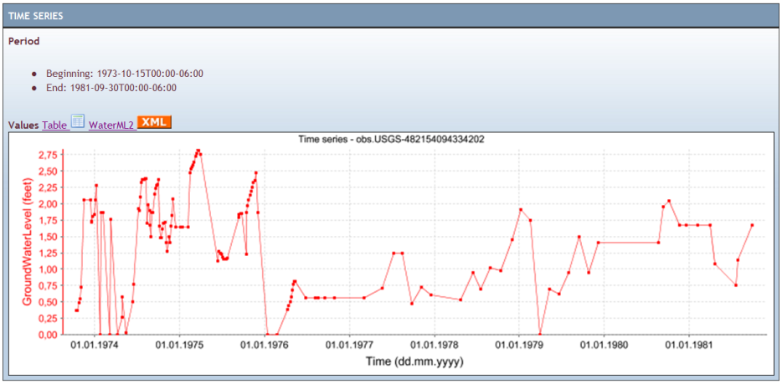
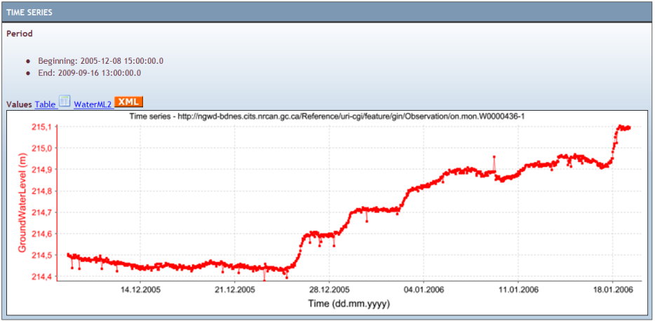
Result2: cross-border interoperability… data
USGS groundwater level
Ontario groundwater level

Slide 19
Surface Water IE

Slide 20
Surface Water IE: Aims
(1) Advancing the development of WaterML 2.0 to the sub domain of surface water observations.
(2) Test compatibility of WaterML 2.0 with existing services and with implementation of the OGC SOS, WFS, WMS standards;
(3) Advance exchange of surface water data between Germany and France in the cross-border area of the Rhine/Rhin river.
(4) Test compatibility of WaterML 2.0 for use with hydrological forecasting systems.
(5) Establish a limited surface water feature model and vocabularies suitable for the provision of surface water data using WaterML 2.0.

Slide 21
Use Cases
Cross Border Data Exchange Use Case
  Co-ordinated by DiSY- Carsten Heidemann and Dieter Mothes
Incremental Data Ingest Use Case
  Co-ordinated by Deltares USA– Peter Gijsbers and NOAA/NWS John Halquist
Global Runoff Use Case
  Co-ordinated by Kisters – Michael Natschke

Slide 22
Services and Clients
Services
  Kisters
    Germany – GRDC data
    Australia – BoM data (Not publically accessible)
  USGS
    Range of US surface water data
  CSIRO
    Tasmania – South Esk
  DiSY
    Rhine data
  IOW Sandre
    Test data
Clients
  Deltares
  Kisters
  52 North
  Uni Calgary

Slide 23
Get Involved!
Public mailing list https://lists.opengeospatial.org/mailman/listinfo/hydro.dwg
Twiki http://external.opengis.org/twiki_public/bin/view/HydrologyDWG
Thank you ...

