Slide 1
Variables & Math Operators
CE 311 K - Introduction to Computer Methods
Daene C. McKinney

Slide 2
Introduction
Computer Memory & Variables
Data Types
Variable Names & Declaration
Assignment Statements
Arithmetic Operators & Math Functions
String Variables

Slide 3
Computer Memory
Values in programs are stored in memory at locations with an address for each location
Computer memory
with 1 integer
Computer memory
with 1 integer
Value in memory at that address
45
12
1652
2548
Actually stored
As 101101
Memory addresses
Actually stored
As 1100

Slide 4
Variables
Names used in place of addresses to represent information in a program
Can contain numbers and/or characters
Variable names
Value in memory at that address
number1
number2
sum
45
12
57
1652
2548
3245
Memory addresses

Slide 5
Data Types
Data Type | Storage size | Range
Byte | 1 byte | 0 – 255
Integer | 2 bytes | -32,767 → +32,767
Long (integer) | 4 bytes | - Big # → + Big #
Single (real) | 4 bytes | -1x10³⁸ → +1x10³⁸
Double (real) | 8 bytes | - Big # → + Big #
String | 1 byte / char | Large

Slide 6
Naming Variables
Type and Name of every variable must declared
Rules for declaring variables
  Start with a letter (a – z)
  Contain only:
    letters (a – z), digits (0 – 9) and underscore (_)
  VB is not case sensitive
x | y12 | sum_1 | austinTemp
radius | area | tax_rate | TABLE

Slide 7
Declaring Variables
Variables are defined (declared) with a Declaration Statement
ALWAYS declare variables
General form:
Dim variable_name as data-type
Examples:
Dim num1 as Integer
Dim num2 as Single, sum as Single
Dim radius as Double

Slide 8
Assigning Values to Variables
General form: identifier = expression
Examples:
Dim x As integer
Dim y As integer
Dim z As integer
x=0
y=0
z=2
y=z
  Dim sum As double
  sum = 0.0
  y =?
Sometimes in VB
ObjectName.PropertyName = expression
Form1.Caption = “MyForm”

Slide 9
Initialization
Numeric variables are automatically initialized to 0:
  Dim varName As Double
To specify a nonzero initial value
  Dim varName As Double = 50

Slide 10
Assignment Statement: Example
Dim numVar1 As Double = 5
Dim numVar2 As Double = 4
numVar1 = 3 * numVar2
lstBox.Items.Add(numVar1)
Output: 12

Slide 11
Multiple Declarations
Dim a, b As Double
Two other types of multiple-declaration statements are
Dim a As Double, b As Integer
Dim c As Double = 2, b As Integer = 5

Slide 12
Arithmetic Operators
Exponentiation ^
Negation -
Multiplication *
Division /
Addition +
Subtraction -
Integer division \
Modulo division Mod

Slide 13
Displaying Numbers
The statement
lstBox.Items.Add(n)
displays the value of n in the list box.
Expressions can also be used
    Dim balance As Double = 1000
    lstBox.Items.Add(1.05 * balance)
Output: 1050

Slide 14
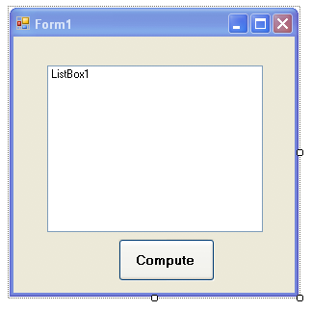
Displaying Numbers
How can I show a number on the screen?
Use a “List Box”
  ListBox1.Items.Add(n)
List Box named “ListBox1

Slide 15
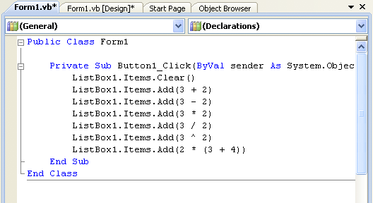
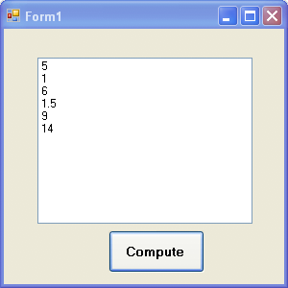
Example
  ListBox1.Items.Add(n)
  “Run” and get display

Slide 16
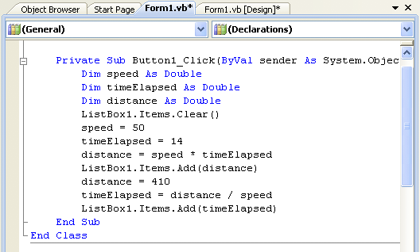
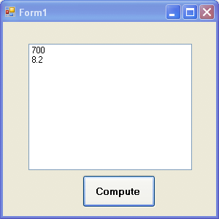
Example Using Variables

Slide 17
Constants
Numeric constant: numeric data, e.g. 7
String constant : character data, e.g., “the”
Hardcoded : constants are programmed directly into source code
Named constants: constants are defined by names and can be changed easily
Example
  Const constantName [As DataType] = Expression
  Const PI As Double = 3.14159

Slide 18
Modulo Division
Modulus operator:
  The result is the remainder when the first argument is divided by the second

Slide 19
Integer Division
Division between two integers results in an integer.
The result is truncated, not rounded
Example:
    5\3 = 1
    3\6 = 0

Slide 20
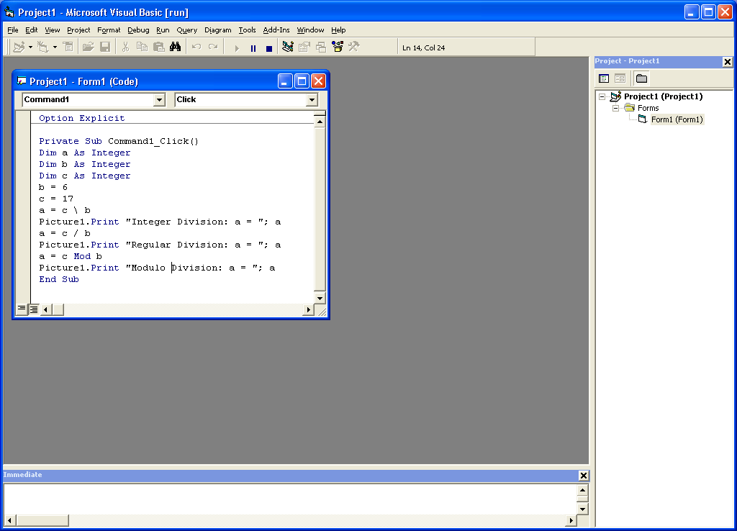
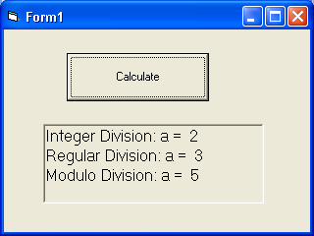
Examples
Dim a as Integer = 27
Dim b as Integer = 6
Dim c as Integer
c = b Mod a
c = ?
c = 6
Dim a as Integer
Dim b as Integer
Dim c as Integer
b = 6
c = 17
a = c\b
a = ?
a = 2

Slide 21
Priority of Operators
Exponentiation
Negation
Multiplication & Division (left to right)
Integer Division
Modulo Division
Addition & Subtraction (left to right)
String Concatenation
Order | Operators | Example | Result
1 | Parentheses ( ) | (2 + 3) * 7
2 | ^ | 2 ^ 3 +1
3 | *, /, \, Mod | 2 + 3 * 7
4 | +, - | 10 – 4 * 2 + 1

Slide 22
Math Functions
  Abs(x) Absolute value of x
  Sqr(x) Square root of x, where x >= 0
  Exp(x) Computes the value of e^{x}
  Log(x) ln x, the natural logarithm of x - base e
  Sin(x) sine of x, where x is in radians
  Cos(x) cosine of x, where x is in radians
  Tan(x) tangent of x, where x is in radians
  Atn(x) inverse tangent of x

Slide 23
Three Types of Errors
Syntax error
Runtime error
Logic error

Slide 24
Syntax Errors
Misspellings
lstBox.Itms.Add(3)
Omissions
lstBox.Items.Add(2 + )
Incorrect punctuation
Dim m; n As Integer

Slide 25
Runtime Error
Overflow error
Dim numVar As Integer = 1000000
numVar = numVar * numVar

Slide 26
Logical Error
Dim average As Double
Dim m As Double = 5
Dim n As Double = 10
average = m + n / 2
Value of average will be 10. Should be 7.5.

Slide 27
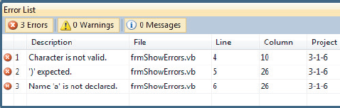
Error List Window
Dim m; n As Double
lstResults.Items.Add(5
lstResults.Items.Add(a)

Slide 28
String Literal
A string literal is a sequence of
characters surrounded by quotation marks.
Examples:
"hello"
"123-45-6789"
"#ab cde?"

Slide 29
String Variable
A string variable is a name to which a
string value can be assigned.
Examples:
country
ssn
word
firstName

Slide 30
String Variable (continued)
Declaration:
  Dim firstName As String
variable name
data type
Assignment:
  firstName = "Fred"

Slide 31
String Variable (continued)
You can declare a string variable and
assign it a value at the same time.
Dim firstName As String = "Fred"

Slide 32
String Variable
You can assign the value of one string
variable to another.
Dim strVar1 As String = "Hello"
Dim strVar2 As String = "Goodbye"
strVar2 = strVar1
lstOutput.Items.Add(strVar2)
Output: Hello

Slide 33
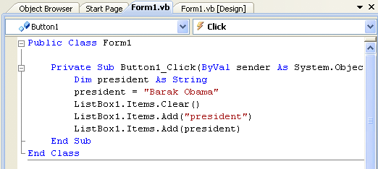
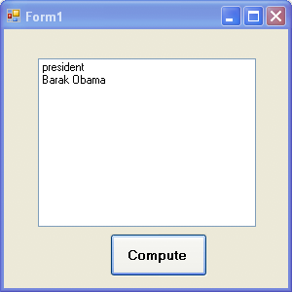
Strings
Name used to refer to a string
General form:
    Dim VarName As String

Slide 34
Text Boxes for Input & Output
The contents of a text box is always a string.
Input example:
strVar = txtBox.Text
Output example:
txtBox.Text = strVar

Slide 35
Data Conversion
Because the contents of a text box is always a string, sometimes you must convert the input or output.
dblVar = CDbl(txtBox.Text)
txtBox.Text = CStr(numVar)
converts a String to a Double
converts a number to a string

Slide 36
Concatenation
Combining two strings to make a new string
quote1 = "We'll always "
quote2 = "have Paris."
quote = quote1 & quote2
txtOutput.Text = quote & " - Humphrey Bogart"
Output:
We'll always have Paris. - Humphrey Bogart

Slide 37
String Properties and Methods
"Visual".Length is 6.
"Visual".ToUpper is VISUAL.
"123 Hike".Length is 8.
"123 Hike".ToLower is 123 hike.
"a" & " bcd ".Trim & "efg" is abcdefg.

Slide 38
Positions in a String
Positions of characters in a string are numbered 0, 1, 2, ….
Consider the string “Visual Basic”.
Position 0: V
Position 1: i
Position 7: B
Substring “al” begins at position 4

Slide 39
Substrings
Let str be a string.
str.Substring(m, n) is the substring of length n, beginning at position m in str.
“Visual Basic”.Substring(2, 3) is “sua”
“Visual Basic”.Substring(0, 1) is “V”

Slide 40
“IndexOf” Method
Let str1 and str2 be strings.
str1.IndexOf(str2)
is the position of the first occurrence of str2 in str1.
(Note: Has value -1 if str2 is not a substring of str1.)
"Visual Basic".IndexOf("is") is 1.
"Visual Basic".IndexOf("si") is 9.
"Visual Basic".IndexOf("ab") is -1.

Slide 41
Empty String
”” is a string with no characters - empty string
lstBox.Items.Add("") skips a line in the list box.
The contents of a text box can be cleared with either the statement
txtBox.Clear()
or the statement
txtBox.Text = ""

Slide 42
Incrementing a Variable
operator example equivalent statement
  += x += 2; x = x+2;
  -= x -= 2; x = x-2;

Slide 43
Comments
Private Sub btnCompute_Click (...)
Handles btnCompute.Click
'Calculate the balance in an account
Dim rate As Double 'Annual rate of interest
Dim curBalance As Double 'Current balance

Slide 44
Internal Documentation
Other people can easily understand the program.
You can understand the program when you read it later.
Long programs are easier to read because the purposes of individual pieces can be determined at a glance.

Slide 45
Line Continuation
A long line of code can be continued on another line by using an underscore (_) preceded by a space
msg = "I'm going to make " & _
"him an offer he can't refuse."

Slide 46
Scope
The scope of a variable is the portion of the program that can refer to it.
Variables declared inside an event procedure are said to have local scope and are only available to the event procedure in which they are declared.

Slide 47
Scope (continued)
Variables declared outside an event procedure are said to have class-level scope and are available to every event procedure.
Usually declared after
Public Class formName
(In Declarations section of Code Editor.)

Slide 48
Summary
Computer Memory & Variables
Data Types
Variable Names & Declaration
Assignment Statements
Arithmetic Operators & Math Functions
String Variables

