Slide 1
Input/Output
CE 311 K - Introduction to Computer Methods
Daene C. McKinney

Slide 2
Introduction
Formatting Numbers
Input From Files
Output To Files
Input Boxes

Slide 3
Formatting Numbers
Display numbers in familiar formats
Examples:
FormatNumber(12345.678, 1) → 12,345.6
FormatCurrency(12345.678, 2) → $12,345.68
FormatPercent(0.185, 2) → 18.5%
Display “n” rounded to “r” decimal places and display with commas
Display dollar sign then “n” to “r” decimal places and display with commas
Display “n” as a percent rounded to to “r” decimal places and percent sign

Slide 4
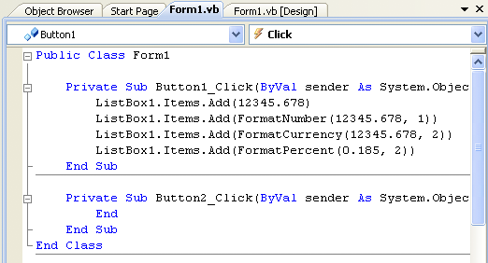
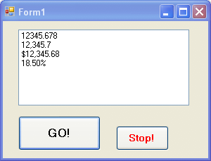
How Do I Use That?
ListBox1
Go Button
Button1
Button2
Stop Button

Slide 5
Input From Files
Three ways:
Assign values to variables in program
Read values from a file
Enter values in text box

Slide 6
Files and Folders
File: holds programs or data. Its name usually consists of letters, digits, and spaces.
Filenames:
Up to 156 characters (letters, digits, etc.)
Extension (.txt, .doc, etc)
Pathnames:
Where does a file live?
Path to the folder containing a file: C:\temp\
Notes:
Think of a disk as a large folder that contains several smaller folders each with its own name.
The naming of folders follow th same rule as naming files
Each folder is identified by listing its name preceded by a backslash
A filespec typically includes the drive, path and the filename.
File is identified by a small
directory or folder is identified by a folder icon
executable file: is identified by a rectangle with a thin bar across top
Go over: How to create a folder
to rename a folder
to delete a folder or file
to Copy a folder or file
To move a folder or file

Slide 7
Key Terms: Folders and Files
Term Example
Disk Hard disk, flash drive, DVD
File name Payroll
Extension .txt
Filename Payroll.txt
Path TextFiles\Payroll.txt
Filespec C:\TextFiles\Payroll.txt
Notes:
Think of a disk as a large folder that contains several smaller folders each with its own name.
The naming of folders follow th same rule as naming files
Each folder is identified by listing its name preceded by a backslash
A filespec typically includes the drive, path and the filename.
File is identified by a small
directory or folder is identified by a folder icon
executable file: is identified by a rectangle with a thin bar across top
Go over: How to create a folder
to rename a folder
to delete a folder or file
to Copy a folder or file
To move a folder or file

Slide 8
CSV File Format
Comma Separated Values (CSV)
Records are stored on one line with a comma between each field
Example: USStates.txt
Delaware,DE,1954,759000
Pennsylvania,PA,44817,12296000
New Jersey,NJ,7417,8135000
Georgia,GA,57906,7637000
(name of state, abbreviation, area, population)

Slide 9
Sample CSV File
First two lines of USStates.txt
Delaware,DE,1954,759000
Pennsylvania,PA,44817,12296000
name abbreviation area population

Slide 10
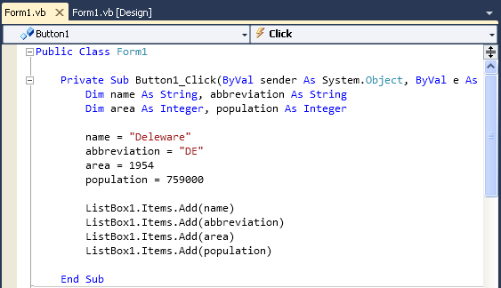
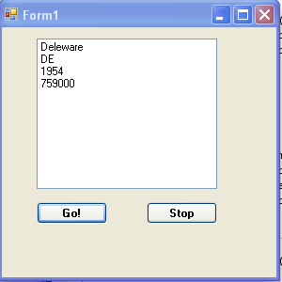
Example w/o Files
This is painful!

Slide 11
Open & Read Files
Data stored in a text file can be read one line at a time with a StreamReader object. Declare a variable that can read from files:
Dim sr As IO.StreamReader = IO.File.OpenText(filespec)
filespec is the file to be read
A pointer is set to the first line of the file.
Read data from the file
str = sr.ReadLine
Reads the line pointed to, assigns the line to the string variable str, and moves the pointer to the next line of the file.
The value of str.EndOfStream will be True after the entire file has been read.
The statement str.Close() terminates communication with the file.

Slide 12
Split Operator
The Split operator provides a way to recover the values from a CSV file.
text = line.Split(”,”c)
This “splits” the string variable “line” into pieces. The splits are made where a comma appears. The pieces are assigned to the text variable “text()”.
text(0) will have the text preceding the 1st comma, text(1) will have the text between the 1st and 2nd commas, etc.

Slide 13
Sample CSV File
First line of USStates.txt
line = “Delaware,DE,1954,759000”
text = line.Split(“,”c)
text(0) text(1) text(2) text(3)
Delaware | DE | 1954 | 759000

Slide 14
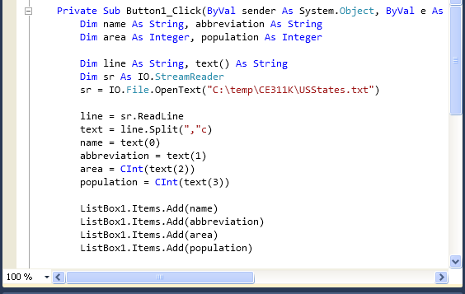
Example w/Files
This is painful!

Slide 15
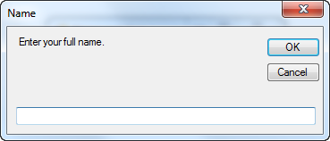
Getting Input from an Input Dialog Box
stringVar = InputBox(prompt, title)
fullName = InputBox("Enter your full name.",
"Name")
title
prompt

Slide 16
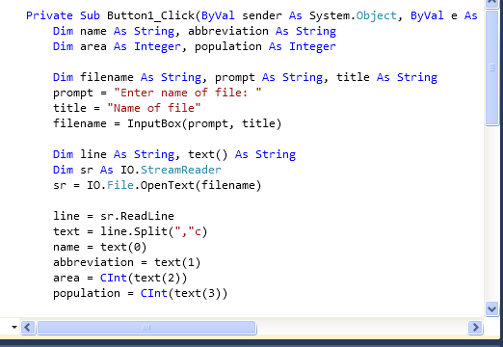
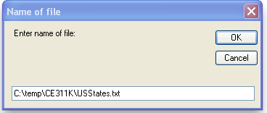
Example w/Files
This is painful!

Slide 17
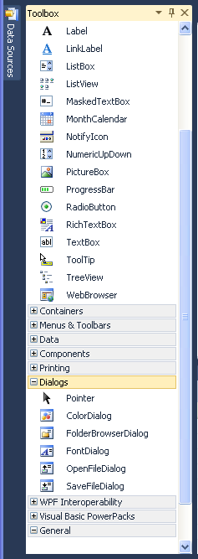
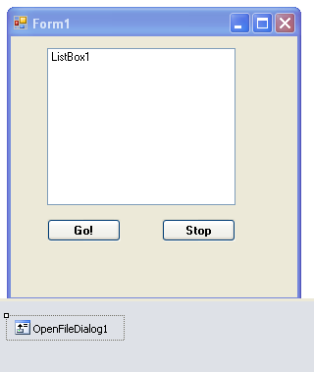
The OpenFileDialog Control
Implements File Open dialog box
Found in Dialogs group of Toolbox
Icon will appear below Document window.

Slide 18
Using the OpenFileDialog Control
To display the control:
OpenFileDialog1.ShowDialog()
After the Open button has been pressed, the file name selected and its complete filespec will be contained in the property:
OpenFileDialog1.FileName

Slide 19
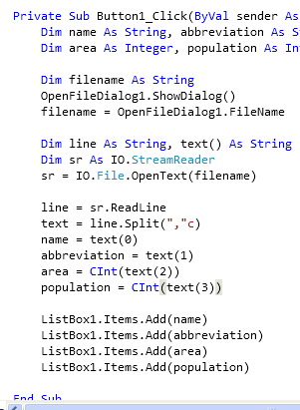
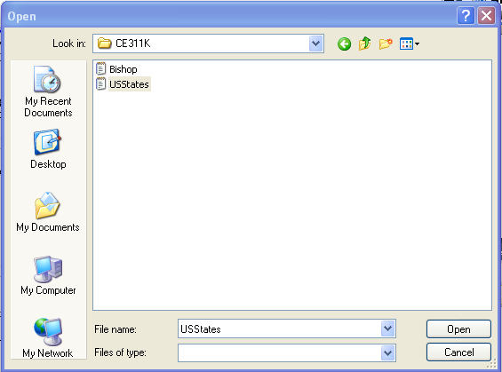
Example w/Files
File to open
That’s better!

Slide 20
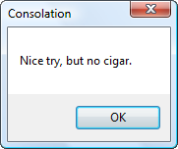
Using a Message Dialog Box for Output
MessageBox.Show(prompt, title)
MessageBox.Show("Nice try, but no cigar.",
"Consolation")
title
prompt

Slide 21
Open & Write a File
Data can be placed in a text file one line at a time with a StreamWriter object.
Dim sw As IO.StreamWriter = IO.File.CreateText(filespec)
filespec is the file to be created and written
Establishes link between computer and disk drive for writing
Write data to the file
sw.WriteLine(info)
initally places the information (info) into the first line of the file
Subsequent statements of that form place information into lines at the end of the file
The statement sw.Close() terminates communication with the file.

Slide 22
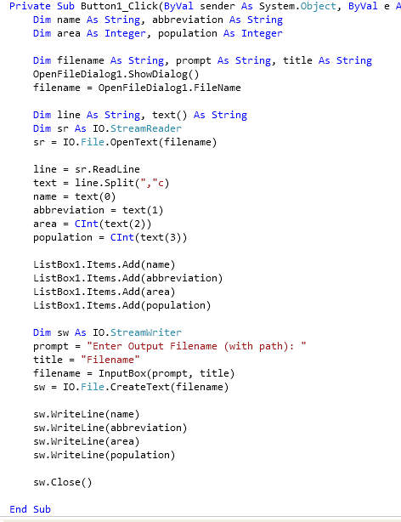
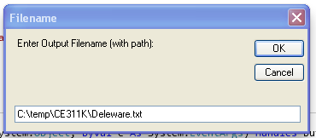
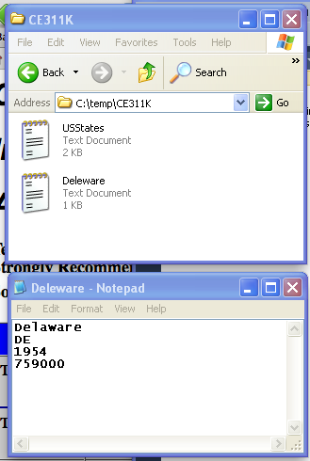
Write to a File
Open input file
Read from input file
Dim sw As IO.StreamWriter
Dim sw As IO.StreamWriter
Open output file
Write to output file

Slide 23
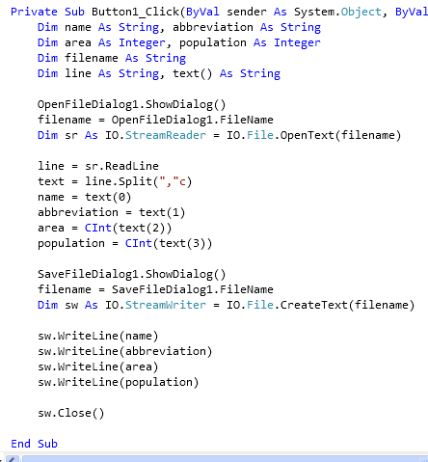
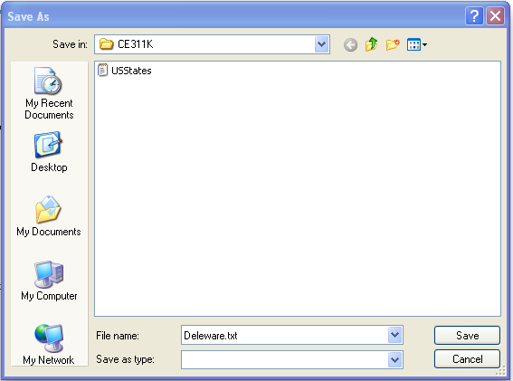
Write to a File
Open input file
Read from input file
Open output file
Write to output file

Slide 24
Using Text Boxes for I/O
The content of a text box is always a string
We can use the contents of a text box to assign values to variables
We can use the contents of a variable to assign values to text boxes
Numbers typed into text boxes are stored as strings and should be converted to numbers before using in calculations

Slide 25
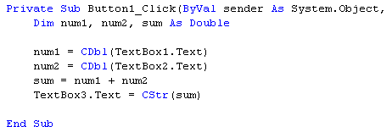
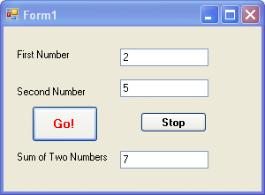
Example

Slide 26
Summary
Formatting Numbers
Input From Files
Output To Files
Input Boxes

