Slide 1
Control Structures: Selection
CE 311 K - Introduction to Computer Methods
Daene C. McKinney

Slide 2
Introduction
ASCII (ANSI) Character Set
Relational Operators
Logical Operators
Program Control – Selection
If/Then, If/Else/Then, …

Slide 3
ASCII Characters
All info is stored in the computer as strings of 0’s and 1’s
Each character is coded to a binary value
ASCII (American Standard Code for Information Interchange)
Codes 33 to 126, represent letters, digits, punctuation marks, and a few miscellaneous symbols
,---.
,.'-. \
( ( ,'"""""-.
`,X `.
/` ` `._
( , ,_\
| ,---.,'o `.
| / o \ )
\ ,. ( .____,
\| \ \____,' \
'`'\ \ _,____,'
\ ,-- ,-' \
( C ,' \
`--' .' |
| | .O |
__| \ ,-'_
/ `L `._ _,' ' `.
/ `--.._ `',. _\ `
`-. /\ | `. ( ,\ \
_/ `-._ / \ |--' ( \
' `-. `' \/\`. `. )
\ -hrr- \ `. | |
http://www.chris.com/ASCII/

Slide 4
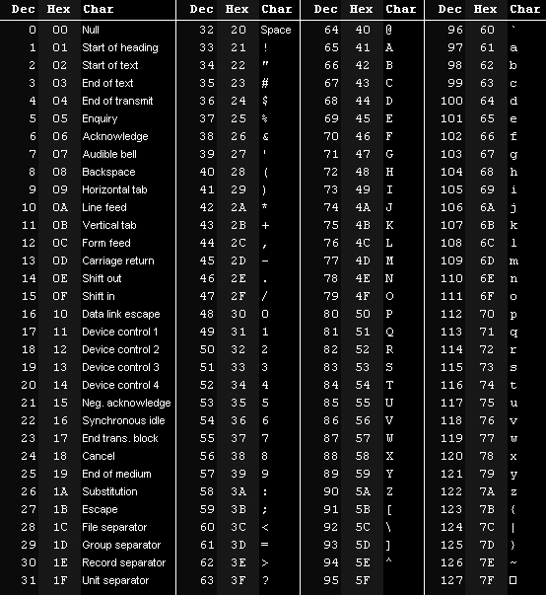
ASCII Character Set

Slide 5
ASCII Character Set
Chr(n) = character with ASCII value n (0 < n < 255)
Asc(str) = ASCII value of the first character of str
TextBox1.Text = Chr(65) displays “A”
ListBox1.Items.Add(Asc(“Apple”)) displays 65

Slide 6
Relational Operators
= equal to
<> not equal to
< less than
> greater than
<= less than equal to
>= greater than equal to
All relational operators have equal precedence and are evaluated left to right

Slide 7
Example - Relational Operators
True or false?
1 < = 1
1 < 1
“car” < “cat”
“Dog” < “dog”
Expression
Result
5 = 1
0 (false)
5 > 1
1 (true)
5 <> 1
1 (true)
5 + 10 = 3 * 5
1 (true)

Slide 8
Logical Operators
Operator | Description | Example | Result
And | Both sides must be true | T And T F And T | T F
Or | One side or other must be true | T Or T F Or T | T T
Not | Negates truth | Not (T) | F

Slide 9
Logical Operators
A | not A | B | not B | A and B | A or B
F | T | F | T | F | F
F | T | T | F | F | T
T | F | F | T | F | T
T | F | T | F | T | T

Slide 10
Examples
Suppose: n = 4 and ans = “Y”
True or False?
( 2 < n ) AND ( n < 6 )
( ans < n ) OR ( n = 6 )
NOT ( n <6 )
( ans = “Y” ) OR ( ans = “y” )
NOT ( ans = “y” )
(( ans < n) AND ( n = 7 )) OR ( ans = “Y”)
( n - 2 ) AND (( n = 7 ) OR ( ans = “y”))

Slide 11
Order of Operations
Parentheses
^
* / \ MOD
+ -
NOT
AND
OR
3 * 5 > 8 * 2 OR 6 * 7 < 100 – 5 ^ 2
T or F?

Slide 12
Program Control
Sequence
Selection
Repetition
no
yes
no
yes

Slide 13
Selection: If – Then
If condition Then
Action 1
End If
Is the
condition
true?
No
Yes
Execute
Action 1

Slide 14
Selection: If – Then – Else
If condition Then
Action 1
Else
Action 2
End If
Is the
condition
true?
No
Yes
Execute
Action 1
Execute
Action 2

Slide 15
Selection: If – Then (variations)
If – Then
If – Then - Else
If – Then - Elseif
N
N
N
?
?
?
Y
Y
N
Y
?
Y

Slide 16
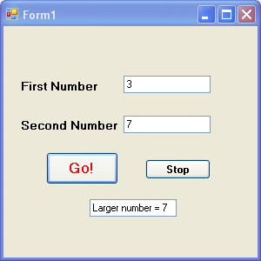
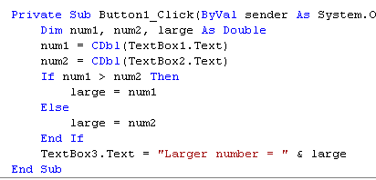
Example
Find the larger of two numbers input by a user

Slide 17
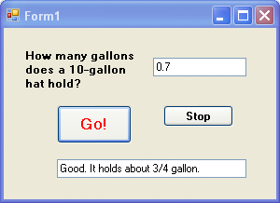
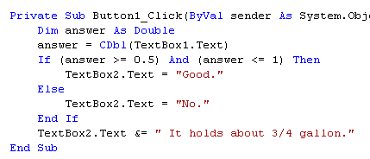
Example
This if block has a logical operator in its condition

Slide 18
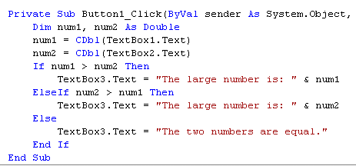
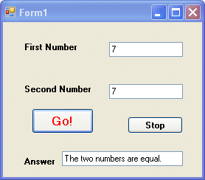
Example
If the two numbers are equal, the program reports this

Slide 19
Select Case Statement
Select Case testExpression
Case a
statements-a
Case b
statements-b
Case c
statements-c
…
Case z
statements-z
Case else
statements-else
End Select
Case a
Case a actions
Case b
Case b actions
Case z
Case z actions
Else actions

Slide 20
Summary
ASCII (ANSI) Character Set
Relational Operators
Logical Operators
Program Control – Selection
If/Then, If/Else/Then, …

