Slide 1
Repetition
CE 311 K - Introduction to Computer Methods
Daene C. McKinney

Slide 2
Introduction
Do – While Loops
Do – Until Loops
Peek
For – Next Loops

Slide 3
Repetition - Loops
Control structures used to repeat statements until a condition is met
Do loop
  Indeterminate looping structure
  Condition stops the loop
For – Next loop
  Determinate looping structure
  Number of cycles stops the loop

Slide 4
Do – While Loops
Beginning of loop
no
Do While condition
Statement(s) …
Loop
?
yes
Loop
End of loop

Slide 5
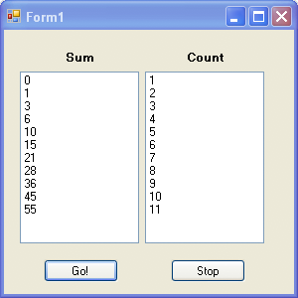
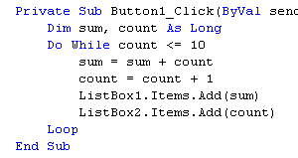
Do – While Loops

Slide 6
Do - Until Loops
Beginning of loop
Do
Statements…
Loop Until condition
no
?
Loop
yes
End of loop

Slide 7
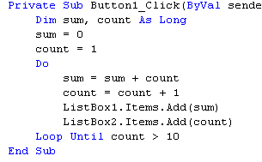
Do - Until Loops

Slide 8
Notes on Loops
Avoid “Infinite” loops
Any “Do-While” statement can be converted to an “Do-Until” statement, and vice-versa
“Do-While” tests at the top of the loop
“Do-Until” tests at the bottom of the loop

Slide 9
Processing Data With Loops
Data in files
  Display
  Select/Search
  Calculation/Transform
Detect the end of a file (EOF)
  Peek: determine when end of file is reached
  Counters: Calculate # of elements in a list
  Accumulators: Sum numerical values in lists
  Flags: Test for certain conditions

Slide 10
Peek
Read data from a file using a Do Loop
How do we detect the End Of File (EOF)?
Value of
    sr.Peek = 1st character of current line in file
If EOF has been reached
    sr.Peek = -1

Slide 11
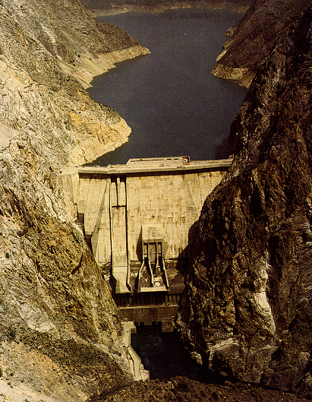
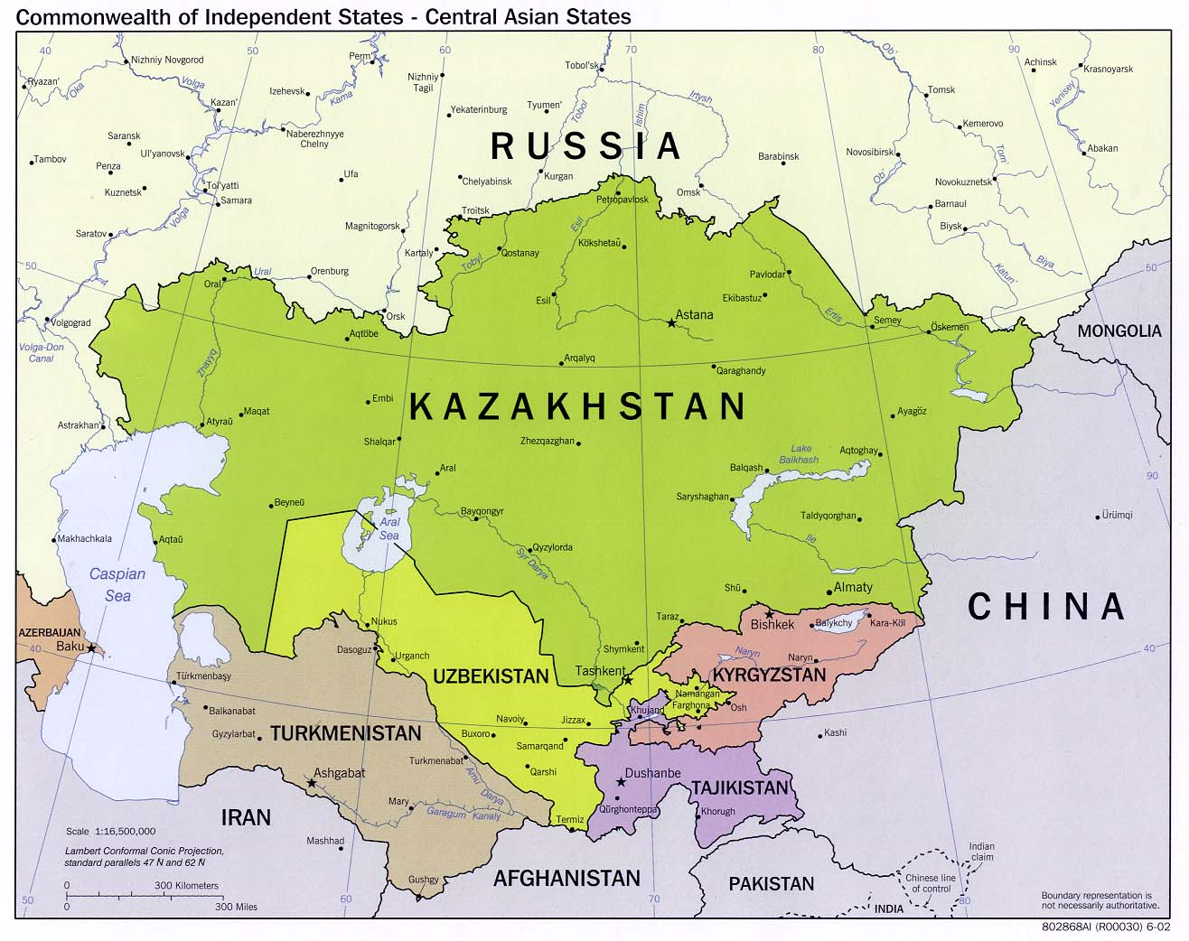
Central Asia
Toktogul Dam
140 m
19.5 km3

Slide 12
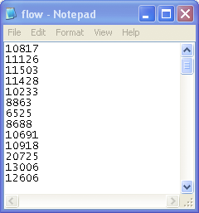
Naryn River Annual Flows
92 annual flows isn’t such a hard problem, but these are derived from 35,580 daily flows – too much for a spreadsheet.

Slide 13
Peeking Into a Data File
    Do While sr.Peek <> -1
More data in the file?
no
Do While sr.Peek <> -1
flow = sr.ReadLine
sum = sum + flow
count = count + 1
Loop
yes
Get more data from file
Counter
Accumulator
Process the data
Execute remaining statements

Slide 14
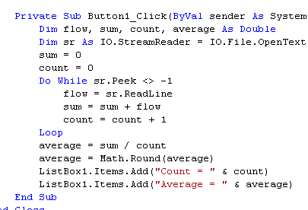
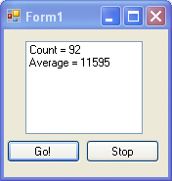
Using Peek

Slide 15
For – Next Loops
Beginning of loop
For i = m To n
statement(s)
Next
i = m
Loop
i > n ?
End of loop
yes
i – control variable
m – initial value of i
n – terminating value of i
next – increment i by 1
statements – get executed
no
Execute
statements
I = i + 1

Slide 16
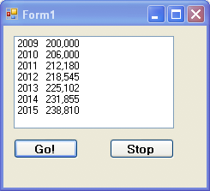
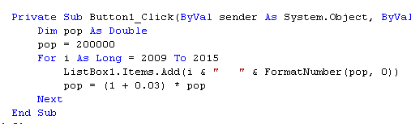
Example
Suppose the population of a city is 200,000 in 2009 and is expected to grow at a rate of 3% per year. Display the population every year up to 2015.

Slide 17
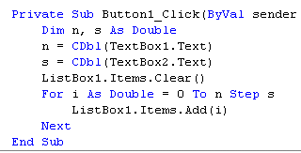
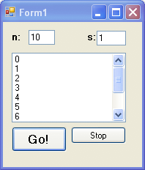
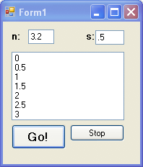
Example
Step s

Slide 18
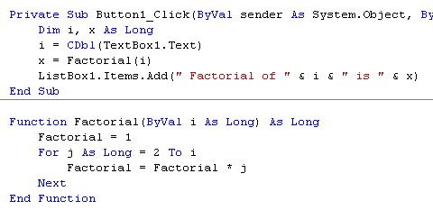
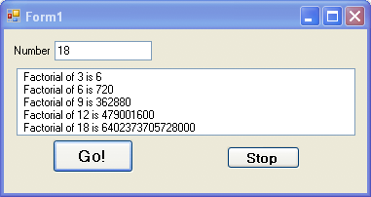
Example - Factorial

Slide 19
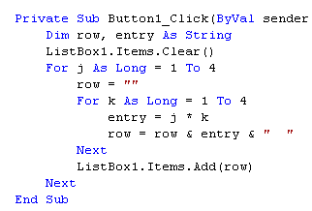
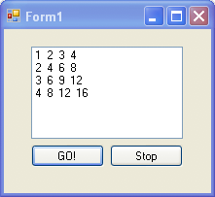
Nested For – Next Loops

Slide 20
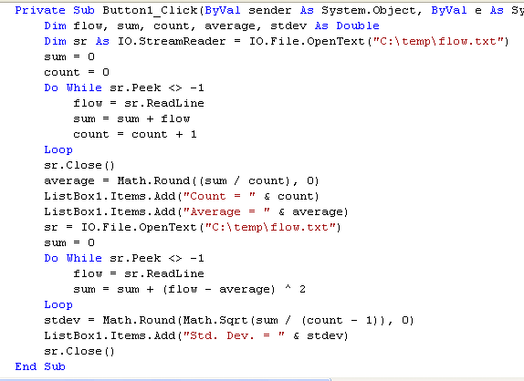
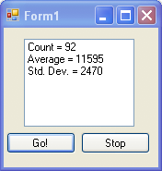
Example
Standard Deviation

Slide 21
Summary
Do – While Loops
Do – Until Loops
Peek
For – Next Loops

